Slide 1
let’s take a few minutes to think about …
link

Slide 2
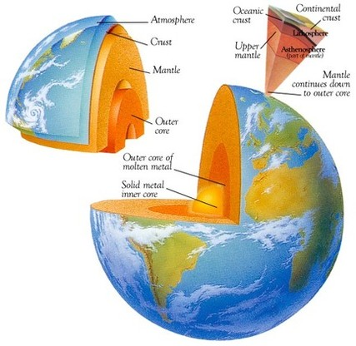
Explore the disciplines of science
(Physics, Chemistry, Astronomy, Geology, Biology)
We’ll start with…..
the Geosphere
the goal (standard)
assessed on … (scales)

Slide 3
first…
explore/review the Rock Cycle…
types of rocks
and how they form
where are these rocks? ___________
what is a ‘rock’
__________________________________________
______________________________________________
examples: ________________________________
mineral
_________________________________________________
_________________________________________________
_________________________________________________
three classifications (categories) of rocks
_______________________________________________
form the crust of Earth
any natural material, hard or soft,
having a distinct mineral composition,
categorized by how it forms
soil is not a mineral/rock because it is composed of decomposed organic matter.
solid inorganic (not living, or composed of once living matter) substance of natural occurrence,
has a crystalline structure
sedimentary, metamorphic, igneous

Slide 4
first…
explore/review the Rock Cycle…
types of rocks
and how they form
where are these rocks? ___________
what is a ‘rock’
__________________________________________
______________________________________________
what do rocks “do” for us?
form the crust of Earth
any natural material, hard or soft,
having a distinct mineral composition,
categorized by how it forms
have the trays out
at the table
shout out characteristics

Slide 5
first…
explore/review the Rock Cycle…
types of rocks
and how they form
where are these rocks? ___________
what is a ‘rock’
__________________________________________
______________________________________________
how did these rocks come to be?
how old? how young?
form the crust of Earth
any natural material, hard or soft,
having a distinct mineral composition,
categorized by how it forms

Slide 6
first…
explore/review the Rock Cycle…
types of rocks
and how they form
where are these rocks? ___________
what is a ‘rock’
__________________________________________
______________________________________________
___________________________________________
how did these rocks come to be?
how old? how young?
_____________________________________________________
so,…. as we go through this year in Integrated Science, we will be looking at
changes on Earth that happened from early Earth (4 billion years ago) to now…
to help keep these events in perspective,
construct a to-scale timeline…
form the crust of Earth
any natural material, hard or soft,
having a distinct mineral composition,
categorized by how it forms
from Earth first began to cool (4 billion ya) to now

Slide 7
first…
explore/review the Rock Cycle…
types of rocks
and how they form
where are these rocks? ___________
what is a ‘rock’
__________________________________________
______________________________________________
____________________________________
mineral
___________________________________
_________________________________________
_________________________________________
three classifications (categories) of rocks
_______________________________________________
how did these rocks come to be? ________________________
form the crust of Earth
any natural material, hard or soft,
having a distinct mineral composition,
categorized by how it forms
soil is not a mineral/rock because it is composed of decomposed organic matter.
solid inorganic (not living, or composed of once living matter) substance of natural occurrence,
has a crystalline structure
sedimentary, metamorphic, igneous
the Rock Cycle
RGB 250 244 230

Slide 8
first…
explore/review the Rock Cycle…
types of rocks
and how they form
where are these rocks? ___________
three classifications (categories) of rocks
_______________________________________________
how did these rocks come to be? ________________________
form the crust of Earth
sedimentary, metamorphic, igneous
the Rock Cycle
first… there had to be rocks to begin the Rock Cycle
4.5 bya Earth molten (melted) ball ….
million years

Slide 9
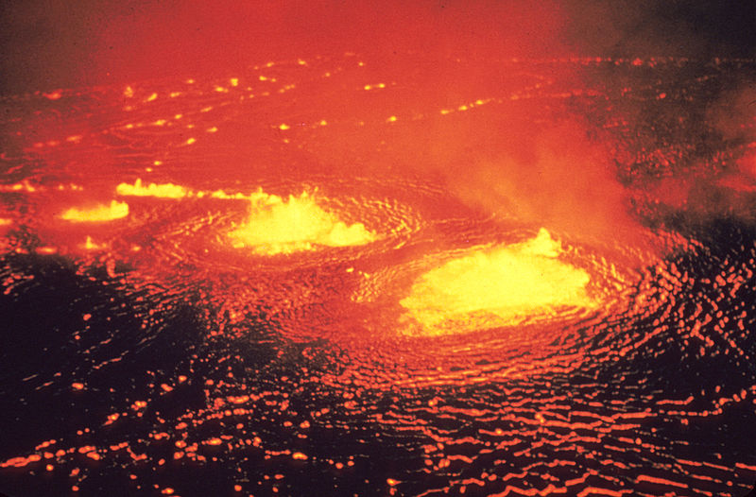
The Earth formed out of the sea of dust and gases swirling
around the forming Sun….. 4.6 billion years ago
Precambriam SuperEon
from 4.6 billion (4600 million) years ago to 545 million years ago
Earth begins… to early life
where’d that “dust” come from?
other Suns (stars)
that “supernova” and
spit their “guts” across the universe
Hades
Stage 1: Hadean Eon
Earth is Forming
Time Period:
4,600-4,000 million years ago

Slide 10
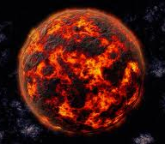
Hadean Eon…
Geologic State of the Earth
matter accumulates due to bombardments
gravity increases
“hot” due to:
bombardments from galactic bodies (ex: meteors)
decay of radioactive isotopes
compression of the matter making up the Earth
early on in the eon… the Earth was molten
matter settled due to differences in density
iron core
silicate crust
began to cool
layers formed – core, mantle, crust (3-44 miles deep)
first rocks

Slide 11
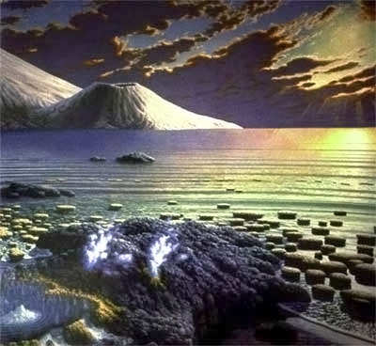
for rocks to change there has to be weathering
there has to be an atmosphere,
and liquid, moving water
Earth’s atmosphere
and
the accumulation of liquid water happened in the Archaen Eon
the breaking down of rocks, soil, and minerals
through contact with the Earth's atmosphere,
water, and biological organisms
Stage 2: Archaen Eon (“ancient”)
Earth gets some more features
and some life
Time Period
4000-2500 million years ago

Slide 12
Archaen Eon…
Composition of the Atmosphere - early on
Earth’s gravity is strong enough to hold an atmosphere
primarily made of the gases from volcanic eruptions
H₂O H₂S
CO₂ H₂O
CH₄ CH₄
NH₃ NH₃
HCl
SO₂
N₂
H₂O 55%
CO₂ 20%
SO₂ 10%
NH₃ 8%
CH₄ 8%
others: H₂S, HCl …
from volcanic
eruptions
from bombardment
with comets and meteors
from the cosmos ???
best guess
from
various
sources
Hydrogen Sulfur
Carbon Nitrogen
Oxygen Chlorine

Slide 13
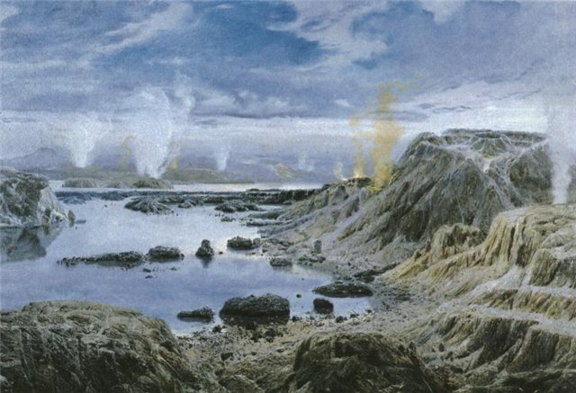
Archean Eon…
Geologic State of the Earth
Crust cooled
atmospheric water condenses
rains and rains and rains for millions of years
oceans form
atmospheric gases dissolve in oceans…
(polar ones) NH₃, SO₂, H₂S
(and some of the nonpolar) CO₂, CH₄, N₂
depleted from atmosphere
First continents form
Volcanic activity
“feeds” the gases of the atmosphere
AND
spews lava up and out onto Earth’s surface
T < 100°C (212°F)

Slide 14
edit….
link to sediment to rock….

Slide 15
crayon lab… demo

Slide 16
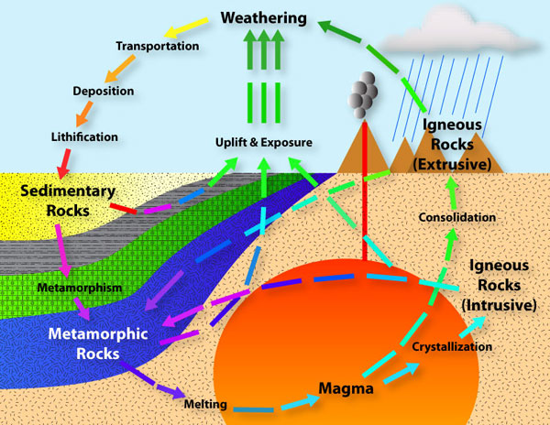
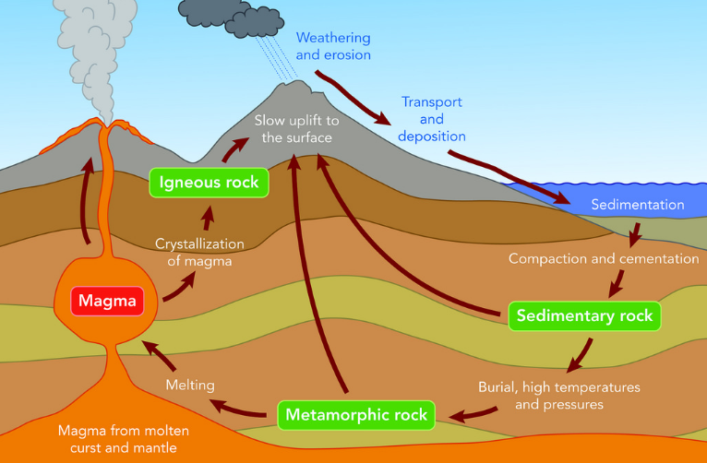
http://www.mineralogy4kids.org/?q=rock-cycle
https://www.australiancurriculumlessons.com.au/2017/04/09/rock-cycle-science-geology-lesson-years-789/

Slide 17
exploring the Rock Cycle…
types of rocks
and how they form
http://www.learner.org/interactives/rockcycle/index.html
Fill in the handout…
and,
respond to the question regarding the role of water
in the Rock Cycle
IF… you happen to finish,
1. identify the types of rocks at the lab bench
2. cut out the cut-and-paste activity… pieces into envelope

