Slide 1
https://www.youtube.com/watch?v=kyH02NjyfPA
freddie

Slide 2
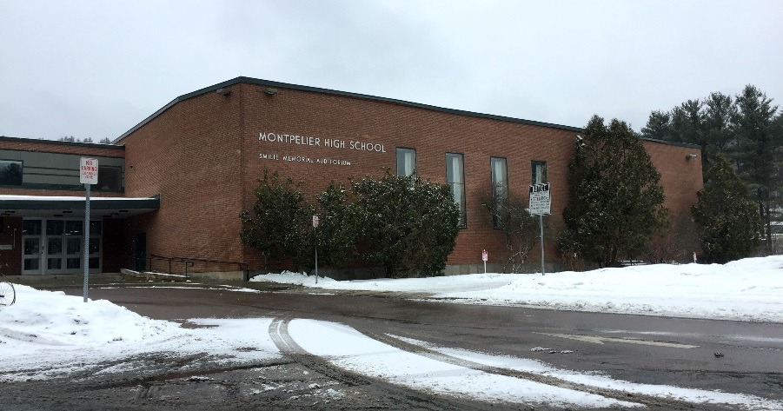
runoff
runoff
Project Options:
engineering/design
The Mud Lot
1. address issues of runoff
onto and off of the Mud Lot
… concerns
… design a new parking lot
that mitigates these runoff issues
runoff
analytical
chemistry
2. address issues of runoff
off of the Mud Lot and into the Winooski
… specific substances of concern
… measure the levels of these water quality factors
… address ways to mitigate these runoff issues
The Winooski

