Slide 1
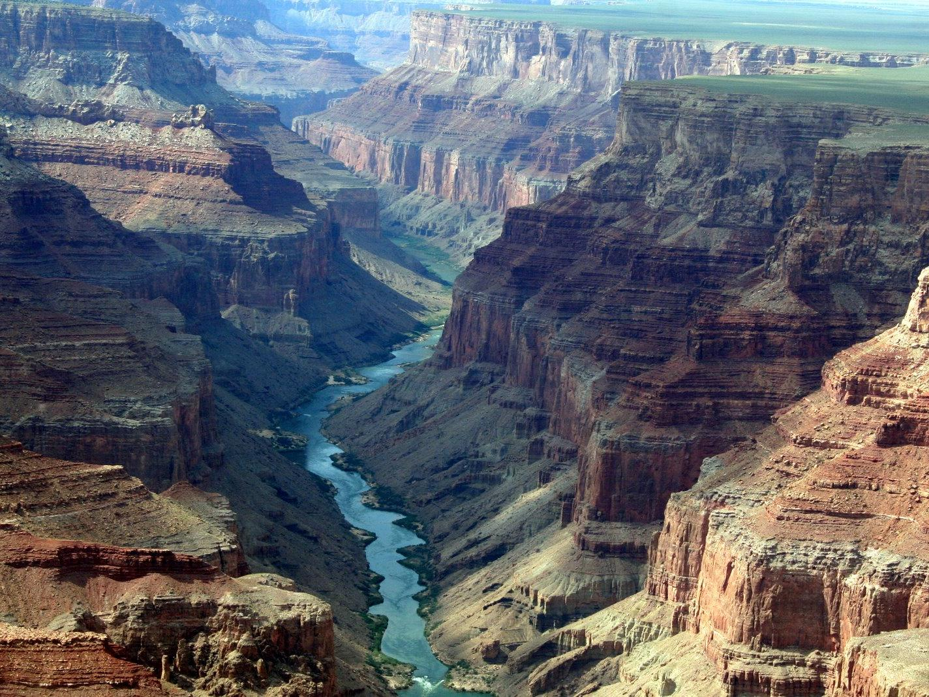
this is now….
how’d this come to be? …

Slide 2
something local….

Slide 3
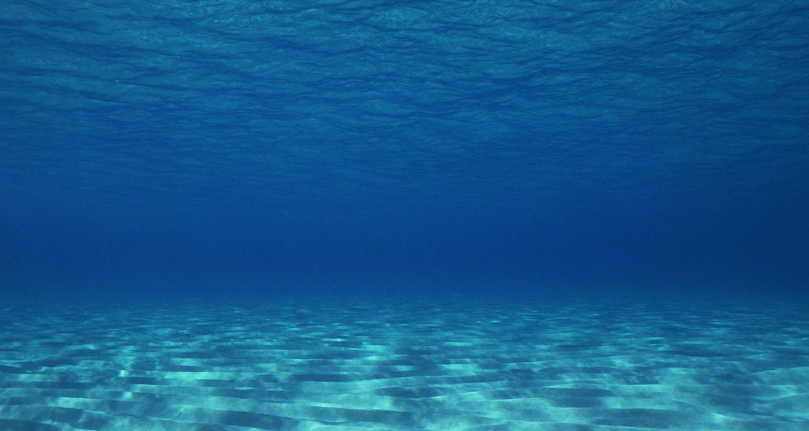
4 billion
years ago
today
The Ocean
620 million years ago
miles and miles and miles

Slide 4
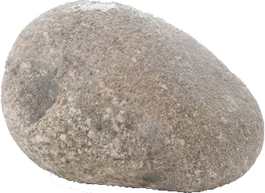
The Sediment (falling into the ocean)
(grains of sand)

Slide 5
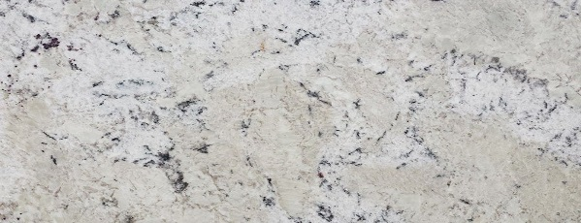
4 billion
years ago
today
620 million years ago
the sediment settles
565 million years ago
(grains of sand)
and becomes rock

Slide 6
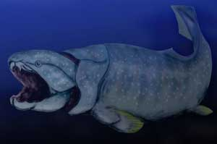
4 billion
years ago
today
565 million years ago
the ocean goes away
560 million years ago

Slide 7
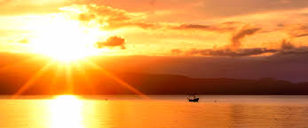
weathering and erosion

Slide 8
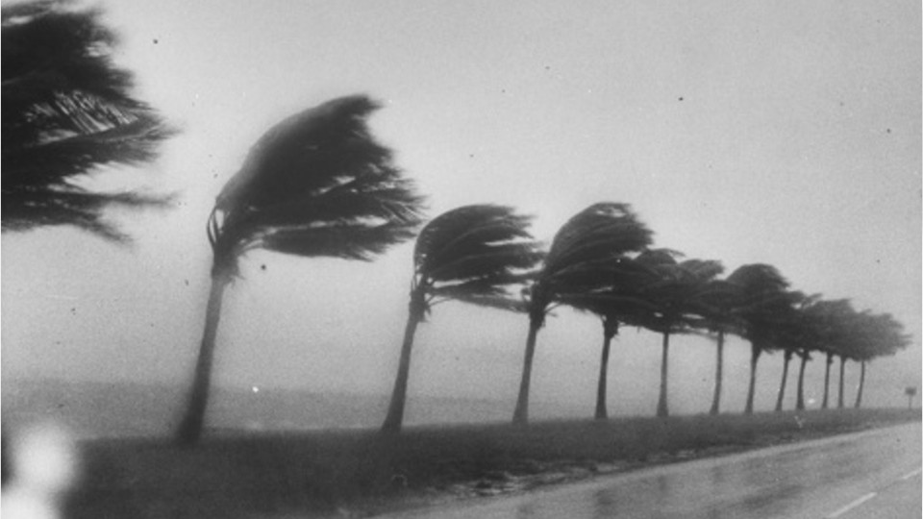
weathering and erosion

Slide 9
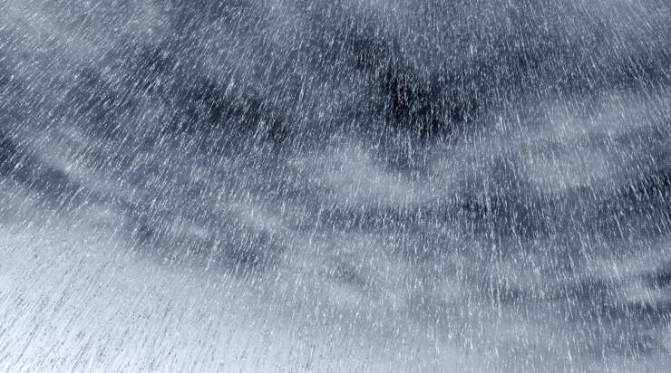
weathering and erosion

Slide 10
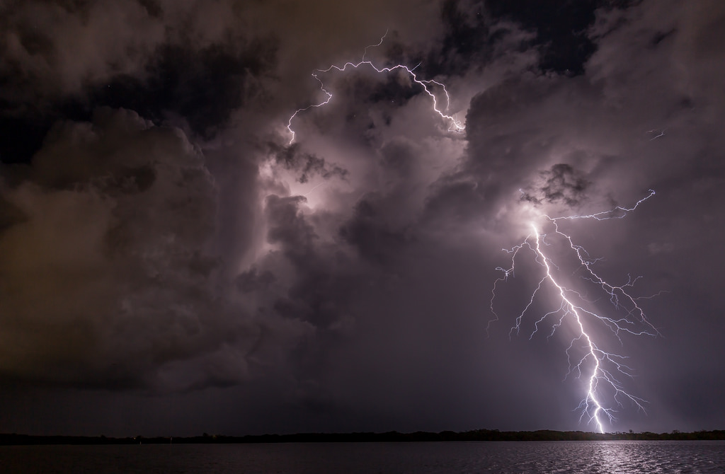
weathering and erosion

Slide 11
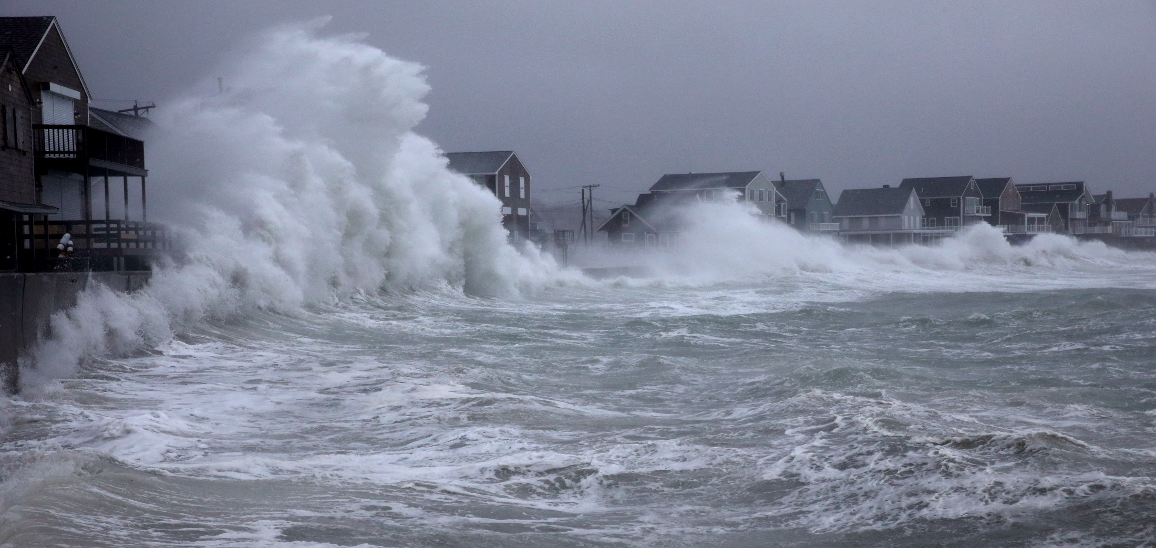
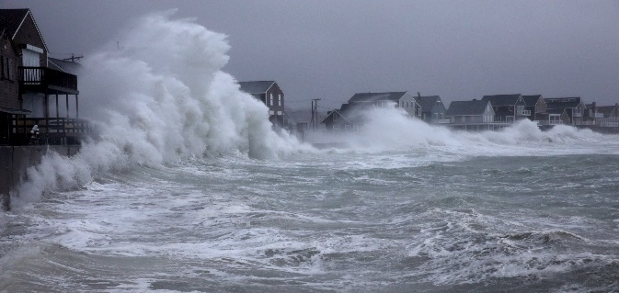
weathering and erosion

Slide 12
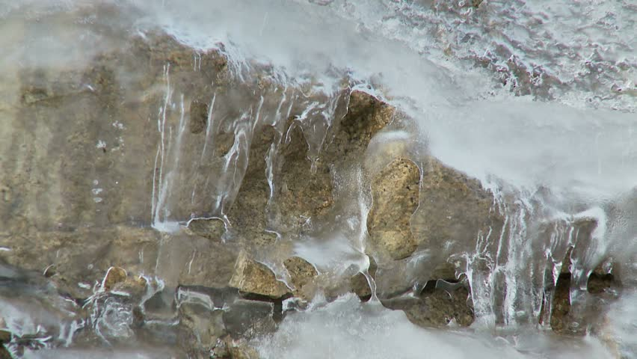
weathering and erosion

Slide 13
4 billion
years ago
today
565 million years ago
550 million years ago
weathering and erosion

Slide 14
4 billion
years ago
today
550 million years ago
545 million years ago
the ocean comes back

Slide 15
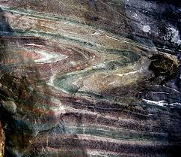
4 billion
years ago
today
545 million years ago
495 million years ago
more sediment settles
and becomes rock

Slide 16
4 billion
years ago
today
495 million years ago
the ocean goes away
490 million years ago

Slide 17
weathering and erosion

Slide 18
weathering and erosion

Slide 19
weathering and erosion

Slide 20
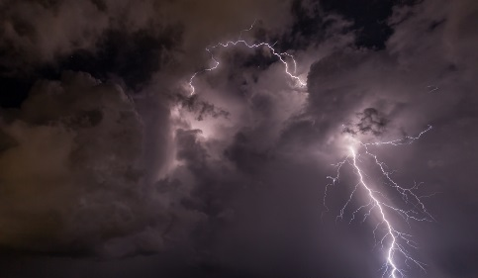
weathering and erosion

Slide 21
weathering and erosion

Slide 22
weathering and erosion

Slide 23
4 billion
years ago
today
490 million years ago
weathering and erosion
480 million years ago

Slide 24
4 billion
years ago
today
480 million years ago
475 million years ago
the ocean comes back

Slide 25
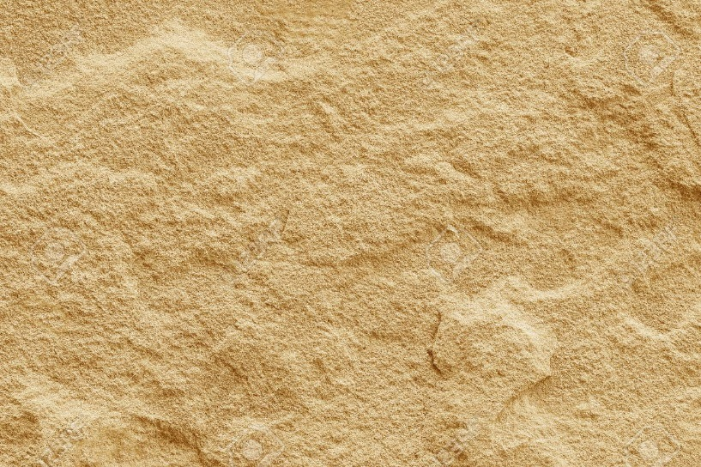
4 billion
years ago
today
475 million years ago
425 million years ago
more sediment settles
and becomes rock

Slide 26
4 billion
years ago
today
425 million years ago
the ocean goes away
420 million years ago

Slide 27
4 billion
years ago
today
420 million years ago
weathering and erosion
410 million years ago

Slide 28
4 billion
years ago
today
410 million years ago
405 million years ago
the ocean comes back

Slide 29
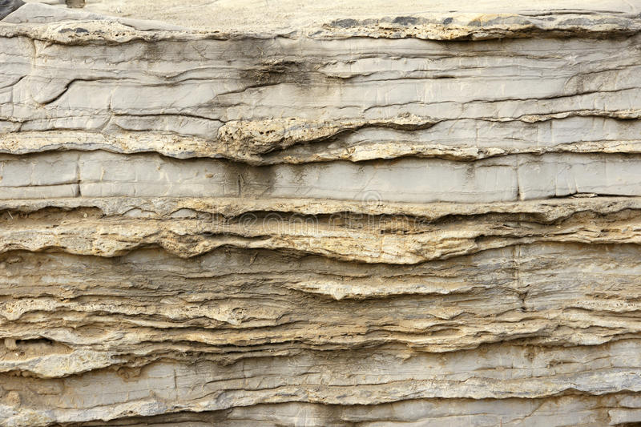
4 billion
years ago
today
405 million years ago
more sediment settles
355 million years ago
and becomes rock

Slide 30
4 billion
years ago
today
355 million years ago
350 million years ago
the ocean goes away

Slide 31
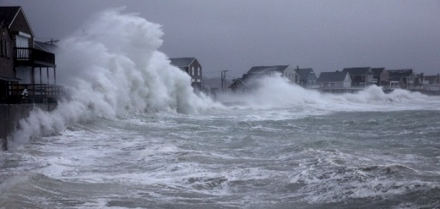
4 billion
years ago
today
350 million years ago
340 million years ago
weathering and erosion

Slide 32
4 billion
years ago
today
340 million years ago
335 million years ago
the ocean comes back

Slide 33
4 billion
years ago
today
335 million years ago
more sediment settles
285 million years ago
and becomes rock

Slide 34
4 billion
years ago
today
285 million years ago
the ocean goes away
280million years ago

Slide 35
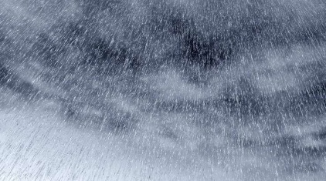
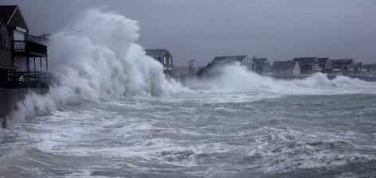
4 billion
years ago
today
280 million years ago
weathering and erosion
270 million years ago

Slide 37
continued weathering and erosion

Slide 38
continued weathering and erosion

Slide 39
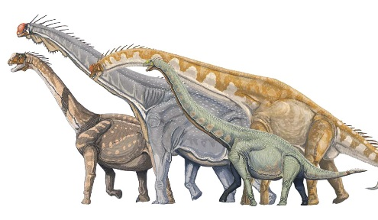
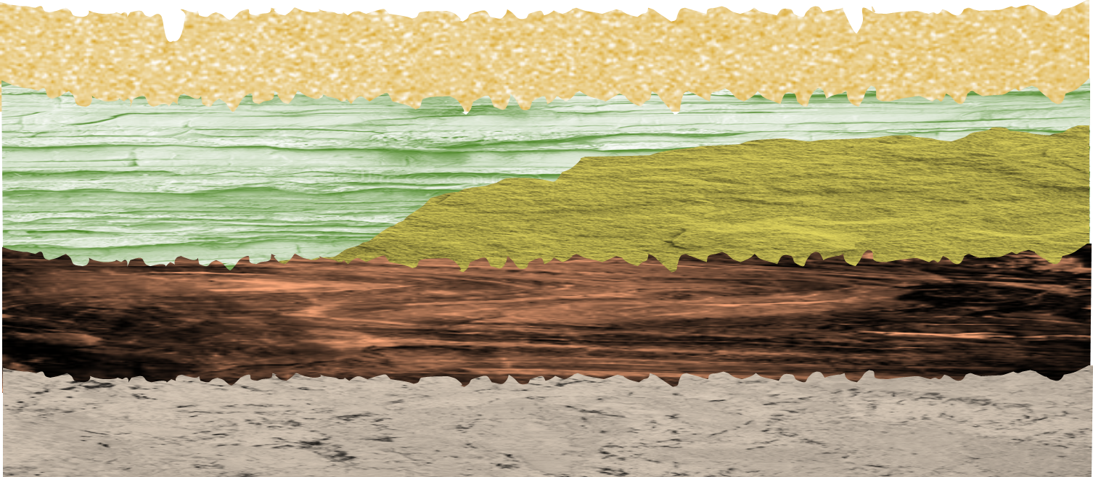
4 billion
years ago
today
water can collect here….
a river might form….
moving water…
more erosion
270 million years ago

Slide 40
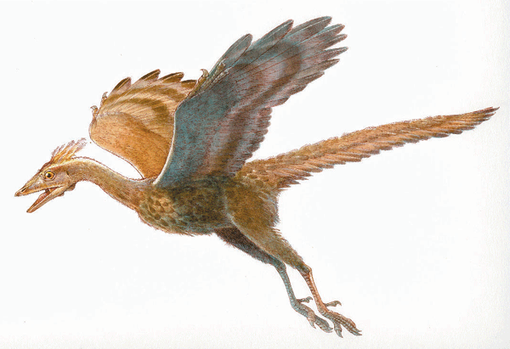
water can collect here….
a river might form….
moving water…
more erosion

Slide 41
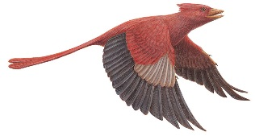
4 billion
years ago
today
water can collect here….
a river might form….
moving water…
more erosion
65 million years ago

Slide 42
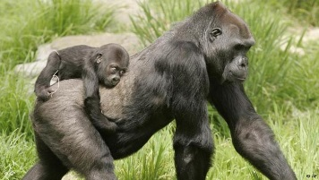
4 billion
years ago
today
water can collect here….
a river might form….
moving water…
more erosion
14 million years ago

Slide 43
4 billion
years ago
today
water can collect here….
a river might form….
moving water…
more erosion
100,000 years ago

