Slide 1
Watershed
IS_Day1_G3 Slide 4
IS_Day1_G4 Slide 4
to understand what is in the water…
we need to first understand where it comes from
(and goes to)
To understand where the water come from…
… we need to understand the land formations…

Slide 2
Vocabulary…
Elevation
Runoff
Tributary
Drainage Basin
Watershed

Slide 3
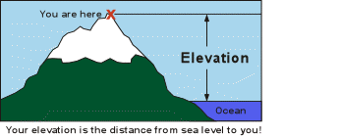
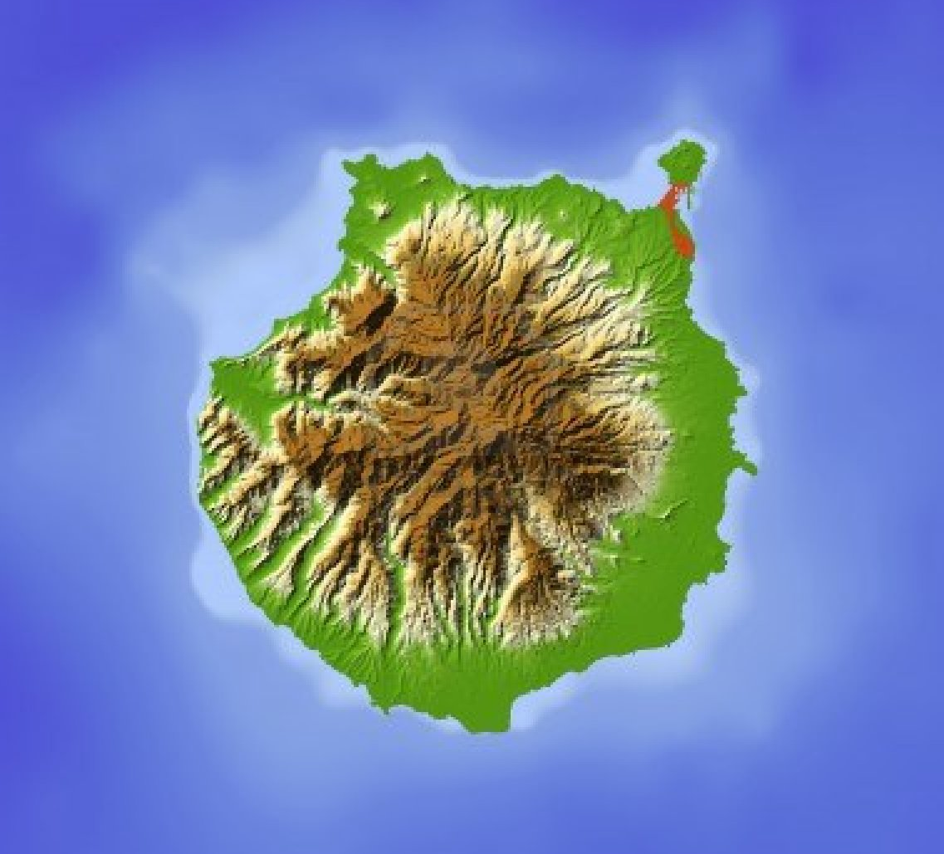
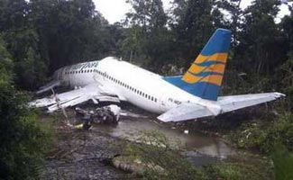
Elevation -
The height of the land above a fixed point
(most commonly sea level)
This is not altitude - which refers to the height above ground
Your plane is flying at an elevation of ground level

Slide 4
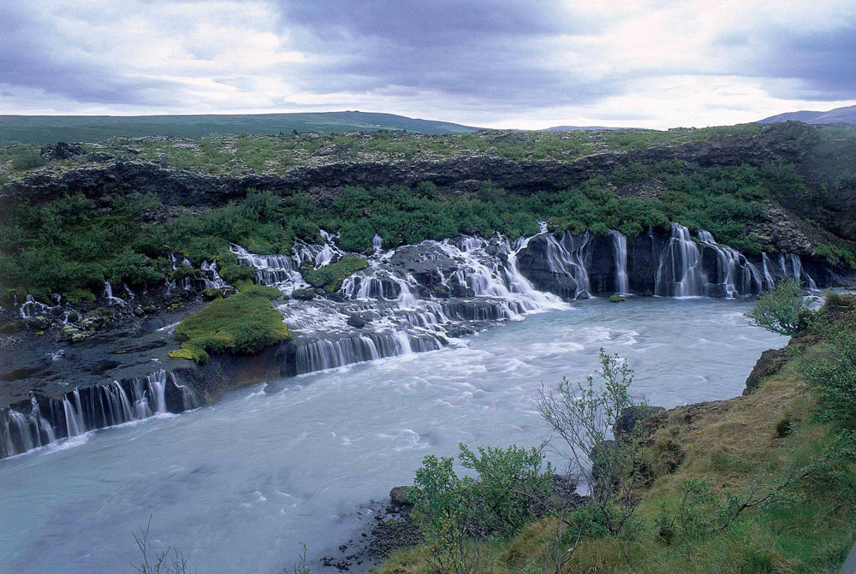
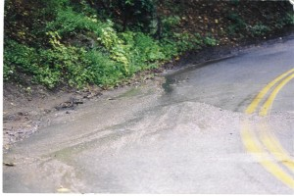
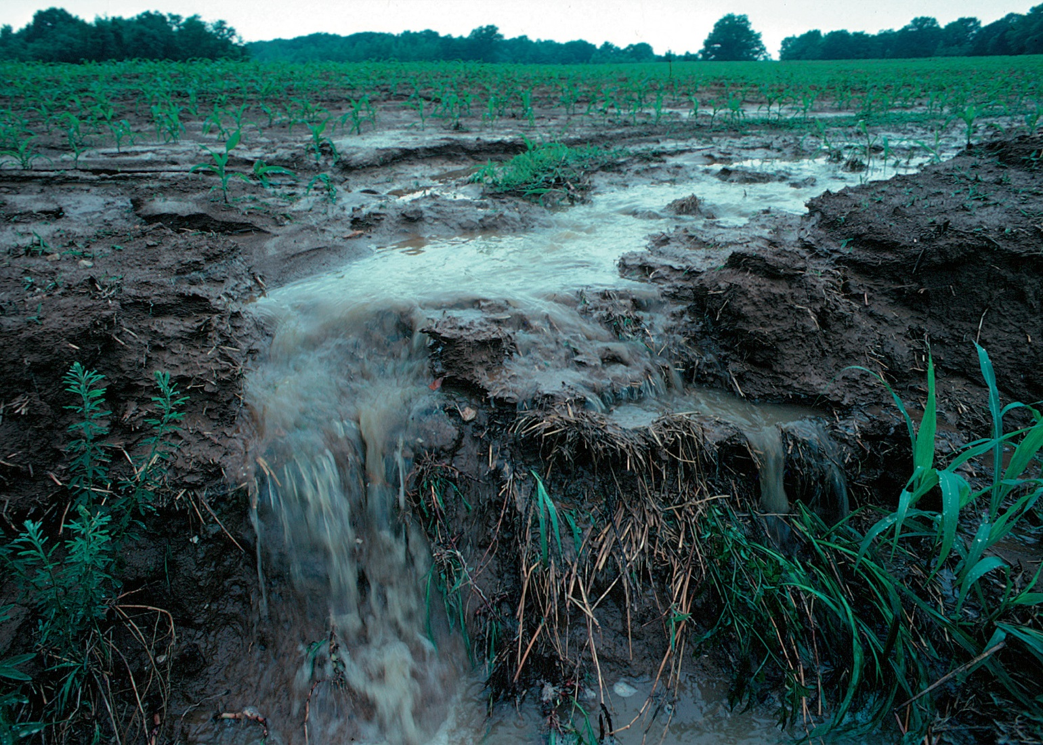
Runoff –
Water that flows over the surface of land
and into a stream, river or lake
runoff will bring with it anything
that is not “nailed down”

Slide 5
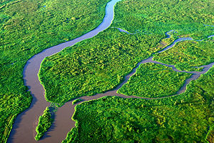
Tributary –
A river or stream that flows into the main stem of a river or a lake

Slide 6
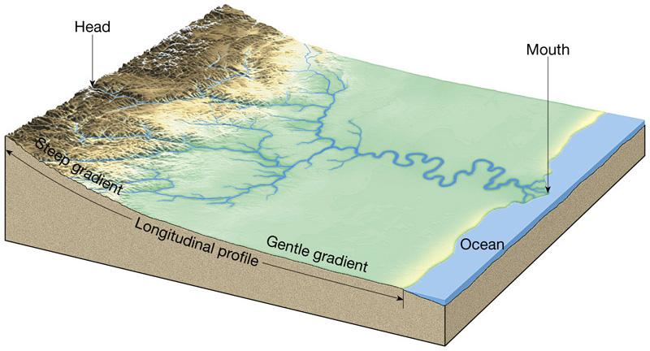
compare tributary to headwaters…
The mouth of a river or stream is where it (the river or stream of focus) goes into a different river or other body of water.
The source or headwaters of a river or stream is the furthest place in that river or stream from its mouth, as measured along the course of the river.

Slide 7
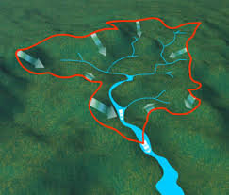
Drainage Basin -
The area of land from which surface water converges to a common point at a lower elevation.
surface water (runoff, stream, river, lake, wetland, ocean)
the drainage basin for
this common point
Wikipedia:
A drainage basin or watershed (North American English usages) is an extent or an area of land where surface water from rain and melting snow or ice converges to a single point at a lower elevation, usually the exit of the basin, where the waters join another waterbody, such as a river, lake, reservoir, estuary, wetland, sea, or ocean.

Slide 8
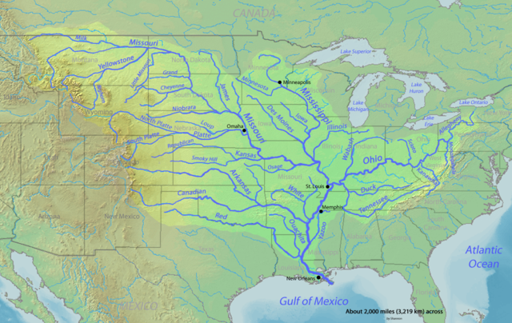
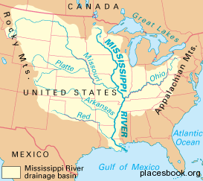
Ohio River
Drainage Basin
Missouri River
Drainage Basin

Slide 9
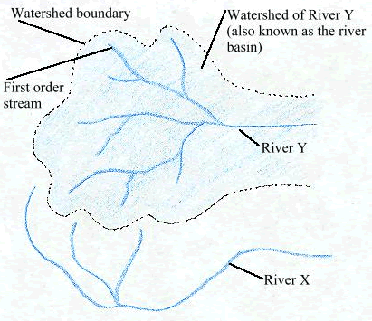
What is a watershed?
Watershed: The area of land where all of the water drains into
the same river or waterbody.
drainage basin
and
watershed
often used
interchangeably
common distinction:
watershed
used for a whole river
drainage basin
for a piece of the watershed

Slide 10
Mississippi River
Drainage Basin / Watershed
Ohio River
Drainage Basin / Watershed
Missouri River
Drainage Basin / Watershed

Slide 11
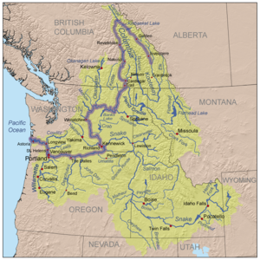
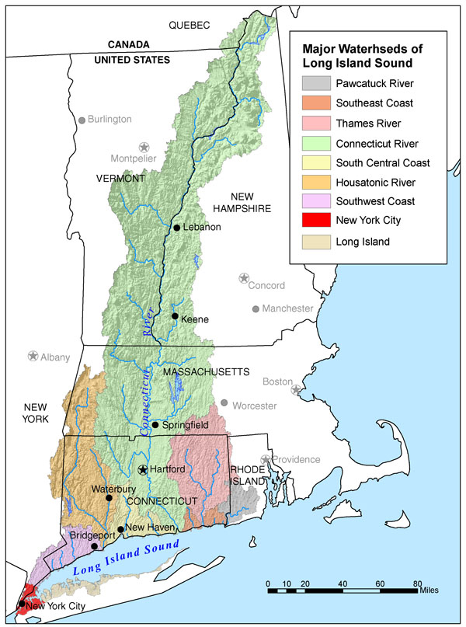
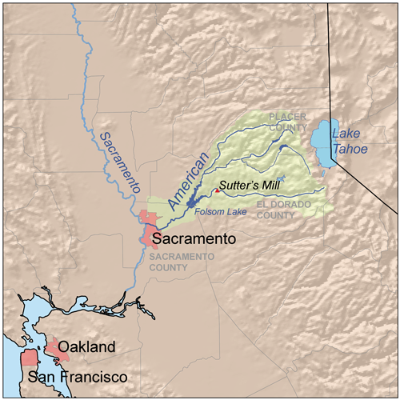
Columbia River
Drainage Basin / Watershed
Connecticut River
Drainage Basin / Watershed
American River
Drainage Basin / Watershed

Slide 12
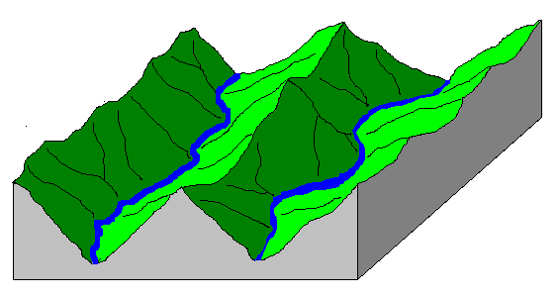
Drainage Divide
Watersheds are separated by drainage divides – or ridgelines
So…. if we want to figure out the watershed for a particular body of water,
we need to be able to find the drainage divides (ridgelines / high points)

Slide 13
Drainage Divide
Watersheds are separated by drainage divides – or ridgelines
So…. if we want to figure out the watershed for a particular body of water,
we need to be able to find the drainage divides (ridgelines / high points)
need surveyors and map makers to make us a map of the terrain
- cumbersome to have a 3-D model of the terrain
- represent the 3-D terrain on a 2-D piece of paper
(contour map)

Slide 14
need example here of outlining watershed (boundary)

Slide 15
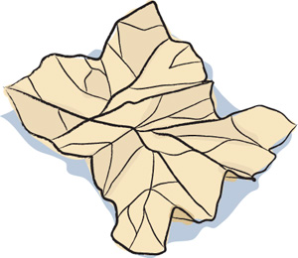
Crumpled Paper Watershed Model
Goal: Create a model a watershed
Materials
8.5” x 11” Paper
Water soluble pens
Squirt bottle
Directions:
1. Crumple up the piece of paper your teacher gave you, and then smooth it back out most of the way. It should still be a bit crumpled, showing small ridges (high points) and valleys (low points).
2. Imagine that this paper is a section of land, and find the ridgelines (the tops of the fold-lines).
3. Use a washable blue marker (not permanent) to color along the ridgelines on your “land.”
“up-folds”
“down-folds”
water-soluble

Slide 16
Make Your Hypotheses
You are going to “rain” on your landform. Answer the following questions to make your hypotheses before conducting the experiment.
1. What do you think will happen to your land when it “rains?”
2. What will happen to the blue ridge lines you colored?
3. Where will the “rainwater” travel?
one “mist” at a time
wait 5 secs or so between “mists”
Follow the directions below to conduct the experiment.
Use a spray bottle of water to create a “rainstorm” over your land. You want to create gentle sprays of mist.
Observe what happens after every misting.
3. As your “rainfall” accumulates, observe the pathways where the excess “rainfall” travels.

Slide 17
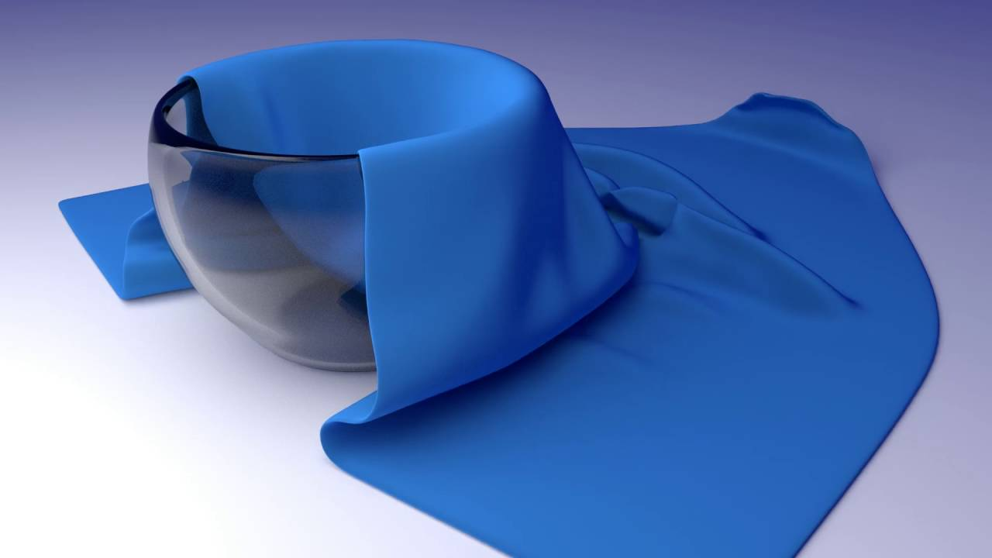
The Towel and The Bowl Activity

Slide 18
Drape one end of a towel over a bowl
Tilt the bowl onto its side
Let the rest of the towel “flow” onto the table
Make some wrinkles (ridges) in the towel…
let your teacher help you
Trace the “gullies” in your towel with blue yarn
Trace the “ridges” in your towel with yellow/green yarn
Identify one low point where water would collect
mark it with an ‘X’ of blue yarn
Outline the land from which the water would flow into your ‘X’
use the red yarn for the outline

