Slide 1
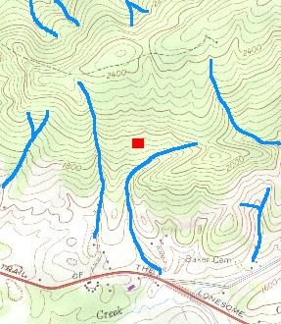
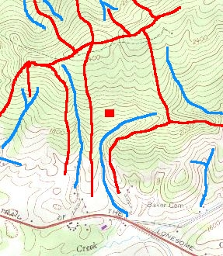
Practice identifying a watershed using your knowledge of contour maps
Spicer Brook (Marshfield) – Hydro 8 Practice 2
No-Name Brook – Hydro 8 Practice 3
Shady Rill (Middlesex) – Hydro 8 Practice 4
Shelburne Pond (near Shelburne) – Hydro 8 Practice 5
Class activity: the whole Winooski River Watershed Identification

Slide 2
Identification of a watershed
definition: The area of land where all of the water drains into
the same river or waterbody.
the watershed is delineated by the ridgelines (high points of land)
the ridgelines are identifiable using contour maps
Franconia Ridge
link

Slide 5
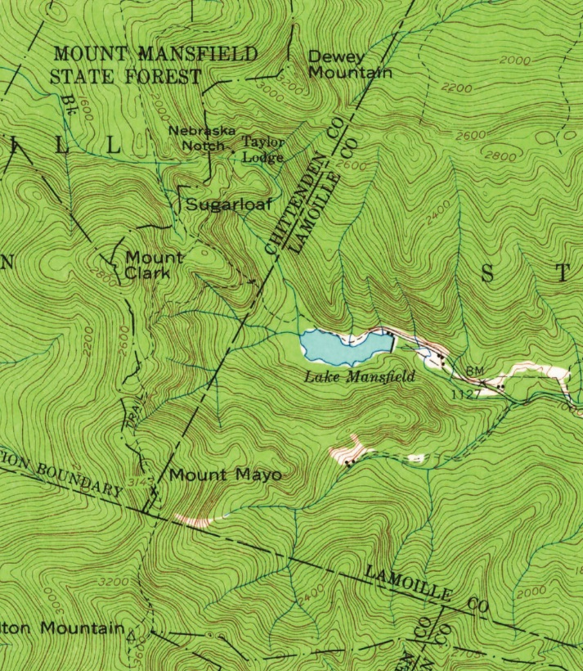

Slide 6
1. Stream A
2. Lake Mansfield

Slide 7
M
O
A

Slide 9
X
X
X
X
X
X
X
X
X
X
X
X
X
X
M
O
A
X
X
X
X
X
X
X
X
X
X

Slide 10
along ridgelines
sources
S
sources
sources
practice with Stevenson Brook first
link

Slide 11
X
X
X
X
X
X
X
X
X
X
Stream A
X
X
S
?
S
M
A
O
X
S
S
X
S
X
X
X
X
X
X
X
X

Slide 12
X
X
X
X
X
X
X
X
X
X
X
S
S
M
A
O
X
S
S
X
S
X
X
X
X
X
X
X
X

Slide 14
X
X
X
X
X
X
X
X
X
X
X
S
S
M
A
O
X
S
S
X
S
X
X
X
X
X
X
X
X

Slide 16
X
X
S
S
X
X
S
S
X
X
X
X
X
Lake Mansfield
S
X
X
S
S
S
M
A
O
X
S
S
X
S
X
X
X
X
X
X
X
X

Slide 17
X
X
S
X
S
S
X
X
S
X
X
X
X
S
X
X
S
S
S
M
A
O
X
S
S
S
X
X
X
X
X
X
X
X
X

Slide 18
X
X
S
S
X
X
S
X
X
X
X
X
X
X
S
S
M
A
O
X
S
X
X
X
X
X
X
X
X
X

Slide 19
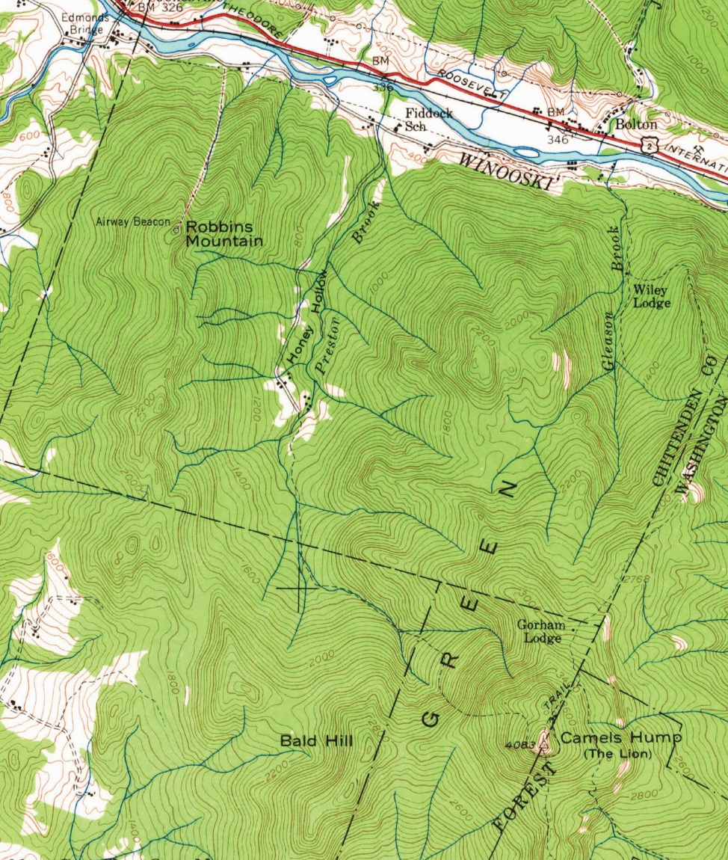
M
watershed
for Prestor Brook
S
S
S
S
S
S
S
S
S
S
S
S
S
S
S
S

Slide 20
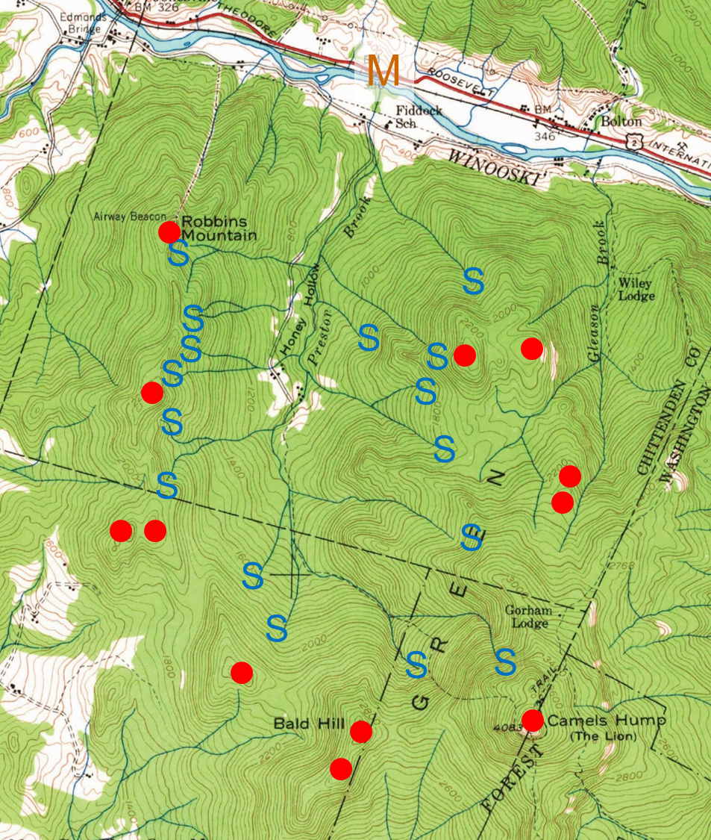
watershed
for Prestor Brook

Slide 21
Find the waterways… highlight in blue.
Identify the high points of land (red).
Connect neighboring highpoints (along highest points) to define a ridgeline (green).
With respect to the ridgelines, identify which way the water would flow.
Identify any waterways flowing into the water of focus (Spicer, Shady Rill, Shelburne Pond, ….
Outline the watershed (orange).
if you can see the start of the waterway (stream, river, etc)
then you can tell which way it flows – towards a larger body of water
Spicer Brook
No-Name Brook
Shady Rill
Shelburne Pond

Slide 22
Map the Winooski River Watershed
Work with your group to delineate the Winooski River watershed for the portion of land shown on your map.
Color the main stem of the Winooski blue
Stevens Brook/Branch
Mad River
Dog River these are the main branches Huntington River blue too
North Branch
Jail Branch
any other water:
brown maps: black
green maps: brown
highpoints ridgelines
brown maps: green
green maps: red
watershed boundary purple
Outline the land (along the ridgelines) from which water would flow into the waters of the Winooski watershed

Slide 23
