Slide 1
Hydrosphere 9 THE WATER CYCLE Date ____________
Firstly: definitions for solid, liquid, and gas (states of matter)
Solid:
volume: definite, shape: definite,
individual particles touch one another AND are rigidly stuck to each other
Liquid:
volume: definite, shape: not definite, take the shape of the container
individual particles move around one another – but stay stuck
(like a square dance)
Gas:
volume: not definite , shape: not definite fill the container
individual particles move around one another / are NOT stuck to each other
… FREE!
Plasma:
“super” hot… so hot that particles collide hard enough to bust electrons off… producing ions – electrically conductive
(hot – 1000’s °C) sea of charged particles.. like the stars, and lightning…

Slide 2
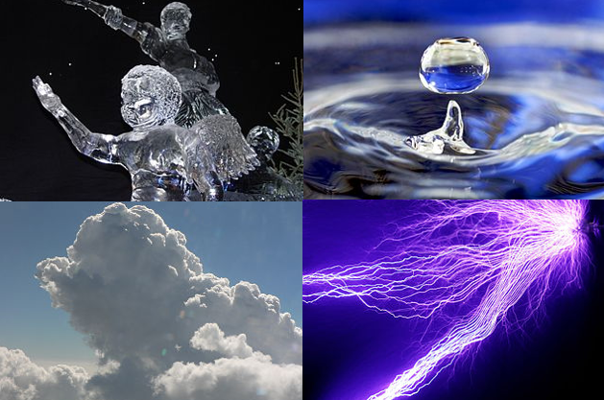

Slide 3
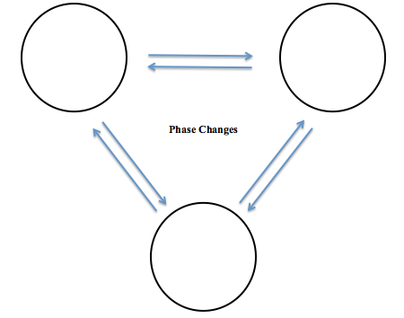
SOLID
LIQUID
state
phase: _______________
_____________________
_____________________
_____________________
a region of material
that is chemically uniform,
physically distinct,
and (often) mechanically separable
example: the state
GAS

Slide 5
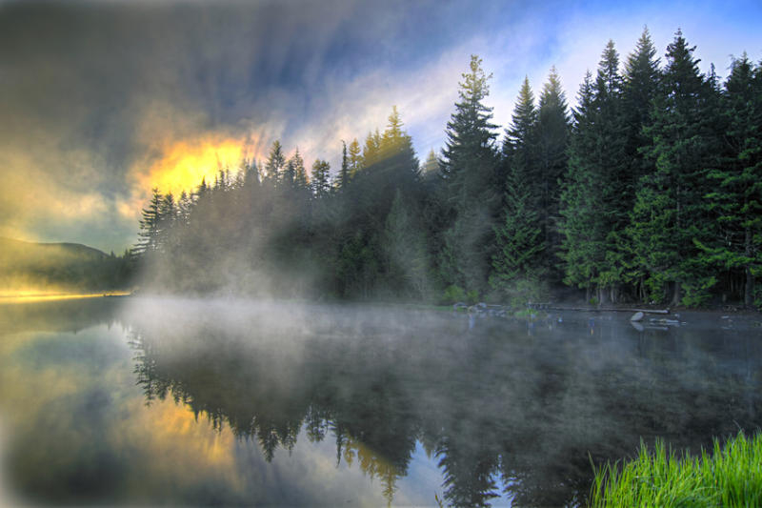
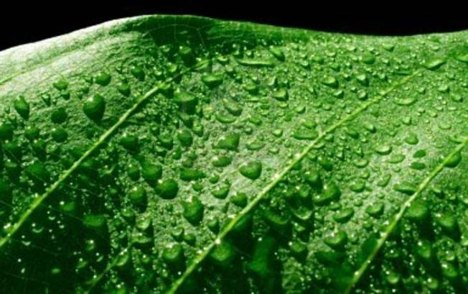
Evaporation:
the transformation from liquid to gas
can occur for the liquid at any temperature – faster when hotter
Transpiration:
the release of water vapor from plants and soil into the air

Slide 6
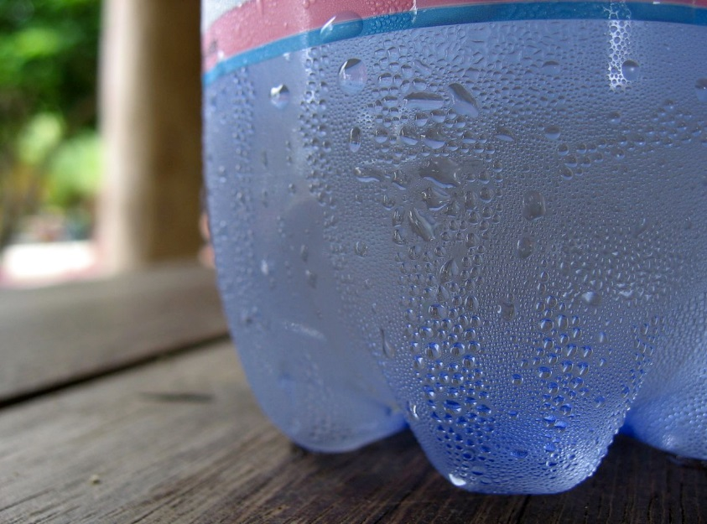
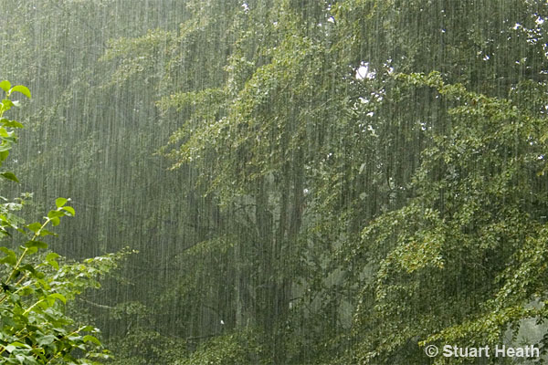
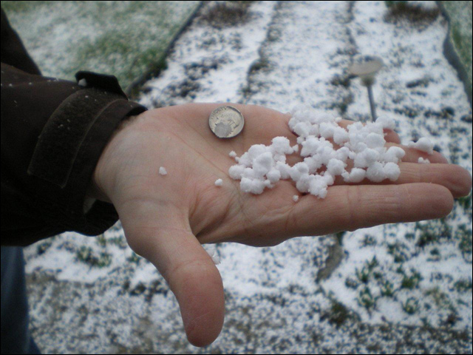
Condensation:
the transformation of gas to liquid
occurs faster when it is colder…
Precipitation:
condensed water vapor that falls
to the Earth's surface
mostly rain,
but also includes snow, hail,
graupel, fog, sleet
Graupel (German pronunciation: [ˈɡʁaʊpɛl]; English /ˈɡraʊpəl/, also called soft hail or snow pellets) is precipitation that forms when supercooled droplets of water are collected and freeze on a falling snowflake, forming a 2–5 mm (0.079–0.197 in) ball of rime. The term graupel comes from the German language.

Slide 7
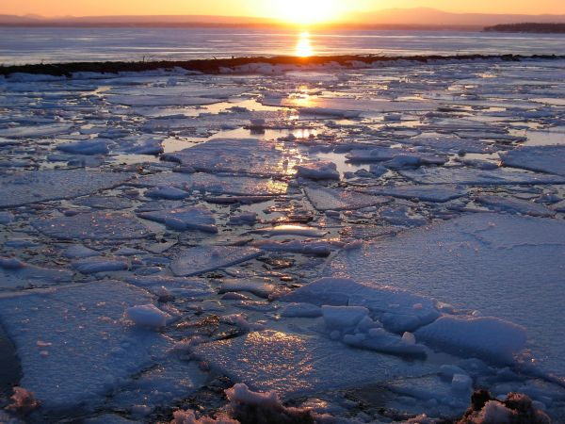
Freezing:
the transformation of liquid to solid
… decreases water flow
Melting:
transformation from solid to liquid
… increases water flow

Slide 8
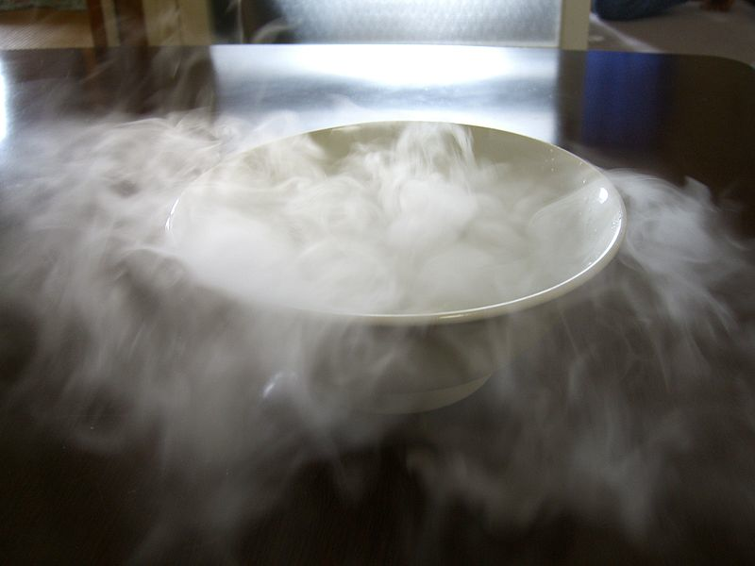
Deposition:
the transformation of gas to solid (without becoming a liquid)
Sublimation:
transformation from solid to gas (without melting)

Slide 9
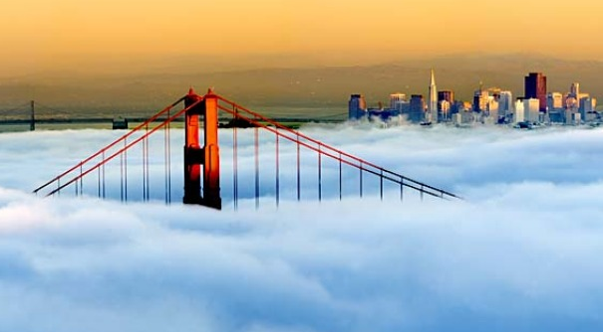
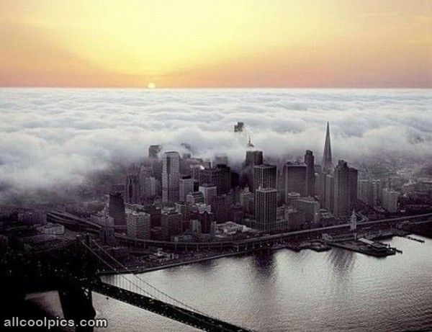
Transportation:
the movement of water — in solid, liquid, or gas states —
through the atmosphere.

Slide 10
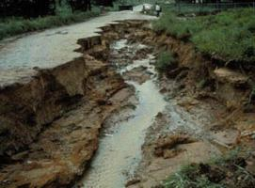
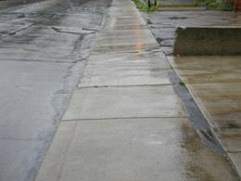
Channel Runoff:
water that flows over the surface
of land that is within a stream,
river, or channel of some type.
Surface Runoff:
water that flows over the surface
of land that is not within a stream,
river, or channel of some type.
As the water flows, the water may
seep into the ground,
evaporate into the air,
become stored in lakes or reservoirs,
or be extracted for agricultural or other human uses

Slide 11
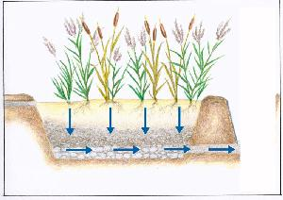
Infiltration:
the flow of water from the ground surface into the ground.
Percolation:
water flowing horizontally through the soil and rocks under the
influence of gravity

Slide 12
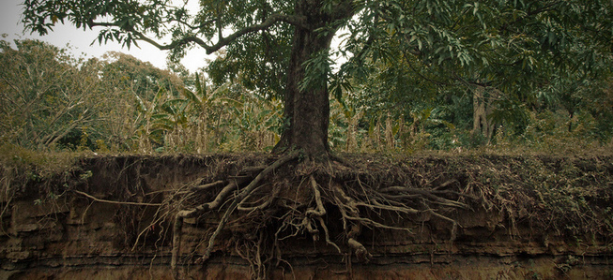
Plant Uptake:
water that is removed from the soil/ rock by plants

Slide 14
transportation
5.
transportation
3.
condensation
6.
7.
precipitation
deposition
18.
condensation
2.
precipitation
4.
sublimation
17.
surface runoff
8.
transpiration
14.
evaporation
10.
evaporation
channel runoff
16.
9.
channel runoff
11.
infiltration
plant uptake
13.
percolation
12.
infiltration
15.

Slide 15
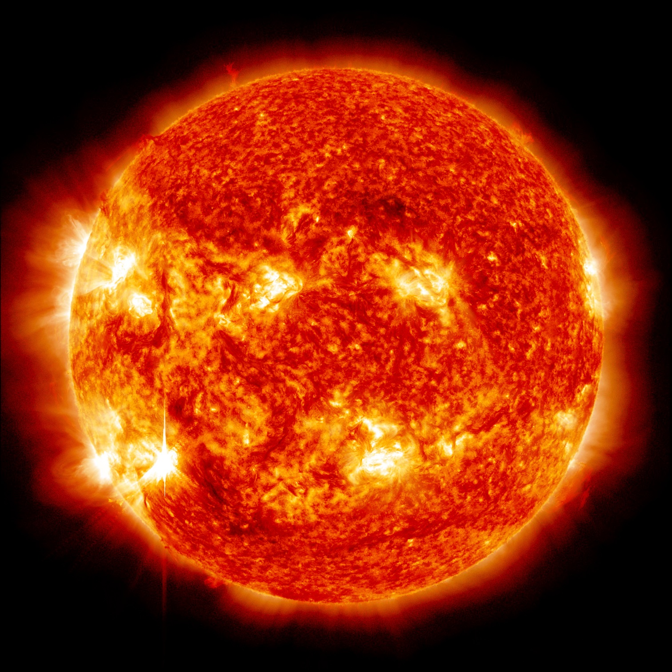
What is the ultimate source of energy that drives this system?

Slide 16
Human Uses for Water
Think about the ways you use water in your everyday life.
Think about ways your households use water.
Create a list of direct uses of water (by humans).
direct water use is when you turn on a tap
[or some other source…] and water comes out
We also use water indirectly. How are some ways we do this?
Example: A cow drinks water, and you may eat beef.
You have indirectly used water by eating the beef.
indirect water use is when you use a product or service that required water to be used for its production, or water use that you aren't readily aware of

Slide 17
Human Uses for Water
Think about the ways you use water in your everyday life.
Think about ways your households use water.
Create a list of direct uses of water.

Slide 18
link 1
link 2
Human Uses for Water
We also use water indirectly. How are some ways we do this?
Example: A cow drinks water, and you may eat beef.
You have indirectly used water by eating the beef.

Slide 19
Where is the World’s Water Stored?
Solid | Liquid | Gas
Solid | Liquid | Gas
glaciers ice caps | oceans groundwater lakes rivers | atmosphere
97.2%
0.001%
2.11%
0.62%
0.009%
0.0001%

Slide 20
Where is the World’s Water Stored?
Glaciers and Ice – 2.11%
Groundwater - 0.62%
Lakes – 0.009%
River – 0.0001%
Oceans - 97.2%
Atmospheric – 0.001%
fresh water - solid…
fresh water – liquid…
salt water – liquid…
fresh water – gas…
How much water is there on Earth?
330,000,000,000,000,000,000,000 Gallons
333 quintillion
330 million trillion

