Slide 1
The Atom…

Slide 2
The Atom…
what do you know so far…
link to BIG and small

Slide 3
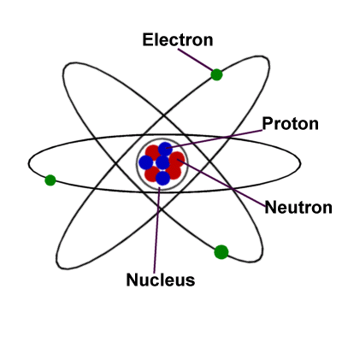
What is an atom?
An atom is a basic unit of matter.
Atoms have a nucleus (central part) made of protons and neutrons.
The nucleus is surrounded by electrons.

Slide 4
If an atom is a basic unit of matter….
…what is an element?
An element is a pure chemical substance consisting of one type of atom.

Slide 5
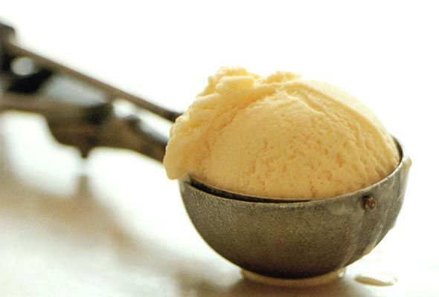
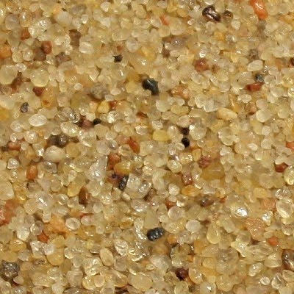
An atom is a basic unit of matter.
An element is a pure chemical substance
consisting of one type of atom.
the piece / amount
of what
an atom is to element
like
a grain is to sand
or
a scoop is to vanilla ice cream
or…

Slide 6
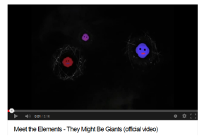

Slide 7
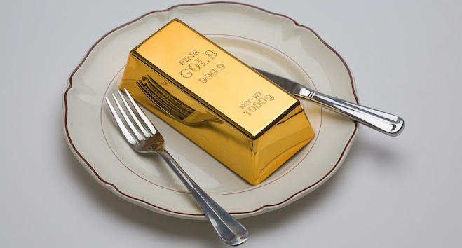
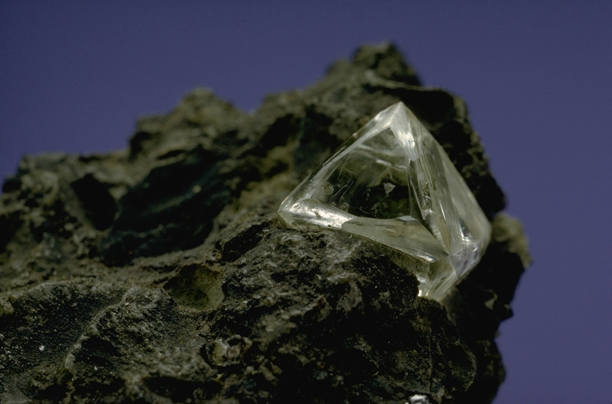
An atom is a basic unit of matter.
An element is a pure chemical substance
consisting of one type of atom.
So…
there are gold atoms
and
silver atoms
and
carbon atoms
and…
How is one type of atom different from another?

Slide 8
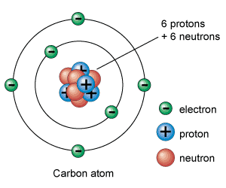
Atoms are made of even smaller pieces…
__________, ____________, ______________
protons
neutrons
electrons
Proton
A positively charged sub-atomic particle.
Protons are part of what make up the nucleus.
the atomic number: the number of protons in an atom
the atomic number defines what type of element the atom is
ex:
if there are 6 protons in the nucleus
then,
the atom is a carbon atom

Slide 9
Neutron
A sub-atomic particle with a neutral charge.
Neutrons are the other part of what makes up the nucleus.
the number of protons plus the number of neutrons
equals the mass number
#Protons + #Neutrons = Mass #
so, if you are given the Mass #
the number of neutrons = Mass # - # protons
atomic number
atomic number _______
# neutrons _______
mass # ________
6
6
12

Slide 10
isotopes of an element
atoms with the same number of protons
but
different numbers of neutrons
most abundant
atomic number
mass number

Slide 11
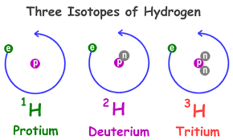
isotopes of an element
atoms with the same number of protons
but
different numbers of neutrons
most abundant
mass number

Slide 12
isotopes of carbon
atomic number
mass number

Slide 13
three most common isotopes of carbon

Slide 14
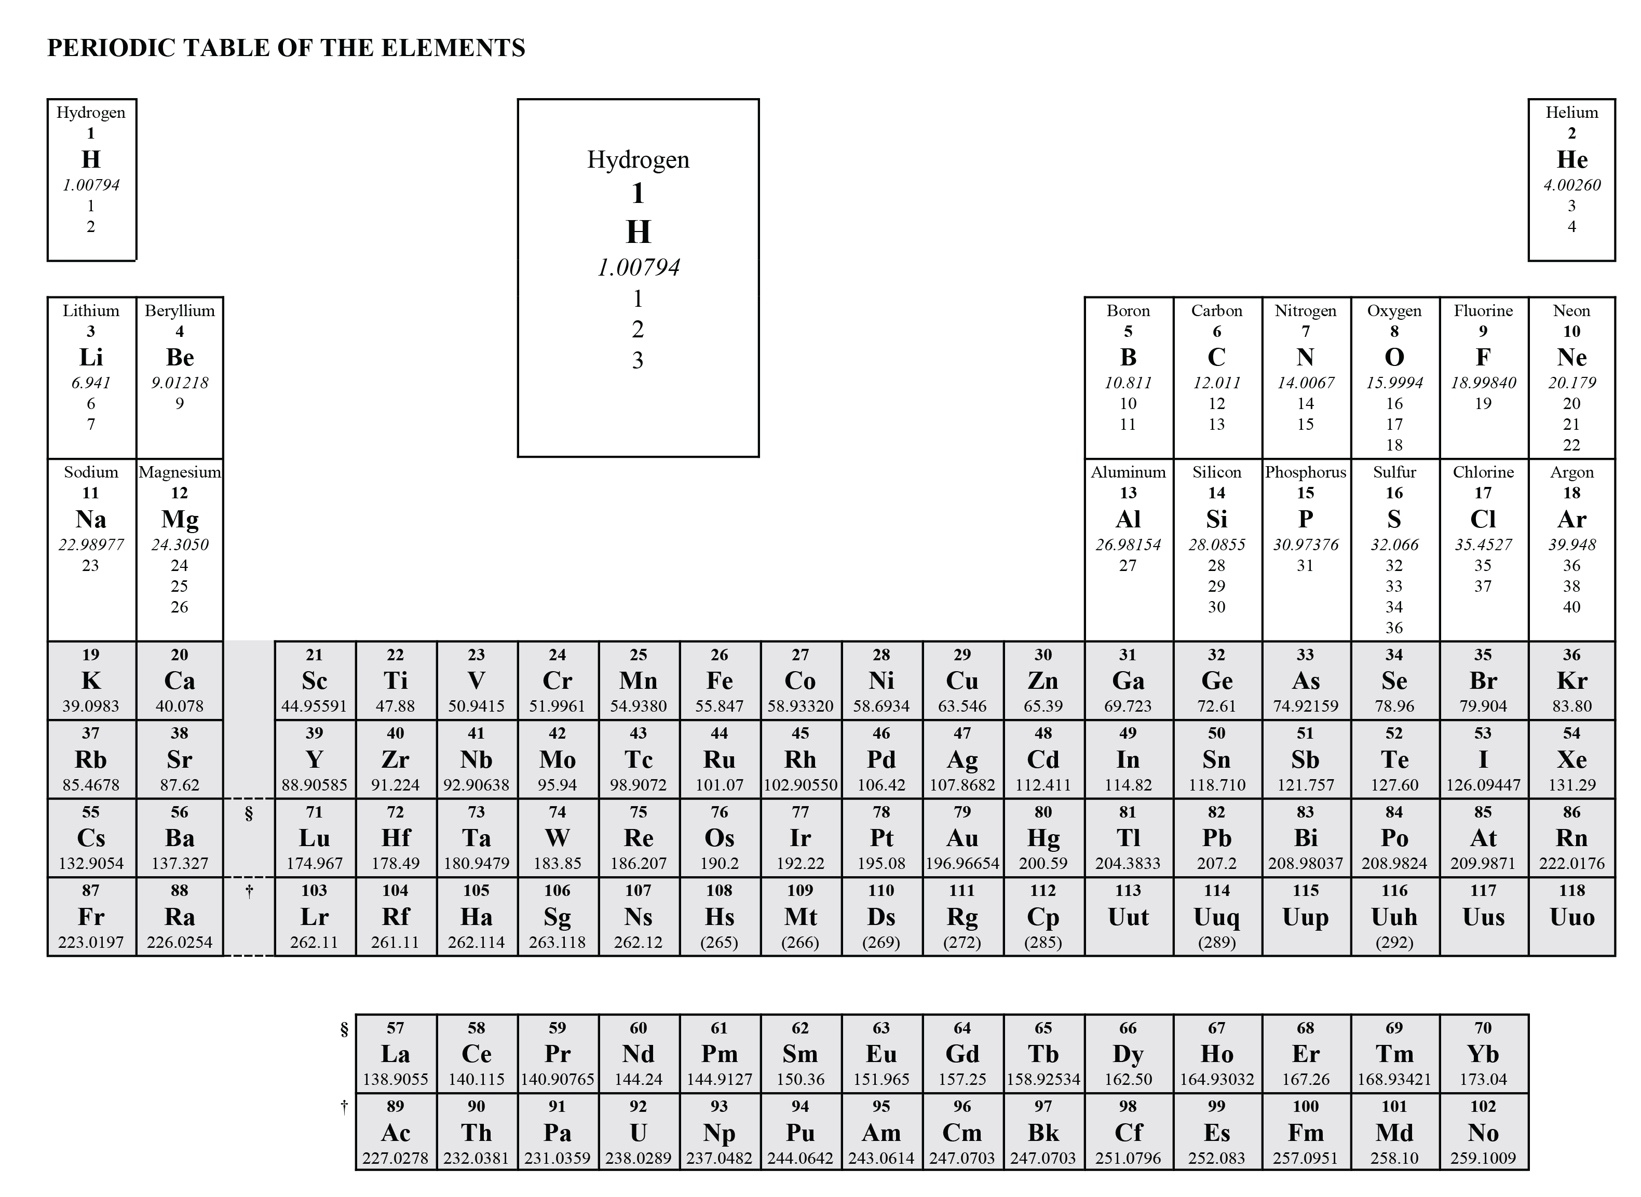
Element Name
Atomic Number
Atomic Mass
Element Symbol
most common
Mass Number(s)
three different isotopes
of hydrogen

Slide 15
Electron
A negatively charged sub-atomic particle.
The number of electrons equals the atomic number in an atom.

Slide 16
Electron
A negatively charged sub-atomic particle.
The number of electrons equals the atomic number in an atom.
Electrons exist in spaces surrounding the nucleus.
We will call these spaces “shells”
We will represent shells as circles
(However the electrons don't orbit the nucleus
like the planets orbit the sun...)
Each shell can hold up to a certain number of electrons.

Slide 17
Representation of an Atom
Electron Shell | 1st | 2nd | 3rd
Maximum number of electrons
2
8
8
represent an atom of Argon…
Atom Name:
Atomic Number = ________
# Protons = _____________
Mass # = _______
Mass # - Number of Protons =
Number of Neutrons: ___________
# Electrons =_________
# electrons in 1st shell = ___________
# electrons in 2nd shell = ___________
# electrons in 3rd shell = ___________

Slide 18
Representation of an Atom
Electron Shell | 1st | 2nd | 3rd
Maximum number of electrons
electrons “fill” shells
closest to the nucleus
before “filling” the next
shell
2
8
8
e⁻
represent an atom of Argon…
e⁻
e⁻
e⁻
Atom Name:
Atomic Number = ________
# Protons = _____________
Mass # = _______
Mass # - Number of Protons =
Number of Neutrons: ___________
# Electrons =_________
# electrons in 1st shell = ___________
# electrons in 2nd shell = ___________
# electrons in 3rd shell = ___________
18
e⁻
e⁻
e⁻
18
e⁻
e⁻
18p
__n
e⁻
e⁻
e⁻
18
e⁻
e⁻
2
e⁻
e⁻
8
e⁻
8
e⁻

Slide 19
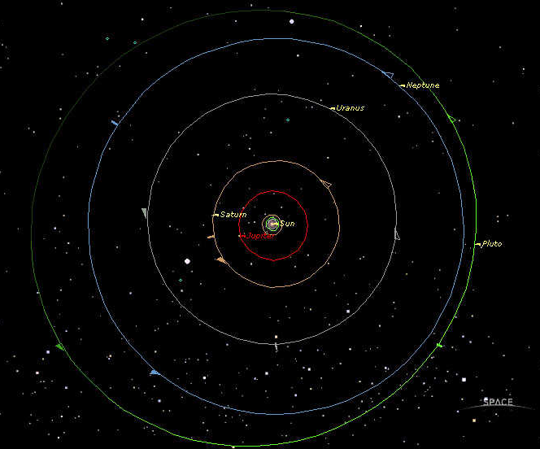
Representation of an Atom
Electron Shell | 1st | 2nd | 3rd
Maximum number of electrons
2
8
8
these circles represent “shells”
a shell is where electrons can be
a shell is not made of anything…
like representing the orbits of planets…

Slide 20
Representation of an Atom
Electron Shell | 1st | 2nd | 3rd
Maximum number of electrons
Hydrogen
Oxygen
Beryllium
Carbon
Sodium
Aluminum
Chlorine
2
8
8
represent an atom of …
PRACTICE
PRACTICE
Homework – Phusikos 1 Practice 1 & 2
Atom Name:
Atomic Number = ________
# Protons = _____________
Mass # = _______
Mass # - Number of Protons =
Number of Neutrons: ___________
# Electrons =_________
# electrons in 1st shell = ___________
# electrons in 2nd shell = ___________
# electrons in 3rd shell = ___________

Slide 21
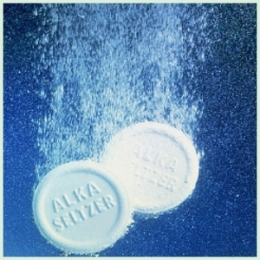
ok.. so atoms are all well and good…
BUT…
atoms SO do NOT like being alone…. (well… we’ll see there’s a few that do…)
Can you think of examples of atoms “together” ?
other examples….
H₂O
CO₂

Slide 22
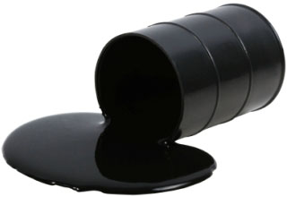
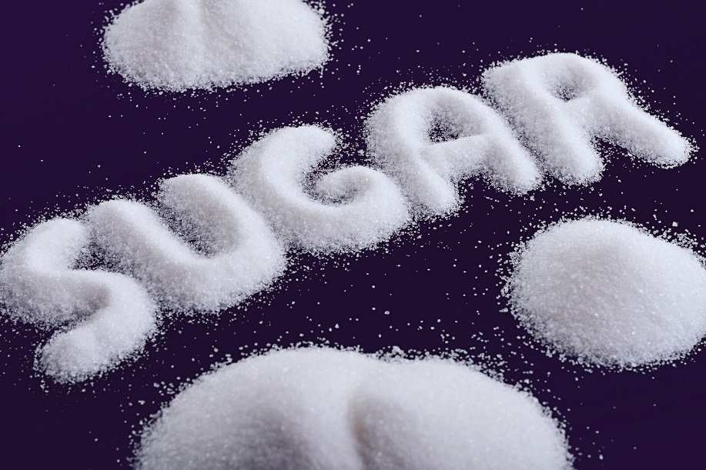
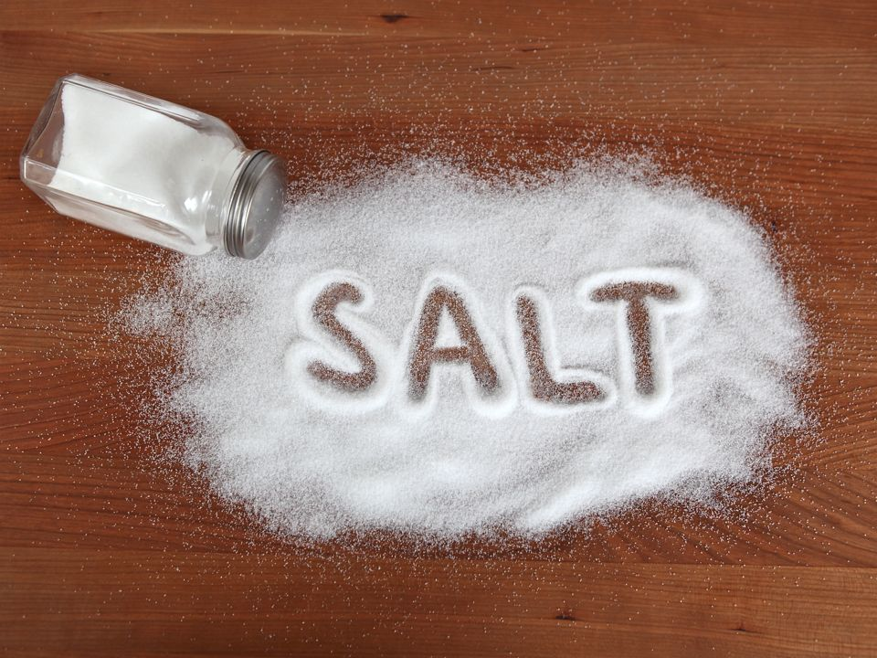
When atoms bond together, new “stuff” forms….
essentially everything around you is made up of
atoms bonded together in some particular pattern
To understand why and how atoms stick together (bond)
need to further describe how electrons are
arranged in single atoms…
other examples….
H₂O
CO₂

Slide 23
Back to the shells…. (places where electrons can be) ….
Electron Shell | 1st | 2nd | 3rd
Maximum number of electrons
Number of orbitals
2
8
8
2
8
8
e⁻
1
4
4
e⁻
next page
e⁻
e⁻
each shell has “sub-shells”
(actually called orbitals)
each orbital can hold
up to 2 (two) electrons
so….
each orbital
surrounds the nucleus…
e⁻
e⁻
e⁻
e⁻
e⁻
e⁻
e⁻
e⁻
e⁻
e⁻
e⁻
e⁻
e⁻
e⁻

Slide 24
Electron Shell | 1st | 2nd | 3rd
Maximum number of electrons
Number of orbitals
2
8
8
1
4
4
e⁻
e⁻
e⁻
1
e⁻
1st shell, ____orbital
max ____electrons
2
e⁻
e⁻
4
e⁻
2nd shell, ____ orbitals
max ___ electrons
8
e⁻
e⁻
e⁻
e⁻
e⁻
4
3rd shell, ___ orbitals
max ___ electrons
this would represent
an atom of
__________
e⁻
e⁻
8
Argon
e⁻
e⁻
e⁻
e⁻

Slide 25
Electron Shell | 1st | 2nd | 3rd
Maximum number of electrons
Number of orbitals
2
8
8
1
4
4
1. each shell is progressively larger
the orbitals within the shell are the same size
e⁻
2. electrons fill a shell before
filling the next shell
3. within a shell,
the electrons will spread out
in the orbitals
BEFORE they pair up
e⁻
e⁻
e⁻
e⁻
e⁻
Carbon (C)
atomic # 6
6 protons
6 electrons in an atom

Slide 26
Electron Shell | 1st | 2nd | 3rd
Maximum number of electrons
Number of orbitals
2
8
8
1
4
4
each shell is progressively larger
electrons fill a shell before
filling the next shell
within a shell,
the electrons will spread out
in the orbitals
BEFORE they pair up
e⁻
e⁻
e⁻
e⁻
e⁻
Nitrogen (N)
atomic # 7
e⁻
e⁻
7 protons
7 electrons in an atom

Slide 27
Electron Shell | 1st | 2nd | 3rd
Maximum number of electrons
Number of orbitals
2
8
8
1
4
4
each shell is progressively larger
electrons fill a shell before
filling the next shell
within a shell,
the electrons will spread out
in the orbitals
BEFORE they pair up

Slide 28
Electron Shell | 1st | 2nd | 3rd
Maximum number of electrons
Number of orbitals
2
8
8
1
4
4
each shell is progressively larger
electrons fill a shell before
filling the next shell
within a shell,
the electrons will spread out
in the orbitals
BEFORE they pair up

Slide 29
Electron Shell | 1st | 2nd | 3rd
Maximum number of electrons
Number of orbitals
2
8
8
Reminders
1
4
4
each shell is progressively larger
electrons fill a shell before
filling the next shell
within a shell,
the electrons will spread out
in the orbitals
BEFORE they pair up
e⁻
e⁻
e⁻
e⁻
e⁻
Nitrogen (N)
atomic # 7
e⁻
e⁻
7 protons
7 electrons in an atom

Slide 30
Electron Shell | 1st | 2nd | 3rd
Maximum number of electrons
Number of orbitals
2
8
8
1
4
4
e⁻
e⁻
e⁻
1
e⁻
1st shell, ____orbital
max ____electrons
e⁻
e⁻
THAT’S TOO HARD TO DRAW!!!!
2
4
e⁻
2nd shell, ____ orbitals
max ___ electrons
8
e⁻
e⁻
e⁻
e⁻
this would be
an atom of
__________
e⁻
4
3rd shell, ___ orbitals
max ___ electrons
e⁻
e⁻
8
Argon
e⁻
e⁻
e⁻
e⁻

Slide 31
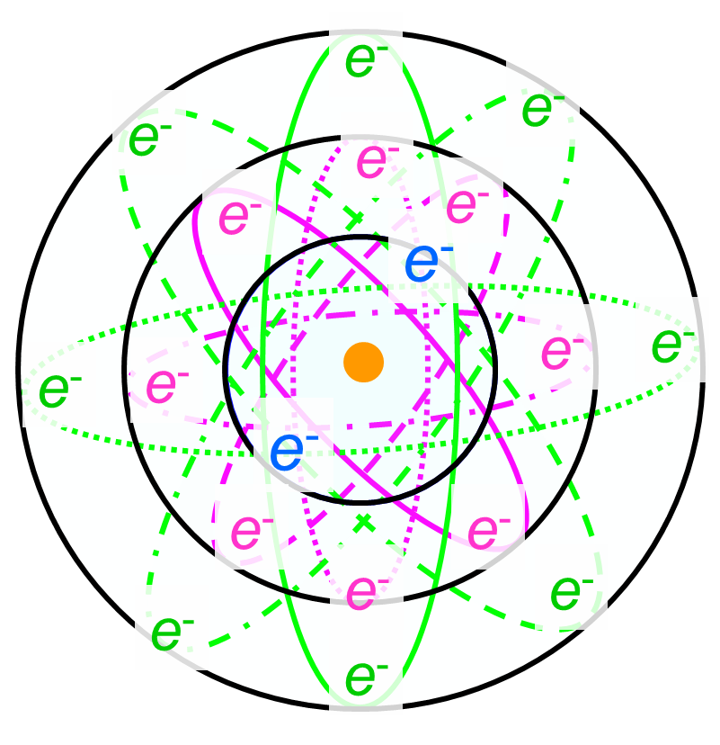
e⁻
e⁻
e⁻
e⁻
e⁻
e⁻
e⁻ e⁻
e⁻
e⁻
so…
go back to the shells
AND
represent the orbitals
just by pairing the electrons
e⁻
e⁻
e⁻
e⁻
e⁻
e⁻
e⁻
e⁻

Slide 32
Electron Shell | 1st | 2nd | 3rd
Maximum number of electrons
Number of orbitals
2
8
8
1
4
4
electrons will
spread out in the orbitals
before they pair up…
(not quite right… but close
enough for now…)
e⁻
e⁻ e⁻
e⁻
e⁻
say there were
6 electrons…
e⁻

Slide 33
Electron Shell | 1st | 2nd | 3rd
Maximum number of electrons
Number of orbitals
2
8
8
1
4
4
electrons will
spread out in the orbitals
before they pair up…
(not quite right… but close
enough for now…)
e⁻
e⁻ e⁻
e⁻
e⁻
say there were
8 electrons…
e⁻
e⁻
e⁻

Slide 34
Electron Shell | 1st | 2nd | 3rd
Maximum number of electrons
Number of orbitals
2
8
8
1
4
4
electrons will
spread out in the orbitals
before they pair up…
(not quite right… but close
enough for now…)
e⁻
e⁻
e⁻
e⁻ e⁻
e⁻
e⁻
say there were
12 electrons…
e⁻
e⁻
e⁻
e⁻
e⁻

Slide 35
Electron Shell | 1st | 2nd | 3rd
Maximum number of electrons
Number of orbitals
2
8
8
1
4
4
electrons will
spread out in the orbitals
before they pair up…
(not quite right… but close
enough for now…)
e⁻
PRACTICE
PRACTICE P1P4
e⁻ e⁻
e⁻
e⁻
e⁻
e⁻
e⁻

Slide 36
Let’s build some models of some atoms….
Phusikos 1 Practice 3
e⁻
e⁻
e⁻
e⁻
e⁻
e⁻
e⁻
e⁻
e⁻ e⁻
e⁻
e⁻
e⁻
e⁻
e⁻
e⁻
e⁻
e⁻
e⁻
e⁻
e⁻
e⁻
e⁻
e⁻
e⁻
e⁻

Slide 37
what is ACCURATE about your
pipe cleaner / bead models?
what is MISLEADING about your
pipe cleaner / bead models?

Slide 38
The Atom
to scale …..
if the nucleus was the size of the state house…
link
http://obeattie.github.io/gmaps-radius/?radiusInput=100&unitSelector=mi&lat=44.262262&lng=-72.579851&z=5&u=mi&r=500

Slide 39
Representation of an Atom
Electron Shell | 1st | 2nd | 3rd
Maximum number of electrons
2
8
8
represent an atom of Argon…
Atom Name:
Atomic Number = ________
# Protons = _____________
Mass # = _______
Mass # - Number of Protons =
Number of Neutrons: ___________
# Electrons =_________
# electrons in 1st shell = ___________
# electrons in 2nd shell = ___________
# electrons in 3rd shell = ___________
electrons “fill” shells
closest to the nucleus
before “filling” the next
shell

