Slide 1
Phusikos 4 – Chemical Bonding
(one step closer to the structure of water)

Slide 2
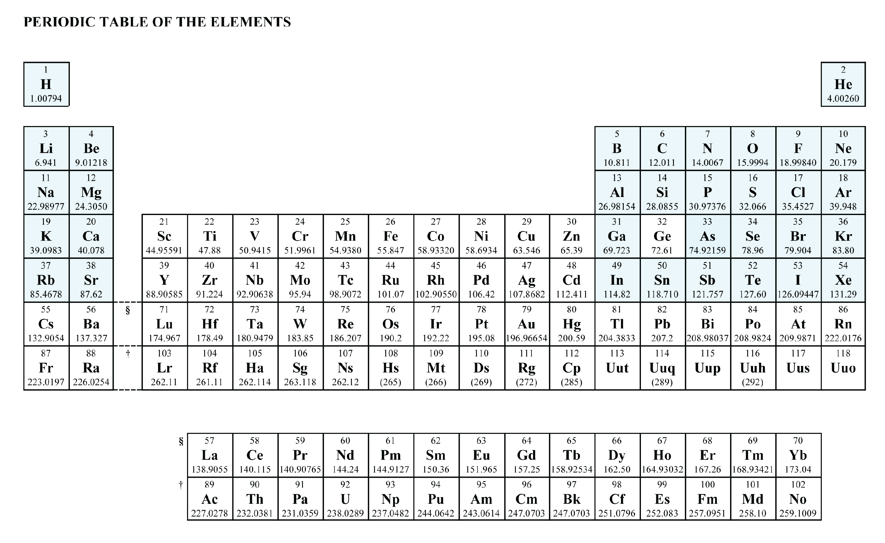
lose 7 electron
lose 6 electrons
gain 1 electron
gain 7 electron
lose 1 electron
lose 5 electrons
gain 2 electrons
ALL SET!!
gain 6 electrons
lose 2 electrons
gain 3 electrons
gain 5 electrons
lose 3 electrons
4 val e⁻
3 val e⁻
5 val e⁻
6 val e⁻
7 valence electrons
1 valence electron
8 valence electrons
2 valence electrons

Slide 3
gain 1 electron
lose 1 electron
gain 2 electrons
ALL SET!!
lose 2 electrons
gain 3 electrons
nonmetal atoms
gain electrons
lose 3 electrons
3 val e⁻
4 val e⁻
5 val e⁻
6 val e⁻
7 val e⁻
1 valence electron
8 valence electrons
2 valence electrons
metal atoms lose electrons

Slide 4
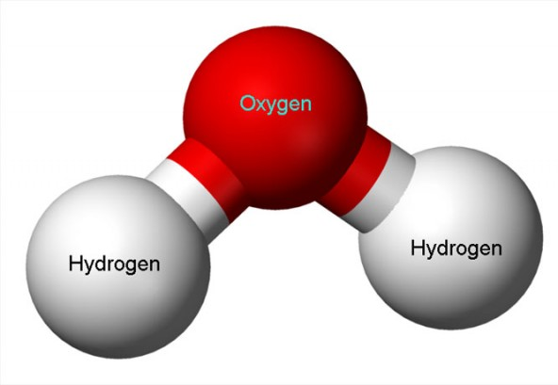
Chemical Bonds (finally)
definition:
a chemical bond is an attraction between atoms
that allow atoms to form particles of chemical substances
that contain two or more atoms

Slide 5
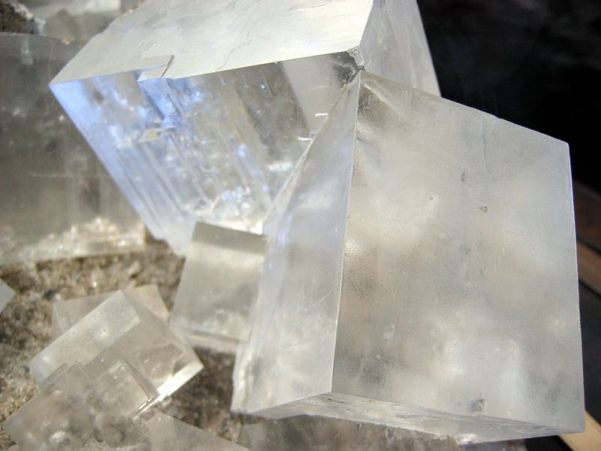
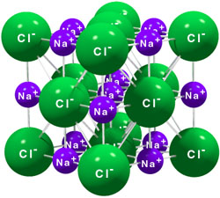
Chemical Bonds (finally)
definition:
a chemical bond is an attraction between atoms
that allow atoms to form particles of chemical substances
that contain two or more atoms

Slide 6
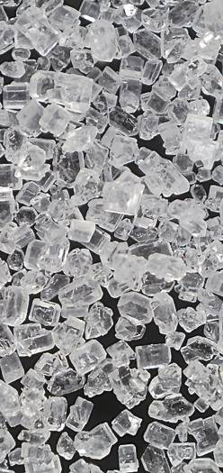
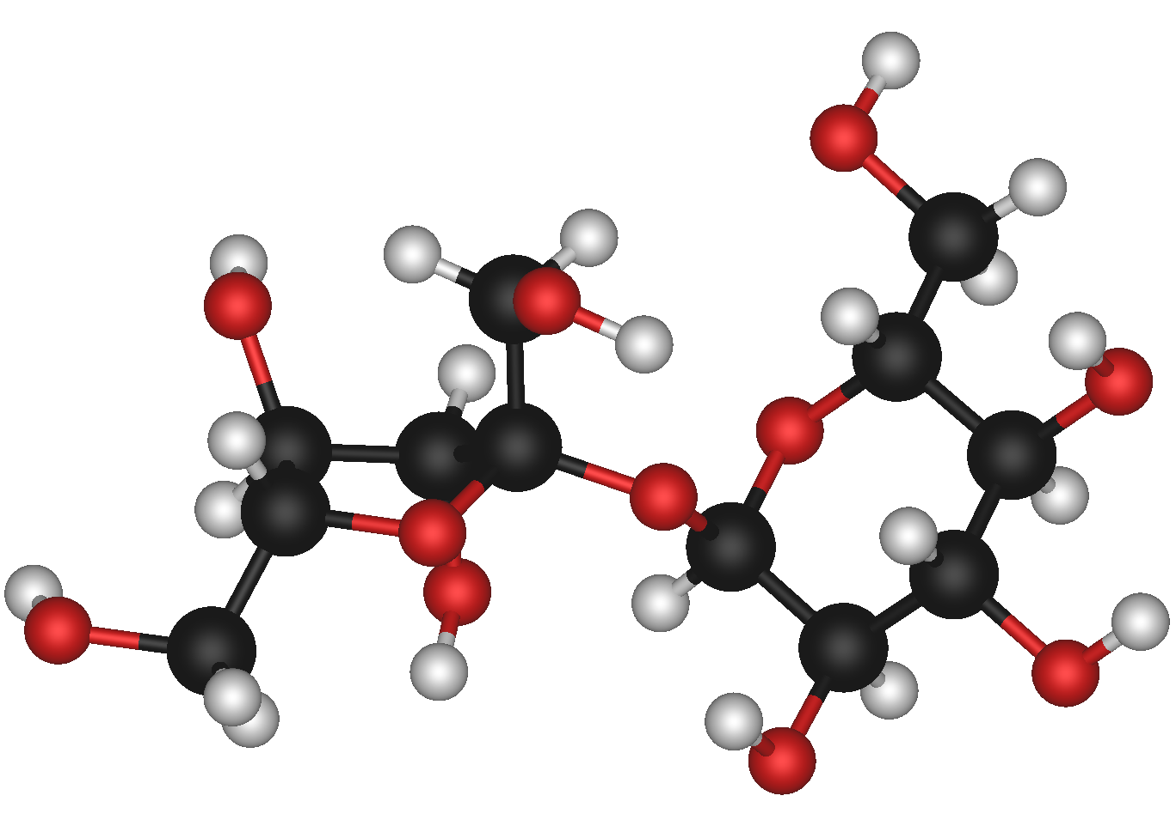
Chemical Bonds (finally)
definition:
a chemical bond is an attraction between atoms
that allow atoms to form particles of chemical substances
that contain two or more atoms

Slide 7
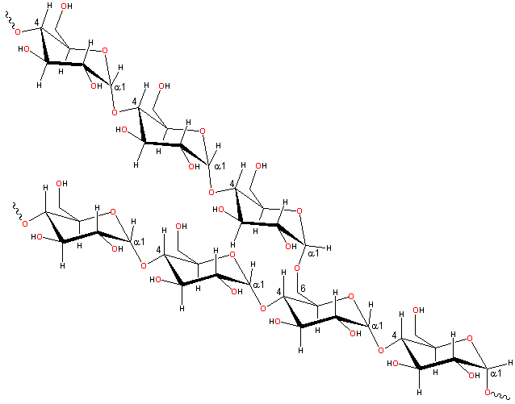
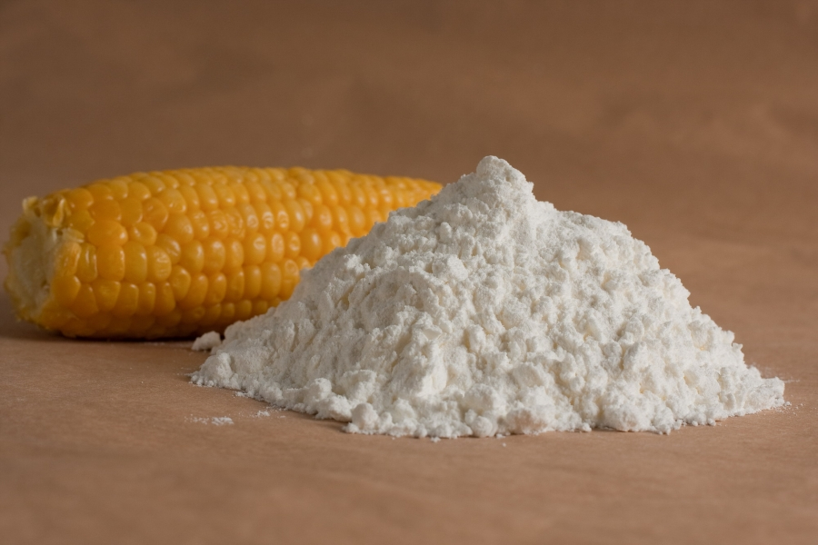
Chemical Bonds (finally)
definition:
a chemical bond is an attraction between atoms
that allow atoms to form particles of chemical substances
that contain two or more atoms

Slide 8
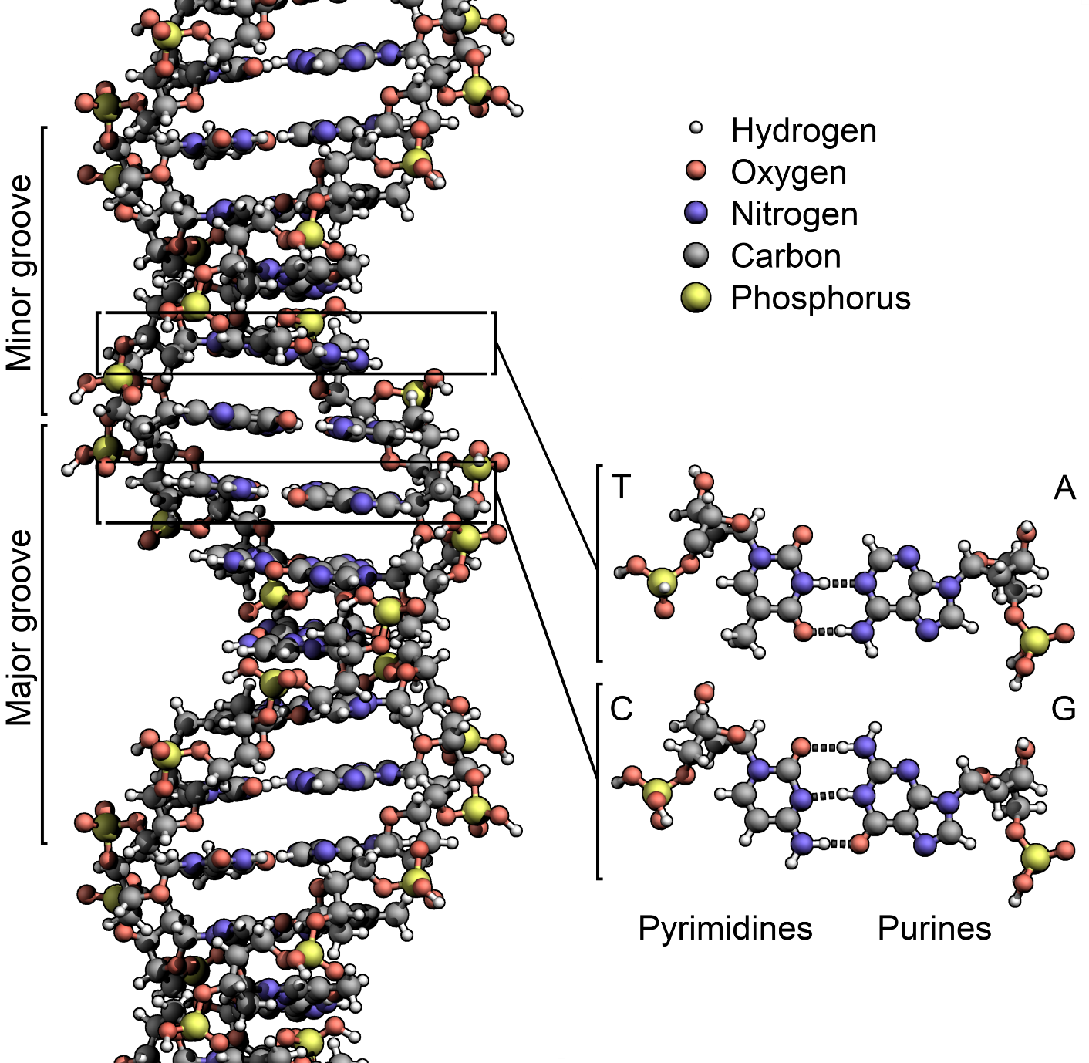
Chemical Bonds (finally)
definition:
a chemical bond is an attraction between atoms
that allow atoms to form particles of chemical substances
that contain two or more atoms

Slide 9
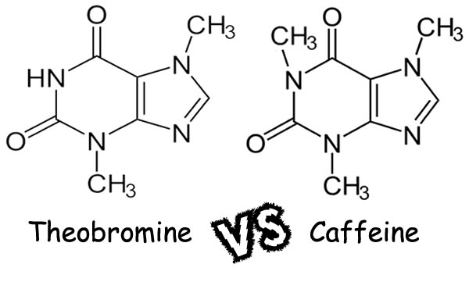
Chemical Bonds (finally)
definition:
a chemical bond is an attraction between atoms
that allow atoms to form particles of chemical substances
that contain two or more atoms

Slide 10
how / why do bonds form ?….
e⁻
it turns out,
the outer shell likes to be full
e⁻ e⁻
e⁻
e⁻
if the outer shell of an atom is NOT full,
it can get full by:
___________________
___________________
___________________
e⁻
e⁻
stealing electrons from other atom(s)
losing (giving) electrons to other atom(s)
sharing electrons with other atom(s)
e⁻
and that accounts for the formation
of bonds between atoms
Electron Shell | 1st | 2nd | 3rd
Maximum number of electrons
2
8
8

Slide 11
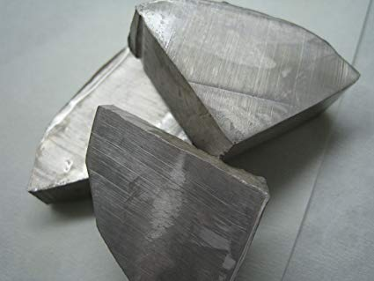
We’ll start with the bonds that form when atoms lose and gain electrons….
ionic bonds
sodium
represents an atom of _______________
______ protons
______ electrons
11
e⁻
11
e⁻
e⁻
outer shell __________
# valence electrons ____
needs to gain ____ to get FOS
needs to lose ____ to get FOS
(“shed”)
3rd
e⁻ e⁻
1
e⁻
7
e⁻
1
11 p
12 n
e⁻
e⁻
which is fewest ?
______________
therefore,
which is more likely?
________________
losing 1 electron
e⁻
e⁻
losing 1 electron

Slide 12
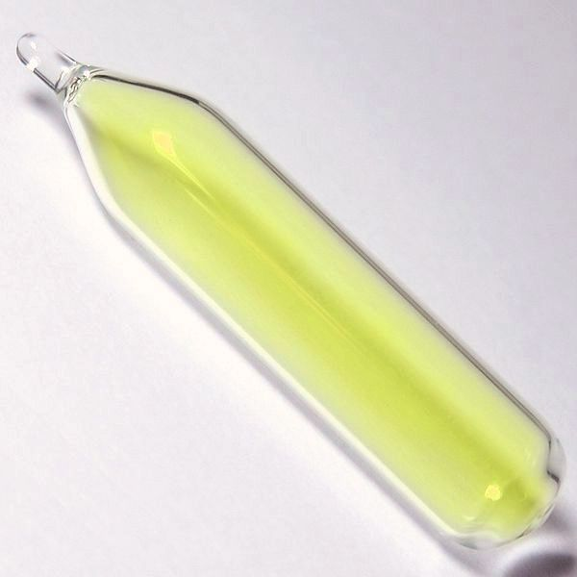
We’ll start with the bonds that form when atoms lose and gain electrons….
ionic bonds
fluorine
represents an atom of _______________
______ protons
______ electrons
9
9
e⁻
outer shell __________
# valence electrons ____
needs to gain ____ to get FOS
needs to lose ____ to get FOS
(“shed”)
2nd
e⁻ e⁻
7
e⁻
1
e⁻
7
9 p
10 n
e⁻
e⁻
which is fewest ?
______________
therefore,
which is more likely?
________________
gaining 1 electron
e⁻
e⁻
gaining 1 electron

Slide 13
e⁻
e⁻
e⁻
9
______ protons
______ electrons
10
e⁻ e⁻
e⁻
e⁻
gains 1 electron
11 p
12 n
FOS!
e⁻
e⁻
e⁻
e⁻
e⁻
e⁻ e⁻
e⁻
e⁻
9 p
10 n
loses 1 electron
e⁻
e⁻
FOS!
______ protons
______ electrons
11
10
e⁻
e⁻

Slide 14
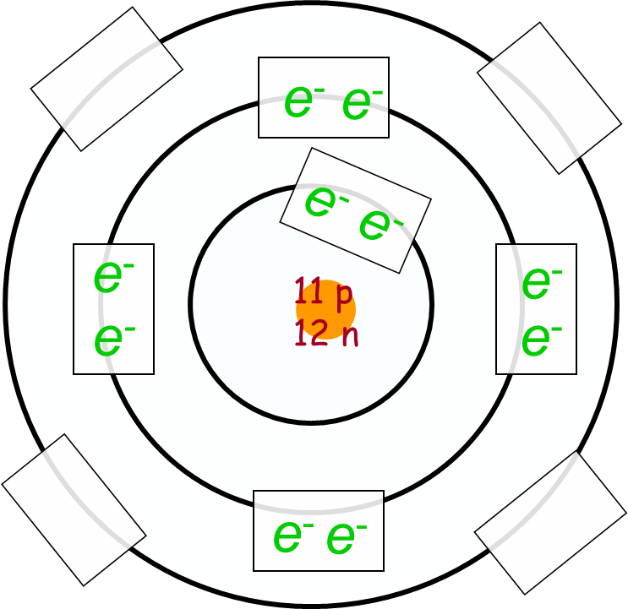
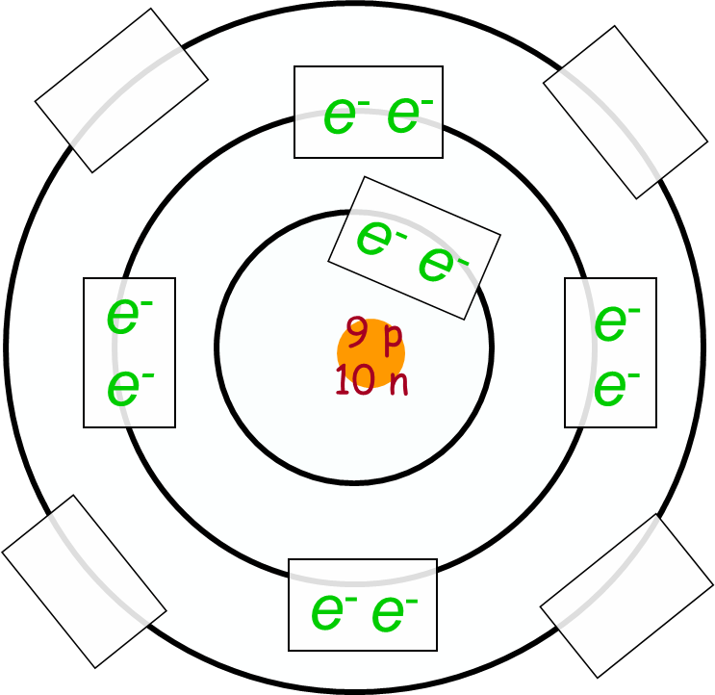
9
______ protons
______ electrons
______ protons
______ electrons
11
10
10
An ion is formed when an atom loses or gains electrons.
Ion:
In an ion, #protons does NOT equal #electrons.
So, there’s either an excess of (+) or an excess of (-).

Slide 15
+
-
______ protons
______ electrons
11
9
______ protons
______ electrons
10
10
An ion is formed when an atom loses or gains electrons
Ion:
In an ion, #protons does NOT equal #electrons.
So, there’s either an excess of (+) or an excess of (-).

Slide 16
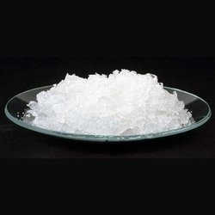
+
-
______ protons
______ electrons
11
9
______ protons
______ electrons
10
10
OPPOSITES ATTRACT!!
= ionic bond

Slide 17
+
-
______ protons
______ electrons
11
9
______ protons
______ electrons
10
OPPOSITES ATTRACT!!
10
= ionic bond
Ionic
Bond
An ionic bond is a type of chemical bond formed through
electrostatic (charged) attraction between a (+) and a (-) ion.

Slide 18
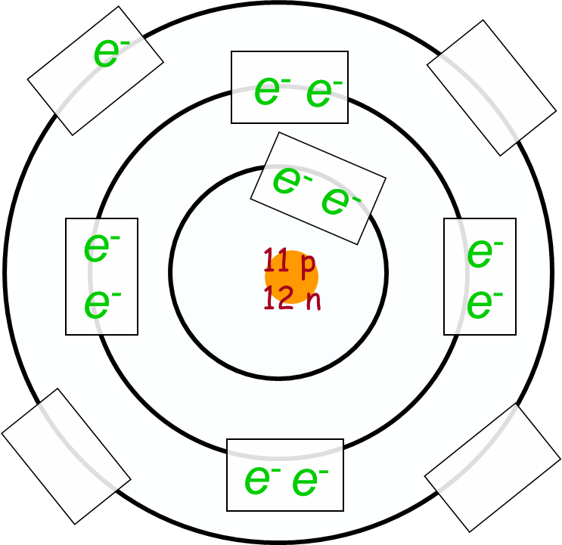
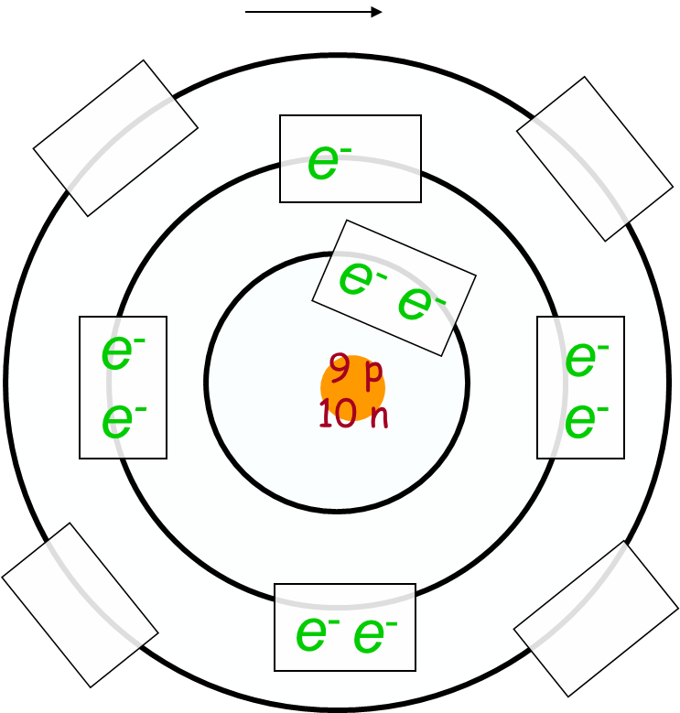
Ionic
Bond
An ionic bond is a type of chemical bond formed through
electrostatic (charged) attraction between a (+) and a (-) ion.
Lewis Dot…
Na
F

Slide 19
Ionic
Bond
An ionic bond is a type of chemical bond formed through
electrostatic (charged) attraction between a (+) and a (-) ion.
Lewis Dot Version
+
-
Na
+
F
Na
F
loses 1 electron
FOS!
gains 1 electron
FOS!

Slide 20
Covalent
Bond
An covalent bond is a type of chemical bond formed through
sharing electron pairs between atoms.
e⁻
e⁻
e⁻
e⁻
e⁻
e⁻
e⁻
e⁻
e⁻
e⁻
e⁻
9 p
10 n
9 p
10 n
e⁻
e⁻
e⁻
e⁻
e⁻
e⁻
e⁻
“wants” _________ electron
“wants” _________ electron
one more
one more

Slide 21
Covalent
Bond
An covalent bond is a type of chemical bond formed through
sharing electron pairs between atoms.
e⁻
e⁻
e⁻
e⁻
e⁻
e⁻
e⁻
e⁻
e⁻
e⁻
e⁻
9 p
10 n
9 p
10 n
e⁻
e⁻
e⁻
e⁻
e⁻
e⁻
e⁻
“wants” _________ electron
“wants” _________ electron
one more
one more

Slide 22
Covalent
Bond
An covalent bond is a type of chemical bond formed through
sharing electron pairs between atoms.
e⁻
e⁻
e⁻
e⁻
e⁻
e⁻
e⁻
e⁻
e⁻
e⁻
e⁻
9 p
10 n
9 p
10 n
e⁻
e⁻
e⁻
e⁻
e⁻
e⁻
e⁻
“wants” _________ electron
“wants” _________ electron
one more
one more

Slide 23
Covalent
Bond
An covalent bond is a type of chemical bond formed through
sharing electron pairs between atoms.
e⁻
e⁻
e⁻
e⁻
e⁻
e⁻
e⁻
e⁻
e⁻
e⁻
e⁻
9 p
10 n
9 p
10 n
e⁻
e⁻
e⁻
e⁻
e⁻
e⁻
e⁻
so, they each share one electron
“wants” _________ electron
“wants” _________ electron
one more
one more

Slide 24
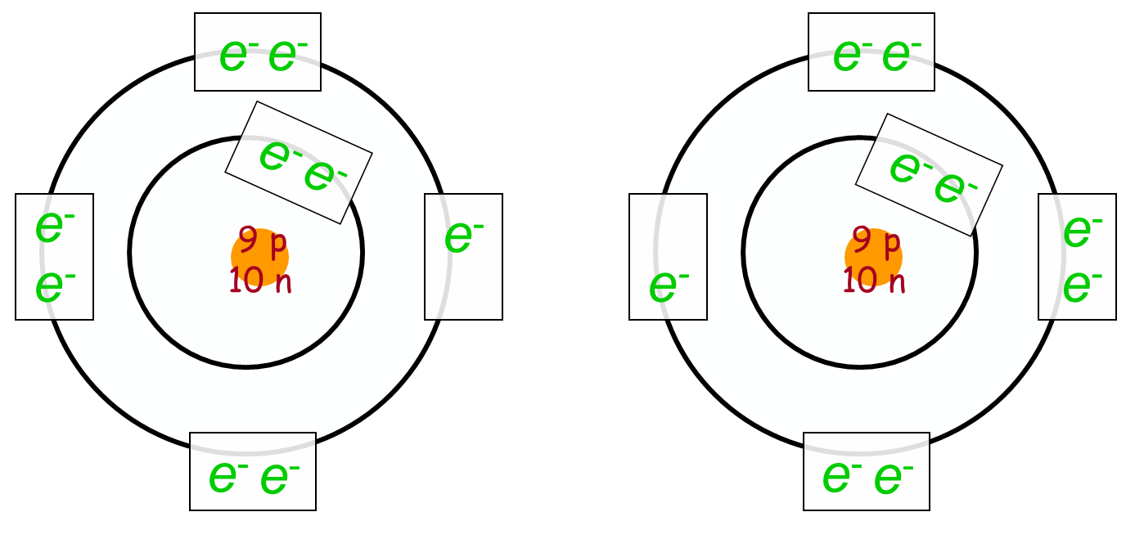
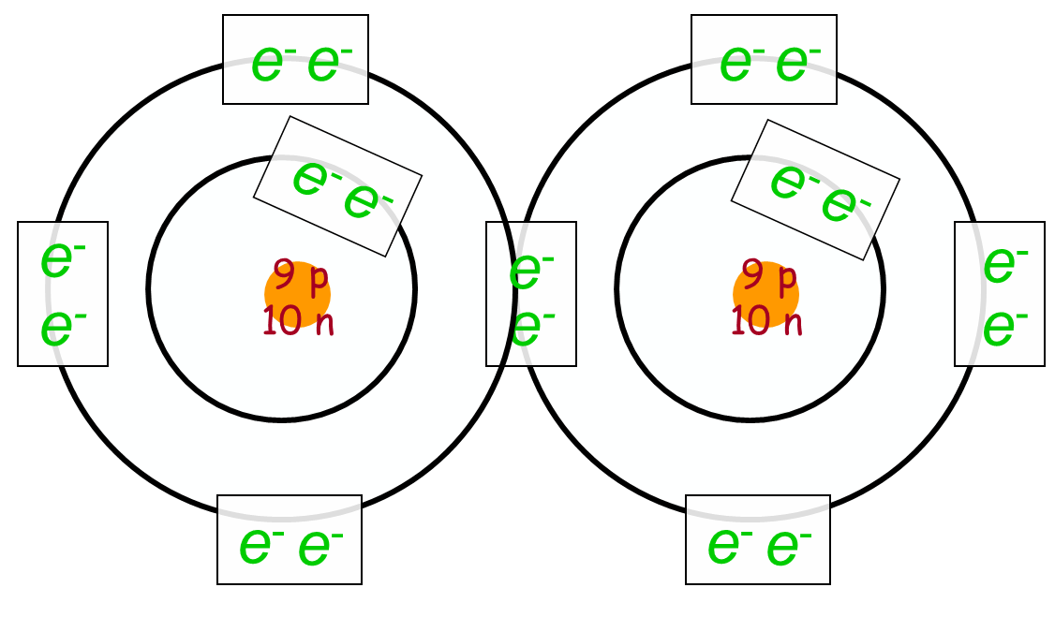
+
Lewis Dot
F
+
F
F
F
each shared pair
simplified Lewis Dot
replaced with a “stick”
F
+
F
F
F
1 “stick” = 1 covalent bond

Slide 25
Covalent Bond tidbits….
electrons are shared in _____________
can share _____________
______________
______________
atoms will share the same # of its own electrons
as it “wants” from another atom (or atoms)
examples… “wants” one, shares one
“wants” two, shares two
“wants” three, shares three
“wants” four, shares four
pairs
one pair
two pairs
three pairs
**KEY**
more bonding examples….

Slide 26
How do we know if an Ionic or Covalent Bond will form between atoms?
gain
share electrons
to get FOS
Non-Metal | + Non-Metal | → | Covalent
 | + Metal | → | Ionic
Metal | + Non-Metal | → | Ionic
 | + Metal | → | Covalent
atoms want to
gain electrons
lose
transfer electrons
to get FOS
atoms want to
lose electrons
gain
transfer electrons
to get FOS
lose
share electrons
to get FOS
we won’t consider metal to metal
Note: Carbon
is a metalloid …
we will consider both
non-metals in our examples
Hydrogen is a “Lone Ranger”…

Slide 27
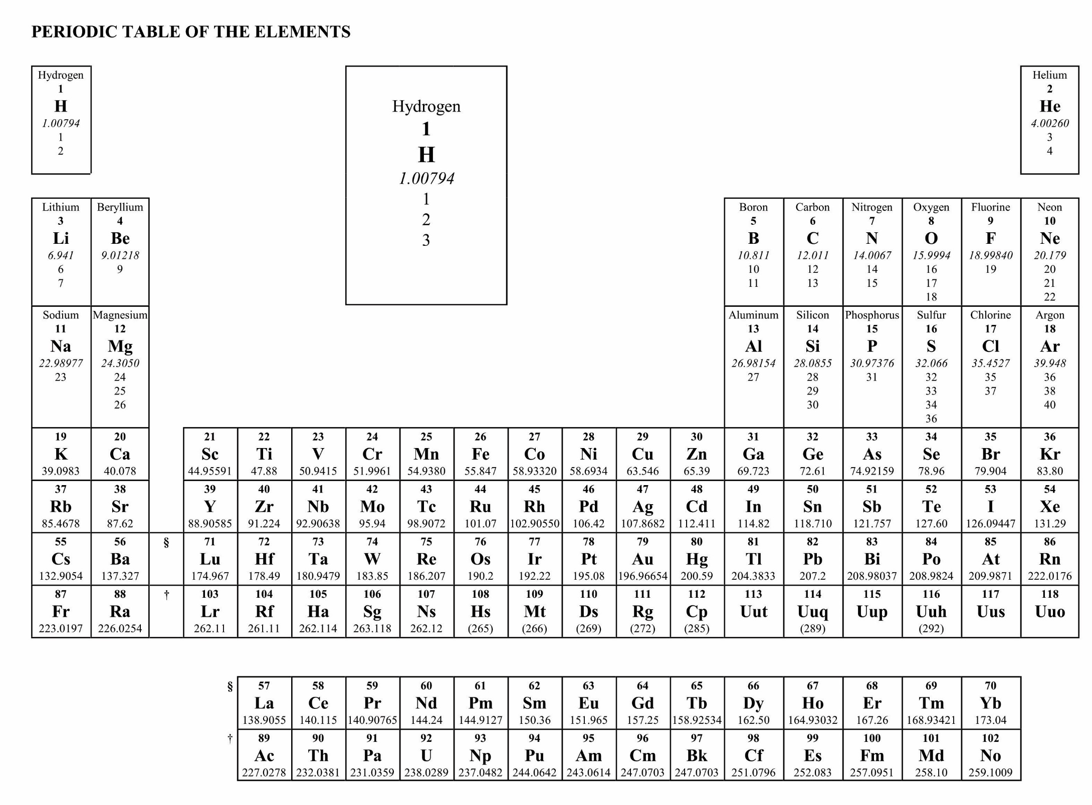
Color code the Periodic Table
Metals
Non-metals

Slide 28
ALL SET!!
in a class
of its own
nonmetal atoms gain electrons
metal atoms lose electrons
8 valence electrons

Slide 29
e⁻
e⁻
e⁻
e⁻
e⁻
e⁻
9 p
10 n
e⁻
e⁻

Slide 31
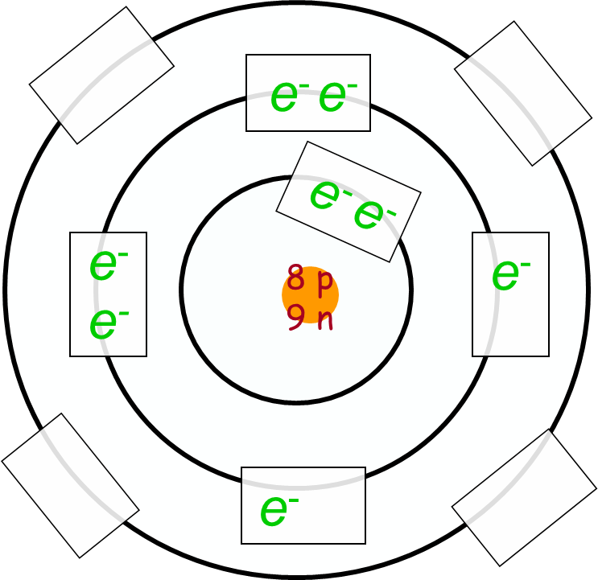
e⁻
e⁻
e⁻
e⁻
e⁻
e⁻
8 p
9 n
e⁻
e⁻

