Slide 1
Phusi 2
notes
Electron Shell | 1st | 2nd | 3rd
Maximum number of electrons
Number of orbitals
2
8
8
1
4
4
e⁻
Outer shell:
______________________
______________________
Outer shell electrons:
______________________
______________________
Inner shell(s):
______________________
______________________
the outermost shell that
has any electrons in it
e⁻ e⁻
e⁻
e⁻
the electrons in the
outer shell
e⁻
e⁻
all the shells except the
outer shell
e⁻

Slide 2
2nd
Outer shell ? _________
How many outer shell electrons ? _________
How many inner shell electrons ? _________
6
2
e⁻
Outer shell:
______________________
______________________
Outer shell electrons:
______________________
______________________
Inner shell(s):
______________________
______________________
the outermost shell that
has any electrons in it
e⁻ e⁻
e⁻
e⁻
the electrons in the
outer shell
e⁻
e⁻
all the shells except the
outer shell
e⁻

Slide 3
2nd
Outer shell ? _________
How many outer shell electrons ? _________
How many inner shell electrons ? _________
6
2
The outershell electrons
are also called:
____________________
they are the electrons that are
________________________
________________________
e⁻
valence electrons
e⁻ e⁻
e⁻
e⁻
aVAILable
available for bonding to
other atoms
e⁻
e⁻
highlight them..
e⁻

Slide 4
PRACTICE Phusi 2 Practice1
(can use P1P1, P1P2, P1P4)
for each example….
highlight the valence electrons in some highlight-y color
write ‘# valence electrons ______’
and fill in the blank
PRACTICE Hydro 2 Practice2
Valence Electrons and the Periodic Table
with your partner(s)….
sort / organize the elements (represented by the cards)
according to the properties listed on the cards
…
you are looking for patterns
once you are “happy” with your organization,
tape the organized element cards onto a piece of paper
PUT ALL PERIODIC TABLES AWAY!!

Slide 5
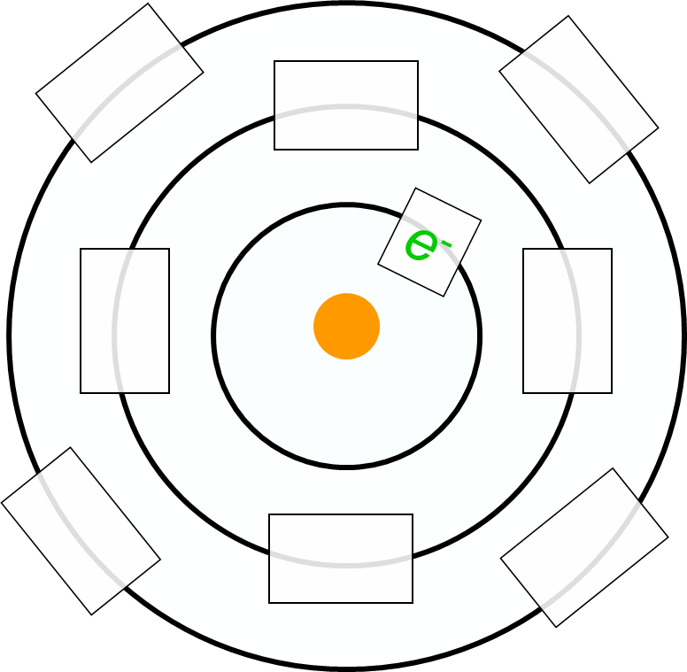
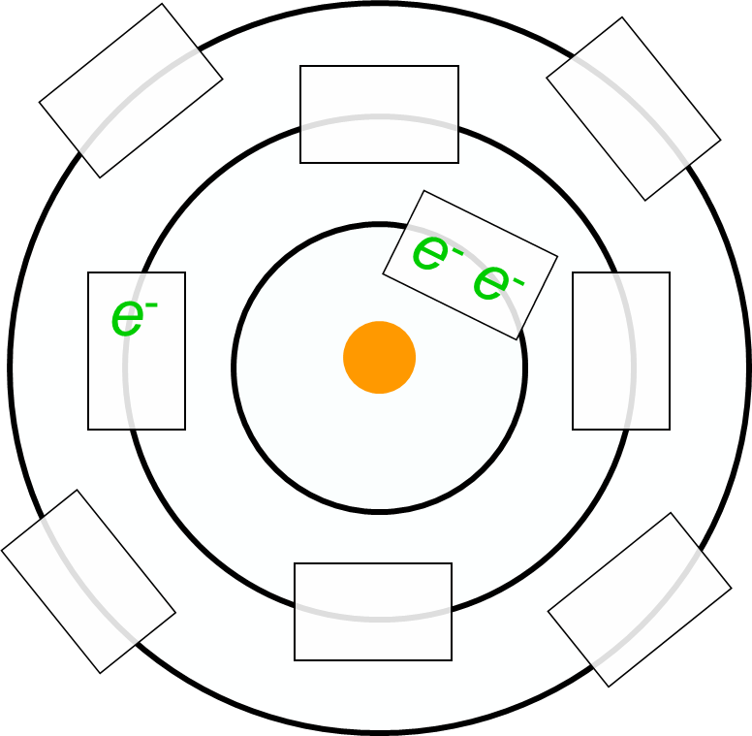
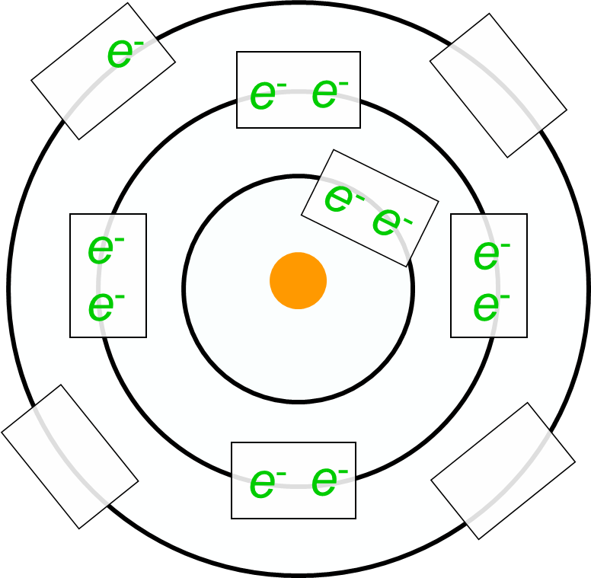
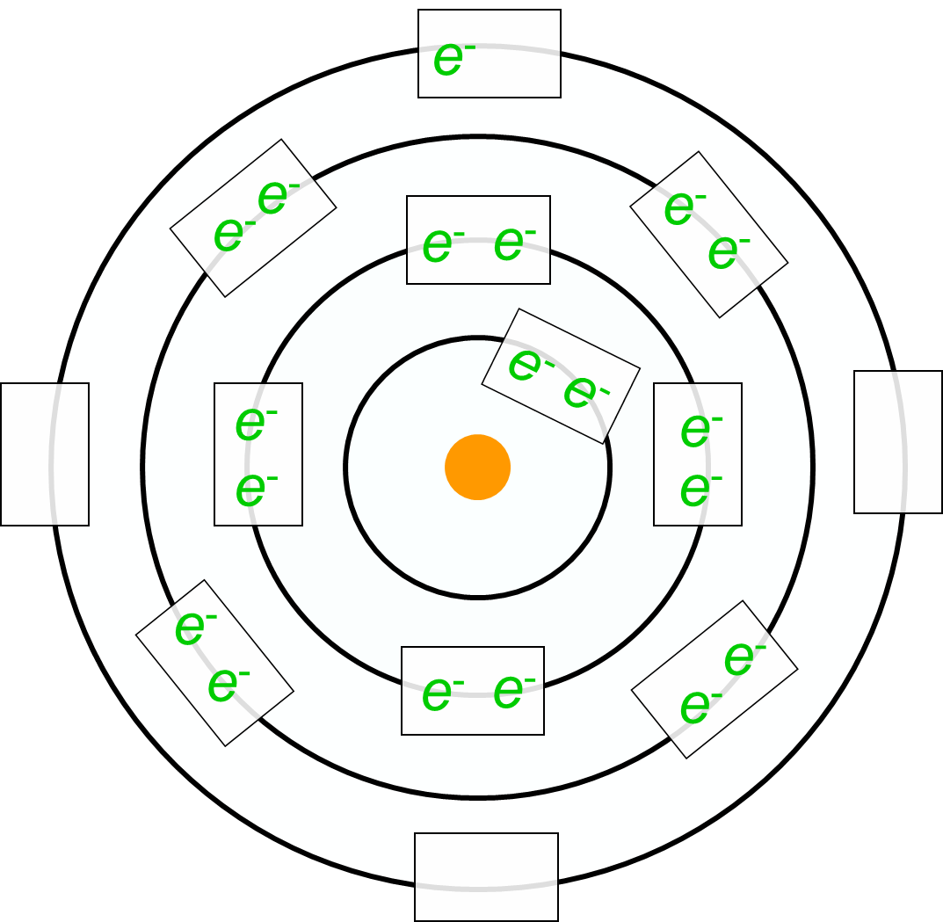
Hydrogen
atomic # 1
Orbital / Shell
Representations of Atoms
Lithium
atomic # 3
highlight valence electrons
Valence Electrons
____________
one
Sodium (Na)
atomic # 11
Potassium (K)
atomic # 19

Slide 6
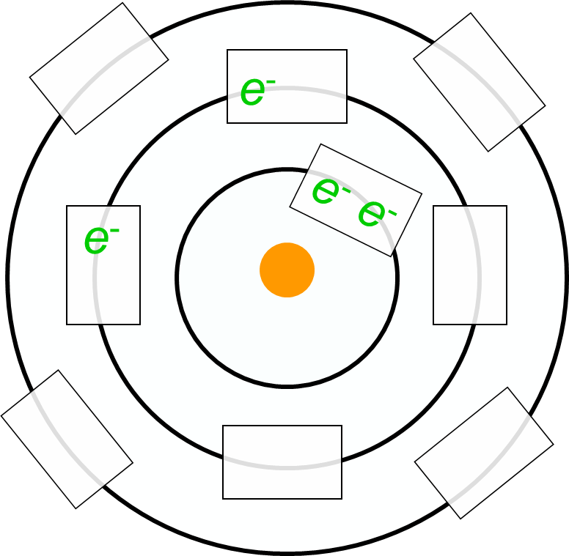
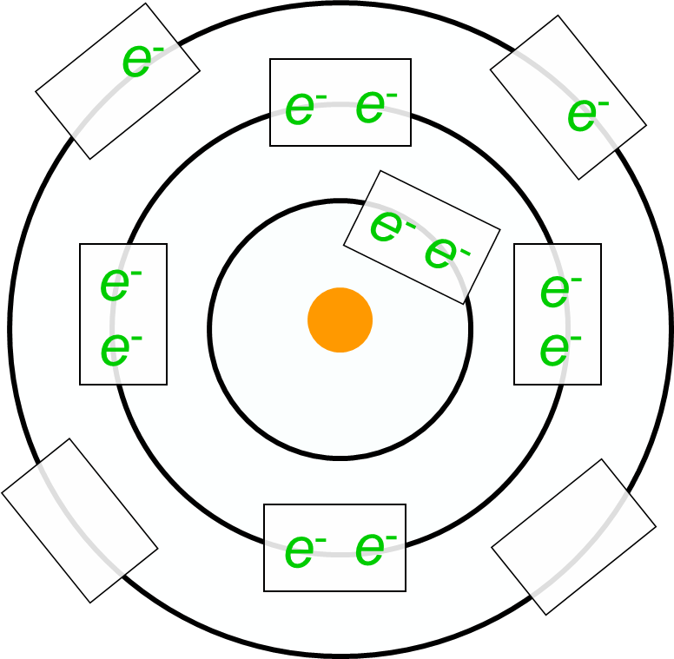
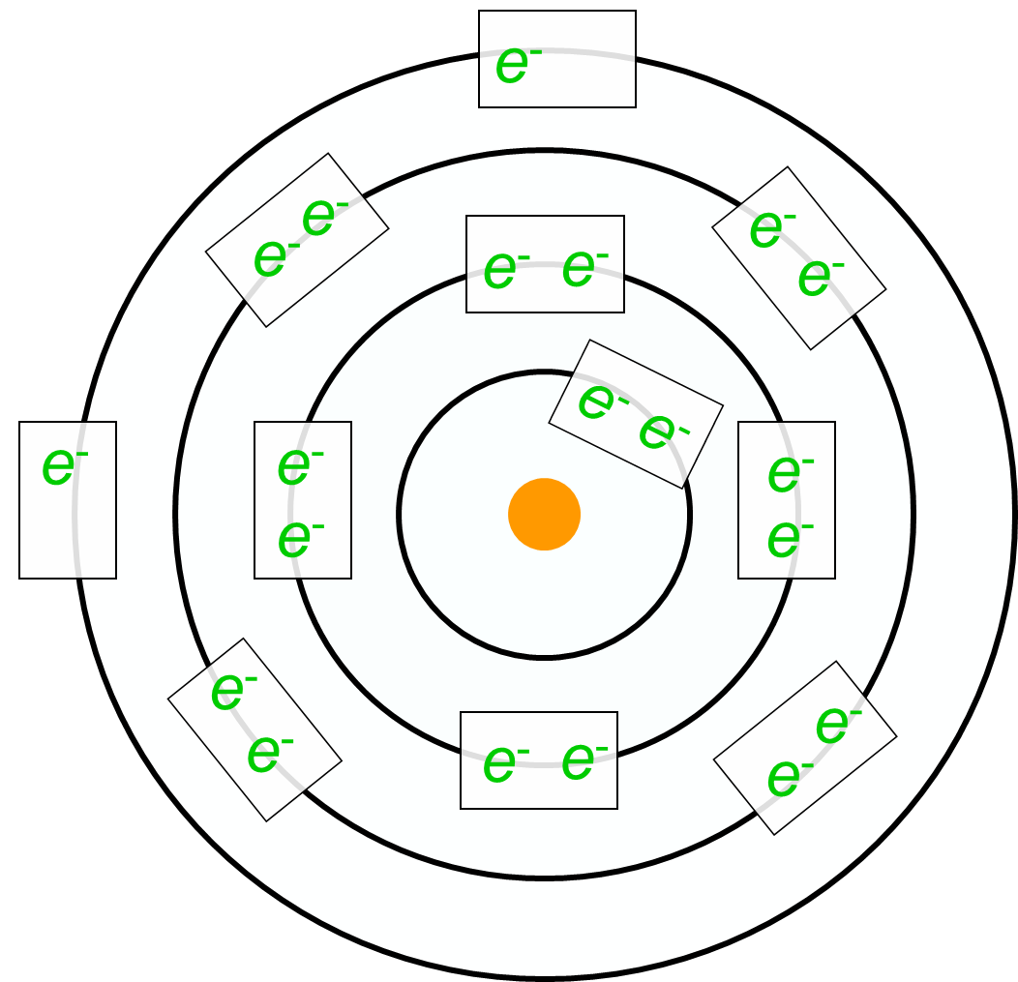
Orbital / Shell
Representations of Atoms
Beryllium
atomic # 4
highlight valence electrons
Magnesium
atomic # 12
Valence Electrons
____________
two
Calcium
atomic # 20

Slide 7
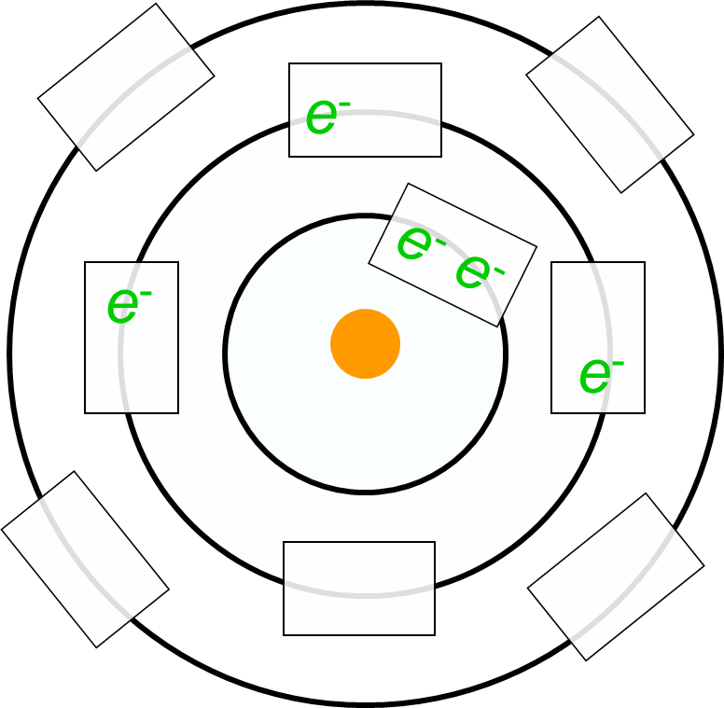
Orbital / Shell
Representations of Atoms
Boron
atomic # 5
highlight valence electrons
Aluminum
atomic # 13
Valence Electrons
____________
three

Slide 8
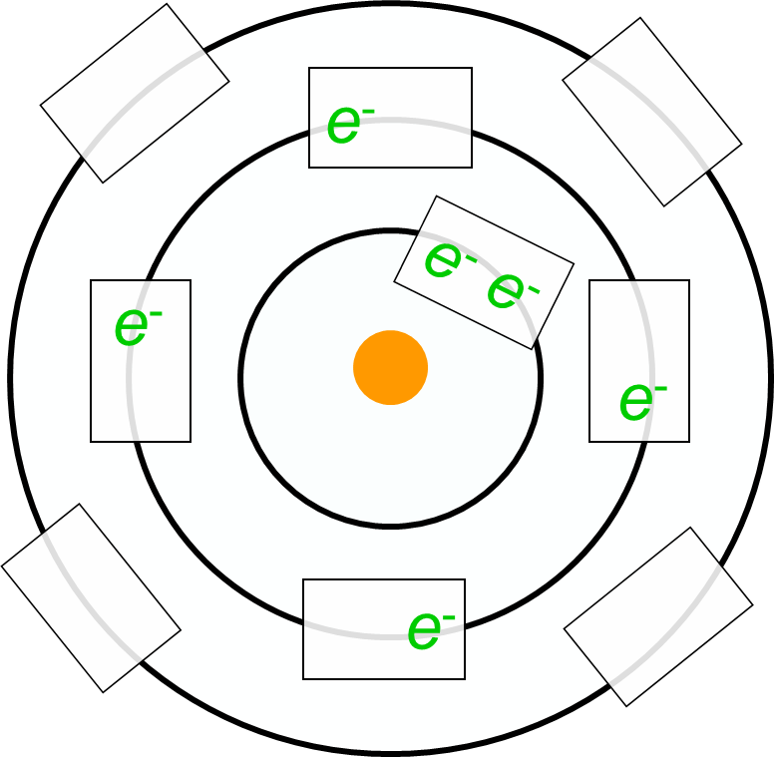
Orbital / Shell
Representations of Atoms
Carbon
atomic # 6
highlight valence electrons
Silicon
atomic # 14
Valence Electrons
____________
four

Slide 9
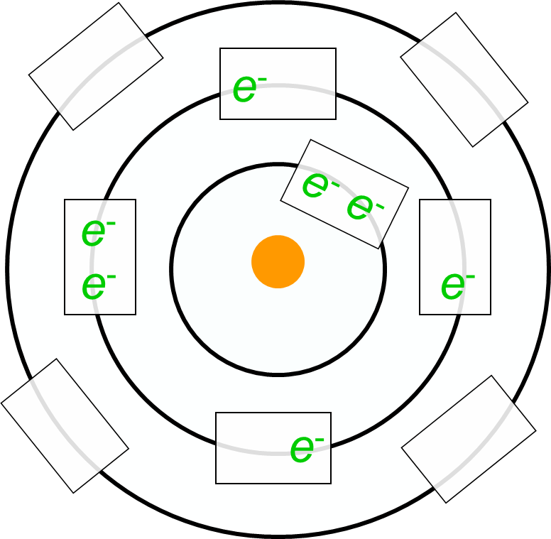
Orbital / Shell
Representations of Atoms
Nitrogen
atomic # 7
highlight valence electrons
Phosphorus
atomic # 15
Valence Electrons
____________
five

Slide 10
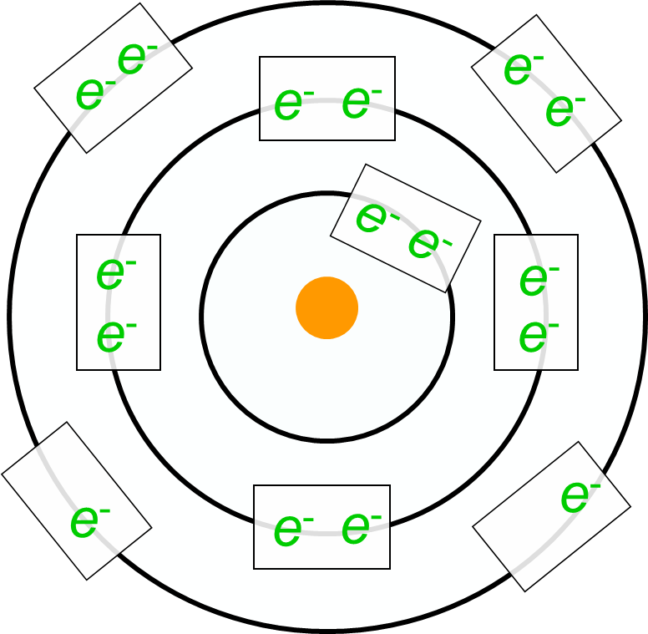
Orbital / Shell
Representations of Atoms
Oxygen
atomic # 8
highlight valence electrons
Sulfur
atomic # 16
Valence Electrons
____________
six

Slide 11
Orbital / Shell
Representations of Atoms
Fluorine
atomic # 9
highlight valence electrons
Chlorine
atomic # 17
Valence Electrons
____________
seven

Slide 12
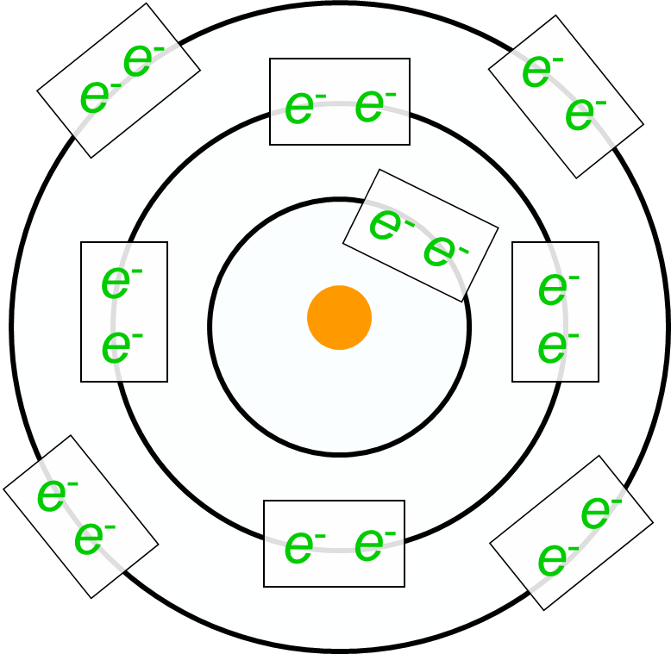
Orbital / Shell
Representations of Atoms
Neon
atomic # 10
highlight valence electrons
Argon
atomic # 18
Valence Electrons
____________
eight

Slide 13
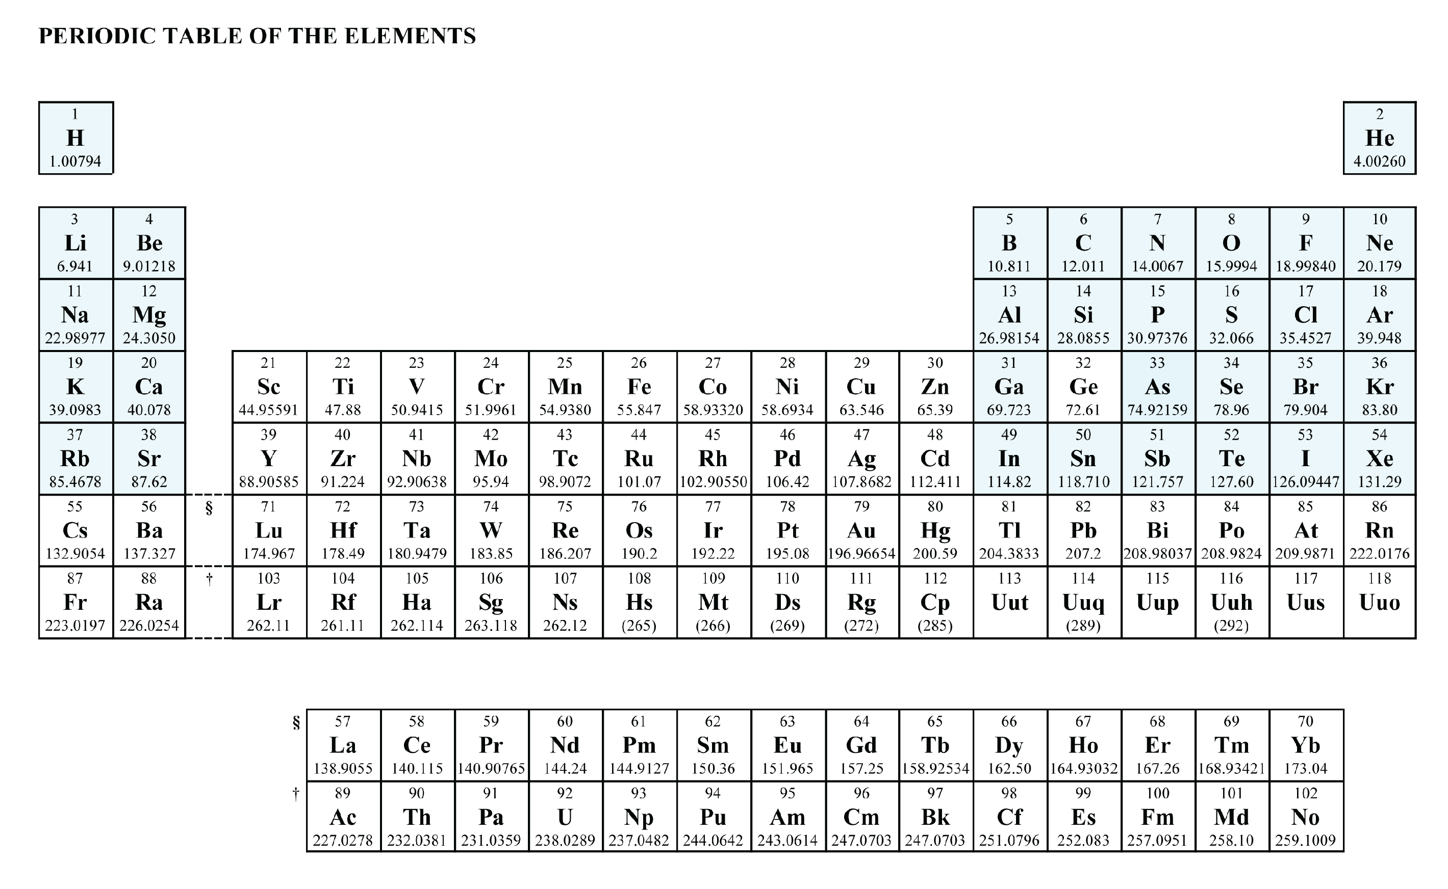
hmmm……
one key property / pattern
4 val e⁻
3 val e⁻
5 val e⁻
6 val e⁻
1 valence electron
7 valence electrons
2 valence electrons
8 valence electrons

Slide 14
2nd
Outer shell ? _________
How many outer shell electrons ? _________
How many inner shell electrons ? _________
6
2
The outershell electrons
are also called:
____________________
they are the electrons that are
________________________
________________________
e⁻
valence electrons
e⁻ e⁻
e⁻
e⁻
aVAILable
available for bonding to
other atoms
e⁻
e⁻
How many of these
valence electrons are
available to make bonds ?
e⁻
Well……

Slide 15
2nd
Outer shell ? _________
How many outer shell electrons ? _________
How many inner shell electrons ? _________
6
2
The outershell electrons
are also called:
____________________
they are the electrons that are
________________________
________________________
e⁻
valence electrons
e⁻ e⁻
available for bonding to
other atoms
e⁻
e⁻
e⁻
e⁻
How many of these
valence electrons are
available to make bonds ?
Well……
e⁻
it turns out,
the outer shell likes to be full

Slide 16
The outershell electrons
are also called:
____________________
they are the electrons that are
________________________
________________________
e⁻
valence electrons
e⁻ e⁻
available for bonding to
other atoms
e⁻
e⁻
e⁻
e⁻
How many of these
valence electrons are
available to make bonds ?
Well……
e⁻
it turns out,
the outer shell likes to be full
Electron Shell | 1st | 2nd | 3rd
Maximum number of electrons
2
8
8

Slide 17
Well……
e⁻
it turns out,
the outer shell likes to be full
e⁻ e⁻
e⁻
e⁻
if the outer shell is NOT full,
it can get full by:
___________________
___________________
___________________
e⁻
e⁻
stealing electrons
losing (giving) electrons
sharing electrons
e⁻
Electron Shell | 1st | 2nd | 3rd
Maximum number of electrons
2
8
8

Slide 18
if the outer shell is NOT full,
it can get full by:
___________________
___________________
___________________
stealing electrons
losing (giving) electrons
sharing electrons
you can’t steal, lose or share….
unless there is someone else
to steal from, give to, or share with

Slide 19
Well……
e⁻
it turns out,
the outer shell likes to be full
e⁻ e⁻
e⁻
e⁻
if the outer shell is NOT full,
it can get full by:
___________________
___________________
___________________
e⁻
e⁻
stealing electrons from other atom(s)
losing (giving) electrons to other atom(s)
sharing electrons with other atom(s)
e⁻
and that accounts for the formation
of bonds between atoms
Electron Shell | 1st | 2nd | 3rd
Maximum number of electrons
2
8
8

Slide 20
so….
if the outer shell is FULL _______________________
____________________________________
if the outer shell is NOT full, _____________________
_____________________________________
_____________________________________
_____________________________________
nothing happens
the atom is “happy” all by itself
the atom will steal, lose, share electrons
WITH other atoms
and that accounts for the formation of bonds
and new “stuff”
before we get to how the bonds form,
need to work more with valence electrons for single atoms

Slide 21
e⁻
e⁻
outer shell __________
# valence electrons ____
needs to gain ____ to get FOS
needs to lose ____ to get FOS
2nd
6
2
e⁻ e⁻
6
e⁻
e⁻
which is fewest ?
______________
therefore,
which is more likely?
________________
gaining 2 electrons
e⁻
e⁻
gaining 2 electrons
Electron Shell | 1st | 2nd | 3rd
Maximum number of electrons
2
8
8

Slide 22
e⁻
e⁻
e⁻
outer shell __________
# valence electrons ____
needs to gain ____ to get FOS
needs to lose ____ to get FOS
3rd
1
7
e⁻ e⁻
1
e⁻
e⁻
e⁻
e⁻
which is fewest ?
______________
therefore,
which is more likely?
________________
losing 1 electrons
e⁻
e⁻
losing 1 electrons
Electron Shell | 1st | 2nd | 3rd
Maximum number of electrons
2
8
8

Slide 23
e⁻
e⁻
e⁻
e⁻
outer shell __________
# valence electrons ____
needs to gain ____ to get FOS
needs to lose ____ to get FOS
3rd
4
4
e⁻ e⁻
4
e⁻
e⁻
e⁻
e⁻
which is fewest ?
______________
therefore,
which is more likely?
________________
neither
e⁻
e⁻
e⁻
e⁻
neither
Electron Shell | 1st | 2nd | 3rd
Maximum number of electrons
2
8
8

Slide 24
hmmm……
one key property / pattern
4 val e⁻
3 val e⁻
5 val e⁻
6 val e⁻
1 valence electron
7 valence electrons
2 valence electrons
8 valence electrons
ok… let’s look a little more at the elements
SPARKY

Slide 25
in a class
of its own

Slide 26
lose 7 electron
lose 6 electrons
gain 1 electron
gain 7 electron
lose 1 electron
lose 5 electrons
gain 2 electrons
ALL SET!!
gain 6 electrons
lose 2 electrons
gain 3 electrons
gain 5 electrons
lose 3 electrons
4 val e⁻
3 val e⁻
5 val e⁻
6 val e⁻
7 valence electrons
1 valence electron
8 valence electrons
2 valence electrons

Slide 27
Non-Metals:
atoms gain e-
gain 1 electron
lose 1 electron
gain 2 electrons
ALL SET!!
lose 2 electrons
gain 3 electrons
Metals:
atoms lose e-
lose 3 electrons
4 val e⁻
3 val e⁻
5 val e⁻
6 val e⁻
7 valence electrons
1 valence electron
8 valence electrons
2 valence electrons

Slide 28
ALL SET!!
in a class
of its own
atoms gain electrons
atoms lose electrons
8 valence electrons
Phusi 2 Practice 5

