Slide 1
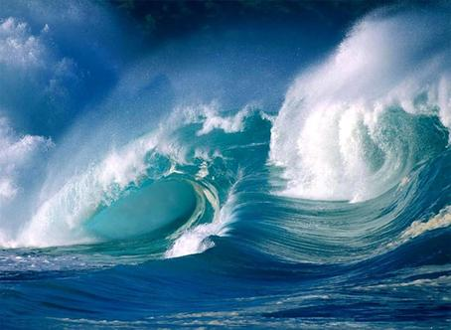
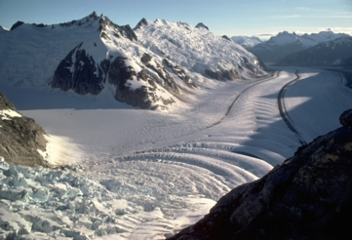
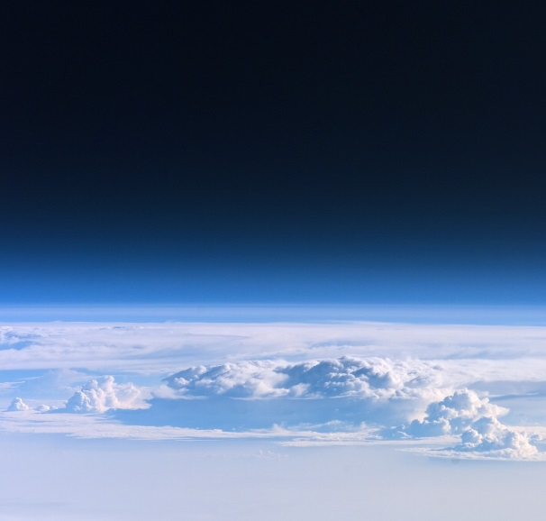
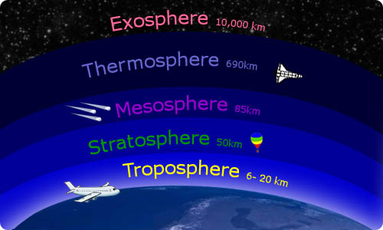
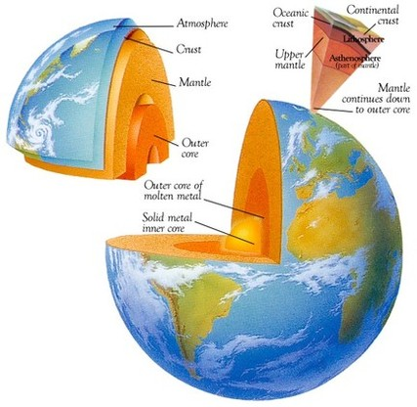
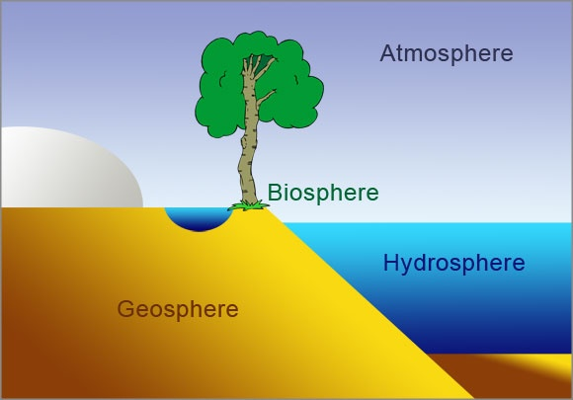
link to slide 4
Explore the disciplines of science
(Physics, Chemistry, Astronomy, Geology, Biology)
through studying
the Hydrosphere
the Atmosphere
the Geosphere
the Biosphere

Slide 2
Explore the disciplines of science
(Physics, Chemistry, Astronomy, Geology, Biology)
through studying
now…..
the Hydrosphere

Slide 3
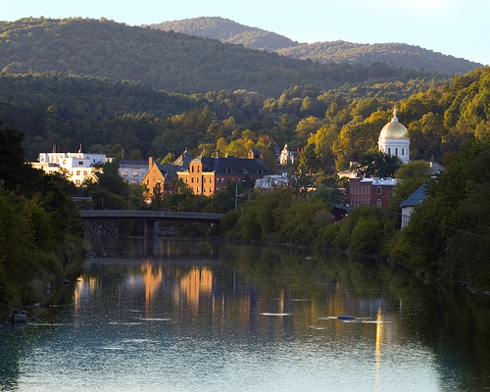
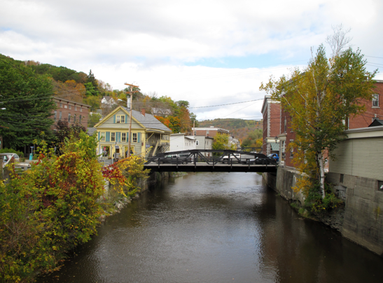
We live here, work here, play here
and all of those actions
take a toll on the river...
What can we do to make our impact less?
Why do we care about the river?

Slide 4
Winooski Watershed
Where does the water that flows outside MHS come from?
(List as many
cities/towns
as you can)
Where are the headwaters of the main branch of the Winooski?
Where does the Winooski flow?
List as many rivers as you can that flow into the Winooski.
What might the water flowing into Lake Champlain bring with it?
the watershed
what’s in the water… and why

Slide 5
Water Quality
… the chemical, physical, biological, and radiological characteristics of water.
It is a measure of the condition of water relative to the requirements of one or more biotic species and or to any human need or purpose.
It is most frequently used by reference to a set of standards against which compliance, generally achieved through treatment of the water, can be assessed. The most common standards used to assess water quality relate to health of ecosystems, safety of human contact, and drinking water.
- what “stuff” is in the water
- how much is there of that “stuff”
- is that “stuff” at that level hazardous to humans and/or other species
if that “stuff” can be hazardous at some level, we call it a _______________
pollutant

Slide 6
Water Quality
- what “stuff” is in the water
- how much is there of that “stuff”
- is that “stuff” at that level hazardous to humans and/or other species
if that “stuff” can be hazardous at some level, we call it a ________________
pollutant
What water are we talking about? __________________________
Where’s this water ? ________________________________
Where’s not this water? ______________________________
__________________________________________
drinking water / habitat water
rivers, lakes, oceans, ground water
ice caps (solid), glaciers (solid),
atmosphere (gas)

Slide 7
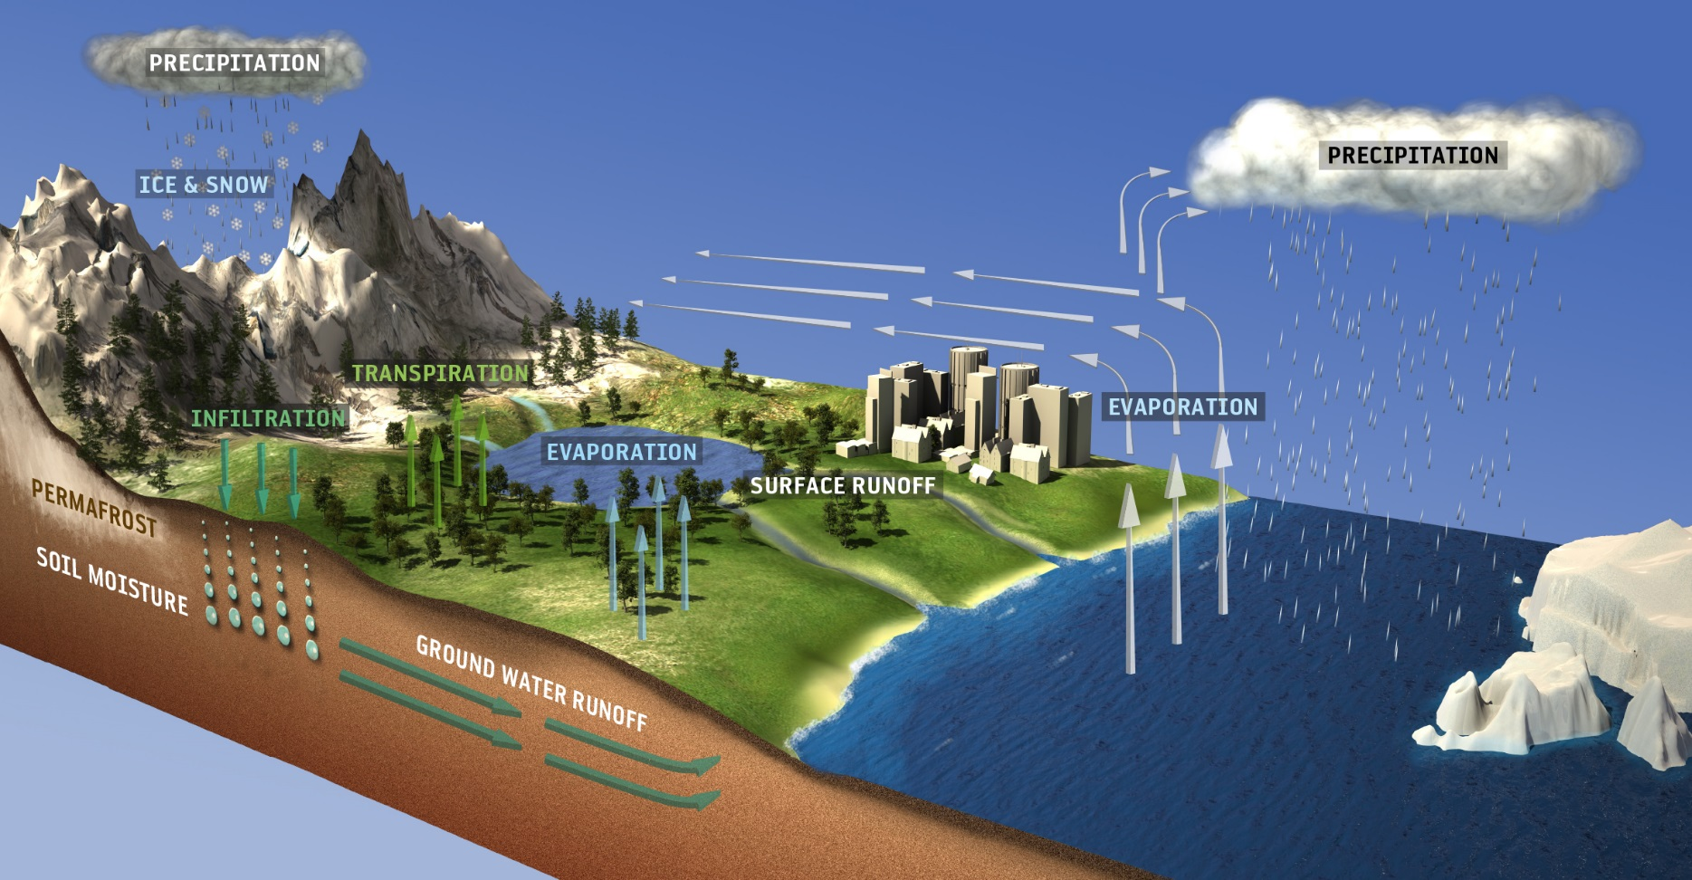
Water Quality
- what “stuff” is in the water
- how much is there of that “stuff”
- is that “stuff” at that level hazardous to humans and/or other species
What water are we talking about? __________________________
Where’s this water ? ________________________________
Where’s not this water? ______________________________
__________________________________________
drinking water / habitat water
rivers, lakes, oceans, ground water
ice caps (solid), glaciers (solid),
atmosphere (gas)

Slide 8
Water Quality
- what “stuff” is in the water
- how much is there of that “stuff”
- is that “stuff” at that level hazardous to humans and/or other species
What are some of the “stuffs” that we DON’T want in the water?
What are some of the “stuffs” that we DO want in the water?

Slide 9
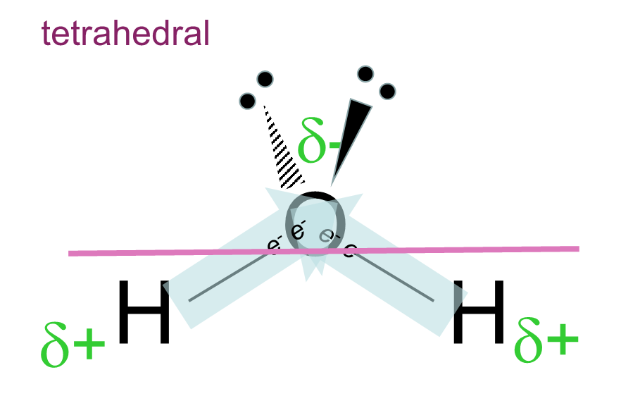
Water Quality
What determines how much of the “stuff” is safe to be in the water?
_________________________
plant and animal physiology
link
is the substance directly toxic?
does it lead to conditions that produce undesirable effects?
ex: algae blooms…
link to EPA drinking water standards
link to toxicity of gasoline
link to phosphate considerations
max in
100 g of water
“desirable” in
100 g of water
POLAR
nitrates (NO₃)⁻, ex: sodium nitrate Na(NO₃) | 90 grams | 0.001 gram
phosphates (PO₄)³⁻, ex: sodium phosphate Na₃(PO₄) | 10 grams | 0.00001 gram
any acid, ex: sulfuric acid (in acid rain) H₂SO₄ | any amount | 0.0001 gram
max in
100 g of water
“desirable” in
100 g of water
NON POLAR
oxygen, O₂ | 0.001 grams | the max
carbon dioxide, CO₂ | ~0.001 grams | the max
gasoline (hydrocarbon mixture), ex: C₈H₁₈ | 0.00007 grams | none

Slide 10
Water Quality
What determines how much of the “stuff” is safe to be in the water?
_________________________
plant and animal physiology
link
is the substance directly toxic?
does it lead to conditions that produce undesirable effects?
ex: algae blooms…
max in
100 g of water
“desirable” in
100 g of water
POLAR
nitrates (NO₃)⁻, ex: sodium nitrate Na(NO₃) | 90 grams | 0.001 gram
phosphates (PO₄)³⁻, ex: sodium phosphate Na₃(PO₄) | 10 grams | 0.00001 gram
any acid, ex: sulfuric acid (in acid rain) H₂SO₄ | any amount | 0.0001 gram
algae blooms
lowers pH
why is “desirable” low ?
why is “desirable” high ?
toxic
all life depends on…
max in
100 g of water
“desirable” in
100 g of water
NON POLAR
oxygen, O₂ | 0.001 grams | the max
carbon dioxide, CO₂ | ~0.001 grams | the max
gasoline (hydrocarbon mixture), ex: C₈H₁₈ | 0.00007 grams | none

Slide 11
Water Quality report for Montpelier’s drinking water
link to 2019 report
How does the “stuff” that is in the water
get into the water ?

Slide 12
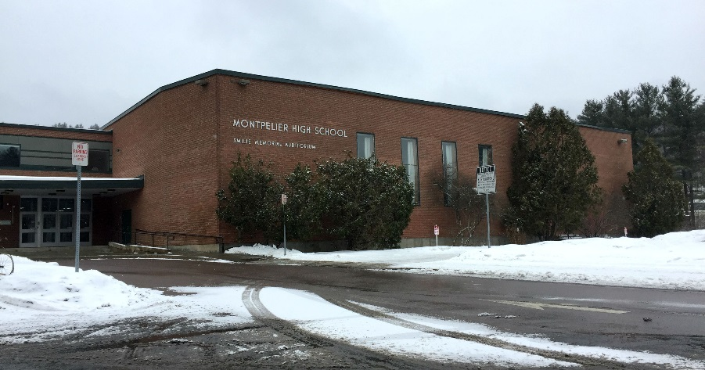
runoff
runoff
Project Options:
engineering/design
The Mud Lot
1. address issues of runoff
onto and off of the Mud Lot
… concerns
… design a new parking lot
that mitigates these runoff issues
runoff
analytical
chemistry
2. address issues of runoff
off of the Mud Lot and into the Winooski
… specific substances of concern
… measure the levels of these water quality factors
… address ways to mitigate these runoff issues
The Winooski

Slide 13
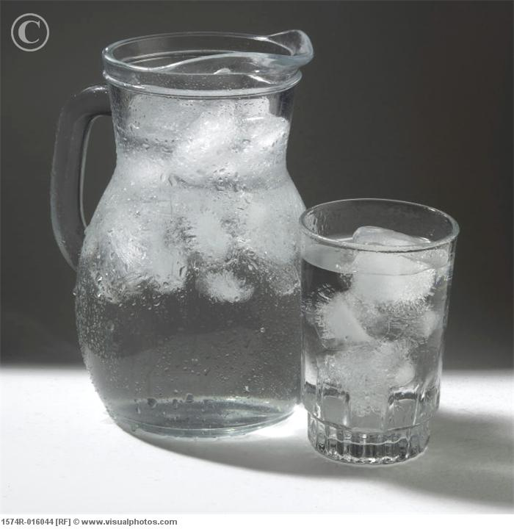
To understand what is in the water
what we can see
and
what we cannot see….
We need to understand the properties of water
To understand the properties of water,
we need to understand
its composition
and
its structure
AT THE ATOMIC SCALE!
0.0000000001 m
(that’s small!)

Slide 14
tetrahedral
δ-
O
e⁻ e⁻
e⁻ e⁻
H
H
δ+
δ+

Slide 15
We Finally Have all the pieces!!!!
What an ion is!
Why water is happy at H₂O!
What an atom is!
How water is polar and what that means in terms of how water dissolves other things!
What a watershed is!
What covalent and ionic bonds are!
Now why was that all important?
How does it effect your community?

Slide 16
Power of Observation
Sketch
Write
Questions
Concerns
Listen
Discover
What did you see?
What do you want to know more about?
What questions do you have?

Slide 17
Water Quality
- what “stuff” is in the water
- how much is there of that “stuff”
- is that “stuff” at that level hazardous to humans and/or other species
What determines how much of the “stuff” can be in the water?
clue… three words _____________________________
based on what property? _______________________
water is ____________________
so “stuff” that is ___________ will dissolve best in water
and “stuff” that is ____________ will not dissolve much in water
Like Dissolves Like
polarity
polar
polar
not polar
max in
100 g of water
POLAR
nitrates (NO₃)⁻, ex: sodium nitrate Na(NO₃) | 90 grams
phosphates (PO₄)³⁻, ex: sodium phosphate Na₃(PO₄) | 10 grams
any acid, ex: sulfuric acid (acid rain) H₂SO₄ | any amount

Slide 18
Water Quality
What determines how much of the “stuff” can be in the water?
clue… three words _____________________________
based on what property? _______________________
water is ____________________
so “stuff” that is ___________ will dissolve best in water
and “stuff” that is ____________ will not dissolve much in water
Like Dissolves Like
polarity
polar
polar
not polar
max in
100 g of water
POLAR
nitrates (NO₃)⁻, ex: sodium nitrate Na(NO₃) | 90 grams
phosphates (PO₄)³⁻, ex: sodium phosphate Na₃(PO₄) | 10 grams
any acid, ex: sulfuric acid (in acid rain) H₂SO₄ | any amount
max in
100 g of water
NON POLAR
oxygen, O₂ | 0.001 grams
carbon dioxide, CO₂ | ~0.001 grams
gasoline (hydrocarbon mixture), ex: C₈H₁₈ | 0.00007 grams

