Slide 1
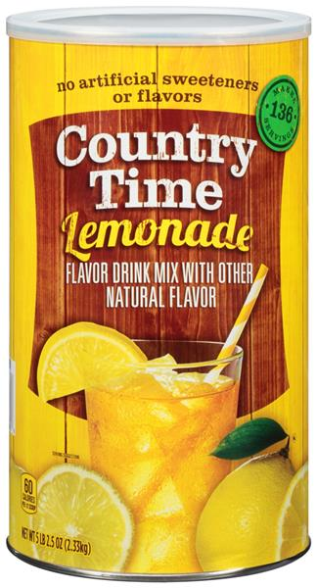
Hydrosphere 6 WHAT’S IN WATER (or not) Date _____________
start with making some “lemonade”
with Country Time “Lemonade” Mix link
mass of water + beaker _________
mass of sugar _______________
combine….
what do you see? ______________________
total mass _________________
evaporation link for lab…
https://www.youtube.com/watch?v=QGFsc3OVass

Slide 2
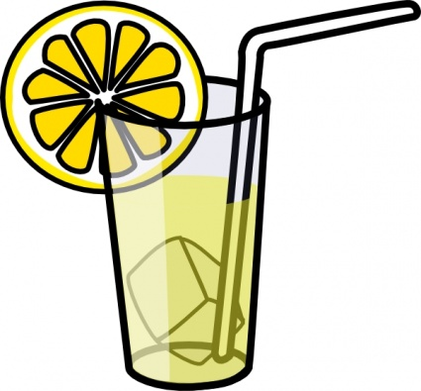
Hydrosphere 6 WHAT’S IN WATER (or not) Date _____________
You added some sugar to water, and you saw
_____________________________________
Did the sugar actually _________ ? _____
What evidence do you have ?
the sugar disappeared!
go away
NO!
What did happen to the sugar?

Slide 3
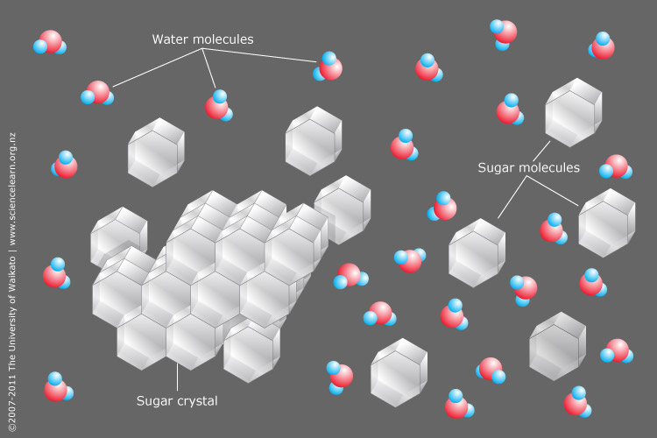

Slide 4
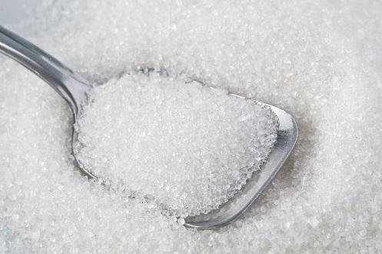
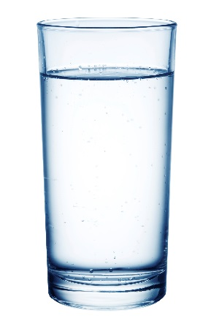
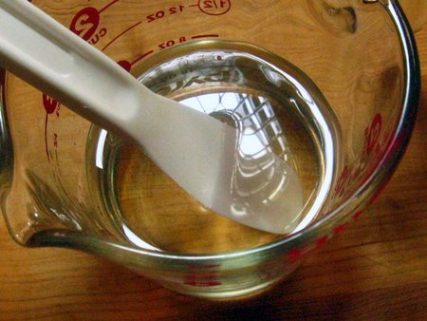
The mixture of sugar and water is called a _________________
the sugar ____________ into the water
the sugar is called the ________________
from the Latin ‘solutus’ meaning loosened
the water is called the ________________
from the Latin ‘solvent’ meaning loosening, unfastening
the combination is called a ___________________
solution
the sugar is soluble
in water
dissolved
solute
solvent
solution
key characteristics of a _________________
_______________________________________
_______________________________________
_______________________________________
solution
the solute is uniformly distributed
the solute “pieces” are too small to see
the solution appears clear (not cloudy or ‘milky’)
and uniform
NOTE:
clarity and color are two different properties…
…. ie something can be clear AND colored (blue glass)

Slide 5
some “definition-y” stuff …
matter ________________________________________________
______________________________________________________
mass ______________________________
can measure mass by __________________
everything that is made up of atoms and ions
can feel it… it has mass and occupies volume
a measure of the amount of matter (amount of atoms)
weighing (the weight)
Law of Conservation of Mass (or Matter)
_____________________________________
_____________________________________
Matter cannot be created or destroyed
but it can be transferred or transformed

Slide 6
Law of Conservation of Mass (or Matter)
_____________________________________
_____________________________________
so, given this is true,
if you add 25 grams of dry lemonade mix to 260 grams of water,
the total mass will be:
a. It will have a mass slightly less than 260 grams, but more than 235 grams.
b. It will have a mass slightly more than 260 grams, but less than 285 grams.
c. It will have a mass of 235 grams.
d. It will have a mass of 285 grams.
e. It will have a mass of 260 grams.
Matter cannot be created or destroyed
but it can be transferred or transformed
260 g
25 g

Slide 7
Law of Conservation of Mass (or Matter)
_____________________________________
_____________________________________
Matter cannot be created or destroyed
but it can be transferred or transformed
so, given this is true,
if you add 25 grams of dry lemonade mix to 260 grams of water,
the total mass will be:
a. It will have a mass slightly less than 260 grams, but more than 235 grams.
b. It will have a mass slightly more than 260 grams, but less than 285 grams.
c. It will have a mass of 235 grams.
d. It will have a mass of 285 grams.
e. It will have a mass of 260 grams.
because,

Slide 8
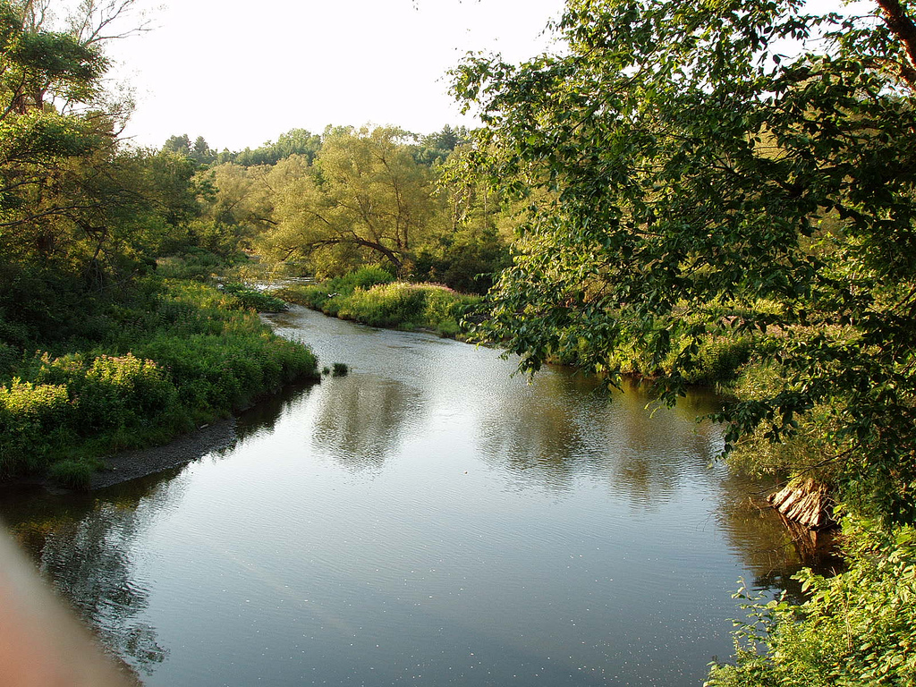
back to what’s in water (or not)
water _________________
want to understand what will, or will not, dissolve in water AND why
explore what does and doesn’t dissolve first….
Solutions - The Golden Rule of Solubility
solvent
polarity of BIG molecules and ionic

Slide 9
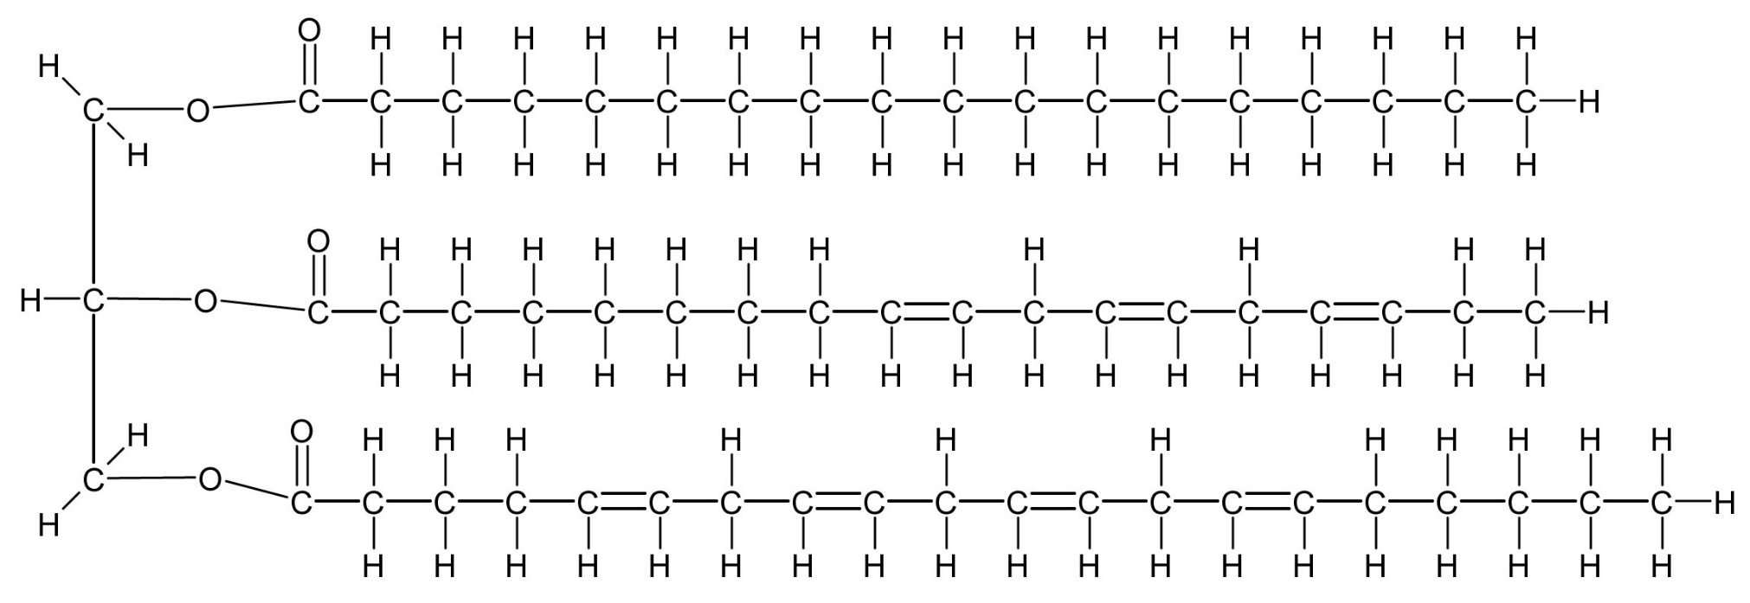
nonpolar
… all CH
partly nonpolar
… CH end
nonpolar
fuel (hydrocarbons)
except for I₂
…larger molecules
…more CH
iodine
isopropanol
(more) nonpolar
… mostly CH
nonpolar
… all CH
Vitamin E
naphthalene
(more) nonpolar
… mostly CH
(food) oil

Slide 10
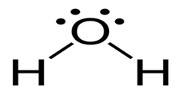
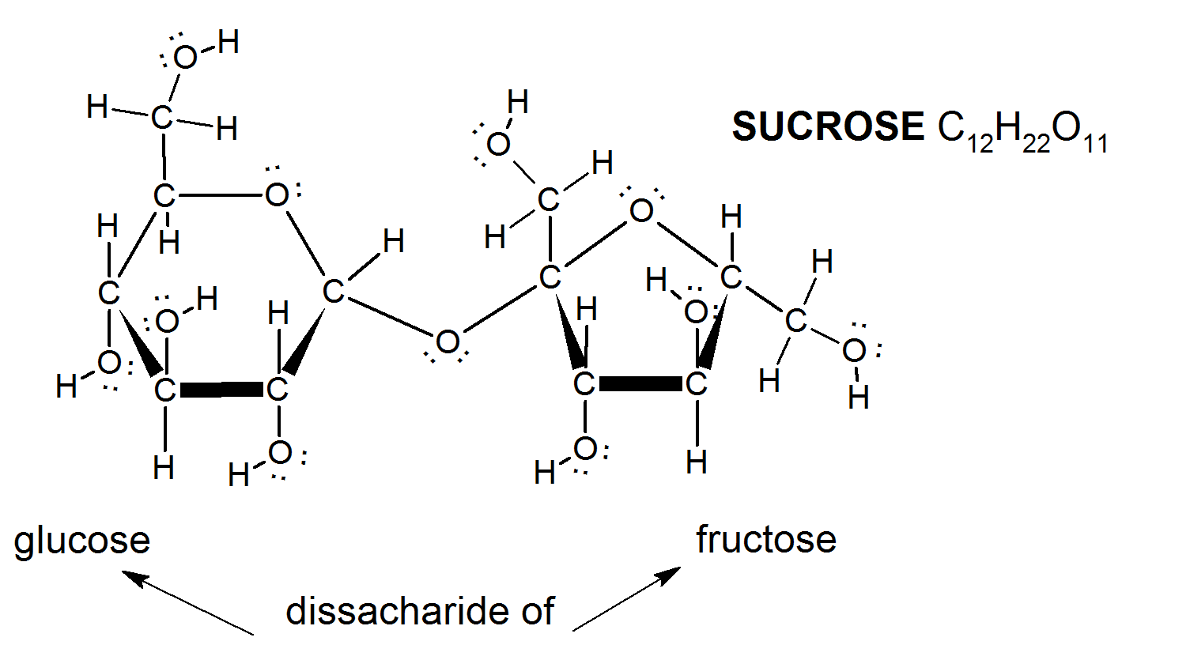
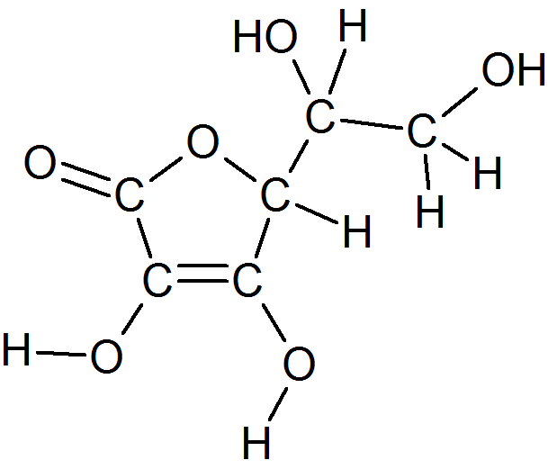
…smaller molecules
…more O and/or “other”
polar
water
polar
… “lots” of O’s
and spread out
partly polar
… an OH end
isopropanol
polar
… “lots” of O’s,
and spread out
polar
… corners different
“polar”
… ionic
Vitamin C
sodium chloride
urea

Slide 11
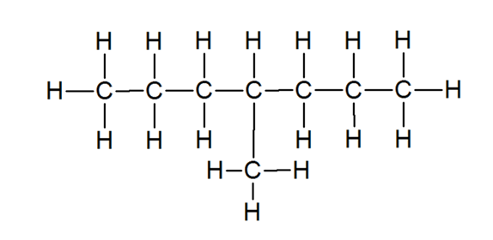
the more ‘like’
the solvent and solute,
the more of the solute
will dissolve
LIKE DISSOLVES LIKE
polar substances dissolve best in polar solvents
non-polar substances dissolve best in non-polar solvents
composition
structure
and polarity
WHY….
water
sodium chloride
fuel (hydrocarbons)
iodine
urea
Vitamin E
Vitamin C

Slide 12
polar
solvent
non- polar
solvent
δ⁻
δ⁺
δ⁻
δ⁺
polar
substance
non- polar
substance
δ⁻
δ⁺
δ⁻
δ⁺

Slide 13
opposites attract (if you are charges)
polar
solvent
δ⁻
δ⁺
δ⁻
δ⁺
stick
together
δ⁻
δ⁺
δ⁻
δ⁺

Slide 14
polar
solvent
δ⁻
δ⁺
δ⁻
δ⁺
stick
δ⁻
δ⁺
δ⁻
δ⁺
polar
substance
non- polar
substance
δ⁻
δ⁺
stick
δ⁻
δ⁺

Slide 15
polar
solvent
δ⁻
δ⁺
δ⁻
δ⁺
stick
δ⁻
δ⁺
δ⁻
δ⁺
polar
substance
Hey… check it out…
that good looking
polar molecule
is very attractive too!
in the mixture: ____________
________________________
________________________
Ex: _____________________
δ⁻
δ⁺
the polar solvent pieces are
“happy “to stick to the polar substance pieces
so,… the substance dissolves
stick
Vitamin C dissolves in water
(and urea, sucrose)
δ⁻
δ⁺
I think I might
go stick with her.

Slide 16
non- polar
solvent
non- polar
substance
in the mixture: ____________
________________________
________________________
Ex: _____________________
the non-polar solvent pieces and the
non-polar substance pieces are free to move freely
so,… the substance dissolves
fuel and Vitamin E (and food oil, naphthalene, iodine)

Slide 17
polar
solvent
δ⁻
δ⁺
δ⁻
δ⁺
stick
δ⁻
δ⁺
δ⁻
δ⁺
non- polar
substance
Fine…
we’ll be fine
all on
our own
in the mixture: ____________
________________________
________________________
Ex: _____________________
Hey…
that non-polar molecule
is not
very attractive!
I’ll just
stay stuck
to my polar
pals …
the polar solvent pieces are “happy” to
stick to themselves (they don’t find the non-polar
substance pieces attractive) so,… the substance doesn’t dissolve
water and Vitamin E

Slide 18
polar
solvent
δ⁻
δ⁺
δ⁻
δ⁺
stick
δ⁻
δ⁺
δ⁻
δ⁺
Hey… check it out…
those ions
are very attractive too!
ionic
substance
+
stick
Hey… check it out…
those polar molecules
are very attractive too!
+
I think I might
go stick with them.

Slide 19
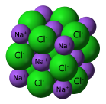
Polar Solvent
and Ionic Substance
Na⁺
δ⁻
δ⁻
δ⁺
Na⁺
δ⁻
δ⁻
δ⁺
δ⁺
δ⁺
δ⁻
Cl⁻
δ⁻
δ⁺
δ⁺
δ⁺
in the mixture: ____________
________________________
________________________
Ex: _____________________
Cl⁻
the ions are
“happy” to stick to the polar substance pieces
so,… the ionic substance dissolves
δ⁻
NaCl dissolves in water

Slide 20
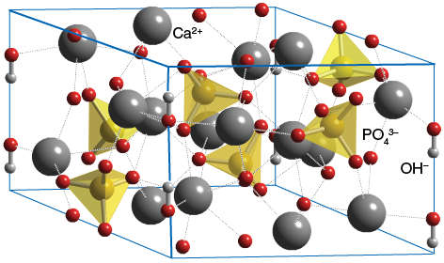
polar
solvent
δ⁻
δ⁺
δ⁻
δ⁺
stick
δ⁻
δ⁺
δ⁻
δ⁺
in the mixture: _______________
___________________________
___________________________
___________________________
___________________________
___________________________
Ex: _____________________
in the super-duper-extreme
ionic substance, the ions are “happier”
stuck to each other than stuck to the
polar solvent pieces… so,… super-duper-extreme
ionic substances do not dissolve
super duper extreme ionic
substance
Hey…
that polar molecule
is not as attractive
as my ion friends!
I’ll just
stay stuck
to my ion
pals …
bone does not dissolve in water

Slide 21
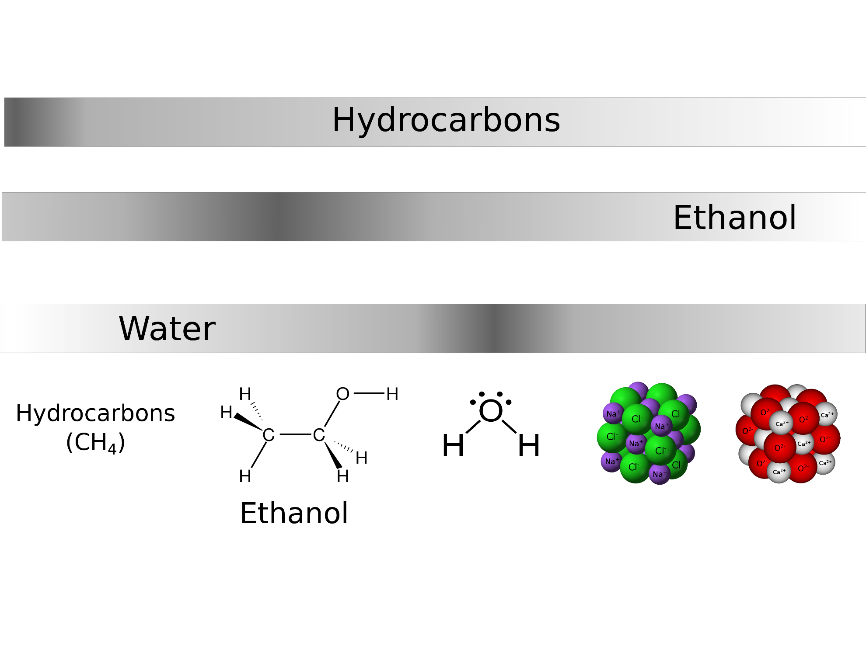
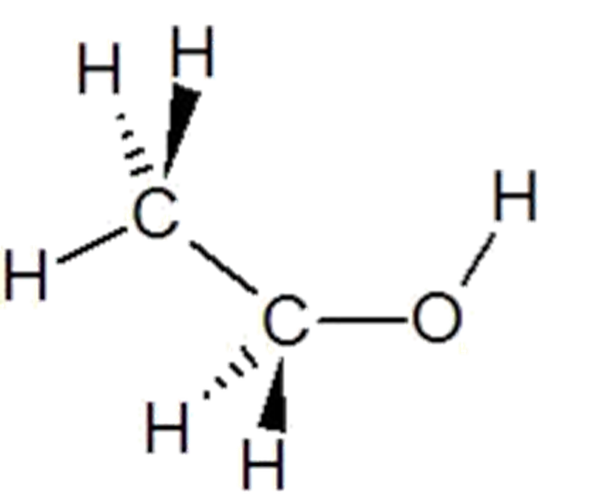
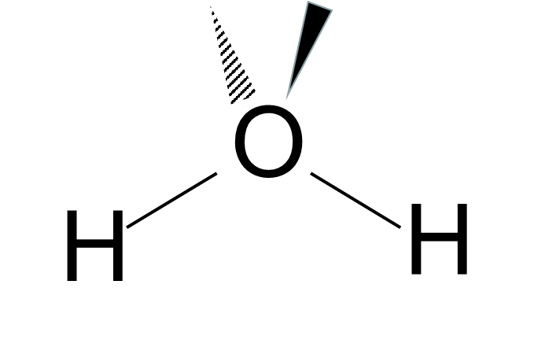
the more like the solvent and substance
the more likely the substance will dissolve
composition
structure
and especially polarity
most soluble
most soluble
solvents
most soluble
Non-Polar
Polar
Ionic
“Extreme”
Ionic
solutes

