Slide 1
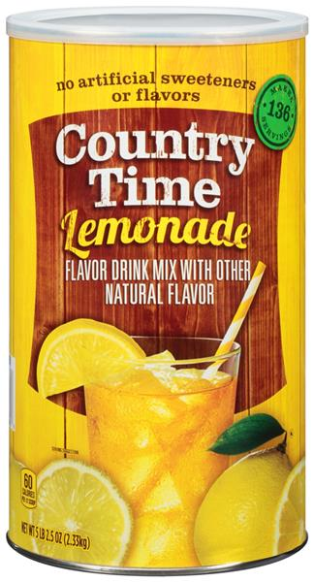
Hydrosphere 6 WHAT’S IN WATER (or not) Date _____________
start with making some “lemonade”
with Country Time “Lemonade” Mix link
mass of water + beaker _________
mass of sugar _______________
combine….
what do you see? ______________________
total mass _________________
evaporation link for lab…
https://www.youtube.com/watch?v=QGFsc3OVass

Slide 2
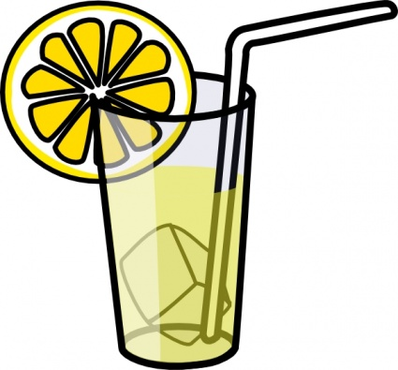
Hydrosphere 6 WHAT’S IN WATER (or not) Date _____________
You added some sugar to water, and you saw
_____________________________________
Did the sugar actually _________ ? _____
What evidence do you have ?
the sugar disappeared!
go away
NO!
What did happen to the sugar?

Slide 3
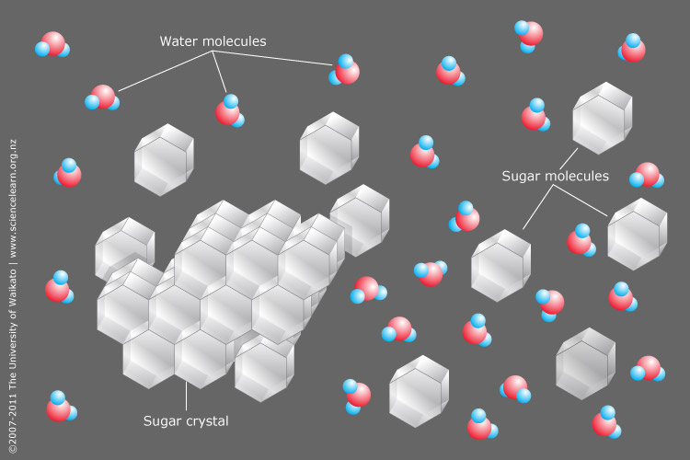

Slide 4
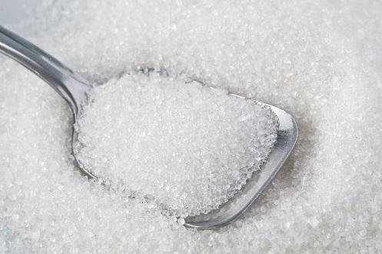
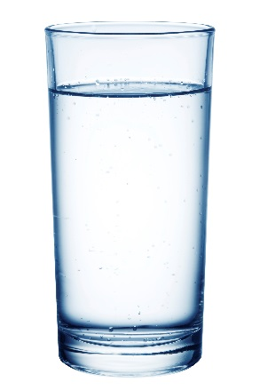
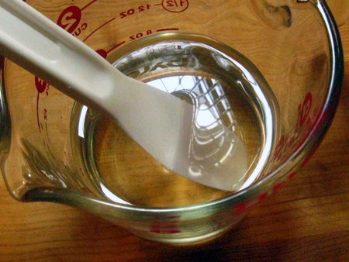
The mixture of sugar and water is called a _________________
the sugar ____________ into the water
the sugar is called the ________________
from the Latin ‘solutus’ meaning loosened
the water is called the ________________
from the Latin ‘solvent’ meaning loosening, unfastening
the combination is called a ___________________
solution
the sugar is soluble
in water
dissolved
solute
solvent
solution
key characteristics of a _________________
_______________________________________
_______________________________________
_______________________________________
solution
the solute is uniformly distributed
the solute “pieces” are too small to see
the solution appears clear (not cloudy or ‘milky’)
and uniform
NOTE:
clarity and color are two different properties…
…. ie something can be clear AND colored (blue glass)

Slide 5
some “definition-y” stuff …
matter ________________________________________________
______________________________________________________
mass ______________________________
can measure mass by __________________
everything that is made up of atoms and ions
can feel it… it has mass and occupies volume
a measure of the amount of matter (amount of atoms)
weighing (the weight)
Law of Conservation of Mass (or Matter)
_____________________________________
_____________________________________
Matter cannot be created or destroyed
but it can be transferred or transformed

Slide 6
Law of Conservation of Mass (or Matter)
_____________________________________
_____________________________________
so, given this is true,
if you add 25 grams of dry lemonade mix to 260 grams of water,
the total mass will be:
a. It will have a mass slightly less than 260 grams, but more than 235 grams.
b. It will have a mass slightly more than 260 grams, but less than 285 grams.
c. It will have a mass of 235 grams.
d. It will have a mass of 285 grams.
e. It will have a mass of 260 grams.
Matter cannot be created or destroyed
but it can be transferred or transformed
260 g
25 g

Slide 7
Law of Conservation of Mass (or Matter)
_____________________________________
_____________________________________
Matter cannot be created or destroyed
but it can be transferred or transformed
so, given this is true,
if you add 25 grams of dry lemonade mix to 260 grams of water,
the total mass will be:
a. It will have a mass slightly less than 260 grams, but more than 235 grams.
b. It will have a mass slightly more than 260 grams, but less than 285 grams.
c. It will have a mass of 235 grams.
d. It will have a mass of 285 grams.
e. It will have a mass of 260 grams.
because,

Slide 8
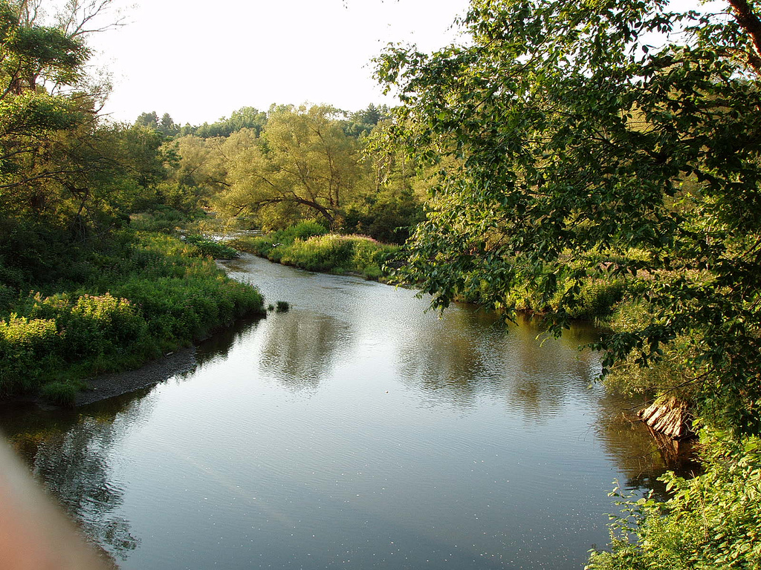
back to what’s in water (or not)
water _________________
want to understand what will, or will not, dissolve in water AND why
explore what does and doesn’t dissolve first….
Solutions - The Golden Rule of Solubility
solvent
polarity of BIG molecules and ionic

