Slide 1
Hydrosphere 5 MOLECULAR SHAPE Date _____________
Review….
Carbon (C) _______________
Hydrogen (H) _____________
Oxygen (O) _______________
Phosphorus (N) _______________
Fluorine (F) __________
Chlorine (Cl) __________
nonmetal
nonmetal
nonmetal
bonding between atoms of these elements:
_____________________
nonmetal
covalent
nonmetal
nonmetal
Lewis Dot Structures
C₂H₂ PF₃
H₂O CCl₄

Slide 2
Hydrosphere 5 MOLECULAR SHAPE Date _____________
Review….
Carbon (C) _______________
Hydrogen (H) _____________
Oxygen (O) _______________
Phosphorus (N) _______________
Fluorine (F) __________
Chlorine (Cl) __________
nonmetal
nonmetal
nonmetal
bonding between atoms of these elements:
_____________________
nonmetal
covalent
nonmetal
nonmetal
Lewis Dot Structures
C₂H₂ PF₃
H₂O CCl₄
These pieces we have drawn represent molecules!

Slide 3
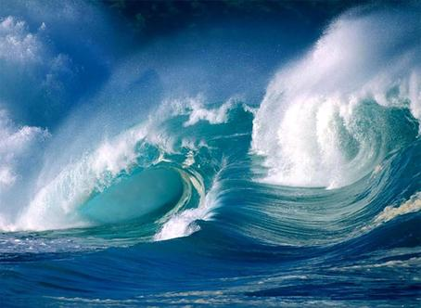
remember…. we are in the “hydrosphere” unit….
trying to understand what might be in water
(or not)
which led us to…
we need to understand the
properties of water
to understand the properties of water
we need to know about it
at the atomic scale…
we now know water is H₂O (and why)
next…
to understand more about water’s properties,
we need to understand the shape of the molecules
(nonmetals to nonmetals)

Slide 4
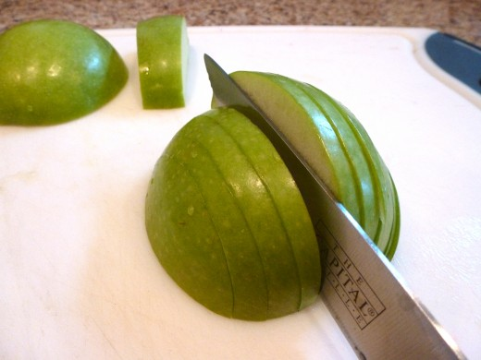
next…
to understand more about water’s properties,
we need to understand the shape of the molecules
shape determines function
Steel can be shaped to perform a variety of functions

Slide 5
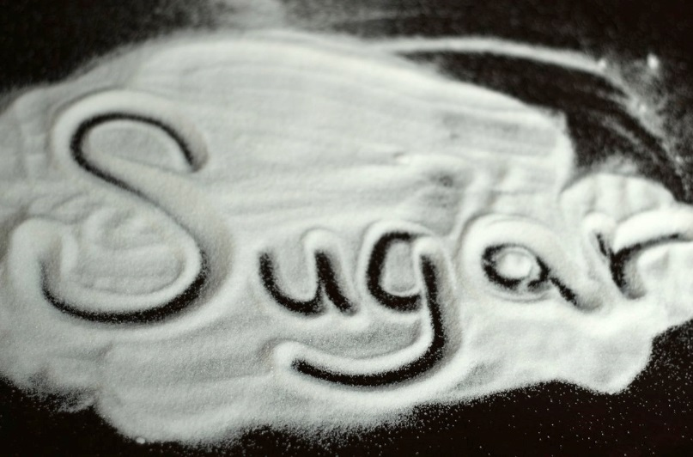
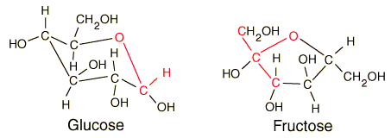
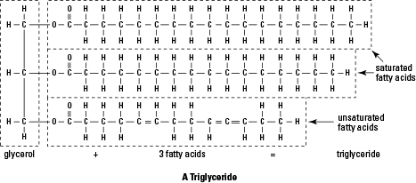
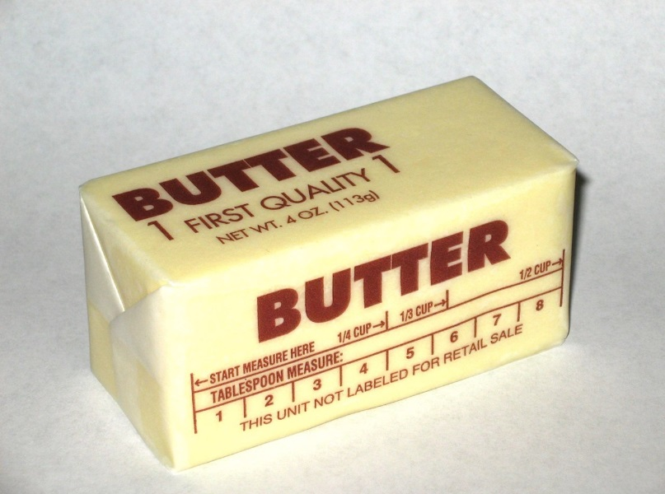
Carbon, Hydrogen, Oxygen are combined and shaped to create different molecules... with distinctly different properties

Slide 6
KEY…
the 3D shape of molecules results from…
opposite charges, (+) and (-) ________________
like charges (+) and (+), (-) and (-) __________________
electrons are all __________________
nuclei are ____________________
so, the electrons are ____________ to the nuclei
and are ____________ by other electrons
attract
repel
-
+
-
-
+
+
negative
positive
attracted
repelled

Slide 7
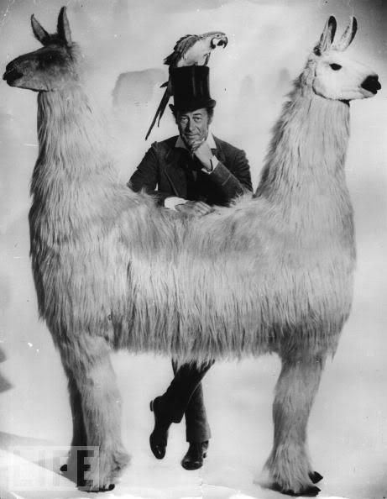
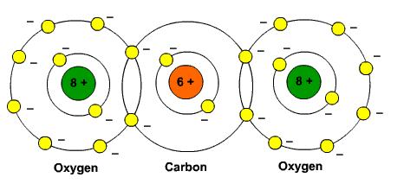
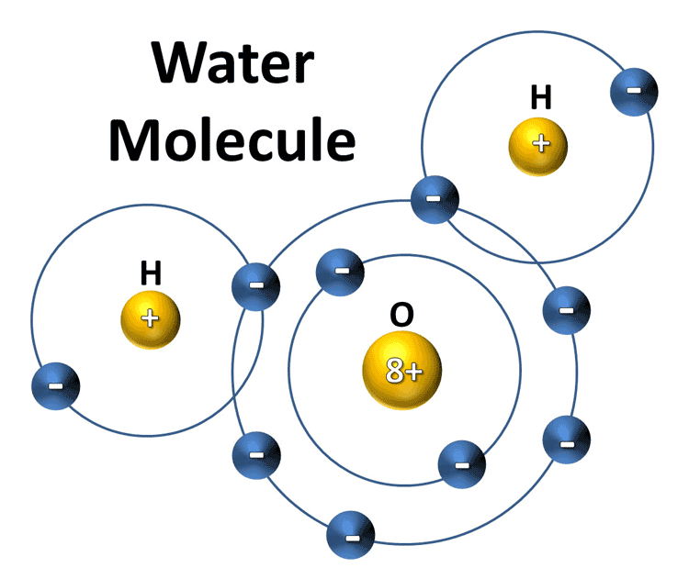
so, the electrons have this push-me-pull-you going on in molecules
“pull-me” to the nuclei
“push-me” away from
other electrons

Slide 8
to determine the 3D shape of a molecule, need to determine three things:
one. which atoms are central and which are outside
central atom: ______________________________
outside atom: ______________________________
two. how many regions of electron density are around each
central atom (REDACA)
- each bond (single, double, or triple) ___________________
- each non-bonding pair __________________________
(we’ll practice in a second…)
three. the geometry that gets these regions of electrons as far from
each other as possible
bonded to two or more atoms
bonded to only one other atom
counts as ONE region
counts as ONE region

Slide 9
it all starts with the Lewis structure…..
H
O
H

Slide 10
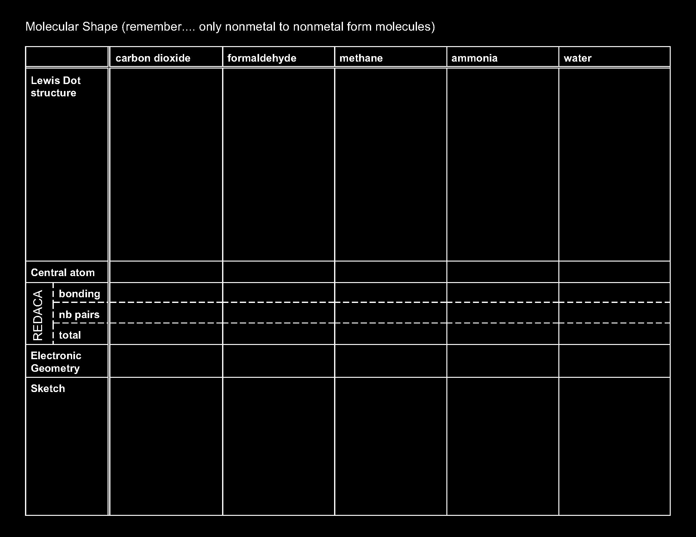

Slide 11
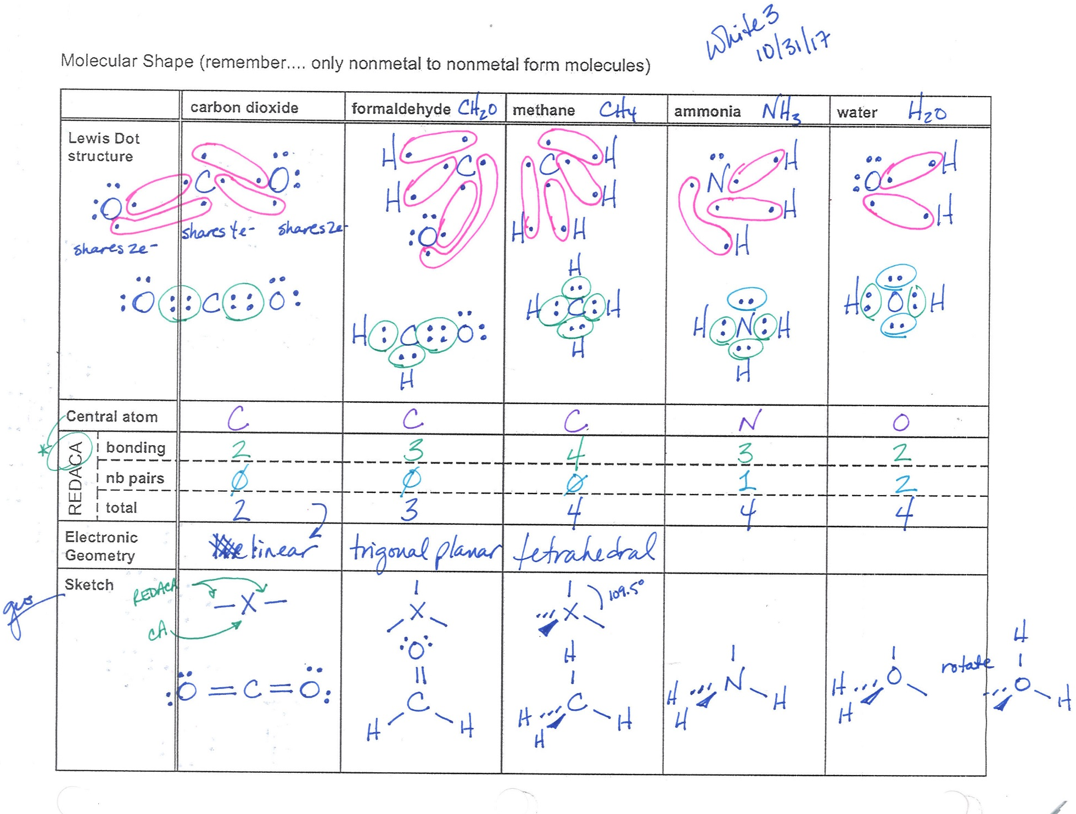

Slide 14
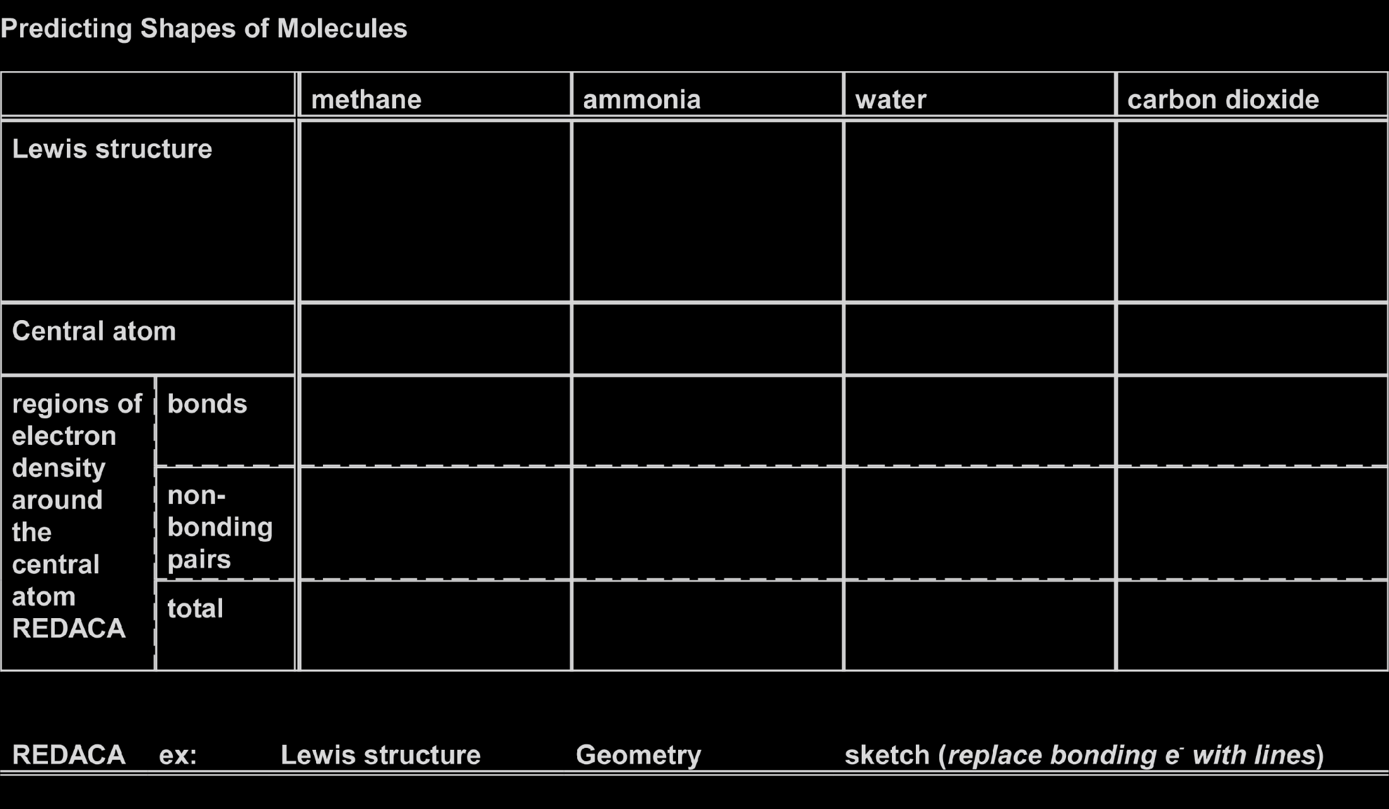
and now,
figure out the geometries that get the regions of electron density
as far apart as possible
start with CO₂

Slide 15
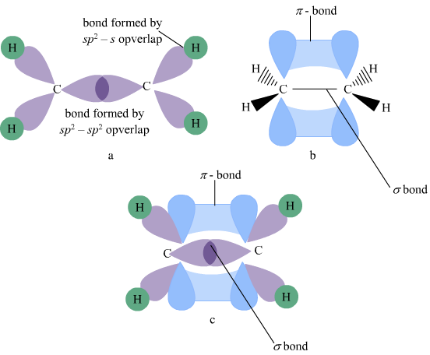
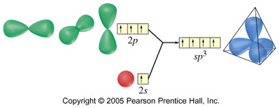
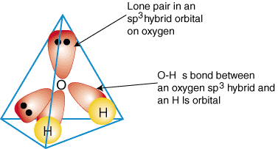
Hydrosphere 8 MOLECULAR SHAPE Date _____________
There are three theories / models that predict and explain the shape of molecules:
Valence Shell Electron Pair Repulsion Theory (VSEPR)
Valence Bond Theory
describes how bonds form, and resulting shapes of molecules
- shapes are a consequence of “morphing” of valence orbitals
- bonds form via overlap of these “morphed” valence orbitals
and electrons shared in overlapped space

Slide 16
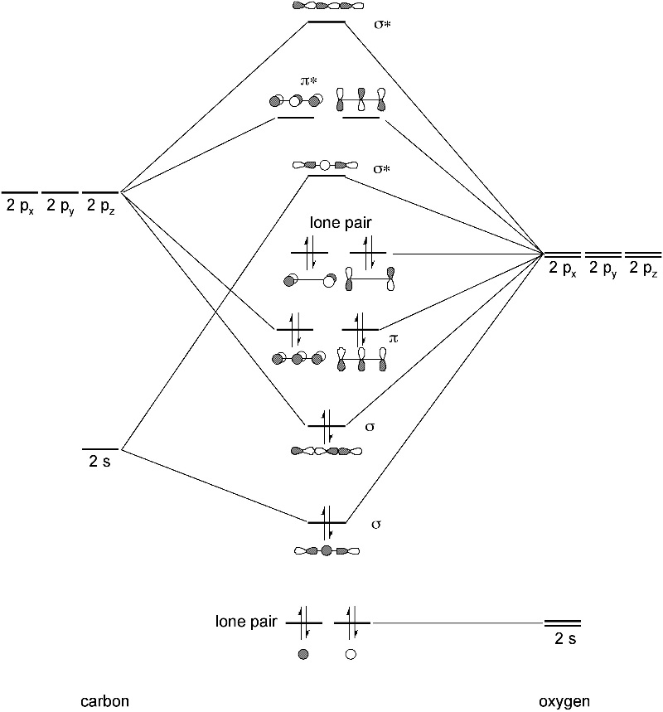
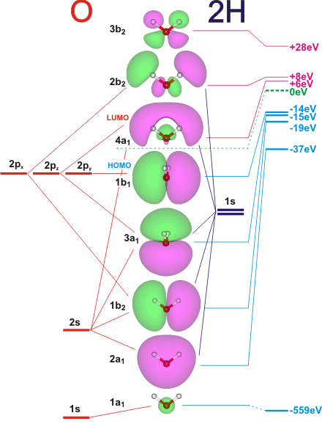
CHAPTER 8 MOLECULAR SHAPE Date _____________
There are three theories / models that deal with the shape of molecules:
Valence Shell Electron Pair Repulsion Theory (VSEPR)
Valence Bond Theory
describes how bonds form, and resulting shapes of molecules
- shapes are a consequence of “morphing” of valence orbitals
- bonds form via overlap of these “morphed” valence orbitals
and electrons shared in overlapped space
Molecular Orbital Theory
most rigorous (in this case this means terrifically complex and mathematical)
describes how bonds form, and resulting shapes of molecules
- a new set of orbitals is calculated from the atomic orbitals
- these new orbitals belong to the whole molecule (molecular orbitals)

Slide 17
CHAPTER 8 MOLECULAR SHAPE Date _____________
There are three theories / models that deal with the shape of molecules:
Valence Shell Electron Pair Repulsion Theory (VSEPR)
Valence Bond Theory
describes how bonds form, and resulting shapes of molecules
- shapes are a consequence of “morphing” of valence orbitals
- bonds form via overlap of these “morphed” valence orbitals
and electrons shared in overlapped space
Molecular Orbital
most rigorous (in this case this means terrifically complex and mathematical)
describes how bonds form, and resulting shapes of molecules
- a new set of orbitals is calculated from the atomic orbitals
- these new orbitals belong to the whole molecule (molecular orbitals)
We will work only with VSEPR

Slide 18
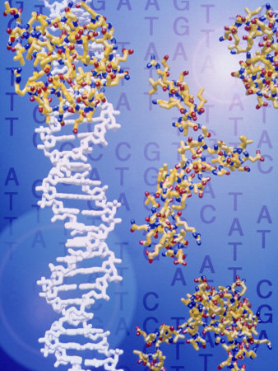
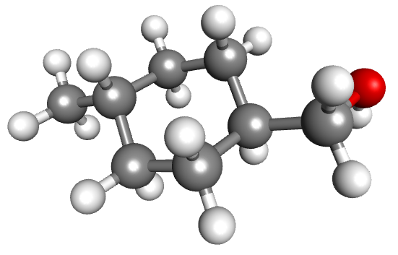
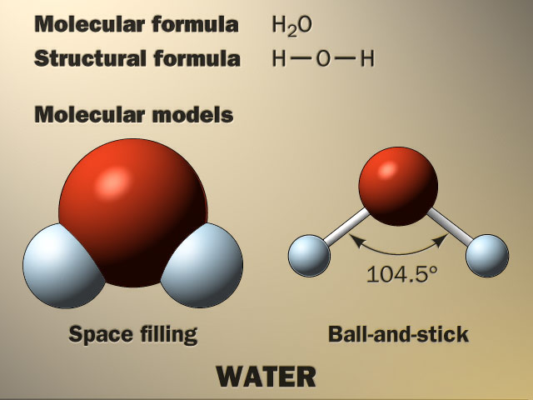
Valence Shell Electron Pair Repulsion Theory (more like a “model”)
Valence Shell Electrons _______________________________
Pair _______________________________________________
Repulsion __________________________________________
VSEPR used to predict 3D shapes of molecules based on
the ___________electrons of a molecule
arranging themselves so that they are __________________
outer shell s and p electrons
electrons “like to be in pairs
electrons are all negatively charged… repel
valence
as far apart as possible
proteins
4-methylcyclohexanemethanol
Water
DNA

Slide 19
