Slide 1
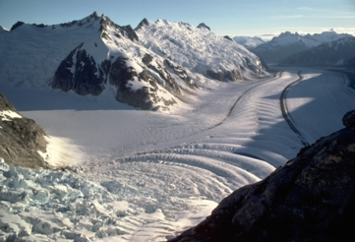
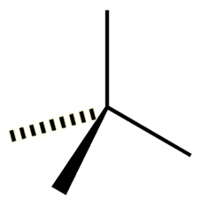
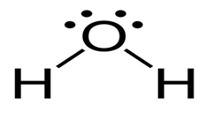
Hydrosphere 5 MOLECULAR POLARITY Date _____________
Things we have learned
about water
Things we knew about water
how are these properties related ? Well….

Slide 2
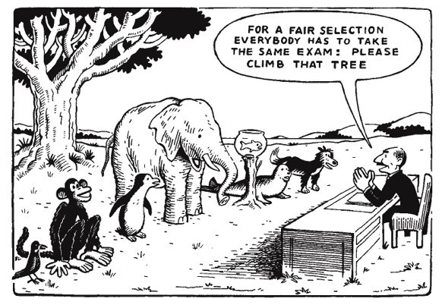
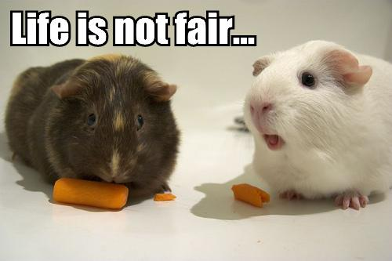
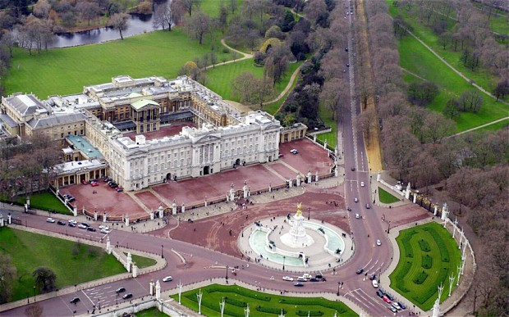
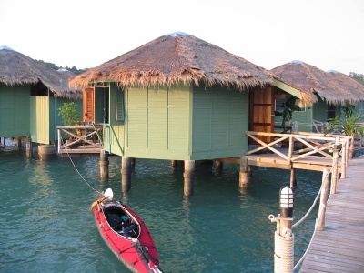
Things we knew about water
Things we have learned about water
- liquid at RT
- salt (NaCl) and sugar (sucrose) dissolve
in water
- oil and "rocks" do not
- H and O atoms bond covalently
- the reason it is 2 H atoms and 1 O atom
- the molecules have tetrahedral geometry
how are these properties related ? Well….
… the answer starts with …
in a covalent bond, _______________________________
_______________________________________________
_______________________________________________
fair sharing is not (necessarily) equal
electrons shared
some atoms get a bigger share of the shared electrons
it’s like the electrons have two homes
primary residence and their vacation home

Slide 3
… the answer starts with …
electrons shared
in a covalent bond, _______________________________
_______________________________________________
_______________________________________________
fair is not equal
some atoms get a bigger share of the shared electrons
it’s like the electrons have two homes
a primary residence and a vacation home
this sharing (or the lack thereof) is determined by
_______________________________
defined as:
________________________________
________________________________
________________________________
________________________________
electronegativity
the tendency of an atom to attract
the shared electrons of a covalent bond
the higher the electronegativity, the greater
the tendency to attract electrons

Slide 4
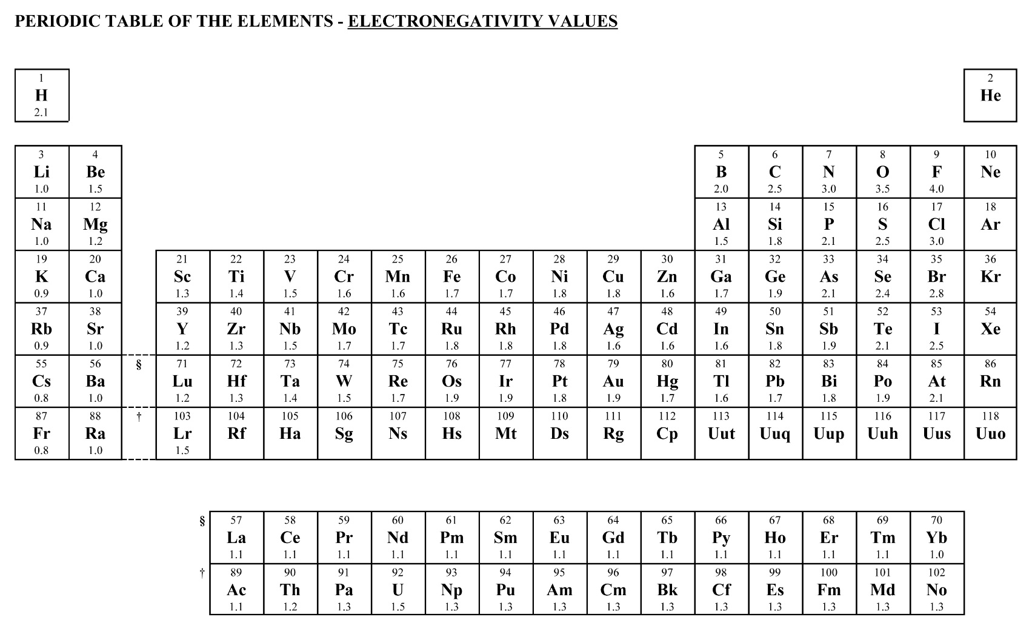
which atoms have a high electronegativity?
the ones that ________________________
___________________________________
which atoms have a low electronegativity?
the ones that ________________________
___________________________________
“really want” electrons
the nonmetal atoms
“want” to lose electrons
the metal atoms

Slide 5
highest
nonmetals
metals
lowest

Slide 6
In our quest to understand the properties of water
how do we use electronegativities?
the electronegativity values tell us
________________________________________________
________________________________________________
wherever the electrons (e⁻) spend more time will be more
________________________________________________
where the shared electrons of a covalent bond
spend most of their time
NEGATIVE

Slide 7
Lewis Dot…
H
F
H
F
nonmetal
nonmetal
electrons ______________
shared
H “wants” _________ F “wants” __________
1 more
1 more
let the oval
represent
where the shared
electrons are
H
F
electronegativity (EN) values: ______ _______
so,
which atom gets the bigger share of the shared electrons?
___________
2.1
4.0
fluorine (F)

Slide 8
let the oval
represent
where the shared
electrons are
a “little bit” positive
δ+
H
F
δ-
a “little bit” negative
electronegativity (EN) values: ______ _______
so,
which atom gets the bigger share of the shared electrons?
___________
electrons are all what charge? _______________
so,
if the electrons spend more time on _____________
the _______________ side becomes more ______________
and,
if the electrons spend less time on ______________
the _______________ side becomes more ______________
2.1
4.0
fluorine (F)
negative
fluorine (F)
fluorine (F)
negative
hydrogen (H)
hydrogen (H)
positive

Slide 9
a “little bit” positive
δ+
H
F
δ-
a “little bit” negative
electronegativity (EN) values: ______ _______
so,
which atom gets the bigger share of the shared electrons?
___________
2.1
4.0
fluorine (F)
a bond in which the electrons are shared unequally
between two atoms
Polar Bond: ___________________________________________
_______________________________________________
_______________________________________________
_______________________________________________
_______________________________________________
the shared electrons spend more time around
the atom with the higher electronegativity
making that end of the bond more negative

Slide 10
Lewis Dot…
O
O
O
O
nonmetal
nonmetal
electrons ______________
shared
O “wants” _________ O “wants” __________
2 more
2 more
let the oval
represent
where the shared
electrons are
O
O
electronegativity (EN) values: ______ _______
so,
which atom gets the bigger share of the shared electrons?
___________
3.5
3.5
neither

Slide 11
O
O
electronegativity (EN) values: ______ _______
so,
which atom gets the bigger share of the shared electrons?
___________
3.5
3.5
neither
Non-Polar Bond: ___________________________________________
_______________________________________________
_______________________________________________
_______________________________________________
_______________________________________________
a bond in which the electrons are shared equally
between two atoms
the shared electrons spend equal time around
both atoms of the bond
neither end of the bond is more negative
(or positive)

Slide 12
2 atom molecules (diatomics) … easy
the bond is either polar or non-polar
now,…
how to decide whether a molecule made of more than 2 atoms
is polar or not
Why do we care!!??
Polarity determines whether stuff sticks …. or not

Slide 13
Part 2….

Slide 14
2 atom molecules (diatomics) … easy
the bond is either polar or non-polar
now,…
how to decide whether a molecule made of more than 2 atoms
is polar or not
Why do we care!!??
Polarity determines whether stuff sticks …. or not

Slide 15
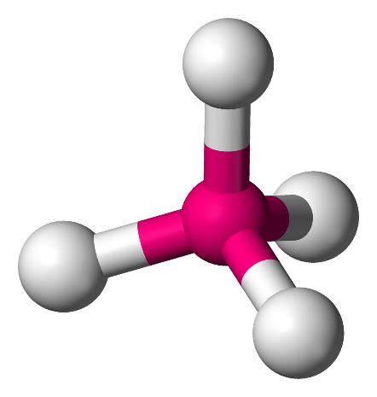
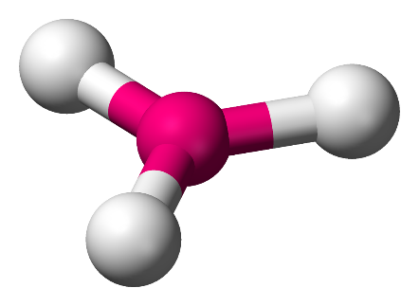
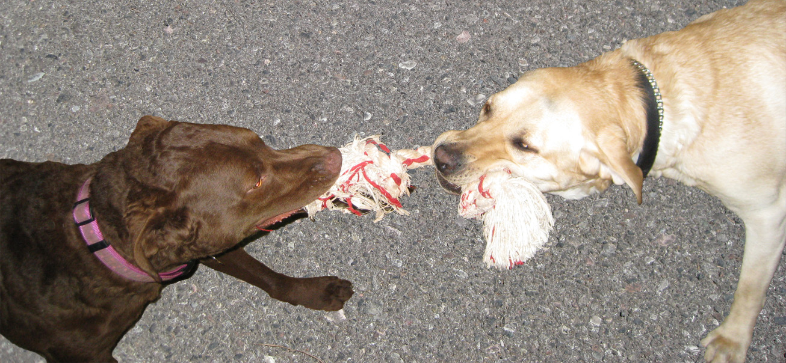
In order to think about polarity for molecules with more than two atoms,
we must remember the shape (geometry) of the molecule we are working with:
linear
trigonal planar
tetrahedral
and….
we need to consider the polarity of each bond…
then… which side of the whole molecule
gets a bigger share of the shared electrons

Slide 16
In order to think about polarity for molecules with more than two atoms,
we must remember the shape (geometry) of the molecule we are working with:
linear
trigonal planar
tetrahedral
and….
we need to consider the polarity of each bond…
to determine the polarity of a molecule…
we need to determine if one side of the WHOLE molecule
is more (-) (and the other side more (+))
a “little bit” positive
δ+
δ-
a “little bit” negative

Slide 17
to determine the polarity of a molecule…
we need to determine if one side of the WHOLE molecule
is more (-) (and the other side more (+))
a “little bit” positive
δ+
δ-
a “little bit” negative
remembering that electrons shift towards the atom(s) that are
__________________________________
can you draw a line through _________________________
and end up with ______________________
and ________________________________
more electronegative
the center of the molecule
more (-) on one side
more (+) on the other side
it is hard to figure out
the center of the molecule
model with some hula hoops… CO₂ and H₂O

Slide 18
model with some hula hoops
the humans represent the nuclei
the hula hoops represent the shared electrons
center of molecule = center of mass
draw a line through
shift shared electrons (hula hoops) towards the more EN atom(s)
is there more “hula hoop” on either side of the center?
yes = polar
no = not polar

Slide 19
O
C
O

Slide 20
shared electrons shift towards the more EN atoms… the oxygens

Slide 21
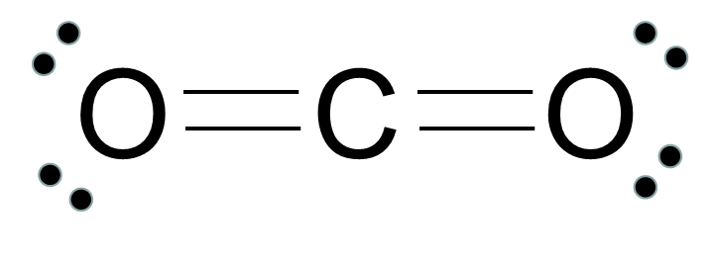
δ+
e⁻ e⁻ e⁻ e⁻
e⁻ e⁻ e⁻ e⁻
δ-
δ-
e⁻ e⁻ e⁻ e⁻
e⁻ e⁻ e⁻ e⁻
even though the electrons have shifted towards the O atoms,
the electrons shifted equally in OPPOSITE directions
SO,
neither side of the whole CO₂ molecule is more (-) or more (+)
NOT polar

Slide 22
O
H
H

Slide 23
the shared electrons shifted towards the O atom,
the O atom is on one side of the molecule… not in the middle
SO,
the O-side of the H₂O molecule is more (-)
polar
δ-
O
e⁻ e⁻
e⁻ e⁻
H
e⁻ e⁻
e⁻ e⁻
H
δ+
δ+

Slide 24
δ+
δ-
e⁻ e⁻ e⁻ e⁻
e⁻ e⁻ e⁻ e⁻
δ-
even though the electrons have shifted towards the O atoms,
the electrons shifted equally in OPPOSITE directions
SO,
neither side of the whole CO₂ molecule is more (-) or more (+)
NOT polar
the shared electrons shifted towards the O atom,
the O atom is on one side of the molecule…
not in the middle
SO,
the O-side of the H₂O molecule is more (-)
δ-
O
e⁻ e⁻
e⁻ e⁻
polar
H
H
δ+
δ+

Slide 25
δ+
δ-
e⁻ e⁻ e⁻ e⁻
e⁻ e⁻ e⁻ e⁻
δ-
even though the electrons have shifted towards the oxygens,
they shifted equally in OPPOSITE directions
SO,
neither side of the whole CO₂ molecule is more (-) or more (+)
NOT polar
THAT’S A LOT OF WORK
WHAT’S AN EASIER WAY?
the shared electrons shifted towards the oxygens,
the oxygen is on one side of the molecule…
not in the middle
SO,
the O-side of the H₂O molecule is more (-)
δ-
O
e⁻ e⁻
e⁻ e⁻
polar
H
H
δ+
δ+

Slide 26
δ+
linear
δ-
e⁻ e⁻ e⁻ e⁻
e⁻ e⁻ e⁻ e⁻
δ-
the “corners” are
___________
the same
NOT polar
look at the corners of the geometry
tetrahedral
δ-
the corners are ___________
different
O
e⁻ e⁻
e⁻ e⁻
polar
H
H
δ+
δ+

Slide 27
definition:
Non-Polar Molecule: (no side of the molecule is more (-) or more (+))
_______________________________________________
_______________________________________________
_______________________________________________
_______________________________________________
_______________________________________________
_______________________________________________
description:
two types:
a molecule in which all bonds are nonpolar bonds
(electrons are shared equally in all bonds)
a molecule in which some or all of the bonds are polar
but
the polar bonds are symmetrically opposed
recognize by:
corners of
the geometry
are all the same
definition:
Polar Molecule: (one side of the molecule is more (-) and the other more (+))
_______________________________________________
_______________________________________________
_______________________________________________
_______________________________________________
description:
recognize by:
corners of
the geometry
are NOT all the same
a molecule in which some or all of the bonds are polar
and
the bond polarities are asymmetrically opposed
δ+
δ-

Slide 28
look at the corners of the geometry
linear
X
trigonal planar
X
tetrahedral
X
the corners of the geometry
may be occupied by an atom
or a non-bonding pair

Slide 29
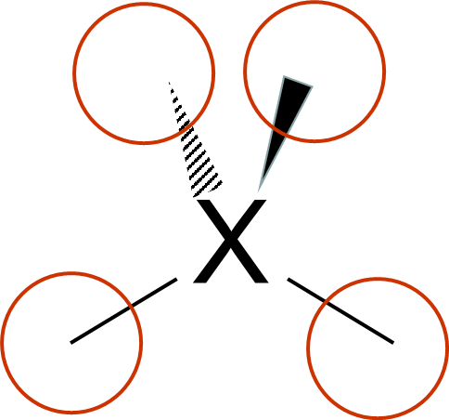
look at the corners of the geometry
tetrahedral
H
H
the same
corners are _____
so, __________
NOT polar
C
H
H
H
H
N
H
different
corners are _____
so, __________
O
polar
corners are _____
so, __________
different
H
H
polar

Slide 30
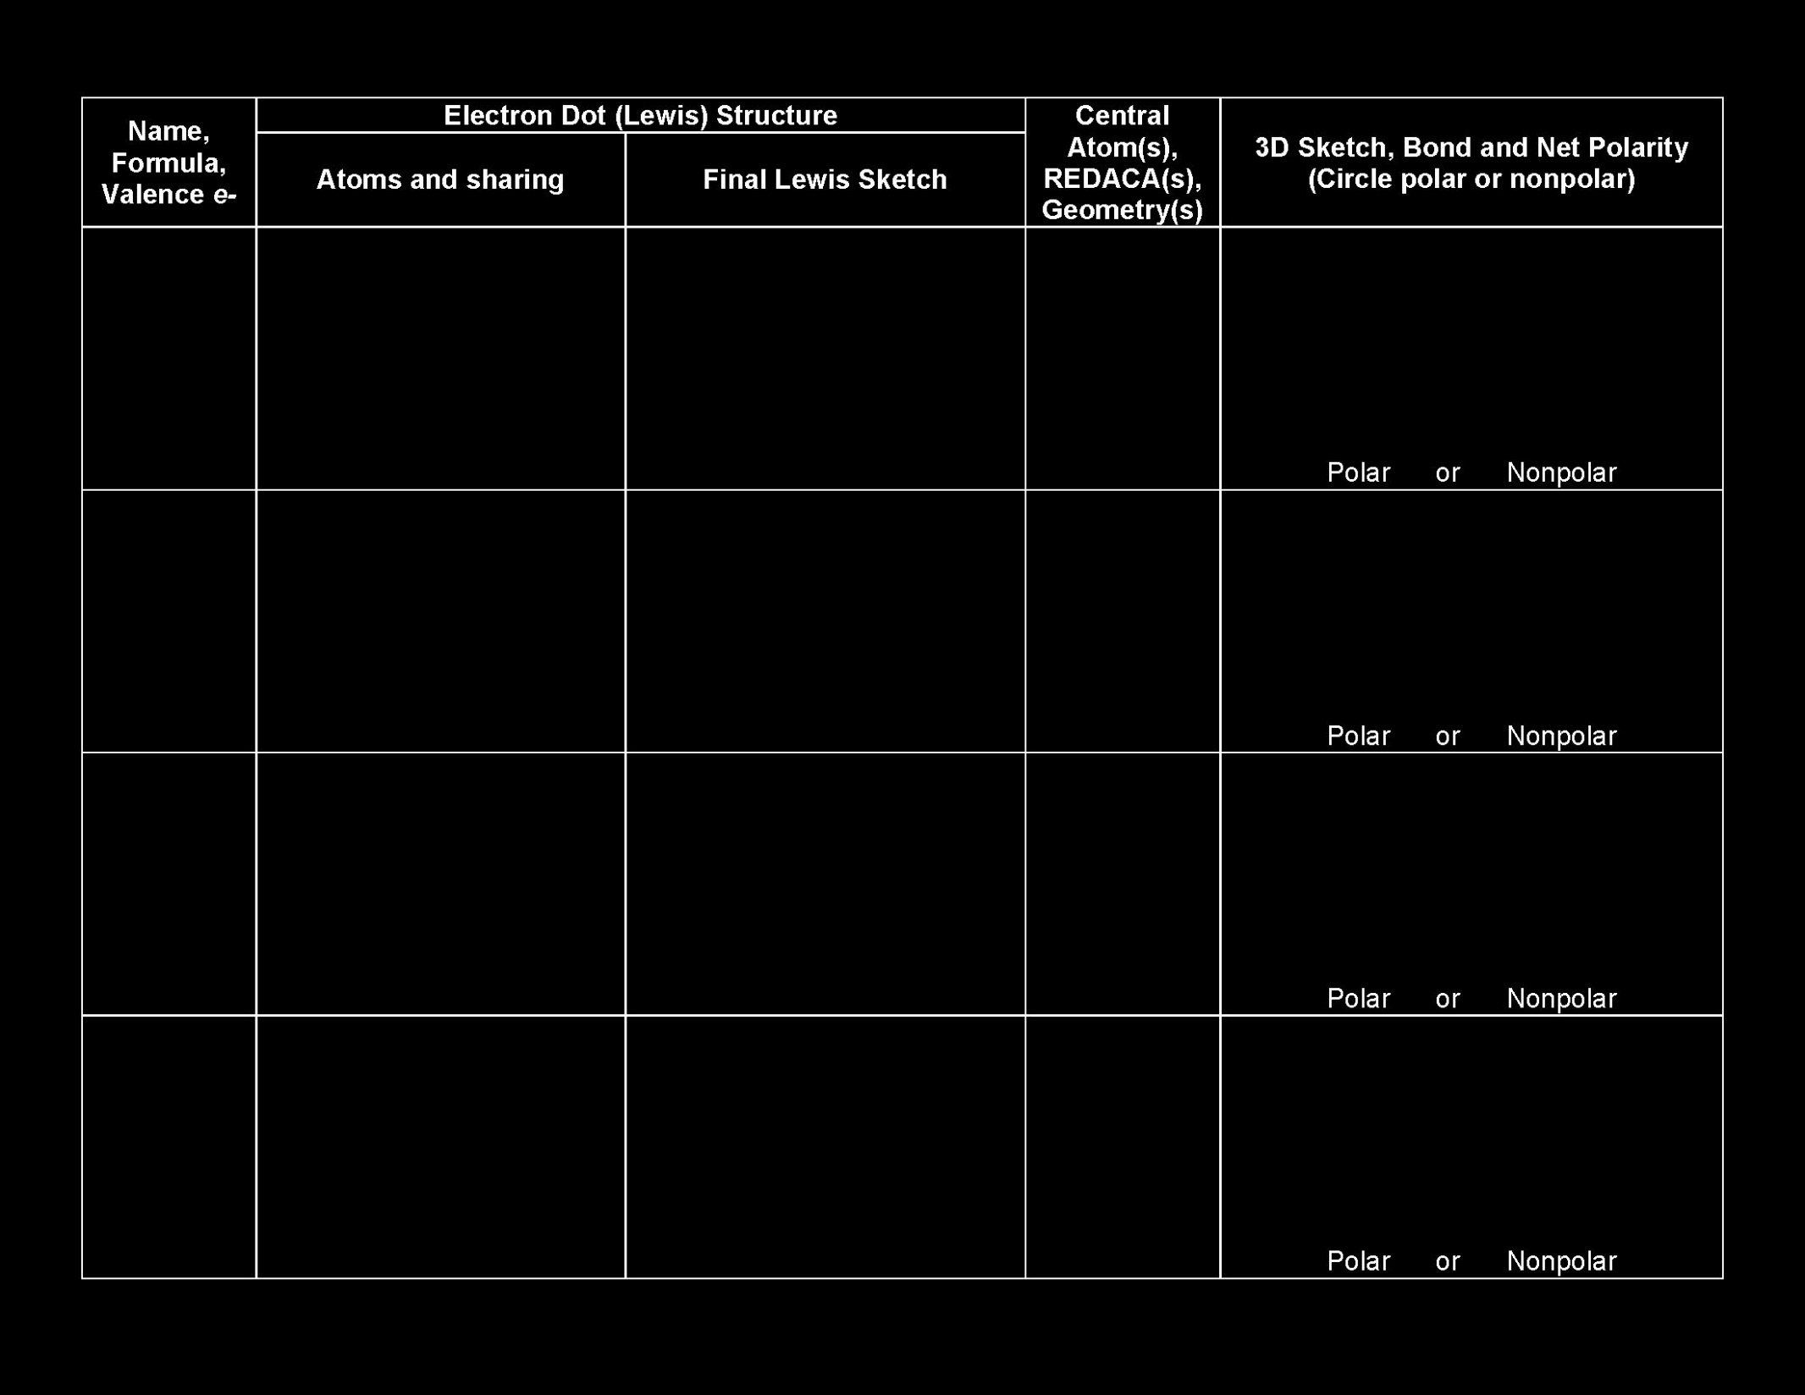

Slide 31
H5P2
H5P3
Part 3….

Slide 32
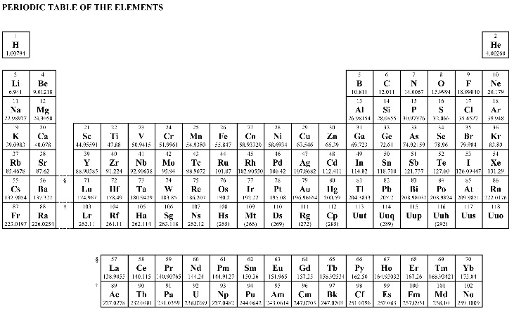
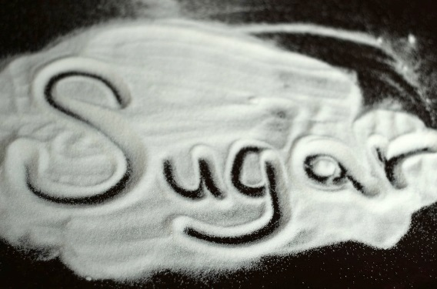
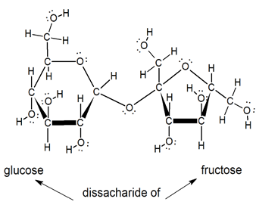
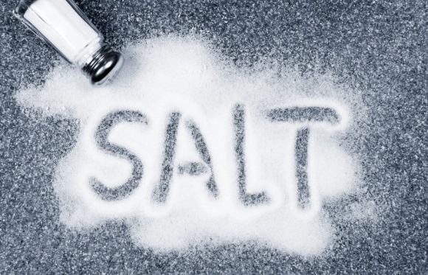
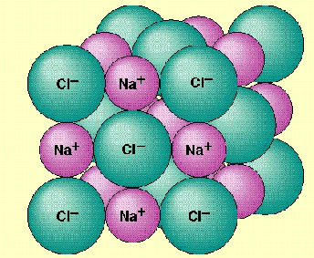
BIG Molecules and Ionic Substances
molecules ….
nonmetals to nonmetals – covalent bonds
electrons shared
ionic substances ….
metals to nonmetals – ionic bonds
electrons transferred

Slide 33
some of the components of gasoline
key component of the cell membrane
phospholipid ___________________________
(phosphatidyl choline)

Slide 34
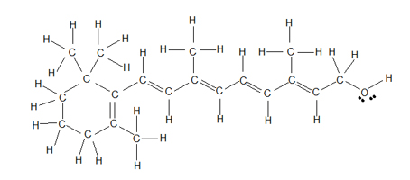
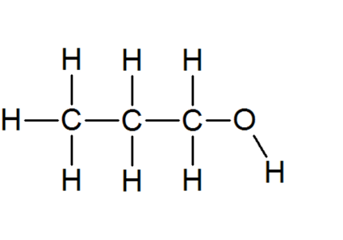
soap particle (sodium stearate)
Vitamin A
isopropanol

Slide 35
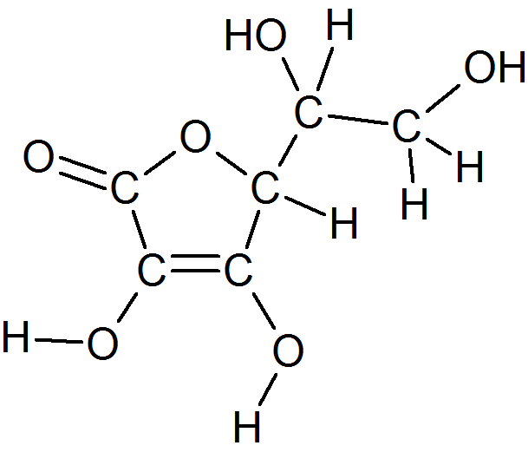
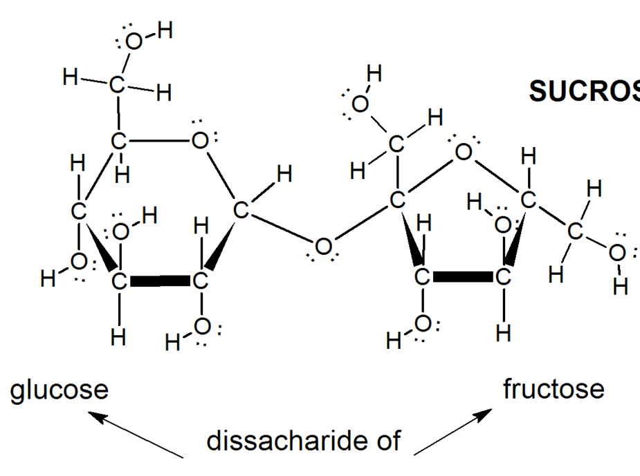
Vitamin C
Sucrose

Slide 36
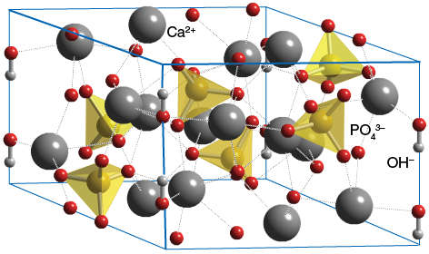
Sodium Chloride ______________
common table salt
Hydroxyapaptite _________________
2[Ca]²⁺[PO₄]³⁻[OH]⁻
bone and teeth

Slide 37
more than
3 central atoms…
BIG Molecules (_______________________)
nonmetal to nonmetal
CH group(s)
nonpolar
the greater abundance of CH’s,
the more nonpolar the whole molecule
hydrocarbons
O and OH group(s)
polar
the greater abundance of O’s and OH’s,
AND the more distributed throughout the structure
the more polar the whole molecule
Both CH and O / OH
BIG molecules can have regions that are polar
and regions that are nonpolar
CH region = non-polar
O / OH region = polar
the CH and O/OH regions are separated

Slide 38
Ionic Structures (_______________________)
metal to nonmetal
Ionic
electrons are transferred… from _______ to ________
so,
get ___________
_______________________________
_______________________________
degrees of ___________________
mildly extreme (NaCl)
extreme
super duper extreme (Al₂O₃)
metal
nonmetal
positive ions and negative ions
fully charged particles
Extremely “polar”
Extremely “polar”
depends on
the charges on
the ions
and complexity
of structure
color code the structures…
CH | O / OH | ionic

Slide 39
nonpolar
some of the components of gasoline
regions of CH
and O
are separated
….both
BUT… preponderance of CH… more nonpolar
key component of the cell membrane
phospholipid ___________________________
(phosphatidyl choline)

Slide 40
nonpolar and ionic (polar)
soap particle (sodium stearate)
Vitamin A
both
but…
more nonpolar

Slide 41
Vitamin A
both
but…
more nonpolar
regions of CH
and O/OH
are separated
….both
AND… “not too much” of CH…
….both
isopropanol

Slide 42
Vitamin C
both CH and O regions…
the O regions are distributed throughout…
so,
polar
Sucrose

Slide 43
ionic (polar)
Sodium Chloride ______________
common table salt
Hydroxyapaptite _________________
2[Ca]²⁺[PO₄]³⁻[OH]⁻
bone and teeth
ionic (polar)

Slide 44
Tug of war Each finger represents an electronegativity of 0.1
So if one end of the rope is flourine then you would have 4 people
using all 10 fingers
4.0/0.1 = 40 fingers
Carbon EN = 2.5
you would have 2 people using two hands,
and one additional person using one hand
Hydrogen EN = 2.1
two people using both hands,
and a third person using just one finger.
Distribute the rope based on a 2D representation of the molecule

Slide 45
δ+
δ-
O
C
O
δ-

