Slide 1
We Finally Have all the pieces!!!!
What an ion is!
Why water is happy at H₂O!
What an atom is!
How water is polar and what that means in terms of how water dissolves other things!
What a watershed is!
What covalent and ionic bonds are!
Now why was that all important?
How does it effect your community?

Slide 2
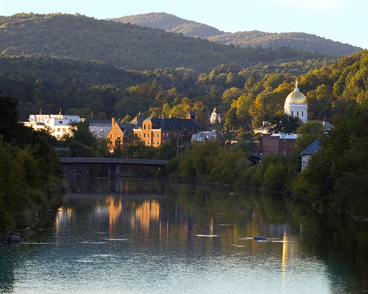
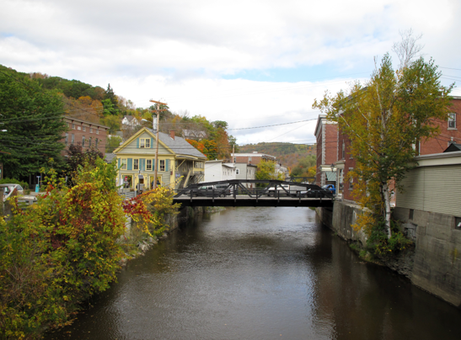
We live her, work here, play here and all of those actions take a toll on the river...
what can we do to make our impact less?

Slide 3
Water Quality
… the chemical, physical, biological, and radiological characteristics of water.
It is a measure of the condition of water relative to the requirements of one or more biotic species and or to any human need or purpose.
It is most frequently used by reference to a set of standards against which compliance, generally achieved through treatment of the water, can be assessed. The most common standards used to assess water quality relate to health of ecosystems, safety of human contact, and drinking water.
- what “stuff” is in the water
- how much is there of that “stuff”
- is that “stuff” at that level hazardous to humans and/or other species
if that “stuff” can be hazardous at some level, we call it a _______________
pollutant

Slide 4
Water Quality
- what “stuff” is in the water
- how much is there of that “stuff”
- is that “stuff” at that level hazardous to humans and/or other species
if that “stuff” can be hazardous at some level, we call it a ________________
pollutant
What water are we talking about? __________________________
Where’s this water ? ________________________________
Where’s not this water? ______________________________
__________________________________________
drinking water / habitat water
rivers, lakes, oceans, ground water
ice caps (solid), glaciers (solid),
atmosphere (gas)

Slide 5
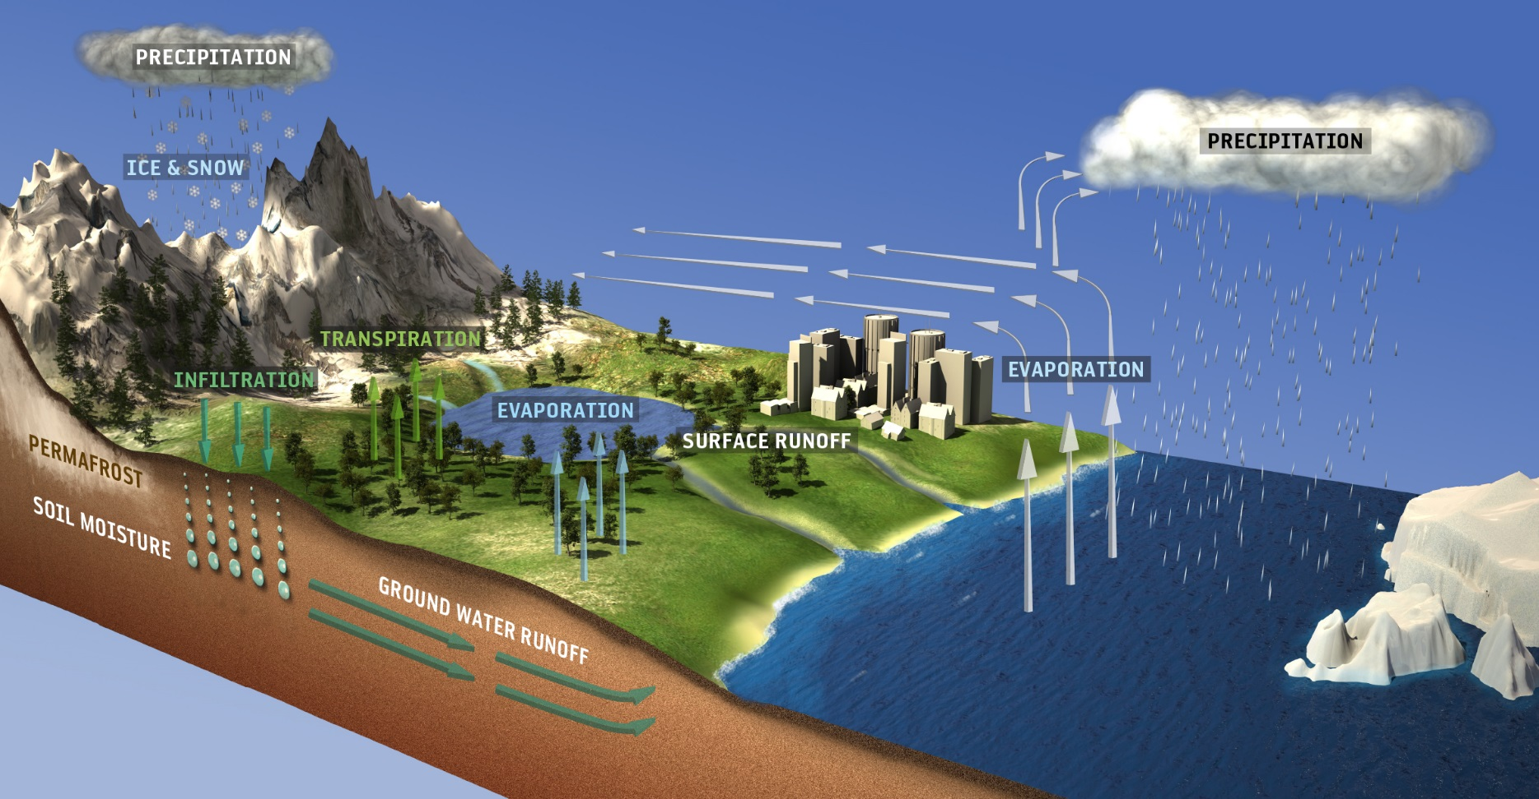
Water Quality
- what “stuff” is in the water
- how much is there of that “stuff”
- is that “stuff” at that level hazardous to humans and/or other species
What water are we talking about? __________________________
Where’s this water ? ________________________________
Where’s not this water? ______________________________
__________________________________________
drinking water / habitat water
rivers, lakes, oceans, ground water
ice caps (solid), glaciers (solid),
atmosphere (gas)

Slide 6
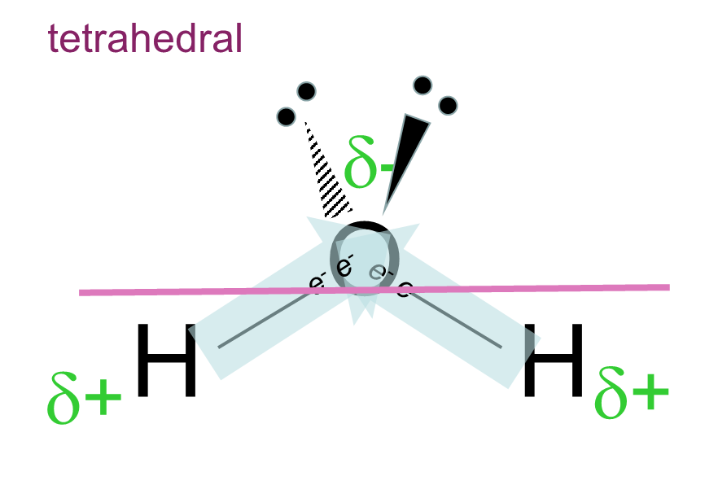
Water Quality
- what “stuff” is in the water
- how much is there of that “stuff”
- is that “stuff” at that level hazardous to humans and/or other species
What determines how much of the “stuff” can be in the water?
clue… three words _____________________________
based on what property? _______________________
water is ____________________
so “stuff” that is ___________ will dissolve best in water
and “stuff” that is ____________ will not dissolve much in water
Like Dissolves Like
polarity
polar
polar
not polar
max in
100 g of water
POLAR
nitrates (NO₃)⁻, ex: sodium nitrate Na(NO₃) | 90 grams
phosphates (PO₄)³⁻, ex: sodium phosphate Na₃(PO₄) | 10 grams
any acid, ex: sulfuric acid (acid rain) H₂SO₄ | any amount

Slide 7
Water Quality
What determines how much of the “stuff” can be in the water?
clue… three words _____________________________
based on what property? _______________________
water is ____________________
so “stuff” that is ___________ will dissolve best in water
and “stuff” that is ____________ will not dissolve much in water
Like Dissolves Like
polarity
polar
polar
not polar
max in
100 g of water
POLAR
nitrates (NO₃)⁻, ex: sodium nitrate Na(NO₃) | 90 grams
phosphates (PO₄)³⁻, ex: sodium phosphate Na₃(PO₄) | 10 grams
any acid, ex: sulfuric acid (in acid rain) H₂SO₄ | any amount
max in
100 g of water
NON POLAR
oxygen, O₂ | 0.001 grams
carbon dioxide, CO₂ | ~0.001 grams
gasoline (hydrocarbon mixture), ex: C₈H₁₈ | 0.00007 grams

Slide 8
Water Quality
What determines how much of the “stuff” is safe to be in the water?
_________________________
plant and animal physiology
link
is the substance directly toxic?
does it lead to conditions that produce undesirable effects?
ex: algae blooms…
link to EPA drinking water standards
link to toxicity of gasoline
link to phosphate considerations
max in
100 g of water
“desirable” in
100 g of water
POLAR
nitrates (NO₃)⁻, ex: sodium nitrate Na(NO₃) | 90 grams | 0.001 gram
phosphates (PO₄)³⁻, ex: sodium phosphate Na₃(PO₄) | 10 grams | 0.00001 gram
any acid, ex: sulfuric acid (in acid rain) H₂SO₄ | any amount | 0.0001 gram
max in
100 g of water
“desirable” in
100 g of water
NON POLAR
oxygen, O₂ | 0.001 grams | the max
carbon dioxide, CO₂ | ~0.001 grams | the max
gasoline (hydrocarbon mixture), ex: C₈H₁₈ | 0.00007 grams | none

Slide 9
Water Quality
What determines how much of the “stuff” is safe to be in the water?
_________________________
plant and animal physiology
link
is the substance directly toxic?
does it lead to conditions that produce undesirable effects?
ex: algae blooms…
max in
100 g of water
“desirable” in
100 g of water
POLAR
nitrates (NO₃)⁻, ex: sodium nitrate Na(NO₃) | 90 grams | 0.001 gram
phosphates (PO₄)³⁻, ex: sodium phosphate Na₃(PO₄) | 10 grams | 0.00001 gram
any acid, ex: sulfuric acid (in acid rain) H₂SO₄ | any amount | 0.0001 gram
algae blooms
lowers pH
why is “desirable” low ?
why is “desirable” high ?
toxic
all life depends on…
max in
100 g of water
“desirable” in
100 g of water
NON POLAR
oxygen, O₂ | 0.001 grams | the max
carbon dioxide, CO₂ | ~0.001 grams | the max
gasoline (hydrocarbon mixture), ex: C₈H₁₈ | 0.00007 grams | none

Slide 10
Water Quality report for Montpelier’s drinking water
link to 2016 report
How does the “stuff” that is in the water
get into the water ?

Slide 11
Turn to your partner and answer these 3 questions.
What is stormwater runoff?
What pollutants can be transported in stormwater runoff?
What strategies have you seen that are used to move or collect stormwater runoff?
Class Ideas-Share out your small group brainstorms

Slide 12
Turn to your partner and answer these 3 questions.
What is stormwater runoff?
What pollutants can be transported in stormwater?
\
What strategies have you seen that are used to move or collect stormwater runoff?

Slide 13
Point Source Pollution: direct discharge into water

Slide 14
Non-Point Source Pollution: indirect discharge into water.

Slide 15
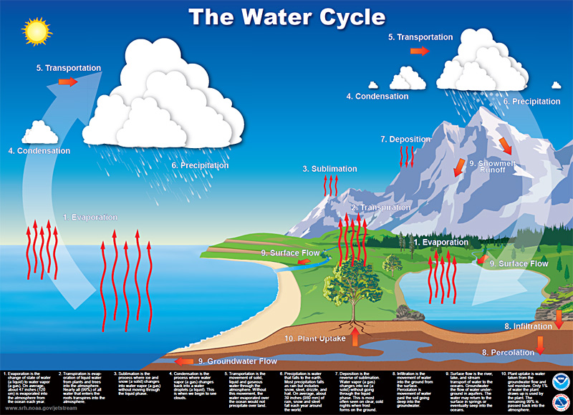
Think about the water cycle...
what aspects of the water cycle can we (humans)
slow down
or
speed up
to reduce non-point source pollution?
slow down: runoff
speed up: infiltration, plant uptake

Slide 16
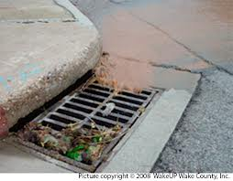
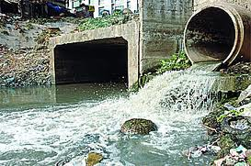
Gray Stormwater Infrastructure:
Pipes, catch basins and stormdrains that collect stormwater and discharge it, untreated, into waterbodies.
What are the effects of gray stormwater infrastructure on water quality?

Slide 17
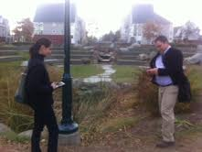
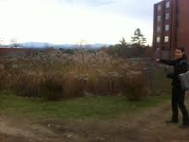
Green Stormwater Infrastructure:
Uses infiltration, evapotranspiration, storage and reuse to reduce runoff and/or help remove pollutants from runoff.
What are the effects of green stormwater infrastructure on water quality?

Slide 18
Three Green Stormwater Infrastructure Concepts
1. Infiltration
2. Evapotranspiration
3. Storage & Reuse
Green Stormwater Infrastructure Concept:
What is it?
Why does it work?
What methods are used to apply this concept to stormwater
management (Putting the concept to work)?

Slide 20
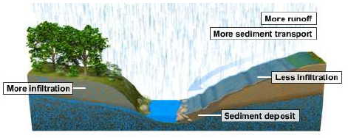
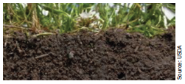
Infiltration

Slide 21
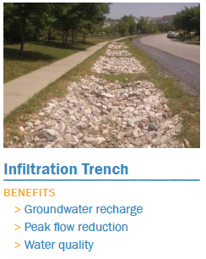
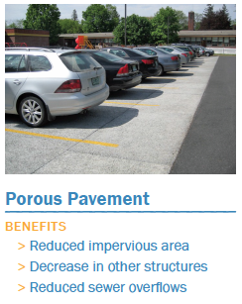
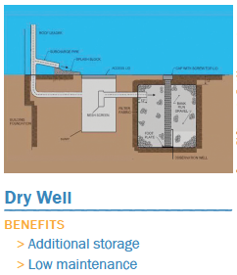

Slide 22
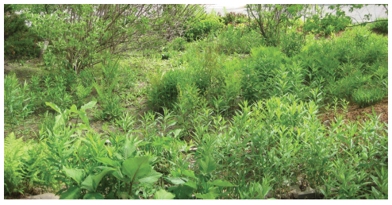
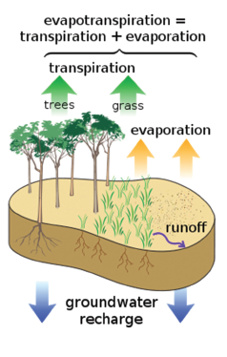
Evapotranspiration

Slide 23
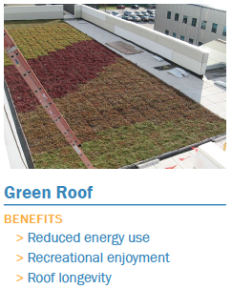
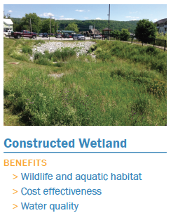
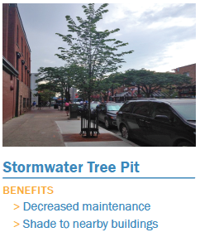

Slide 24
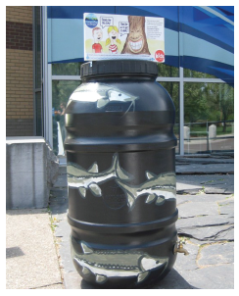
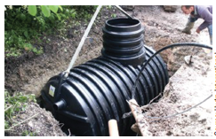
Storage and Reuse

Slide 25
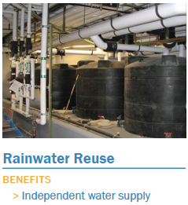

Slide 26
tetrahedral
δ-
O
e⁻ e⁻
e⁻ e⁻
H
H
δ+
δ+

