Slide 1
Toni
she/her
curious
Blackboard
1 2
3 4
1
2
1
2
1 2
3 4
3
4
3
4
1 2
3 4

Slide 2
21Sc
Scandium
53I
Iodine
119E
Excitedium
7N
Nitrogen
58Ce
Cerium
53I
Iodine
16S
Sulfur
9F
Fluorine
92U
Uranium
7N
Nitrogen

Slide 3
Agenda:
Welcome
A few policy details…
Share….
Start with Geosphere…
ATTENDANCE
COURSE OVERVIEW
Course Description
Marking Period Units

Slide 4
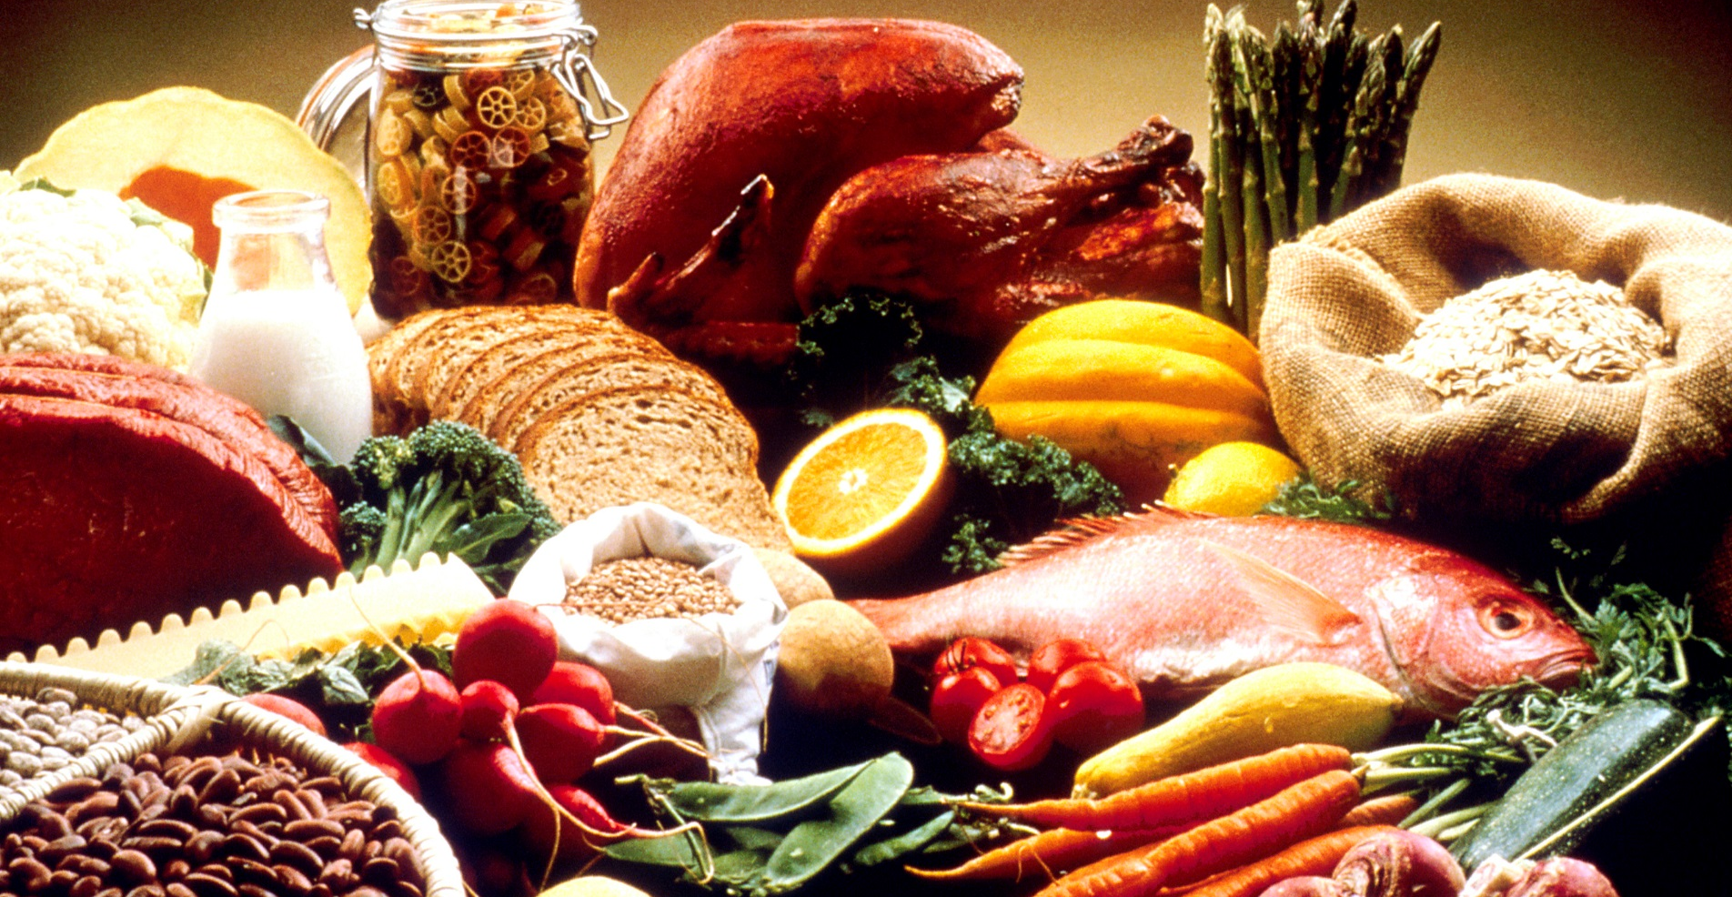
FOOD Policy
NO FOOD….
….. it’s the law
(drinks OK)

Slide 5
Cell Phone (usage) Free Zone
into the room, cell phone into your backpack…
if it is out… (2 options)
- place it lovingly into my hand
- off to the planning room

Slide 6
HOMEWORK
assignments posted on white board
and,
MHS Integrated Science website (mhsis.weebly.com)
date = date posted
due date = next day we meet
UNLESS otherwise posted
so, for “tomorrow”…
late work…
accepted up until the “dead dead line” (typically, EOMP)

Slide 7
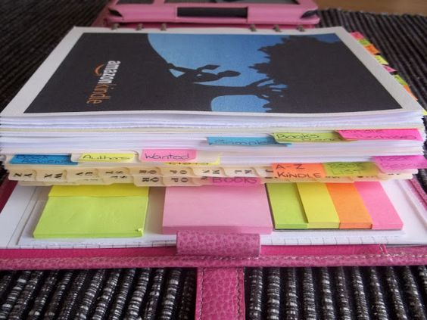
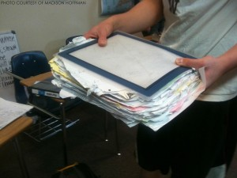
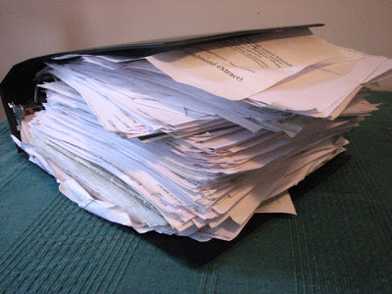
BINDER / NOTEBOOK
- you are expected to keep a binder for class (~2”)
- becomes your primary source of information for the course
- it will only serve you if it is
organized
complete

Slide 8
Grading Practices
A’s B’s C’s ….
1 2 3 4
Got It …. Not So Much
100 90 80 70 …
grading practices

Slide 9
Share….
1. Write your name (first and last) on the paper
AND
2. a brief (like a few words brief) response to:
What does Integrated Science mean to you?
(‘integrated’ or ‘science’ or ‘integrated science’)

Slide 10
integrated
done
science
done
integrated science
done

Slide 11
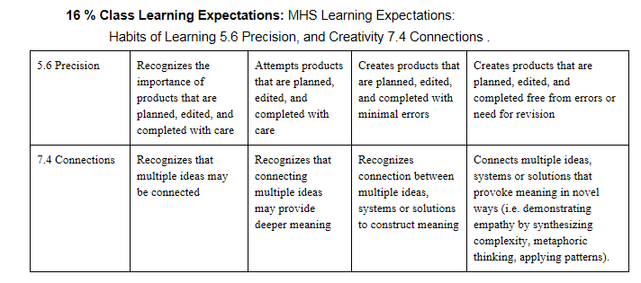
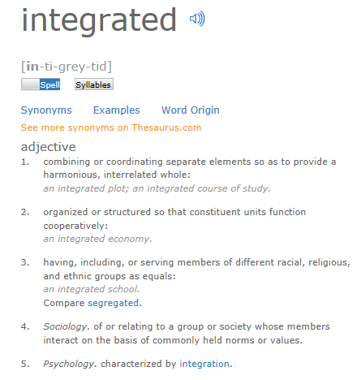
What does Integrated Science mean to you?
(‘integrated’ or ‘science’ or ‘integrated science’)

Slide 12
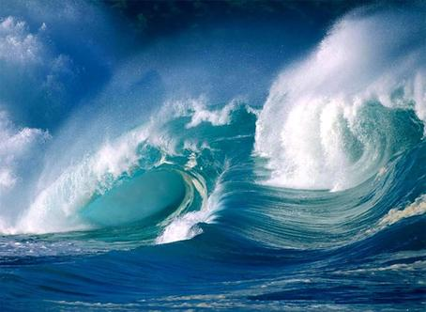
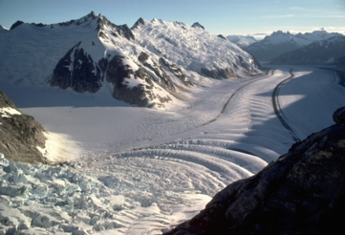
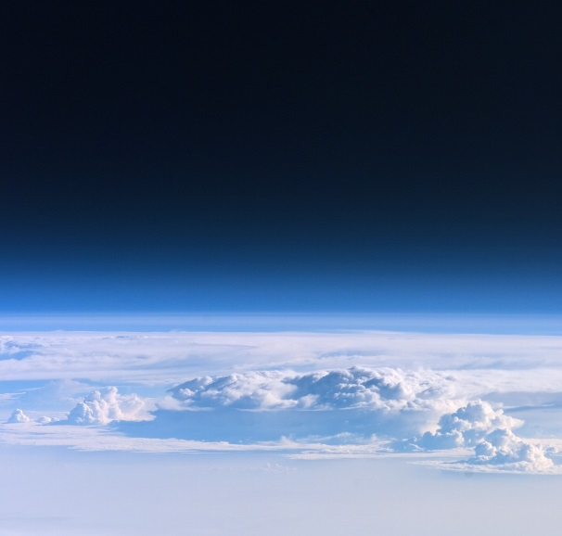
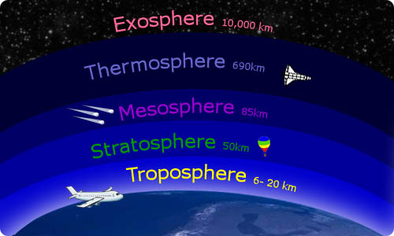
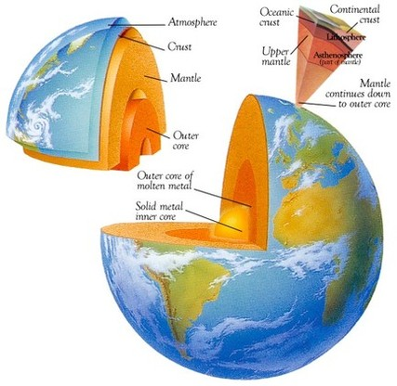
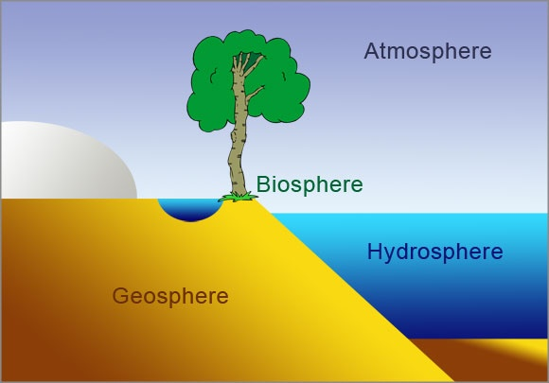
Explore the disciplines of science
(Physics, Chemistry, Astronomy, Geology, Biology)
through studying
with an underlying theme of Environmental Science
and a focus on
the connections between these systems
and the Greenhouse Effect
the Hydrosphere
the Atmosphere
the Geosphere
the Biosphere

Slide 13
Explore the disciplines of science
(Physics, Chemistry, Astronomy, Geology, Biology, Environmental Science)
We’ll start with…..
the Geosphere
the goal (standard)
assessed on … (scales)

Slide 14
first…
explore/review the Rock Cycle…
types of rocks
and how they form
where are these rocks? ___________
what is a ‘rock’
__________________________________________
______________________________________________
examples: ________________________________
mineral
_________________________________________________
_________________________________________________
_________________________________________________
three classifications (categories) of rocks
_______________________________________________
(notesheet)
form the crust of Earth
any natural material, hard or soft,
having a distinct mineral composition,
categorized by how it forms
soil is not a mineral/rock because it is composed of decomposed organic matter.
solid inorganic (not living, or composed of once living matter) substance of natural occurrence,
has a crystalline structure
sedimentary, metamorphic, igneous

Slide 15
first…
explore/review the Rock Cycle…
types of rocks
and how they form
where are these rocks? ___________
what is a ‘rock’
__________________________________________
______________________________________________
what do rocks “do” for us?
form the crust of Earth
any natural material, hard or soft,
having a distinct mineral composition,
categorized by how it forms

Slide 16
first…
explore/review the Rock Cycle…
types of rocks
and how they form
where are these rocks? ___________
what is a ‘rock’
__________________________________________
______________________________________________
how did these rocks come to be?
how old? how young?
form the crust of Earth
any natural material, hard or soft,
having a distinct mineral composition,
categorized by how it forms

Slide 17
first…
explore/review the Rock Cycle…
types of rocks
and how they form
where are these rocks? ___________
what is a ‘rock’
__________________________________________
______________________________________________
___________________________________________
how did these rocks come to be?
how old? how young?
_____________________________________________________
so,…. as we go through this year in Integrated Science, we will be looking at
changes on Earth that happened from early Earth (4 billion years ago) to now…
to help keep these events in perspective,
construct a to-scale timeline…
form the crust of Earth
any natural material, hard or soft,
having a distinct mineral composition,
categorized by how it forms
NOTE… rocks that are here now,
are mostly not this old
from Earth first began to cool (4 billion ya) to now

Slide 18
exploring the Rock Cycle…
types of rocks
and how they form
http://www.learner.org/interactives/rockcycle/index.html
Fill in the handout…
and,
respond to the question regarding the role of water
in the Rock Cycle
IF… you happen to finish,
1. identify the types of rocks at the lab bench
2. cut out the cut-and-paste activity… pieces into envelope

Slide 19
let’s take a few minutes to think about …
link

Slide 20
integrated
done
science
done
integrated science
done

Slide 21
integrated
done
science
done
integrated science
done

Slide 22
integrated
done
science
done
integrated science
done

Slide 23
integrated
done
science
done
integrated science
done

Slide 24
Toni
she/her
curious
1 2
3 4
5 6
4
3
1 2
4
3
3 4
5 6
1 2
3 4
2
1
2
1
Blackboard

Slide 25
Blackboard
Toni
she/her
curious
2
1
2
1
3 4
1 2
4
3
1 2
4
3
4 5 6
3 4 5
1 2 3

