Slide 1
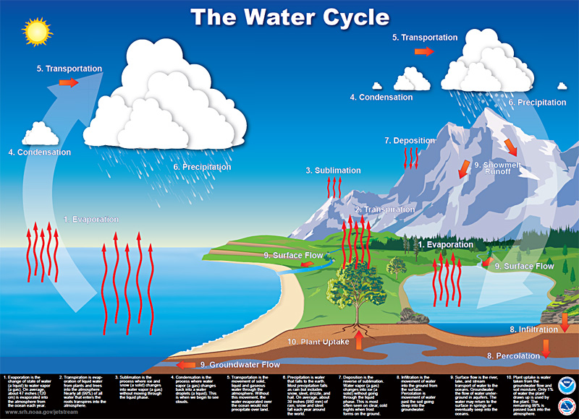
Transportation
Transportation
Condensation
Precipitation
Deposition
Condensation
Precipitation
Sublimation
Melting
Freezing
Transpiration
Evaporation
Evaporation
Surface Flow
Surface Flow
Infiltration
Plant Uptake
Groundwater Flow
Percolation

Slide 2
Earth’s T
Transportation
Clouds
Condensation
Precipitation
-
Condensation
Precipitation
Melting
Vapor
Freezing
+
Transpiration
Evaporation
Evaporation
Surface Flow
Ice Caps
Lakes, Ponds, Rivers
Oceans
Infiltration
Plant Uptake
Groundwater Flow
Percolation

