Slide 1
transportation
5.
transportation
3.
condensation
6.
7.
precipitation
deposition
18.
condensation
2.
precipitation
4.
sublimation
17.
surface runoff
8.
transpiration
14.
evaporation
10.
evaporation
channel runoff
16.
9.
channel runoff
11.
infiltration
plant uptake
13.
percolation
12.
infiltration
15.

Slide 2
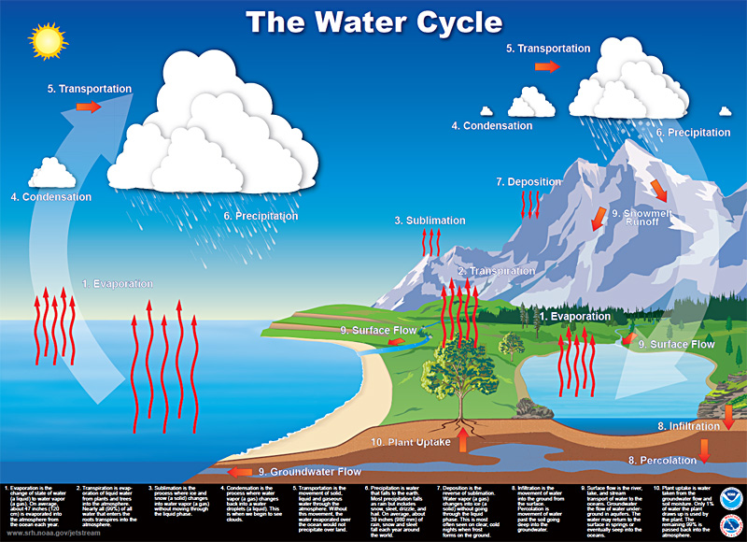
Transportation
System Model….
this picture is a system model….
BUT
we want to re-represent this diagram using standard symbols…
be explicit about the relevant components (stocks) of the system
their form and place
AND
be explicit about the processes (flows) that move the components
from form to form
and/or
from place to place
remove (or be able to remove) the “pretty” background
Transportation
Condensation
Precipitation
Deposition
Condensation
Precipitation
Sublimation
Melting
Freezing
Transpiration
Evaporation
Evaporation
Surface Flow
Surface Flow
Infiltration
Plant Uptake
Groundwater Flow
Percolation

Slide 3
System Model….
this picture is a system model….
BUT
we want to re-represent this diagram using standard symbols…
be explicit about the relevant components (stocks) of the system
their form and place
AND
be explicit about the processes (flows) that move the components
from form to form
and/or
from place to place
remove (or be able to remove) the “pretty” background

Slide 4
Earth’s T
Transportation
Clouds
Condensation
Precipitation
-
Condensation
Condensation
Precipitation
Surface Flow
Vapor
+
Transpiration
Evaporation
Evaporation
Evaporation
Surface Flow
Surface Flow
Ice Caps
channel runoff
Lakes, Ponds, Rivers
Freezing
Melting
Oceans
Infiltration
Plant Uptake
Infiltration
Percolation

Slide 5
Earth’s T
Transportation
Clouds
Condensation
Precipitation
-
Condensation
Condensation
Precipitation
Surface Flow
Vapor
+
Transpiration
Evaporation
Evaporation
Evaporation
Surface Flow
Surface Flow
Ice Caps
channel runoff
Lakes, Ponds, Rivers
+
Freezing
Melting
Oceans
Infiltration
Plant Uptake
Infiltration
Percolation

Slide 6
Transportation
Transportation
Condensation
Precipitation
Deposition
Condensation
Precipitation
Sublimation
Surface Flow
Transpiration
Evaporation
Evaporation
Surface Flow
Channel Flow
Infiltration
Plant Uptake
Percolation
Infiltration

Slide 8
Transportation
Transportation
Condensation
Precipitation
Deposition
Condensation
Precipitation
Sublimation
Melting
Freezing
Transpiration
Evaporation
Evaporation
Surface Flow
Surface Flow
Infiltration
Plant Uptake
Groundwater Flow
Percolation

