Slide 1
Watershed
Hydro1&2 Intro_G4 Slide 4
to understand what is in the water…
…we need to understand where the water
comes from (and goes to)
To understand where the water comes from…
….we need to understand the land formations…

Slide 2
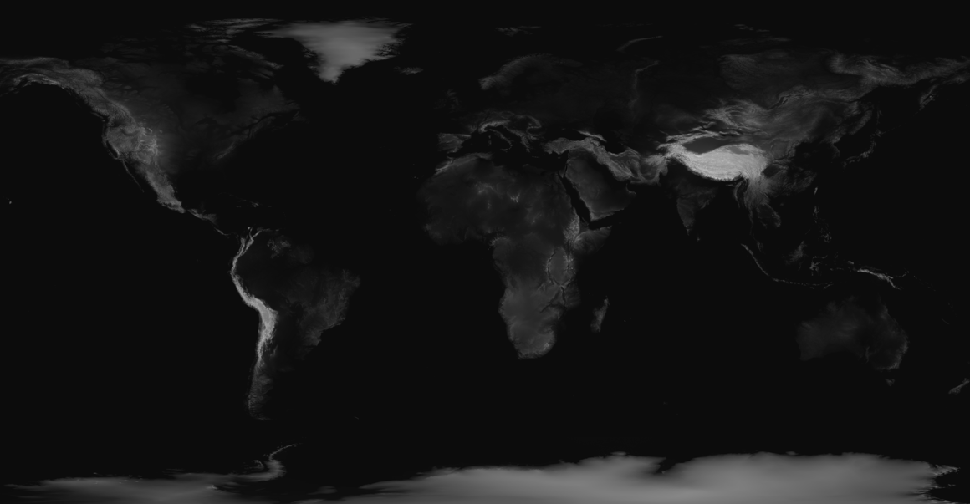
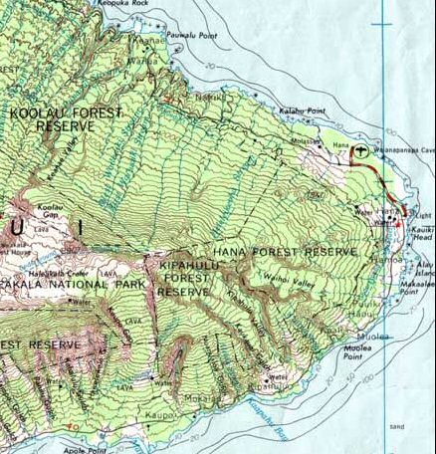
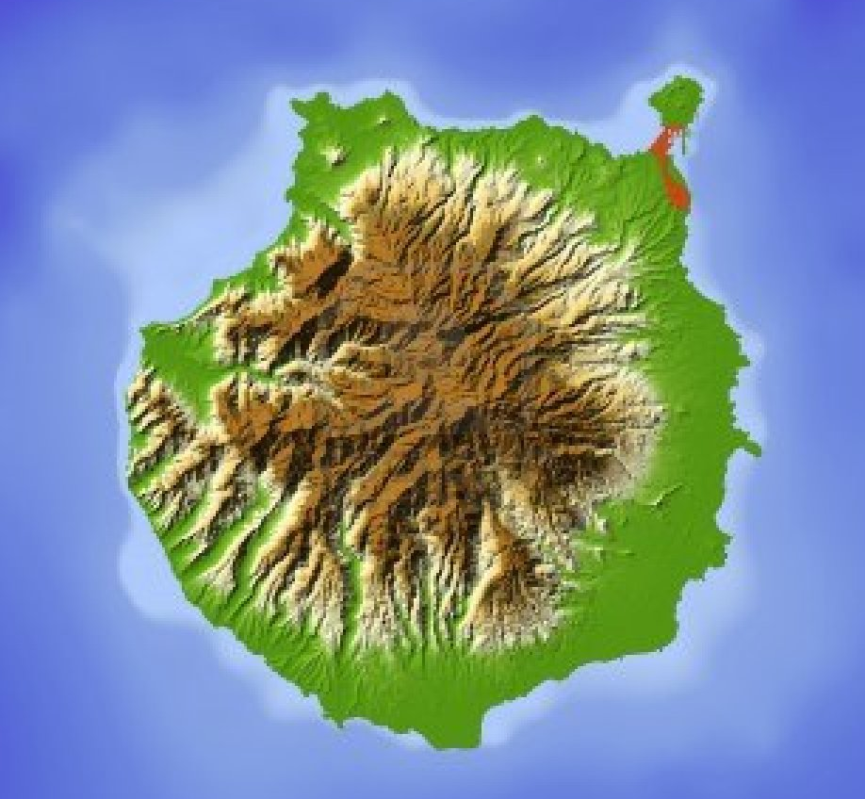
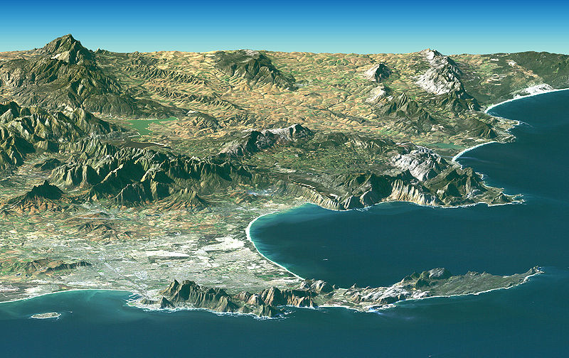
Ways to Represent Heights of Land
contour mapping

Slide 3
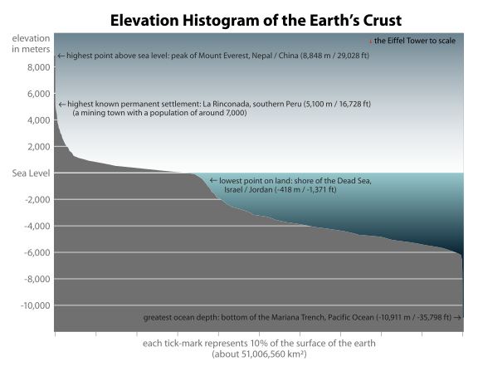
elevation _________________________________________
_________________________________________________
the elevation of a geographic location is its height above or below a fixed reference point, most commonly sea level
The elevation of a geographic location is its height above or below a fixed reference point, most commonly a reference geoid, a mathematical model of the Earth's sea level as an equipotential gravitational surface (see Geodetic system, vertical datum).
Elevation, or geometric height, is mainly used when referring to points on the Earth's surface,
while altitude or geopotential height is used for points above the surface, such as an aircraft in flight or a spacecraft in orbit,
and depth is used for points below the surface.

Slide 4
Let’s make some mountains out of Play-$ !!
and then represent them using
contour maps
and
cross sections

Slide 5
Contour maps
Vocabulary….
elevation
contour
contour map
contour interval
cross section

Slide 6
elevation _________________________________________
_________________________________________________
the elevation of a geographic location is its height above or below a fixed reference point, most commonly sea level
The elevation of a geographic location is its height above or below a fixed reference point, most commonly a reference geoid, a mathematical model of the Earth's sea level as an equipotential gravitational surface (see Geodetic system, vertical datum).
Elevation, or geometric height, is mainly used when referring to points on the Earth's surface,
while altitude or geopotential height is used for points above the surface, such as an aircraft in flight or a spacecraft in orbit,
and depth is used for points below the surface.

Slide 7
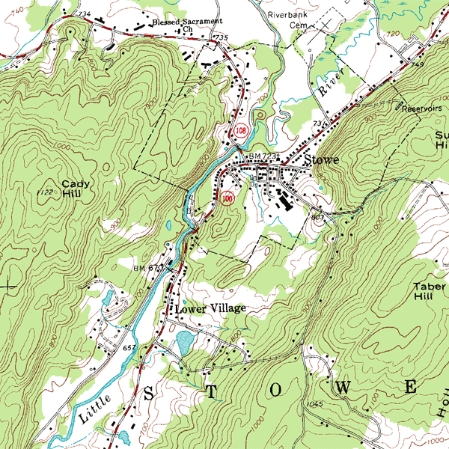
contour _________________________________________
_________________________________________________
in cartography, a contour line (often just called a "contour") joins points of equal elevation
contour map _________________________________________
_________________________________________________
a map illustrated with contour lines, (aka topographic map)
that shows terrain (valleys, cliffs, mountains, gulleys…)
contour interval _________________________________________
_________________________________________________
the difference in elevation represented by each contour line on a topographic map
Play-$ mountains
GoogleEarth Camel’s Hump

Slide 8
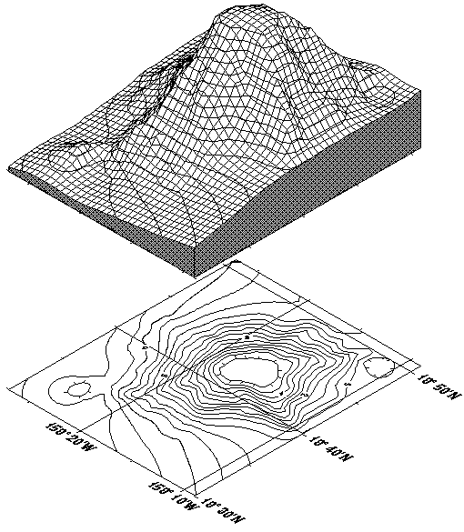
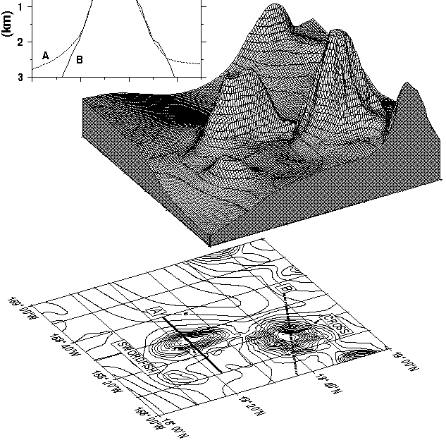
To make a contour map…
- find elevation at “each” point (surveyors)
- connect the neighboring points that are at the same elevation
= contour line

Slide 9
Contour Mapping
What do the lines represent?
Color?
Blue lines?

Slide 10
Below is a contour map of two hills.
Draw a cross section through the peaks.
Which is higher, hill A or hill B? _______
Which is steeper, hill A or hill B ? ________
How can you tell on the contour map?
______________________________
How many feet of elevation are there between
contour lines (contour interval) _________
How high is hill A? ____________
How high is hill B? ____________

Slide 11
Below is a contour map of two hills.
Draw a cross section through the peaks.
Which is higher, hill A or hill B?
_______
Which is steeper, hill A or hill B ?
________
How can you tell on the
contour map?
_______________________
How many feet of elevation are there
between contour lines (contour interval)
_________
How high is hill A? ____________
How high is hill B? ____________

Slide 12
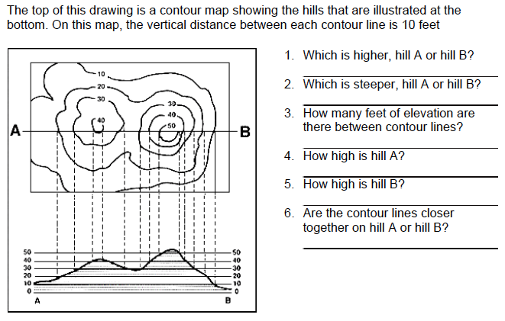
PRACTICE 1,2,3

Slide 13
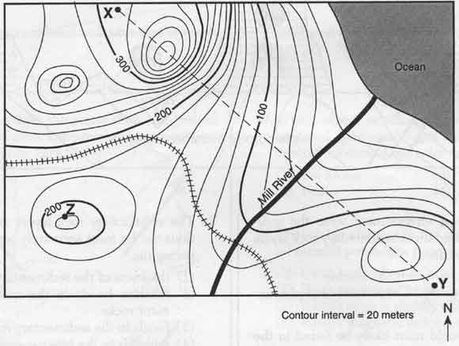
Interpreting Contour Maps
● recognize paths on contour maps for
○ going up
___________________________________________
○ going down
___________________________________________
○ staying at the same elevation
___________________________________________
cross contours, elevation increases
cross contours, elevation decreases
stay on a contour

Slide 14
Interpreting Contour Maps
● recognize patterns associated with contour lines
○ the closer the lines, the _____________ the land
○ the further the lines, the _____________ the land
steeper
flatter

Slide 15
Interpreting Contour Maps
● recognize patterns associated with contour lines
○ the closer the lines, the _____________ the land
○ peaks (high points) look like ____________
(careful... could be a low point - check the elevations)
steeper
land goes up
on all sides
smallest circles

Slide 16
Interpreting Contour Maps
● recognize patterns associated with contour lines
○ the closer the lines, the _____________ the land
○ peaks (high points) look like circles
(careful... could be a low point - check the elevations)
○ cliffs
- the contour lines are relatively _________ together
- the land is falling off __________
steeper
close
fast

Slide 17
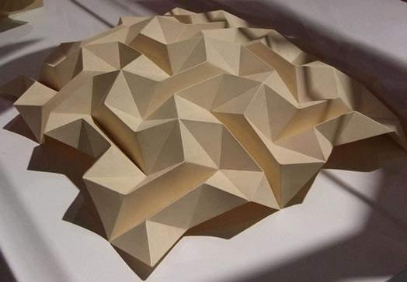
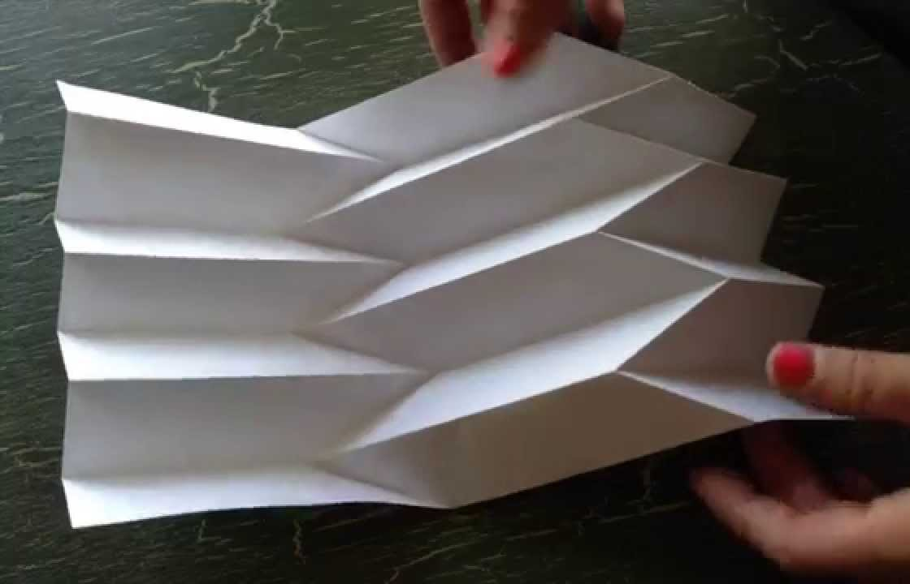
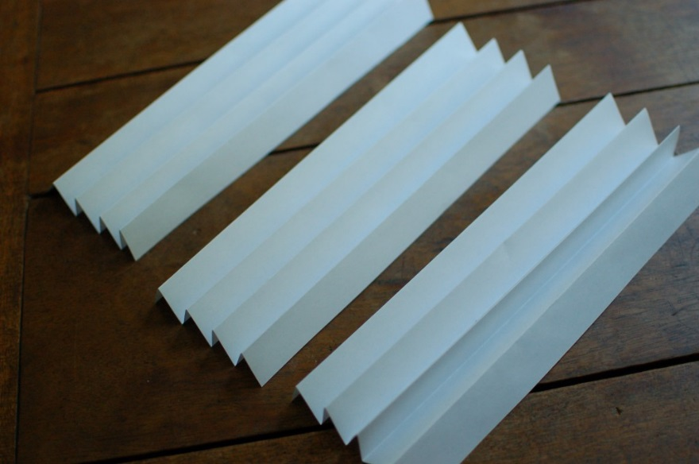
Interpreting Contour Maps
● recognize patterns associated with contour lines
○ the closer the lines, the _____________ the land
○ peaks (high points) look like circles
(careful... could be a low point - check the elevations)
○ cliffs
- the contour lines are relatively _________ together
- the land is falling off __________
○ ridges (an “up-fold” of land)
○ gullies (a “down-fold” of land)
steeper
close
fast
fold some paper

Slide 18
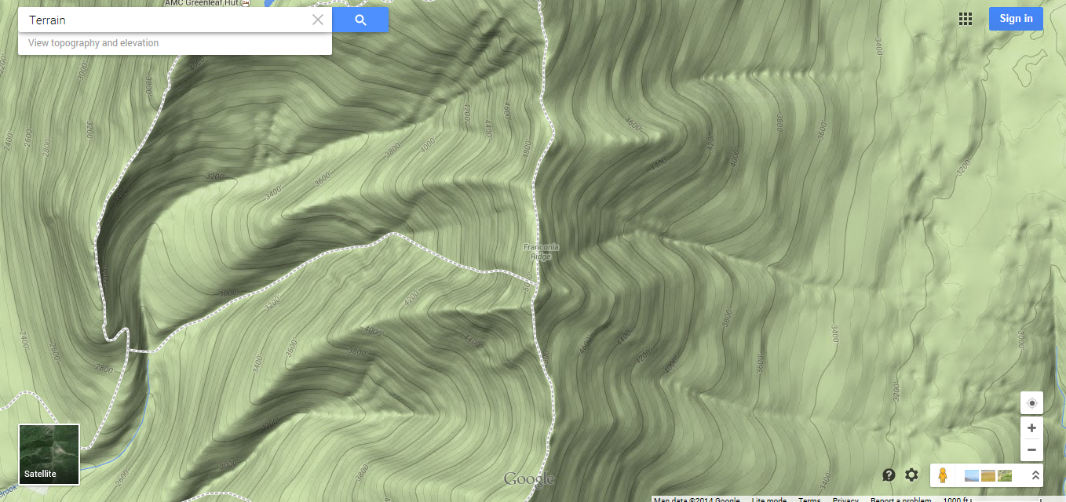
Franconia Ridge, White Mountains, NH

Slide 19
along a ridge, the contour lines
point away from the high point
along a gully, the contour lines
point towards the high point

Slide 21
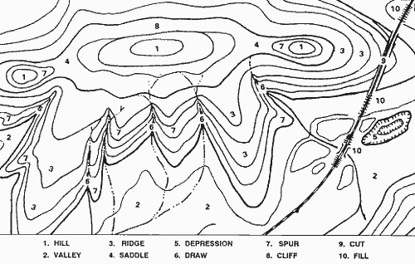

Slide 22
Interpreting Contour Maps
● recognize patterns associated with contour lines
○ the closer the lines, the _____________ the land
○ peaks (high points) look like circles
(careful... could be a low point - check the elevations)
○ cliffs
- the contour lines are relatively _________ together
- the land is falling off __________
○ ridges (an “up-fold” of land)
- the contour lines form
_______________________________________
- along the ridge,
the land is going down more ___________
than to the sides of the ridge
○ gullies (a “down-fold” of land)
- there must be two neighboring high points/ridges
- the contour lines between the high points will form
________________________________________
steeper
close
fast
wedges that point away from the high point
gradually
wedges that point towards the high point

Slide 23
Interpreting Contour Maps
● water will flow __________________
○ the water will flow ______
the _____________ path
like ____________ or ____________
○ the path of the water flowing downhill
will ________________ contour lines
downhill
down
steepest
over a cliff
down a gully
cut across

Slide 24
link to more contour maps….

