Slide 1
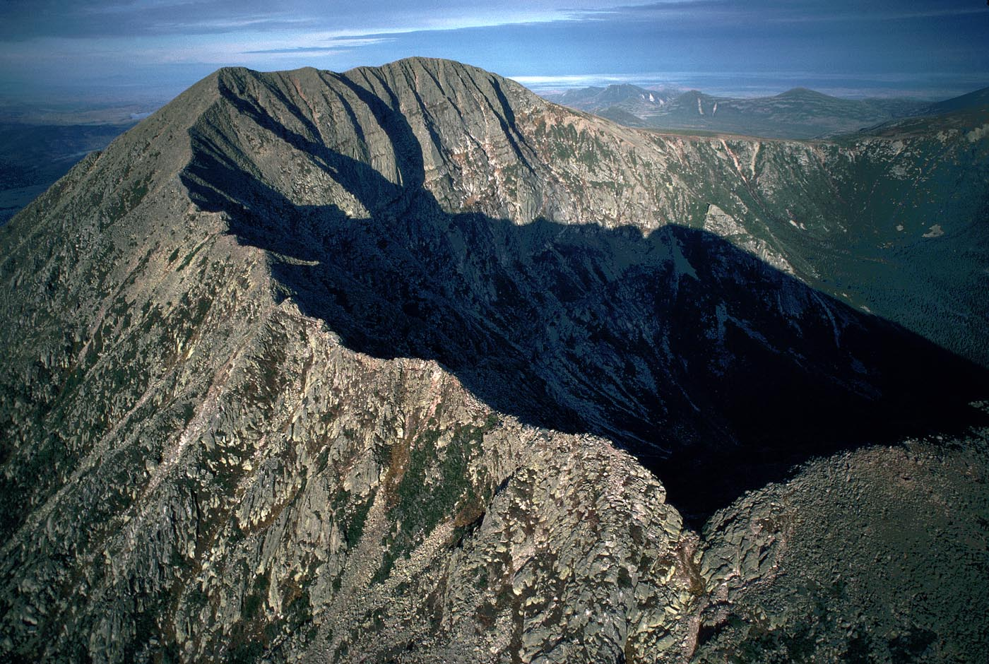
Geosphere 4 & 5
Principles of Geology…

Slide 2
Plates move
http://www.cbsnews.com/news/city-of-kathmandu-shifted-ten-feet-by-earthquake/

Slide 3
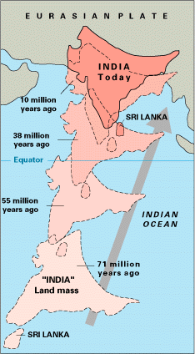
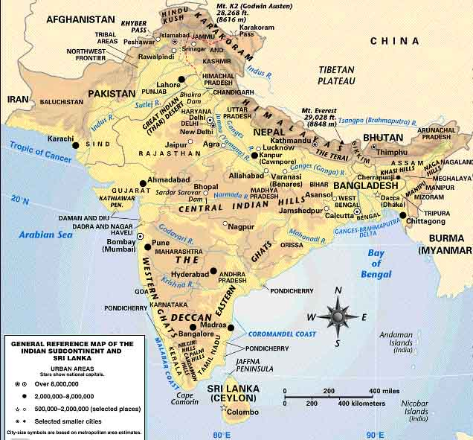
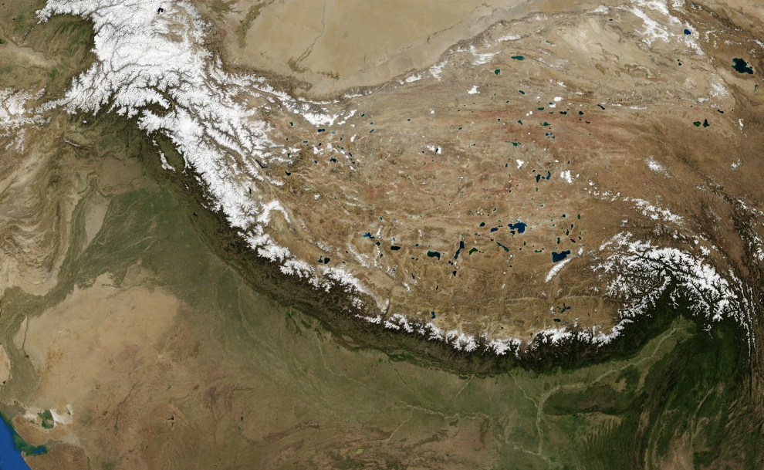
plates can move toward each other (convergent)
if both plates are continental,
this can create mountains
Himalayan Mountains
http://www.absorblearning.com/media/item.action;jsessionid=002DE84AF9EABA42D83251E5DBE8EDDE?quick=12p
http://www.geolsoc.org.uk/Plate-Tectonics/Chap3-Plate-Margins/Conservative/San-Andreas-Fault

Slide 4
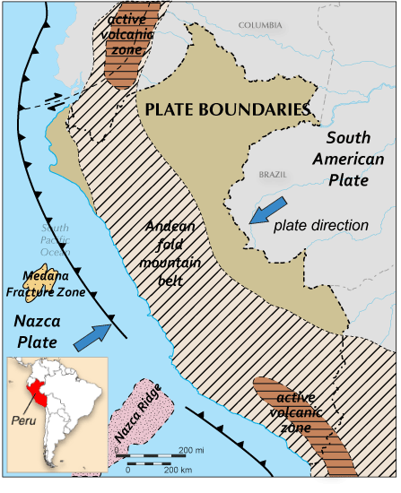
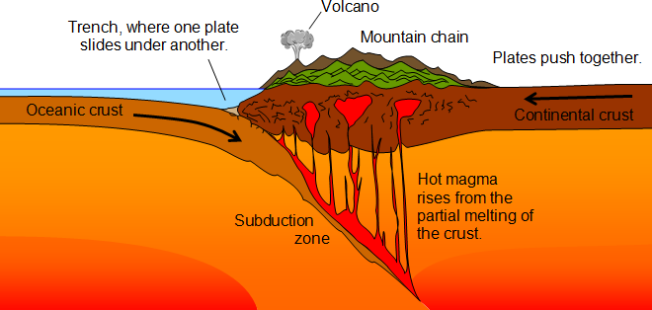
plates can move toward each other (convergent)
if both plates are continental,
this can create mountains
if one plate is oceanic, and the other is continental
the oceanic is pushed underneath the continental plate
and melts…. volcanoes!
Himalayan Mountains
trench
Andes Mountains
mountains
highs and lows

Slide 5
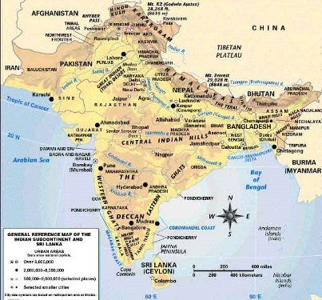
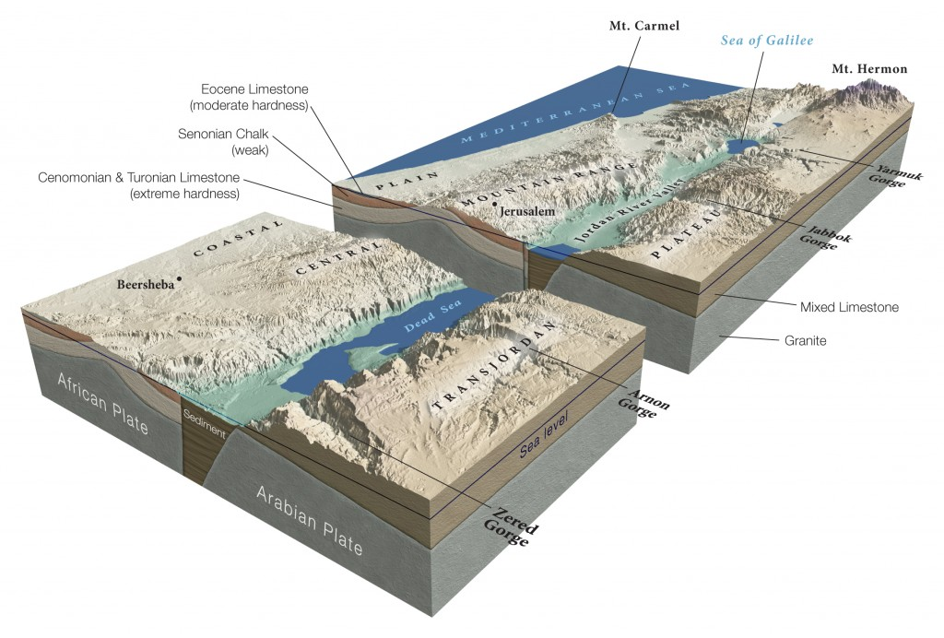
plates can move toward each other (convergent)
if both plates are continental,
this can create mountains
if one plate is oceanic, and the other is continental
the oceanic is pushed underneath the other plate and melts.
plates can move away from each other (divergent)
…. stretch and eventually may split (rift)
in continental plates this creates rift valleys
in oceanic plates this creates new sea floor (from cooling mantle)

Slide 6
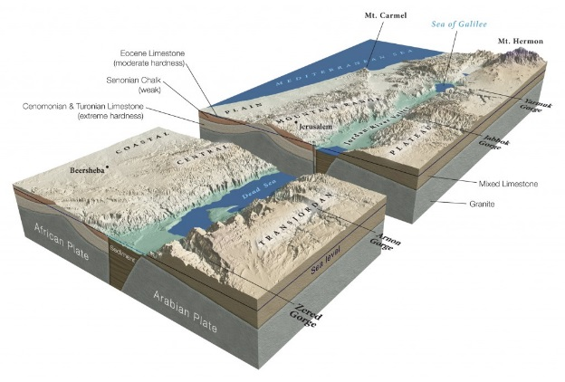
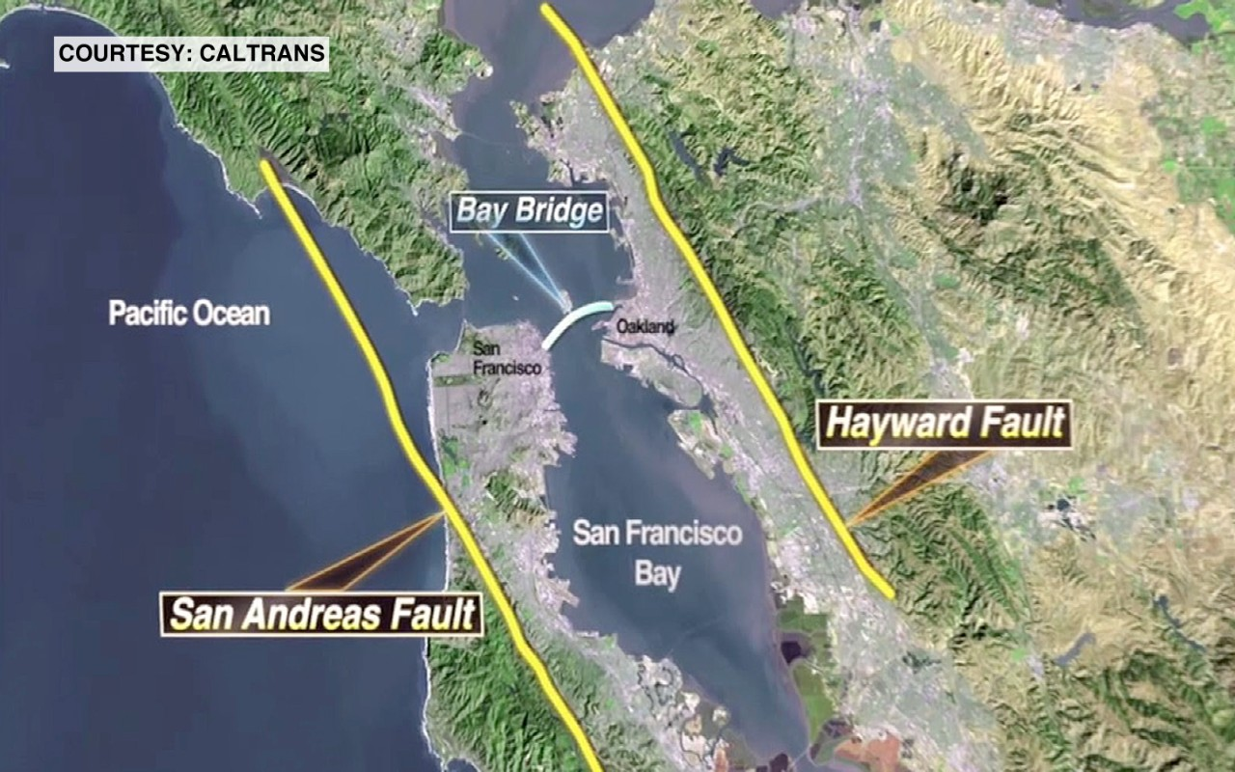
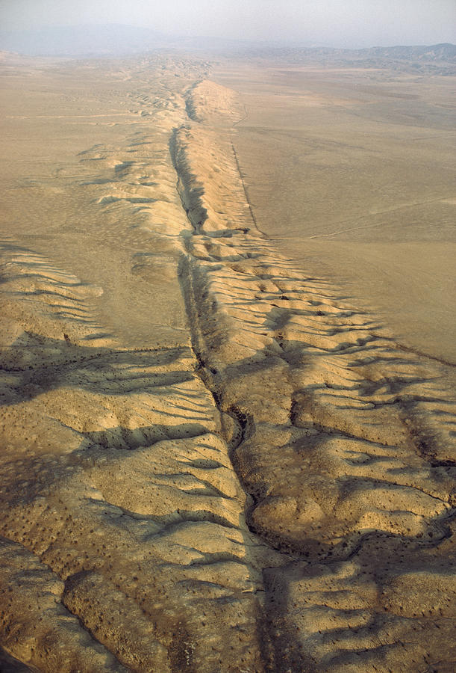
plates can move toward each other (convergent)
if both plates are continental,
this can create mountains
if one plate is oceanic, and the other is continental
the oceanic is pushed underneath the other plate and melts
plates can move away from each other (divergent)
in continents this causes rifts (splits) and rift valleys
in oceanic plates this creates new sea floor
plates can also move alongside each other (transform/transverse)

Slide 7
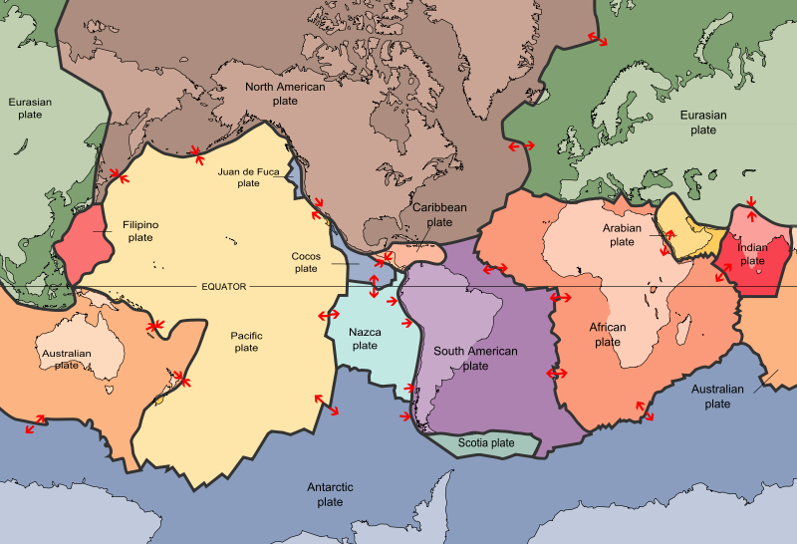
Are there any plate boundaries near Vermont?
Do we ever have earthquakes?

Slide 8
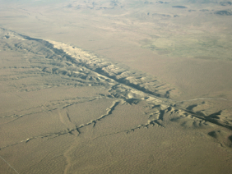
Faults
movement in Earth's lithosphere causes stress
when enough stress builds up, the rock can break, creating a fault
the fault is the crack in the lithosphere
the largest faults on Earth are found at the edges of tectonic plates
(fault lines)
movement along fault lines can cause earthquakes
creating new land features including mountains and valleys
http://simple.wikipedia.org/wiki/Fault_(geology)
http://en.wikipedia.org/wiki/Fault_(geology)
http://geomaps.wr.usgs.gov/parks/deform/gfaults.html

Slide 9
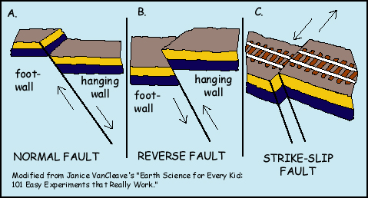
three main types of faults:

Slide 10
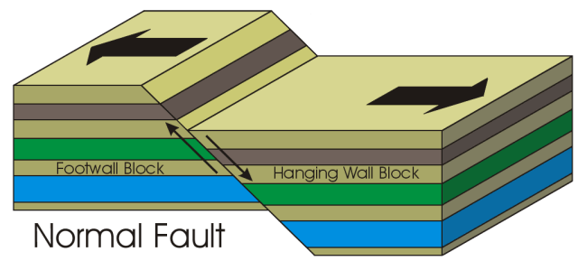
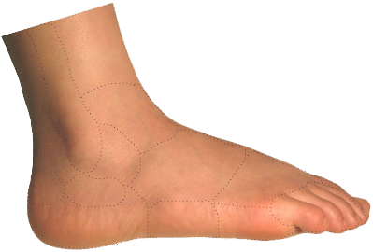
http://video.mit.edu/watch/normal-fault-8182/
divergent
the lithosphere is stretched until a break occurs
the two sides get pulled apart
“normal” because the hanging wall falls in the direction you
would predict based on gravity

Slide 11
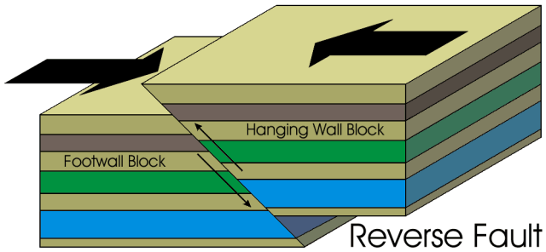
convergent
the lithosphere is “smooshed” until a break occurs
the two sides get pushed together
“reverse” fault: the rock on one side of the fault has been pushed up over the other side
the hanging wall has “fallen” in the opposite direction you
would predict based on gravity

Slide 12
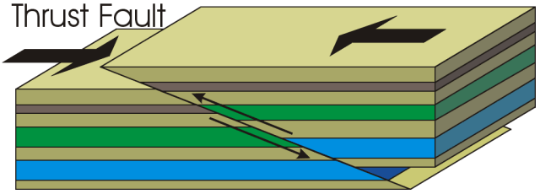
thrust fault
is a reverse fault
that has an angle less than 45 degrees from horizontal

Slide 13
5
4
5
3
4
2
3
1
2
1
convergent
older rock can get pushed up above younger rock…
layer 1 from left is above layer 2 from right
layer 3 from left is above layer 4 from right
etc….

Slide 14
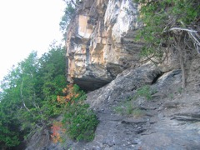
500 million years old
450 million years old

Slide 15
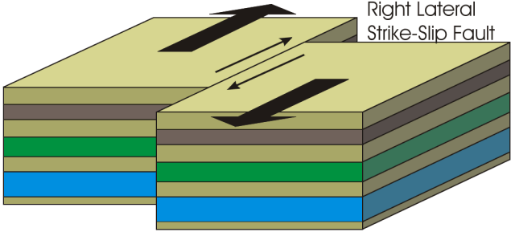
https://www.youtube.com/watch?v=MrrLJ4vXHCs
a fault that is the consequence of the land “chunks”
moving in opposite directions
or the same direction at different speeds
the fault is very nearly vertical

Slide 16
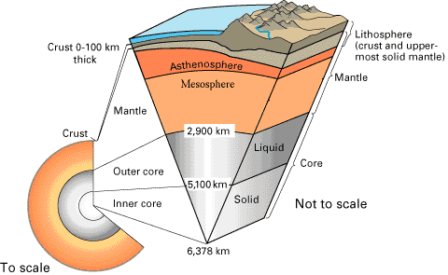
What processes in the Earth would cause faults to form?
_____________________________________
______________________________________
convection currents in the mesosphere and asthenosphere
as a consequence of heating of lower mantle from the core
In what layer of the Earth would faults form?
_____________________________________
_____________________________________
______________________________________
CRrrrrACKS are forming
so, the layer has to be rigid
so, the lithosphere (crust + outer mantle)

Slide 17
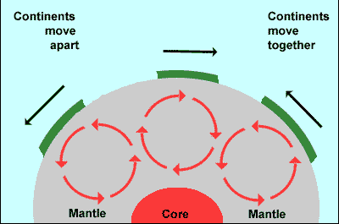
plates can move
away from each other
(divergent)
plates can move
toward each other
(convergent)

Slide 18
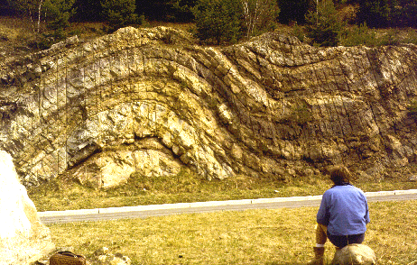
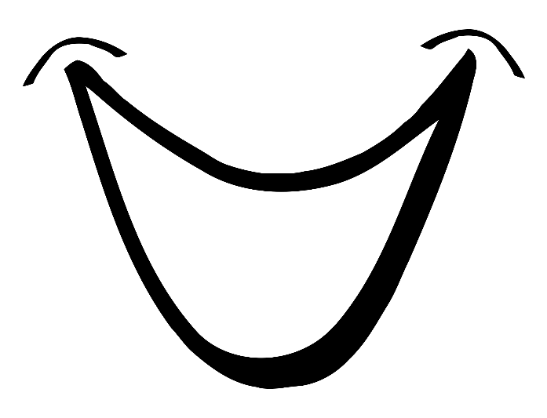
compression in the crust (must be convergent…)
that does NOT cause breaks causes folds.
syncline
anticline
anticline folds have the oldest layers in the middle of the fold
syncline folds have the youngest layers in the middle of the fold

Slide 19
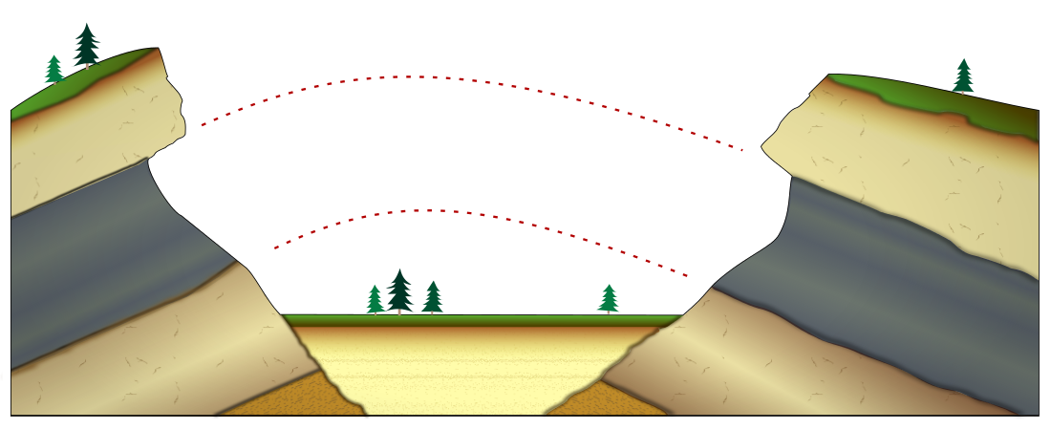
erosion in fold

Slide 20
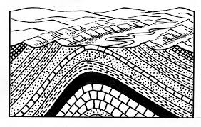
erosion of peak from a fold

Slide 21
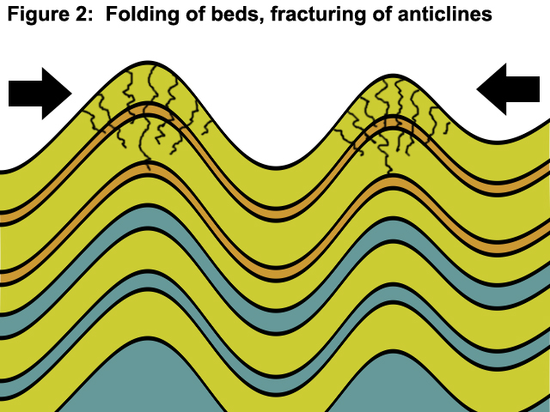

Slide 22
In what layer of the Earth do folds form?
_____________________________________
the lithosphere (crust + outer mantle)
What process in the Earth would cause folds to form?
_____________________________________
______________________________________
convection currents in the lower mantle (mesosphere)
as a consequence of heating from the core
Why would a fold form instead of a fault?
________________________________
______________________________________
______________________________________
the layer has to be deformable (higher T)
bends are forming – not cracks
so, lower pressure AND less force (slower movement)

Slide 23
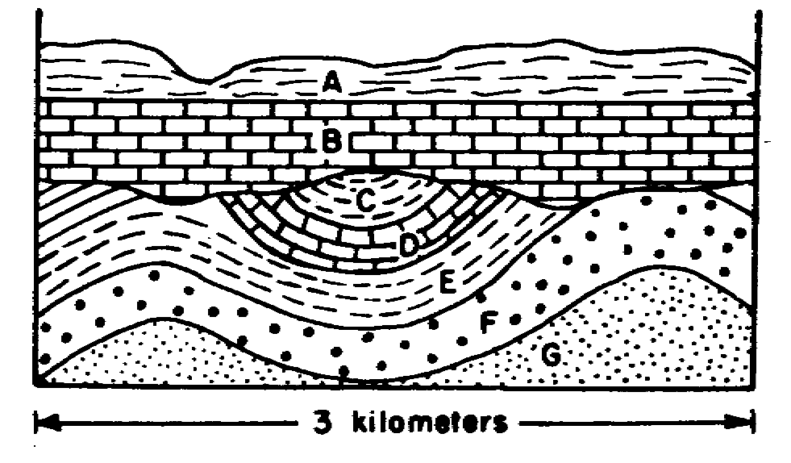
Practice
If there is an unconformity write ‘erosion’ + type of unconformity
If there is folding write ‘folding’ + which type
If there a fault write ‘fault’ + which type
anticline
syscline
anticline
F

Slide 24
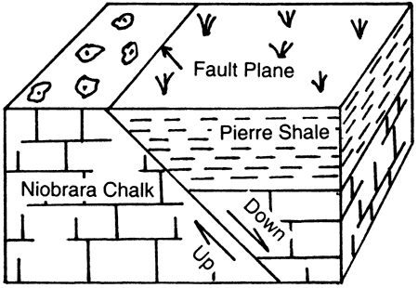
Practice
If there is an unconformity write ‘erosion’ + type of unconformity
If there is folding write ‘folding’ + which type
If there a fault write ‘fault’ + which type
F

Slide 25
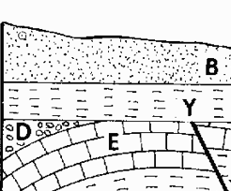
Practice
If there is an unconformity write ‘erosion’ + type of unconformity
If there is folding write ‘folding’ + which type
If there a fault write ‘fault’ + which type

Slide 26
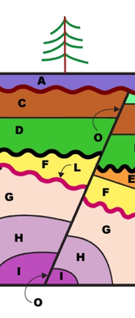
If there is an unconformity write ‘erosion’ + type of unconformity
If there is folding write ‘folding’ + which type
If there a fault write ‘fault’ + which type
K
J
B

