Slide 1
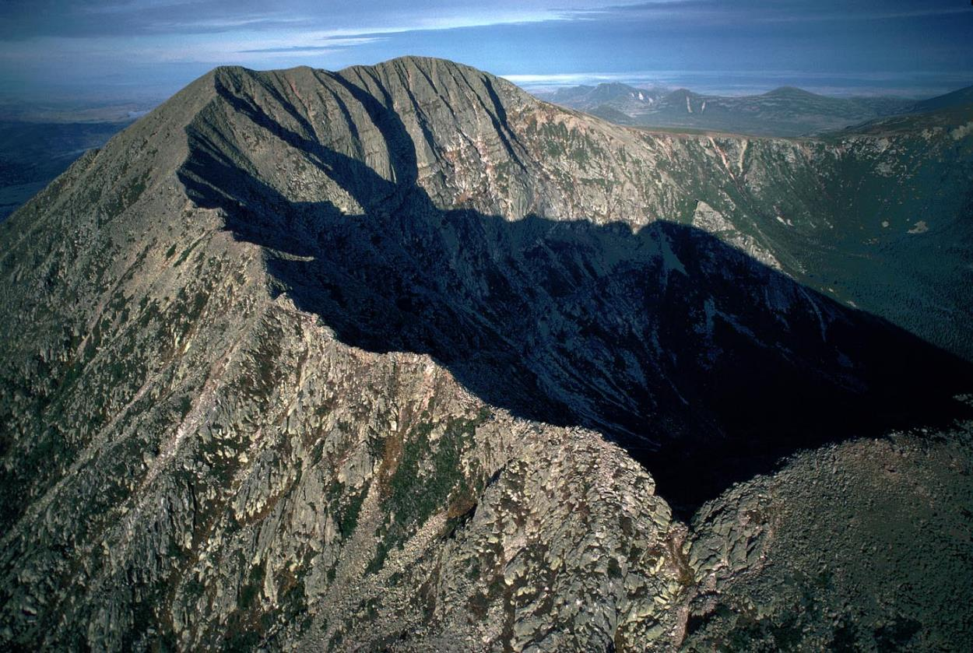
Geosphere 4 & 5
Principles of Geology…

Slide 2
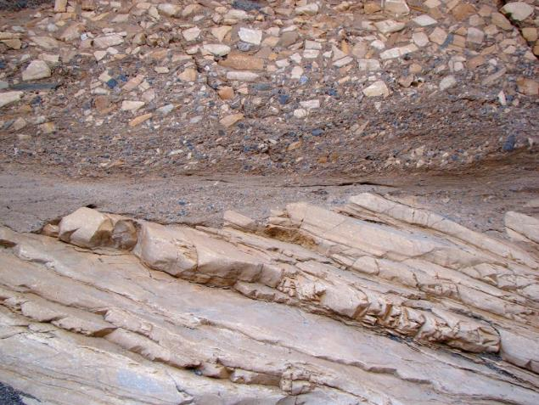
Unconformities
a buried erosional surface
separating two rock layers of different ages
(in geological time … millions of years)
indicates that sediment deposition was not
continuous
indicates that some of the geologic record is
missing due to erosion over geological time (millions of years)
An unconformity is a contact between two rock units in which the upper unit is usually much younger than the lower unit. Unconformities are typically buried erosional surfaces that can represent a break in the geologic record of hundreds of millions of years or more. For example, the contact between a 400‐million‐year‐old sandstone that was deposited by a rising sea on a weathered bedrock surface that is 600 million years old is an unconformity that represents a time hiatus of 200 million years. The sediment and/or rock that was deposited directly on the bedrock during that 200‐million‐year span was eroded away, leaving the “basement” surface exposed. There are three kinds of unconformities: disconformities, nonconformities, and angular unconformities.
http://www.cliffsnotes.com/sciences/geology/geologic-structures/unconformities

Slide 3
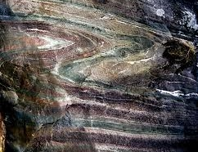
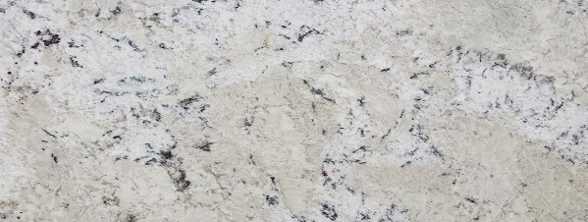
4 billion
years ago
today
480 million years ago
475 million years ago
the ocean comes back

Slide 4
4 billion
years ago
today
475 million years ago
425 million years ago
more sediment settles
and becomes rock

Slide 5
4 billion
years ago
today
425 million years ago
the ocean goes away
420 million years ago

Slide 6
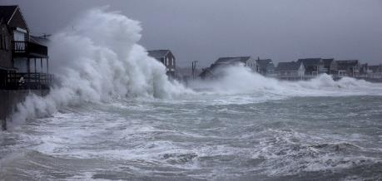
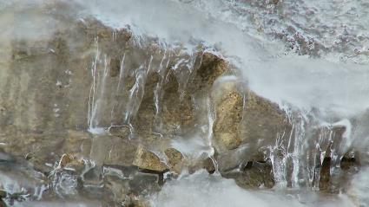
4 billion
years ago
today
420 million years ago
weathering and erosion
410 million years ago

Slide 7
4 billion
years ago
today
410 million years ago
405 million years ago
the ocean comes back

Slide 8
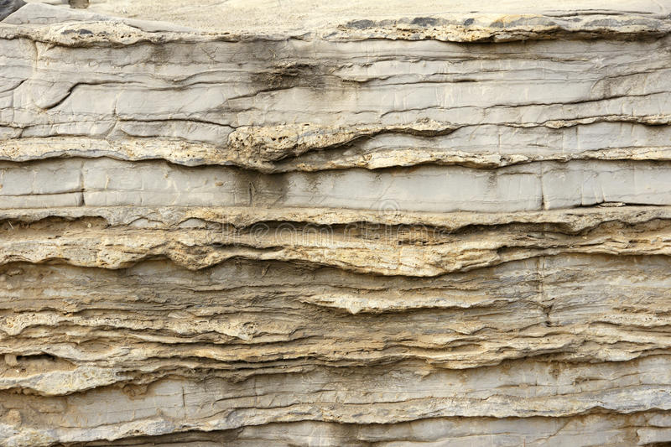
4 billion
years ago
today
405 million years ago
more sediment settles
355 million years ago
and becomes rock
unconformity

Slide 9
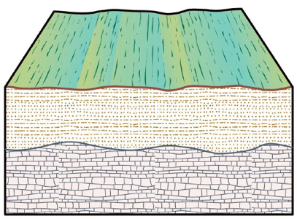
Disconformity
a disconformity is an erosion surface within a sequence of flat-lying sedimentary rocks.
erosion

Slide 10
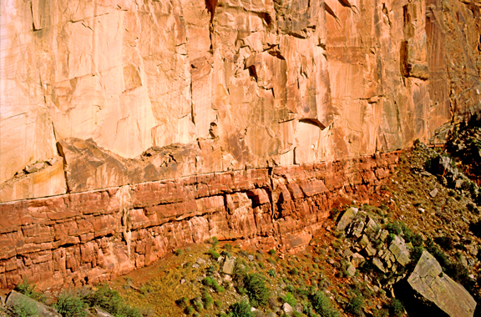
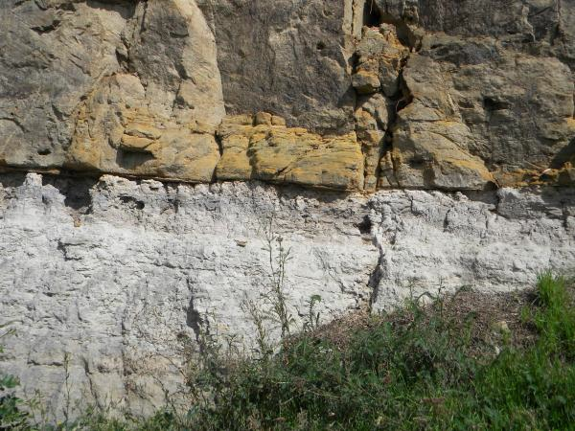
Disconformity
a disconformity is an erosion surface within a sequence of flat-lying sedimentary rocks.

Slide 11
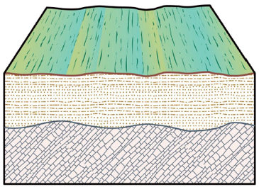
Angular Unconformity
recognized by tilted or deformed sedimentary rocks below flat-lying sedimentary rocks
erosion
Flat
Tilted

Slide 12
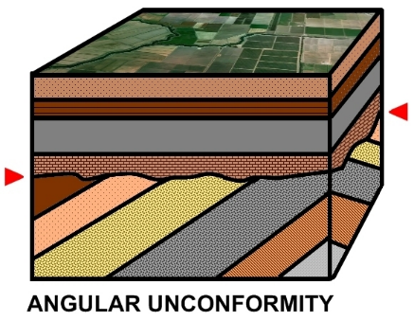
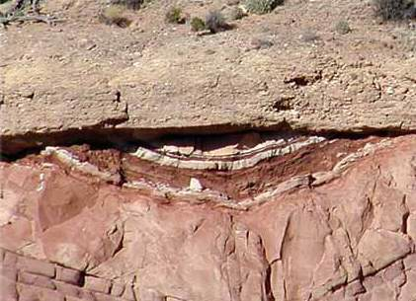
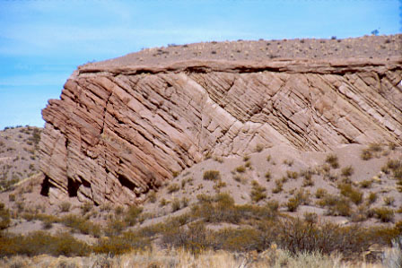
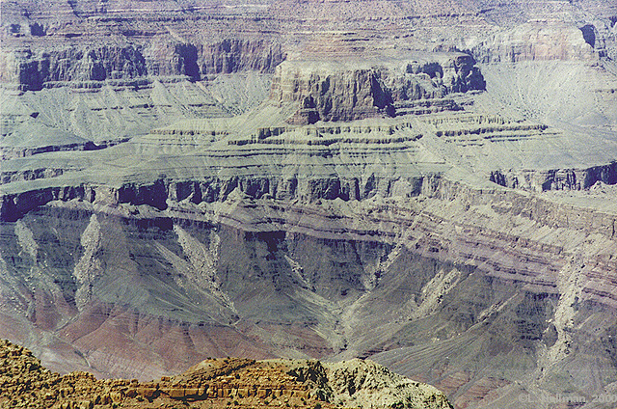

Slide 13
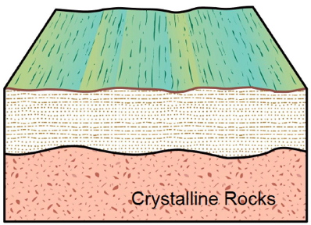
Nonconformity
recognized by sedimentary rocks resting on an eroded surface of igneous or metamorphic rocks.
erosion
metamorphic or igneous

Slide 14
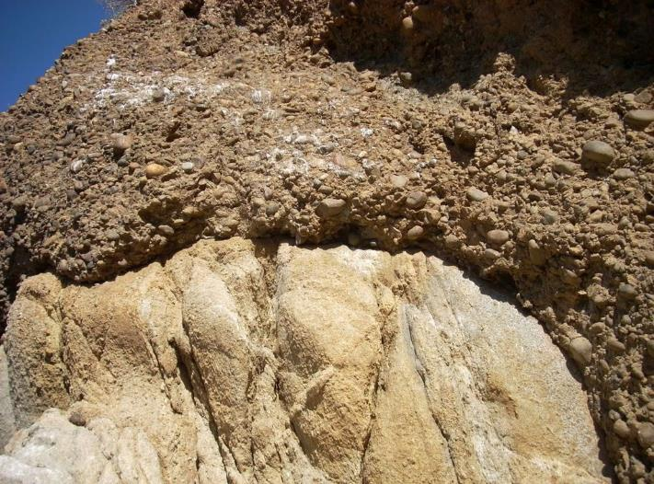
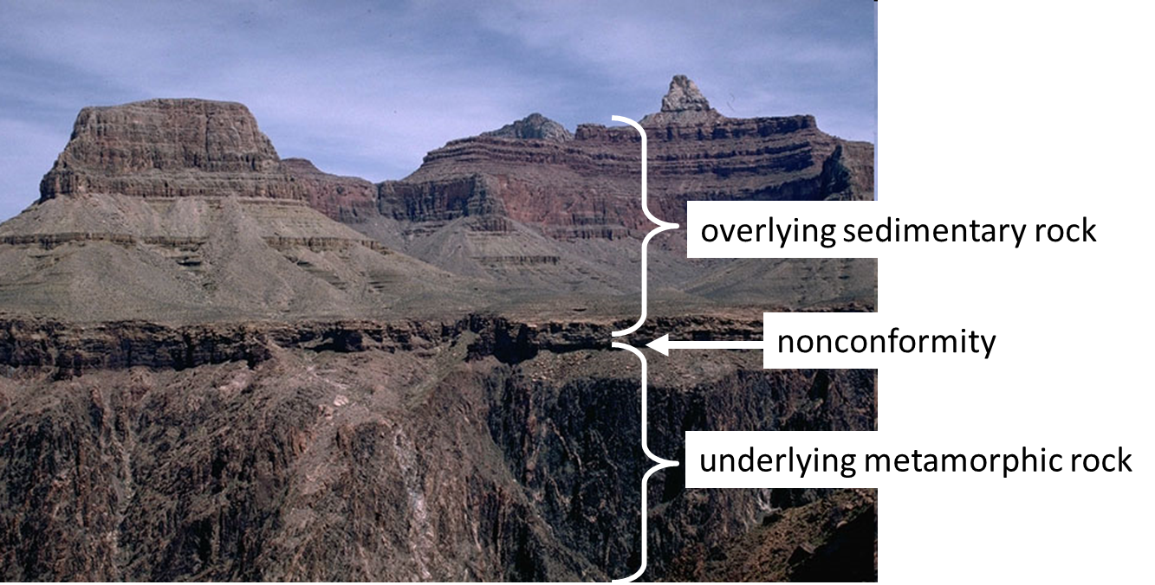
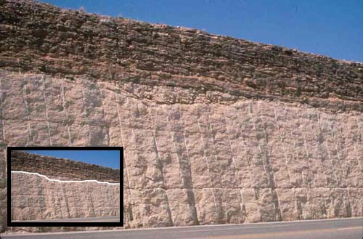

Slide 15
three types of boundaries…
1. erosional (unconformities)
a rock layer has been exposed and weathered for 10-100’s of millions of years
and THEN
another layer deposits

Slide 16
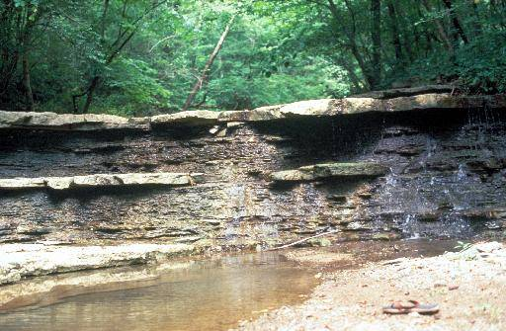
three types of boundaries…
1. erosional (unconformities)
a rock layer has been exposed and weathered for 100’s of millions of years
and THEN
another layer deposits
2. layers caused by environmental changes
a rock layer is continuously deposited (over millions of years)
during that time, there are significant environmental changes
that change the composition and/or structure of the rock
typically, an unconformity (erosional boundary) will be
disrupted – NOT very straight

Slide 17
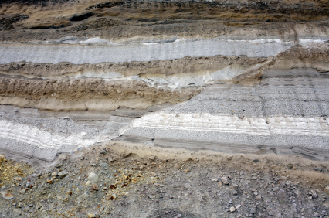
three types of boundaries…
1. erosional (unconformities)
2. layers caused by environmental changes
3. cracks from earthquakes (faults)

Slide 18
1. erosional (unconformities)
a rock layer has been exposed and weathered for 100’s of millions of years
and THEN
another layer deposits
2. layers caused by environmental changes
a rock layer is continuously deposited (over millions of years)
during that time, there are significant environmental changes
that change the composition and/or structure of the rock
typically, an unconformity (erosional boundary)
will be disrupted – NOT very straight
will be less disrupted – relatively straight

Slide 19
typically, in the cartoons,
unconformity – “rough” line
continuous layers (environmental changes) – straight line
practice…..

Slide 20
Geo 4&5 Practice 3
Geo 4&5 Practice 4

