Slide 1
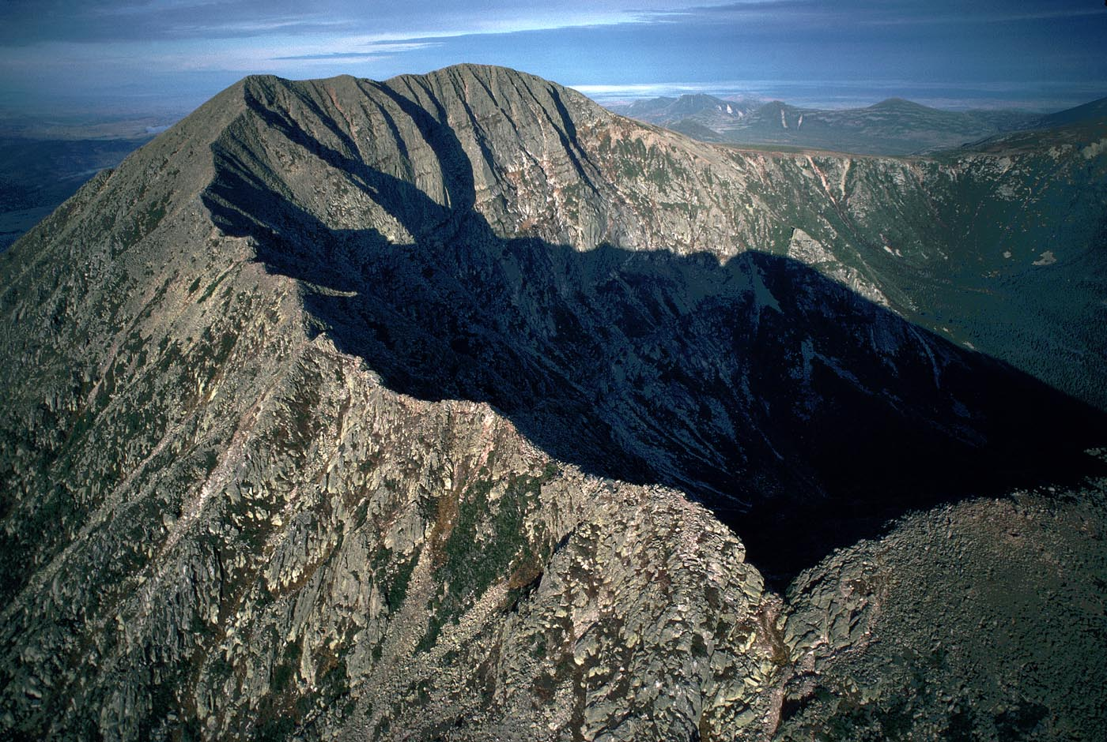
Geosphere 4 & 5
Principles of Geology…

Slide 2
link to layers and erosion

Slide 3
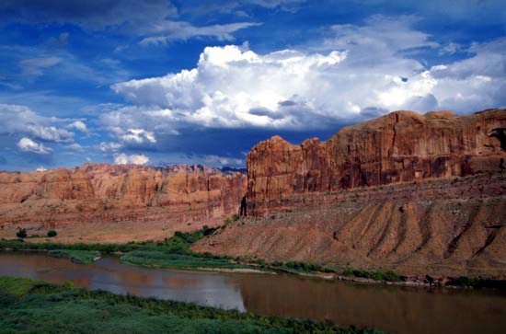
The principle of Uniformitarianism
• the present is the key to the past
• physical processes we see happening today also happened in the past in much the same way

Slide 4
The principle of Uniformitarianism
• the present is the key to the past
• physical processes we see happening today also happened in the past in much the same way

Slide 5
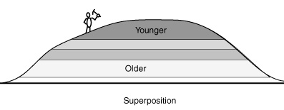
The principle of Superposition
• in a sequence of sedimentary rock layers, each layer must be younger than the one below
• sediment cannot accumulate,
unless there is something for it to accumulate on.
• thus, the sedimentary layer at the bottom is the oldest and the
sedimentary layer at the top is the youngest.

Slide 6
The principle of Superposition
- thus, the layer at the bottom is the oldest and the layer at the top is the youngest.
- as the sediment deposits, it tapers off at the sides (pinches off)
just as sand piles will taper off at the sides

Slide 7
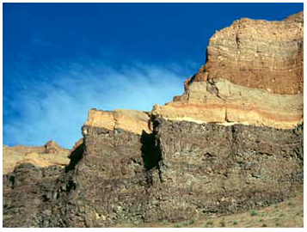
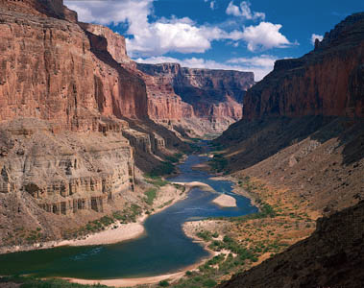
The principle of Superposition
• in a sequence of sedimentary rock layers, each layer must be younger than the one below.
• sediment can’t accumulate unless there is something for it to accumulate on.
• thus, the layer at the bottom is the oldest and the layer at the top is the youngest.

Slide 8
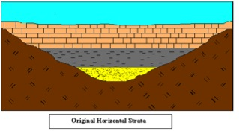
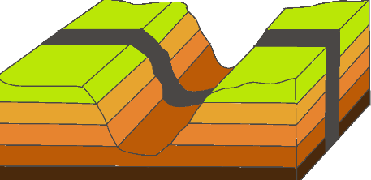
The principle of Original Horizontality
• sediments settle out of a fluid because of gravity
• usually the sediments accumulate on a fairly horizontal surface or a ditch.
• thus, the layers of sedimentary rock will be fairly horizontal until they are tilted by faulting or folding.

Slide 9
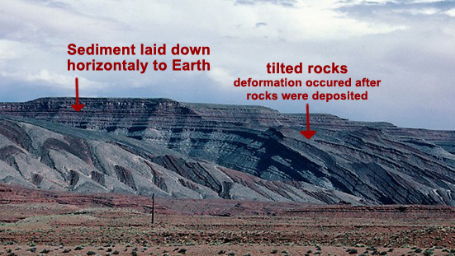
The principle of Original Horizontality
• sediments settle out of a fluid because of gravity.
• usually the sediments accumulate on a fairly horizontal surface.
• thus, the layers of sedimentary rock will be fairly horizontal unless they are tilted by faulting or folding.

Slide 10
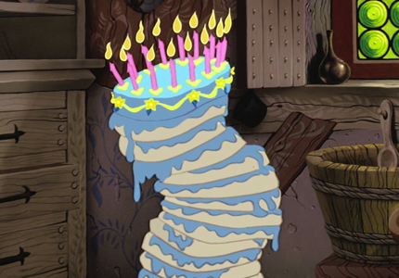
The principle of Original Horizontality
• sediments settle out of a fluid because of gravity.
• usually the sediments accumulate on a fairly horizontal surface.
• thus, the layers of sedimentary rock will be fairly horizontal unless they are tilted by faulting or folding.
All layers are deposited horizontally, but can shift over time

Slide 11
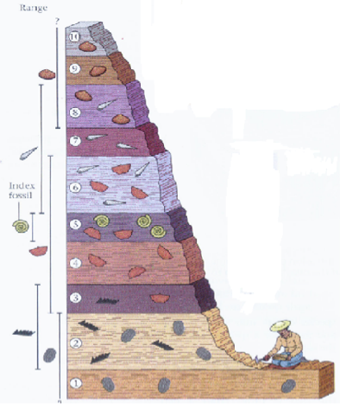
The principle of Faunal Succession
(includes flora and fauna)
a fossil is from a species that lived during a certain period of time
so… the fossil will only be in the sedimentary rock that was laid down during that time

Slide 12
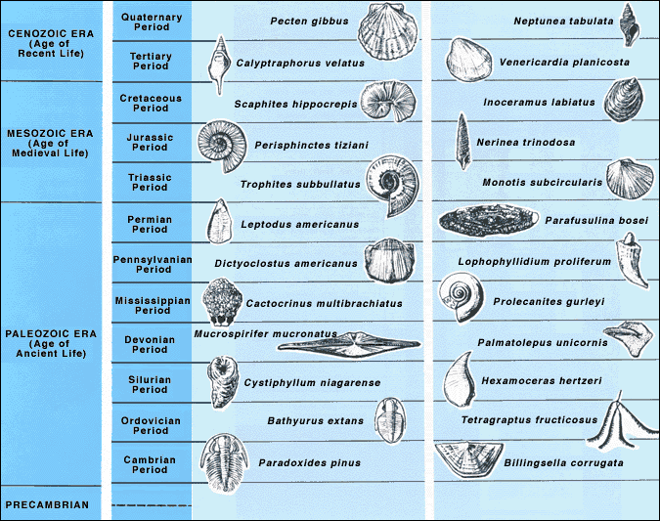

Slide 13
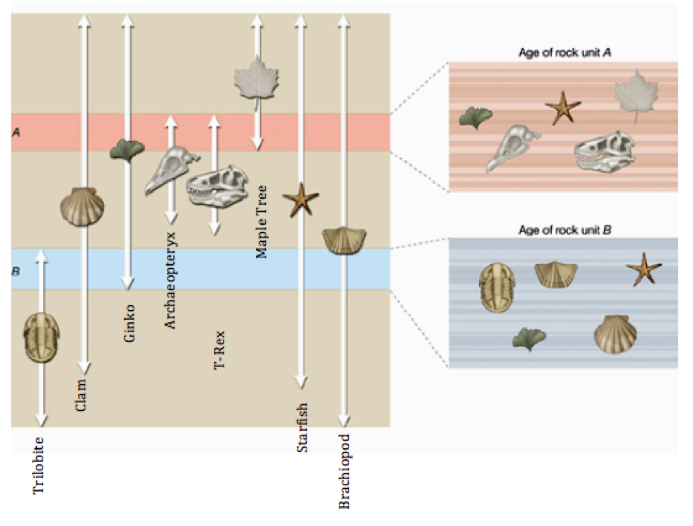
Put these fossils in order of oldest
(which existed longest ago)
to youngest
(which is the last to evolve)

Slide 14
The principle of Faunal Succession
(includes flora and fauna)
a fossil is from a species that lived during a certain period of time
so… the fossil will only be in the sedimentary rock that was laid down during that time

Slide 15
The principle of Faunal Succession
(includes flora and fauna)
• a particular fossil species can only be found in a limited number of sedimentary layers
• once a fossil species disappears it never reappears in younger rocks
• extinction is forever (assumes the DNA record is gone…)
• index fossils are widespread, easily identified, and have a short (time) range

Slide 16
Index fossils (also known as guide fossils, indicator fossils or zone fossils) are
fossils used to define and identify geologic periods (or faunal stages).
They work on the premise that, although different sediments may look different depending on the conditions under which they were laid down, they may include the remains of the same species of fossil.
If the species concerned were short-lived (in geological terms, lasting a few hundred thousand years), then it is certain that the sediments in question were deposited within that narrow time period. The shorter the lifespan of a species, the more precisely different sediments can be correlated, and so rapidly evolving types of fossils are particularly valuable.
The best index fossils are common, easy-to-identify at species level, and have a broad distribution—otherwise the likelihood of finding and recognizing one in the two sediments is minor.
Ammonites fit these demands well, and are the best-known fossils that have been widely used for this. Other important groups that provide index fossils are the corals, graptolites, brachiopods, trilobites, and echinoids (sea urchins). Conodonts may be identified by experts using light microscopy such that they can be used to index a given sample with good resolution. Fossilized teeth of mammals have also been used.
Wikipedia

Slide 17
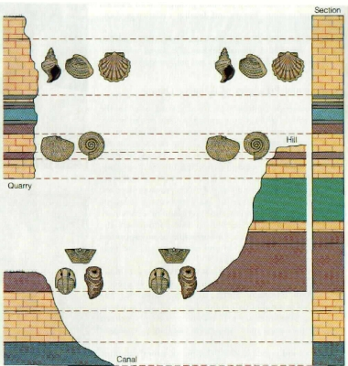
You can stitch different rocks from different locations together
using the principle of Faunal Succession
Geo 4 Practice 1
Geo 4 Practice 2

Slide 18
link to layers and erosion riverbeds

Slide 19
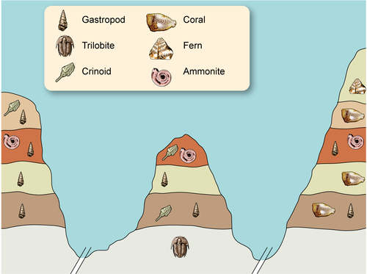
Geo 4 Practice 1
6
the crinoid might not have lived “there”
but,
it had to have lived during that time
5
4
3
2
1

Slide 20
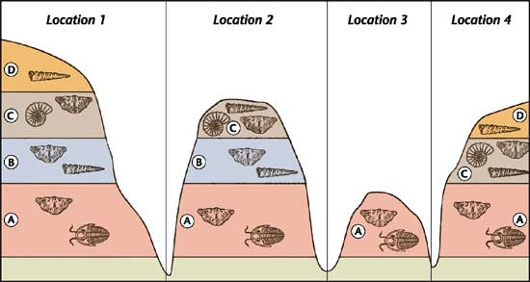
pinched off
what happened to layer B between location 2 and location 4?

Slide 21
Geo 4 Practice 1
erosion….
- one river
- the river had to have started to erode the canyon(s)
after layer 6 or layer 6 would not be there
- why is layer 6 not on the left?
likely answer…. pinched
6
5
4
3
2
1

Slide 22
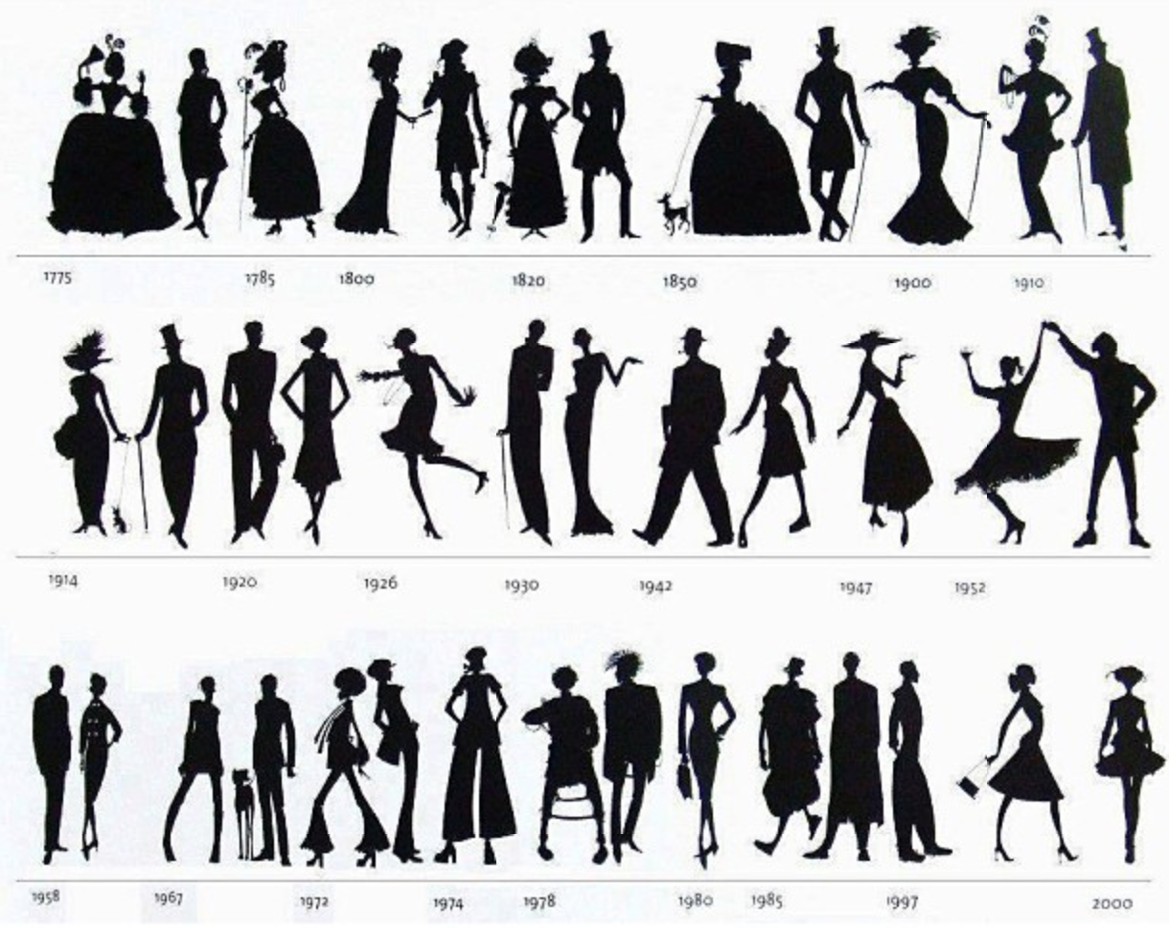
Absolute Dating vs Relative Dating
absolute dating:
using scientific techniques (carbon-14 dating, fossil dating)
to know the actual age of a rock layer
relative dating:
using the Principles of Geology
Uniformitarianism
Superposition
Original Horizontality
Faunal Succession
to determine the relative ages of rock layers (oldest to youngest)

Slide 23
Geo 4 & 5, Practice 3 Relative Dating
Q2
Which is older, “X” or “M” ? Explain.
Q4
Explain why “D” is in two adjacent layers and “M” in in only one.

