Slide 1
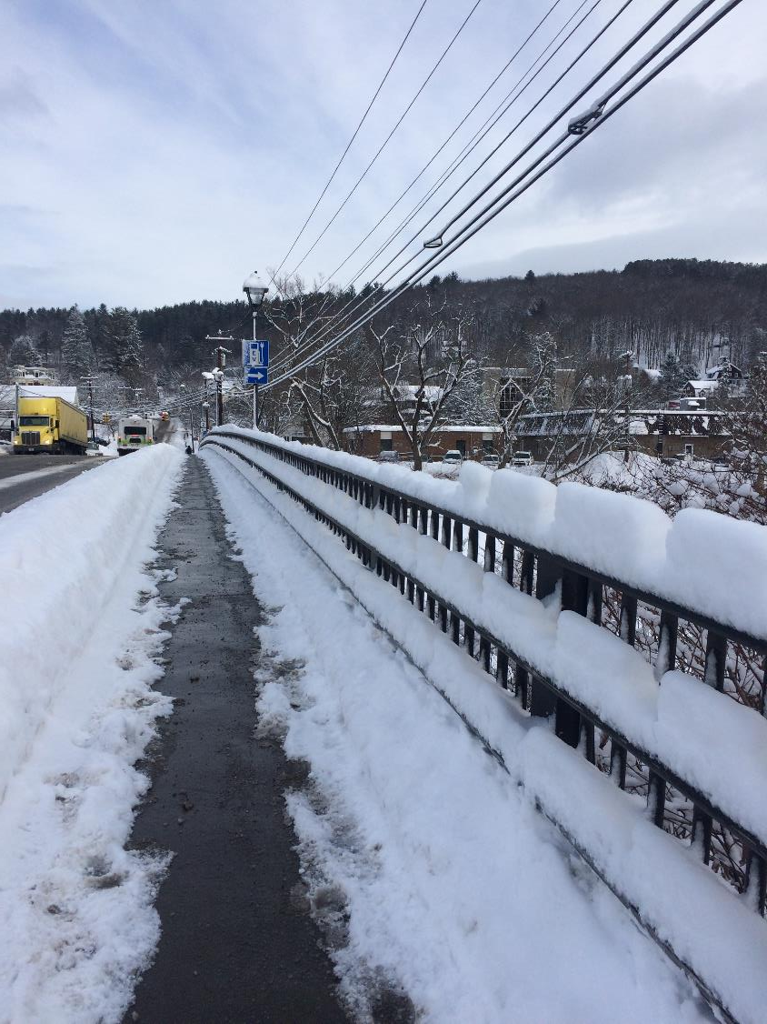
Field Trip Downtown… first hand views of
Point Source Pollution
and Gray Stormwater Infrastructure
Non-Point Source Pollution
and Green Stormwater Infrastructure
The Bailey Street Bridge

Slide 2
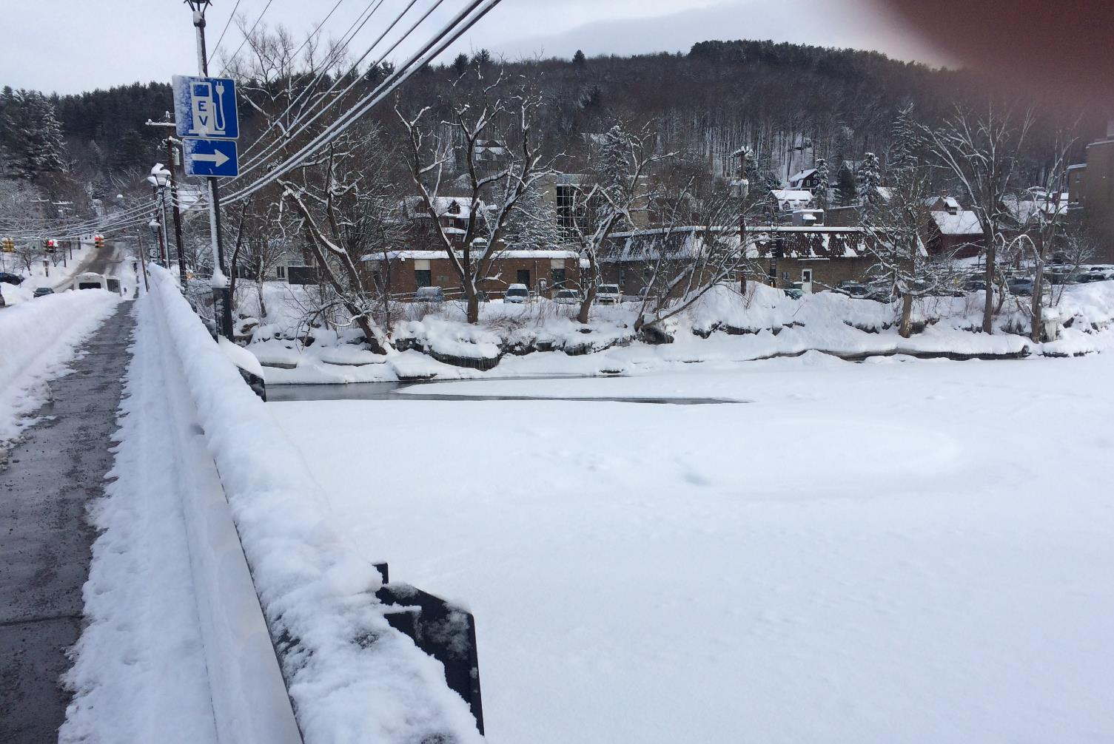
river bank… and trees
The Bailey Street Bridge

Slide 3
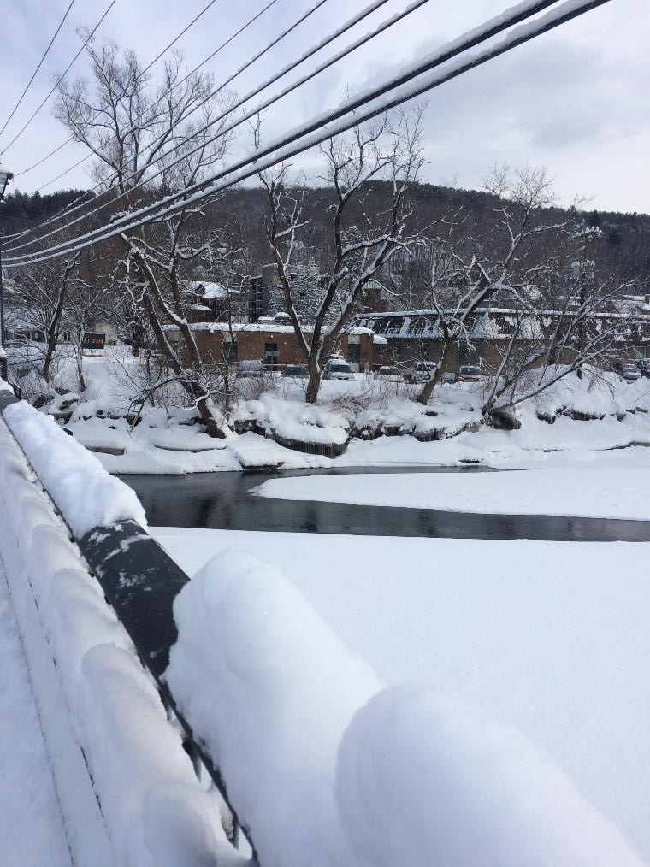
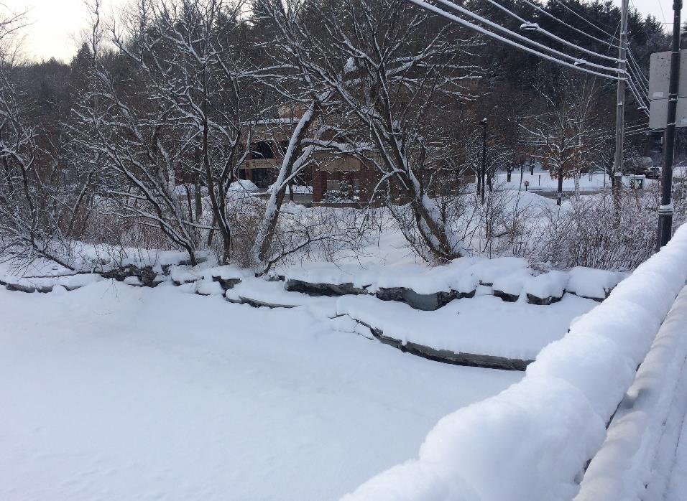
river bank… and trees
“If we hadn’t just had the
biggest snow storm of the year…
you would see some stormwater pipes
here and here.” SB
The Bailey Street Bridge

Slide 4
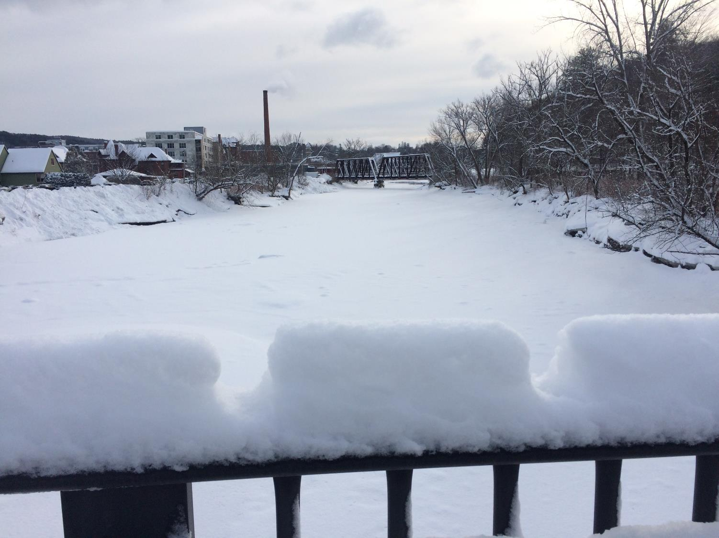
Anything else to notice
with respect to stormwater runoff?
The Bailey Street Bridge

Slide 5
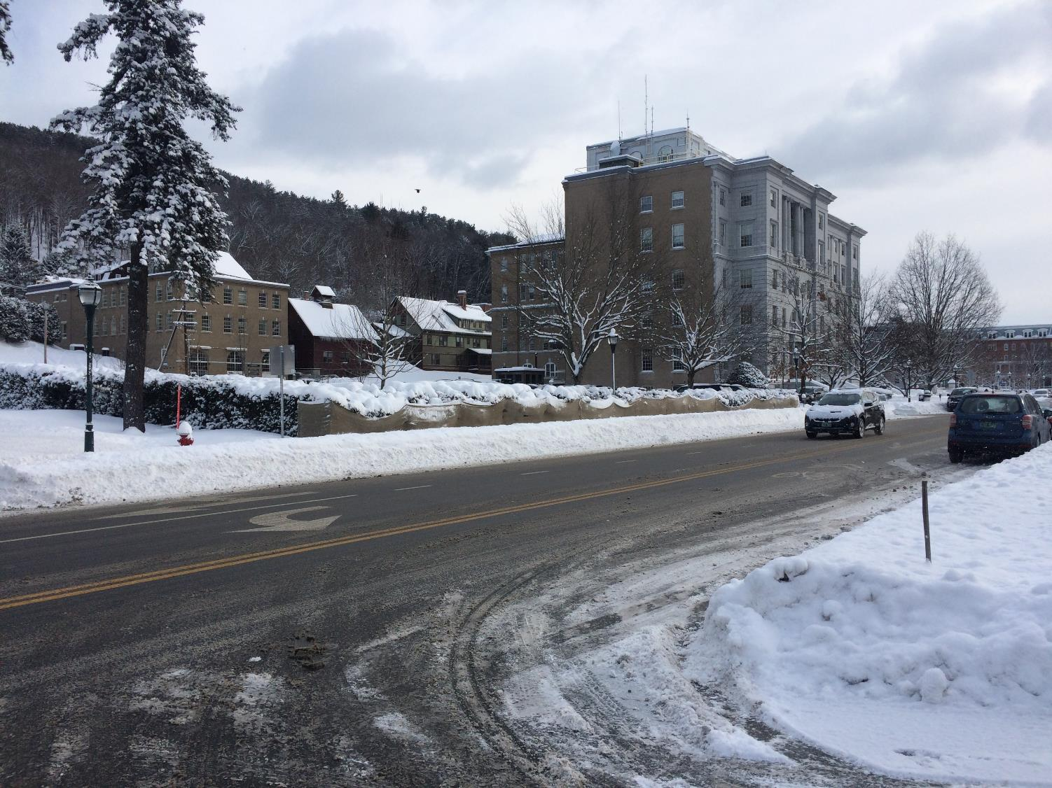
… on the way over to the Capital Parking Lot

Slide 6
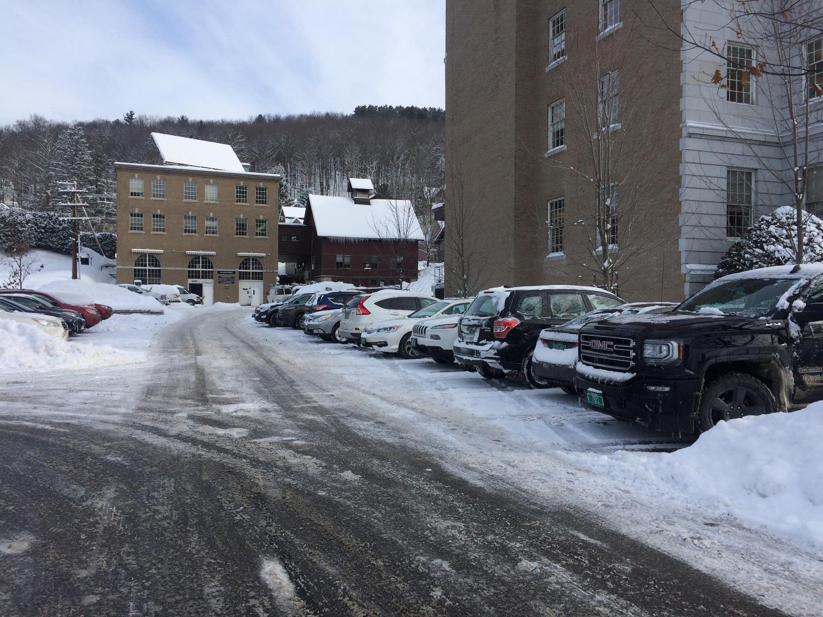
The Capital Parking Lot
upper lot
lower lot

Slide 7
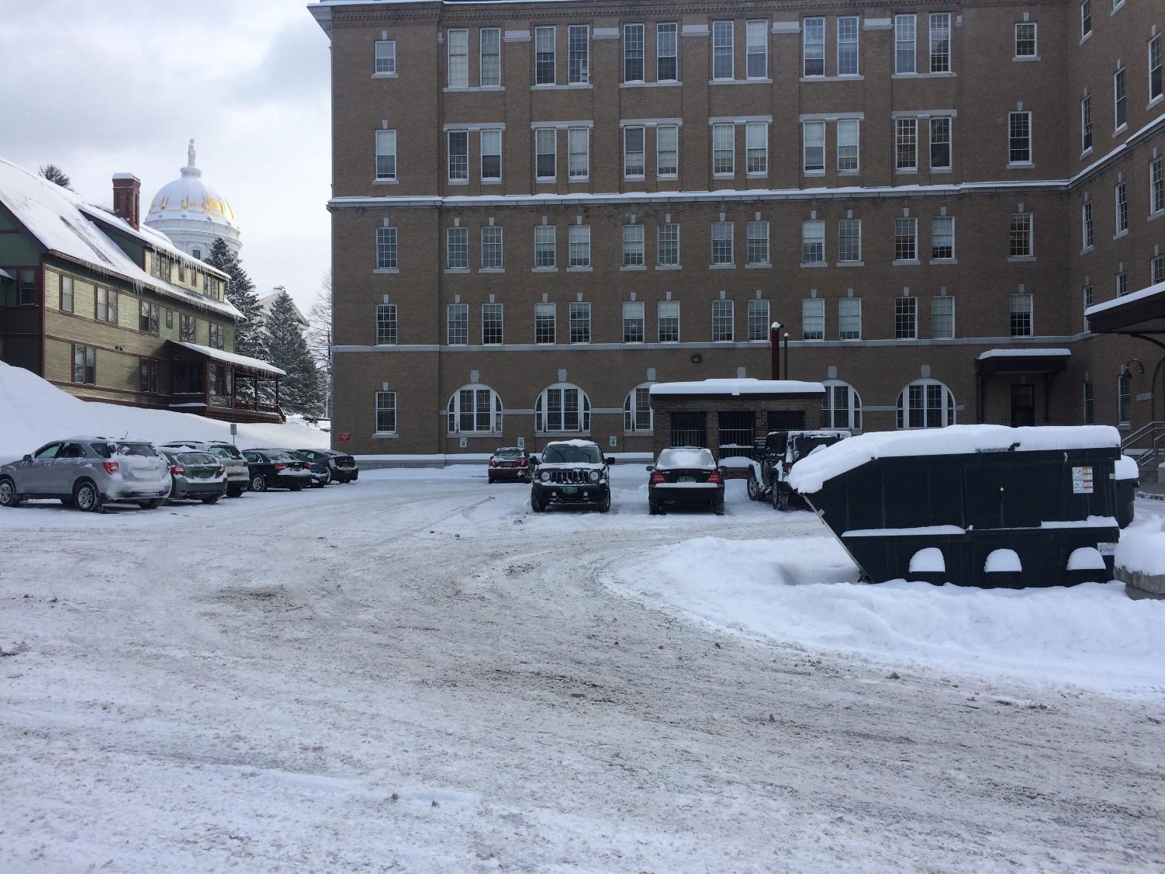
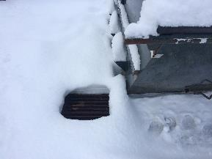
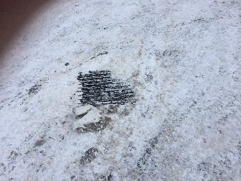
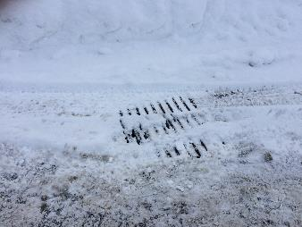
The Capital Parking Lot
upper lot

Slide 8
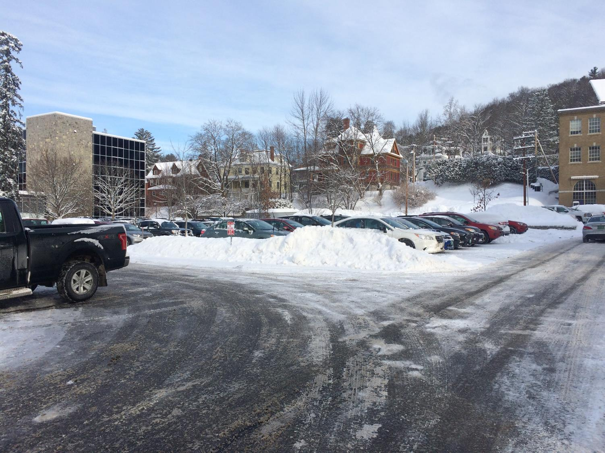
The Capital Parking Lot
lower lot
what’s here that’s not in the upper lot?
(wrt stormwater runoff….)
next slide is a view of some structures here

Slide 9
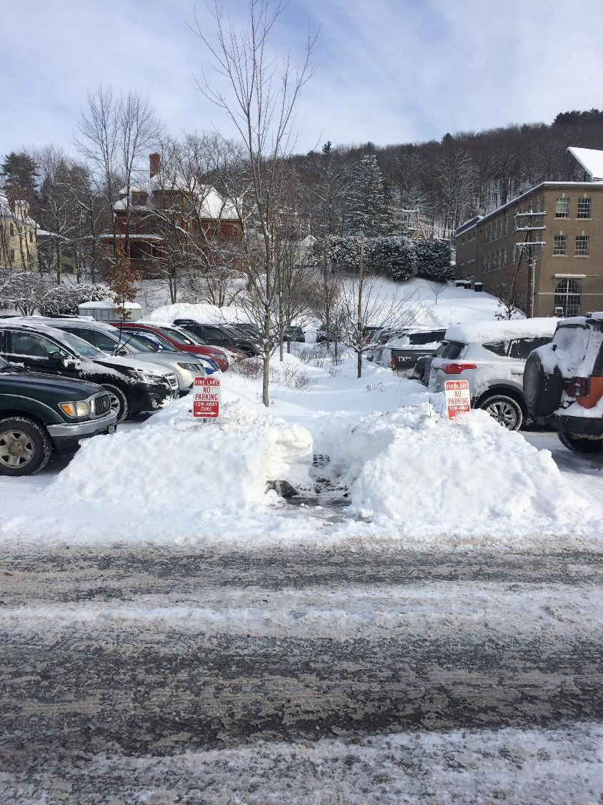
trees
view of features
compliments of
Mr. Bromley’s
fine shoveling…
The Capital Parking Lot
lower lot

Slide 10
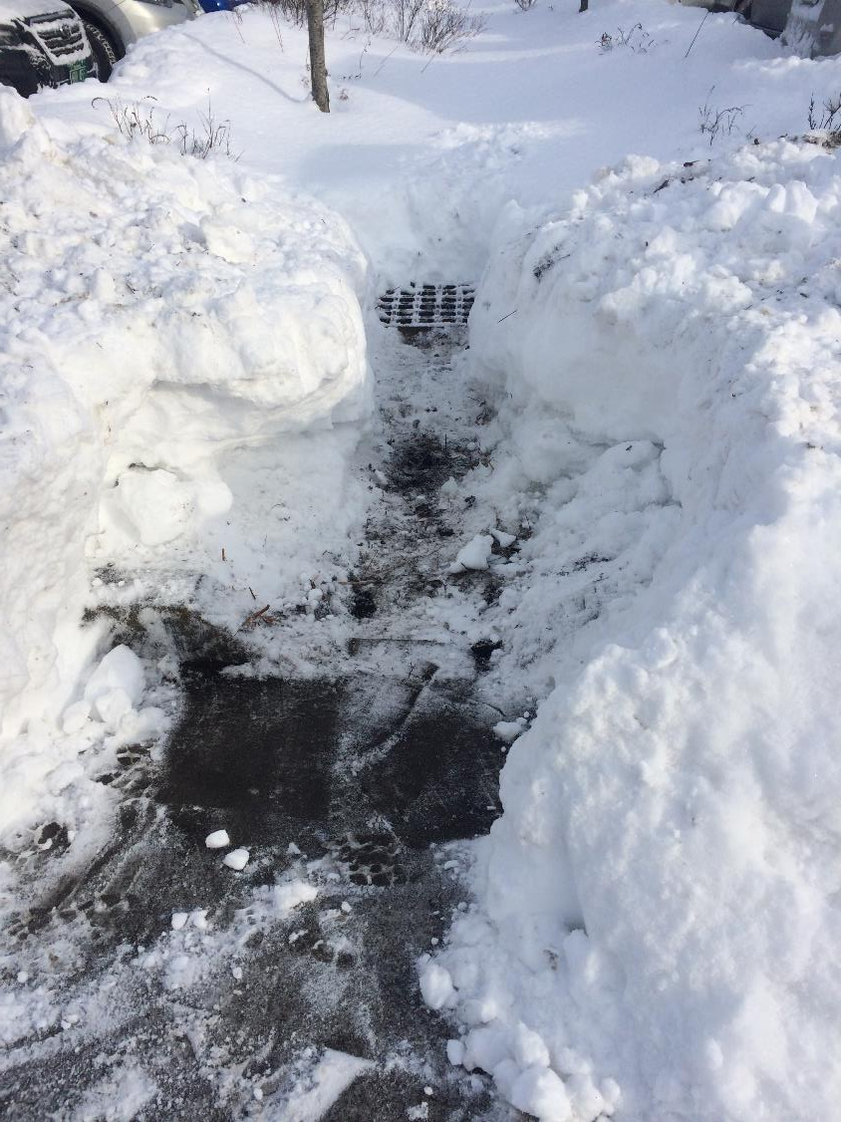
elevated storm drain
surrounded by gravel
closer view….
soil mixed with
large gravel
curb
with gap cut into it
The Capital Parking Lot
lower lot

Slide 11
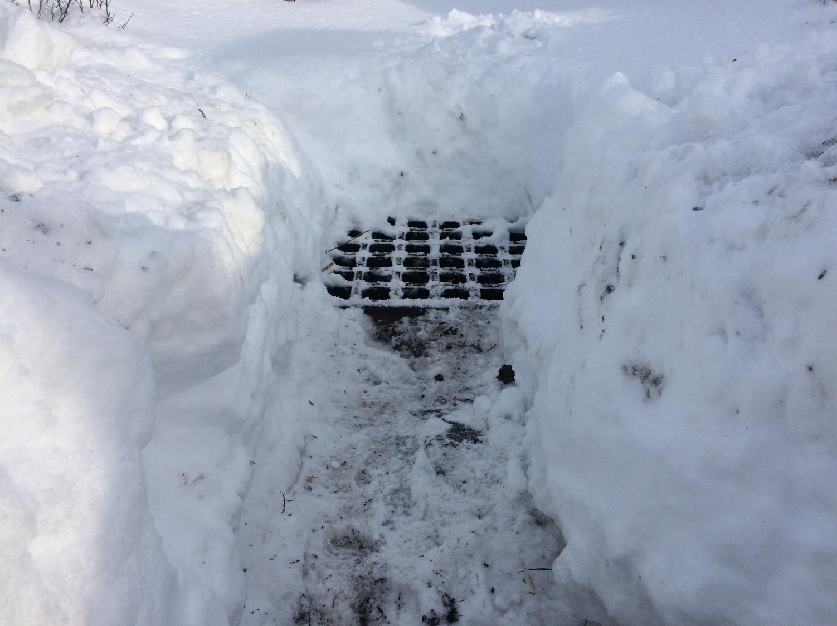
elevated storm drain
surrounded by gravel
The Capital Parking Lot
lower lot

Slide 12
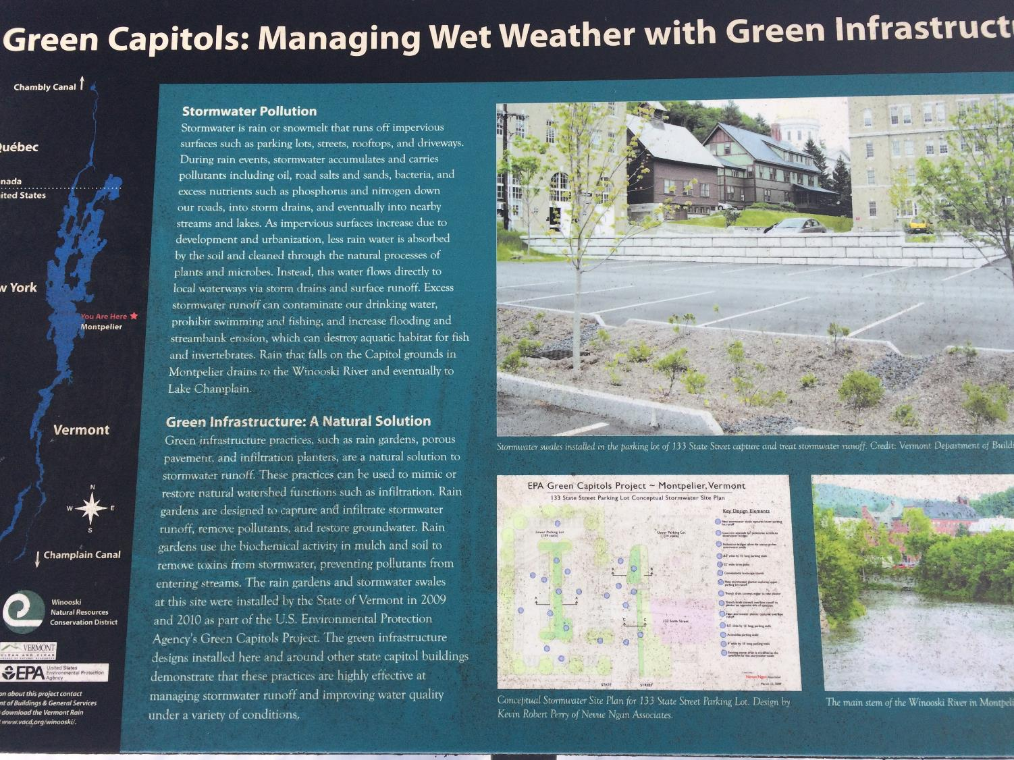
sign beside The Capital Parking Lot
depicting the GSI for the lower lot

Slide 13
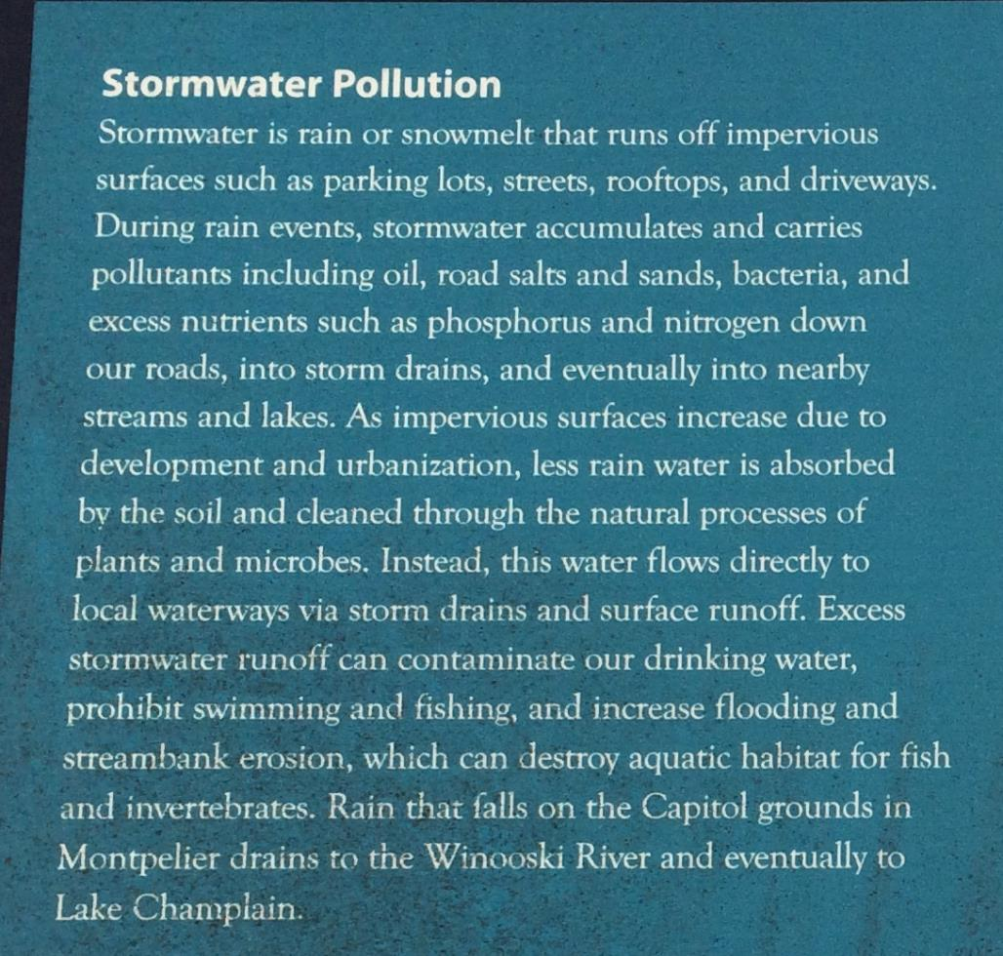
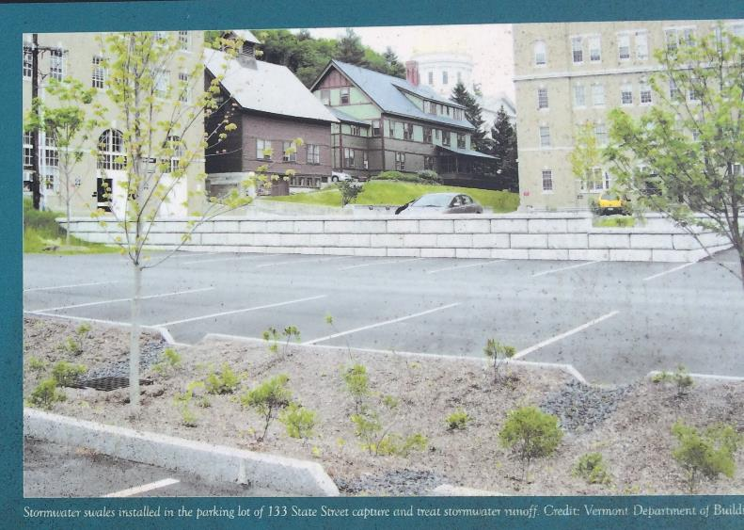
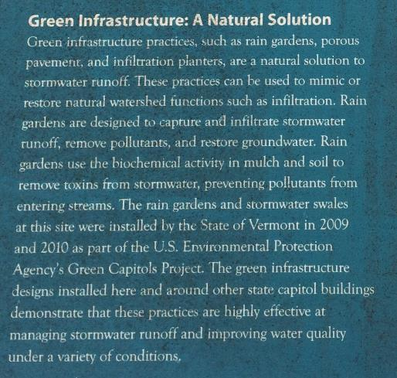
sign beside The Capital Parking Lot
depicting the GSI for the lower lot

Slide 14
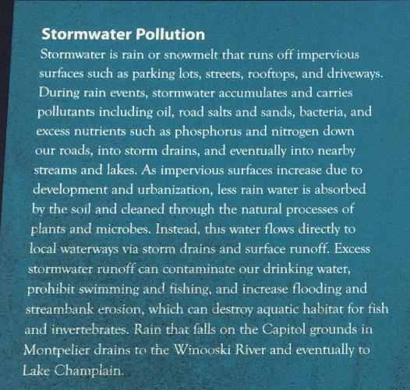
sign beside The Capital Parking Lot
depicting the GSI for the lower lot

Slide 15
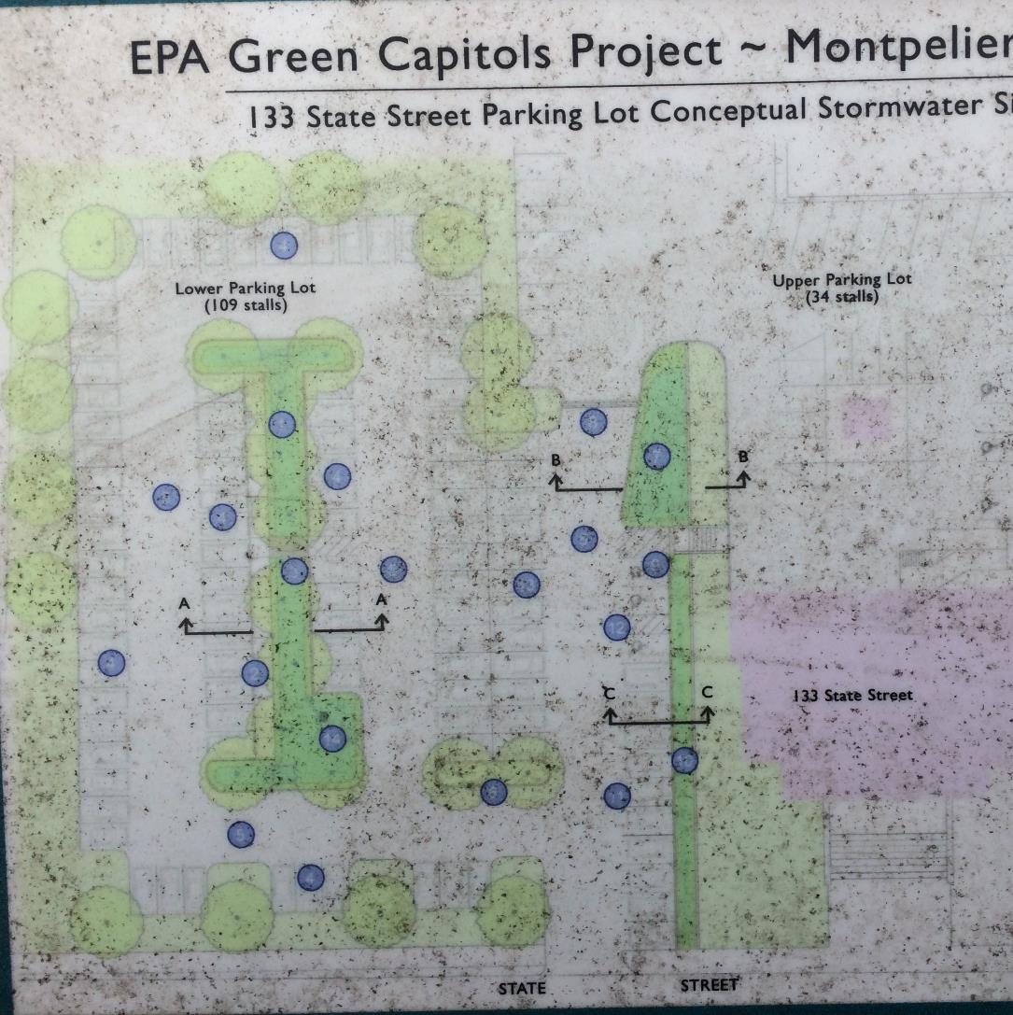
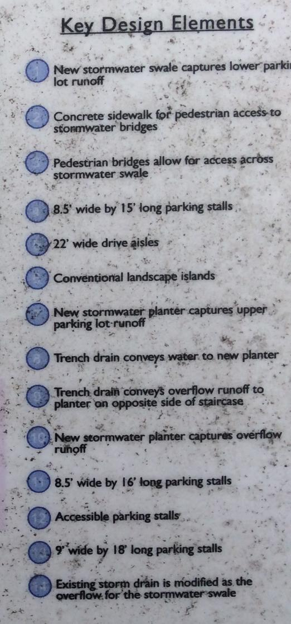
sign beside The Capital Parking Lot
depicting the GSI for the lower lot

Slide 16
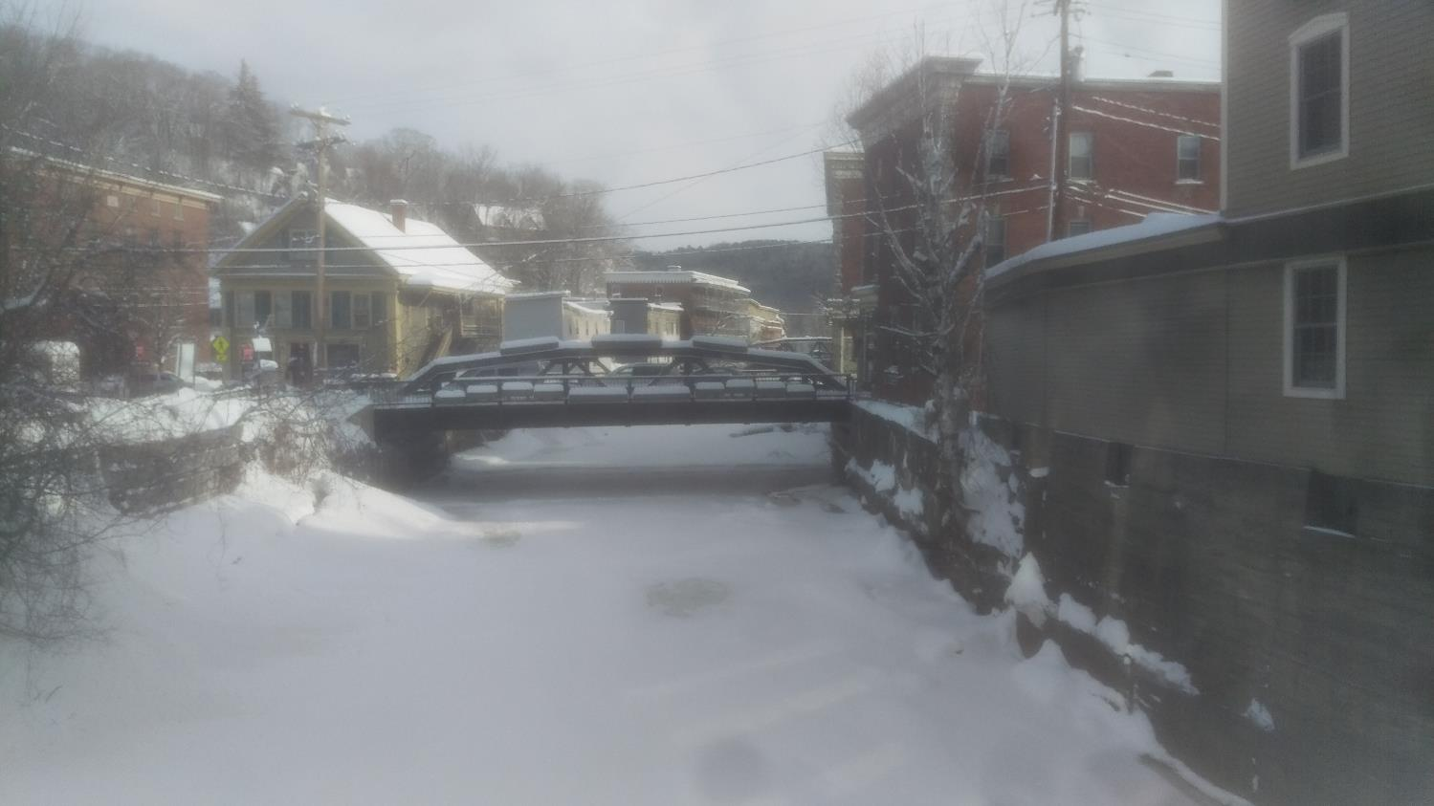
mixed concrete / brick / stone wall
Capital Grounds
is there any GSI anywhere !!??
view up the North Branch from the
State Street Bridge between Capital Grounds and the North Branch Cafe

Slide 17
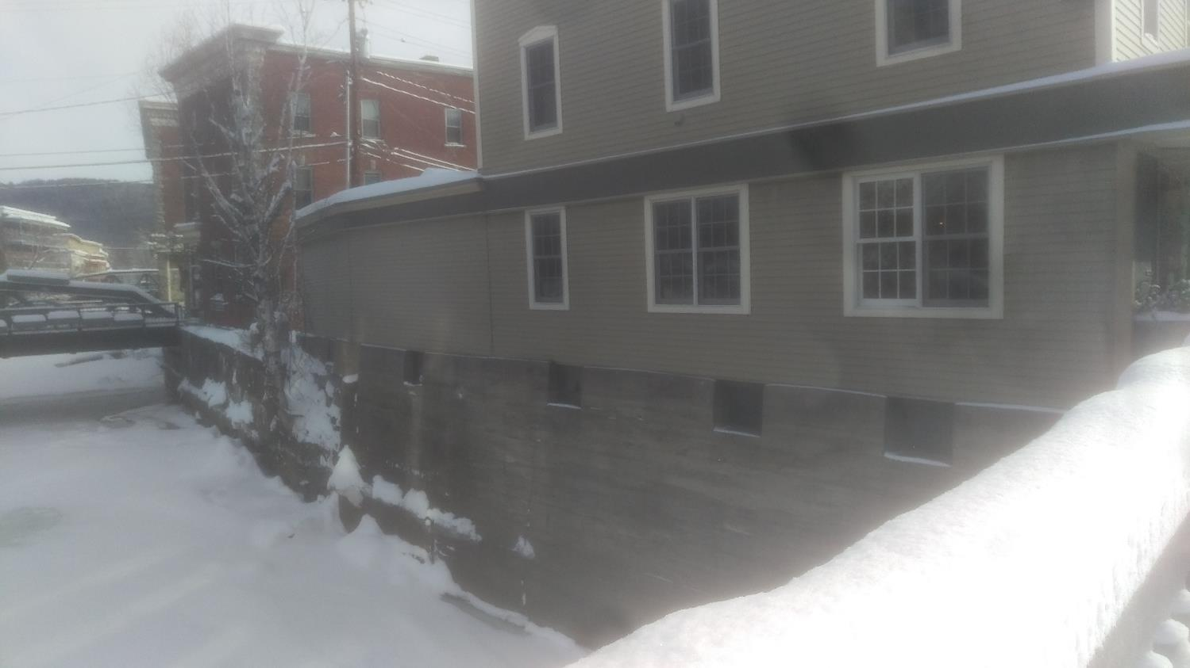
mixed concrete / brick / stone wall
Capital Grounds
view up the North Branch from the
State Street Bridge between Capital Grounds and the North Branch Cafe

Slide 18
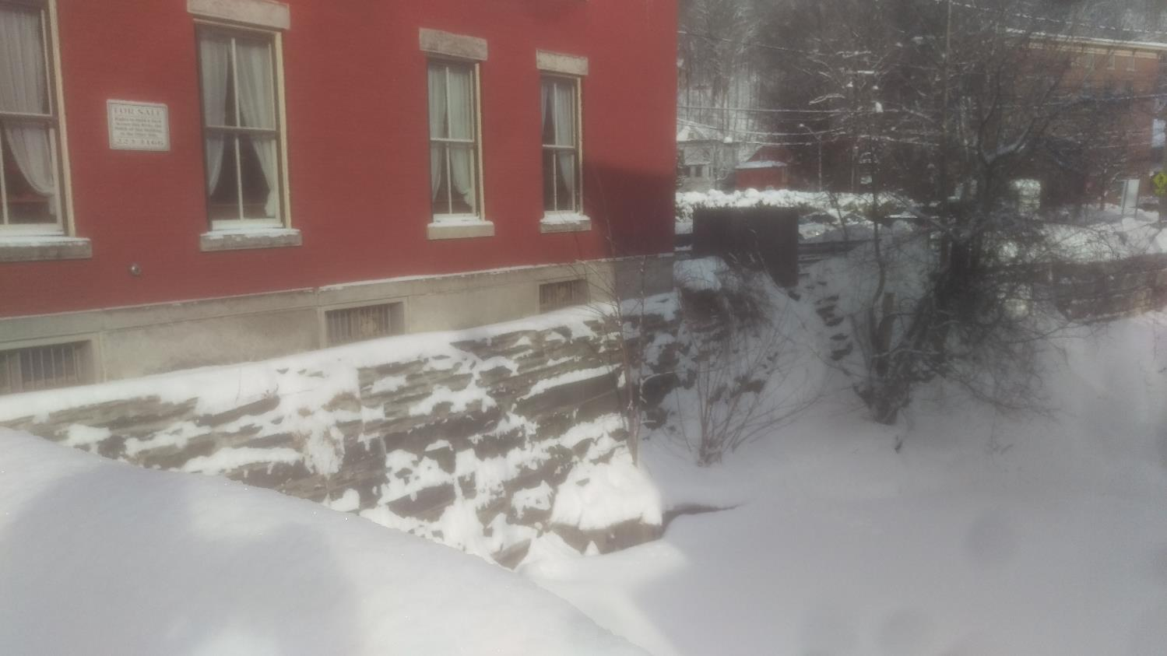
mixed concrete / brick / stone wall
North Branch Cafe
view up the North Branch from the
State Street Bridge between Capital Grounds and the North Branch Cafe

