Slide 1
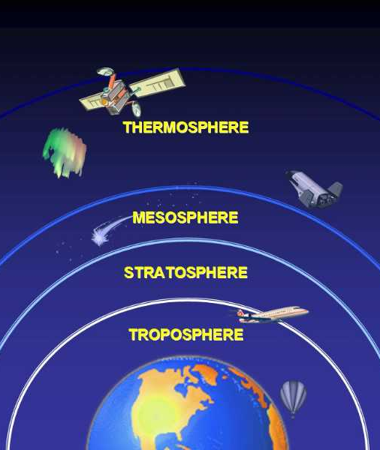
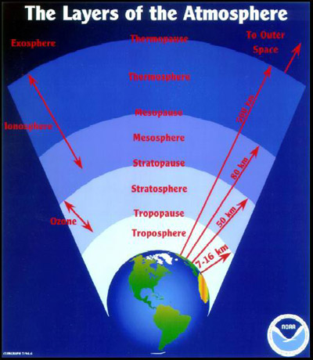
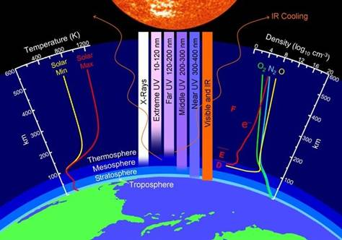
Introduction to the Atmosphere
Over the next several weeks, we will be studying the atmosphere. This is a large topic. Today’s activity is designed to give you an overview of the atmosphere. The film you will watch has a lot of information in it, some of which you may not understand. The goal is to spark some questions and give you an overview of what is to come.
What is the atmosphere?
What are a few things you already know about the atmosphere?
What is one question you have about the atmosphere?

Slide 2
Watch: Earth, The Biography – Atmosphere
https://www.dailymotion.com/video/x5ah6gl
and as you go jot down some notes if it is helpful but we really want you to pay close attention.
Answer the following questions as you watch or after the film is done.
What are three things you found interesting in the film?
What are two things that surprised you?
What is one question you had from the film?
What are some things about the atmosphere that you wish you knew more about?

Slide 3
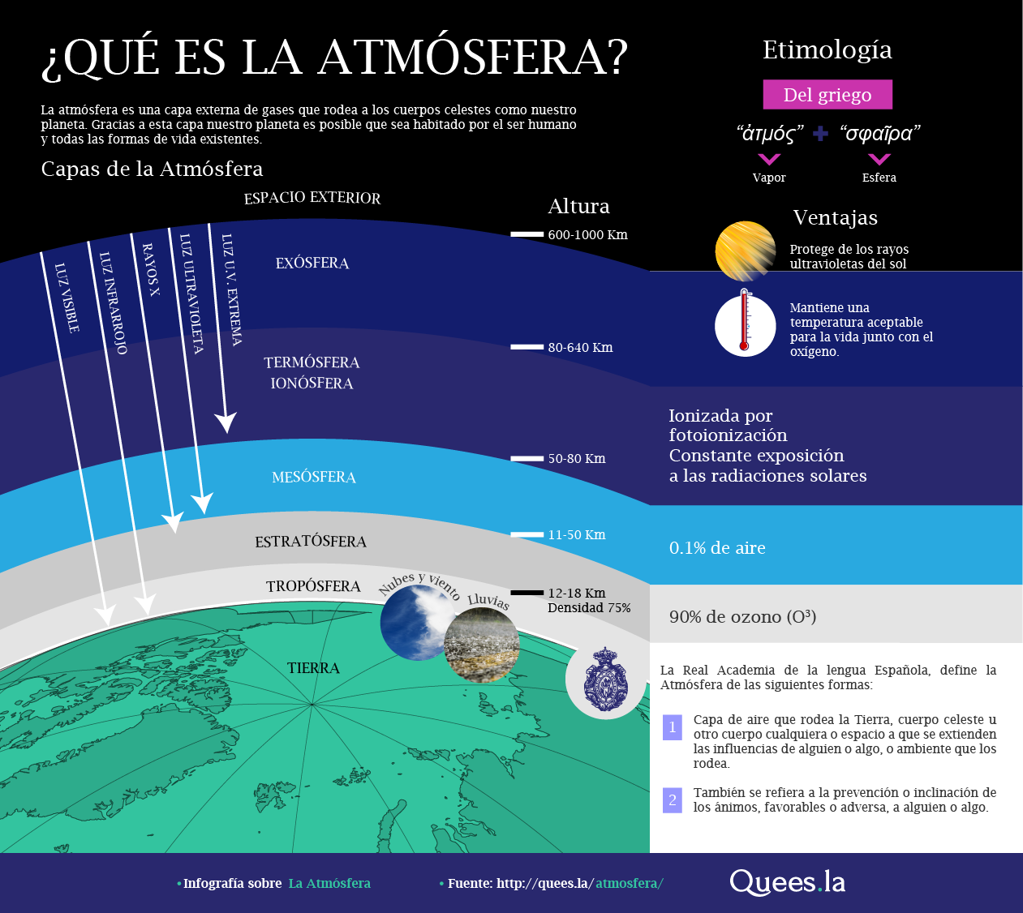
Atmo 4&5
Layers of Earth’s Atmosphere
and
Composition of Earth’s Atmosphere
Layers (out to in): Exosphere
Thermosphere
Mesosphere
Stratosphere
Troposphere
homosphere
(uniform composition)

Slide 4
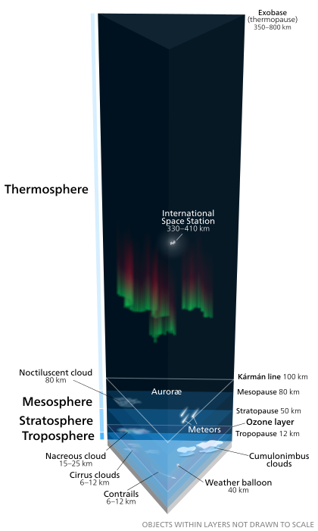
Troposphere (‘tropo’ to turn)
from surface to ~12 km (7.2 mi)
composed of: 78% N₂, 21% O₂, 1% Ar, + trace
density: 2.5×10²⁵ – 6.5×10²⁴ particles/m³
(25 trillion trillion - 6 trillion trillion in a cubic meter)
mean free path (distance between collisions):
0.00000007 m to 0.0000005 m
mean free path: 0.00000007 m to 0.0000005 m
size of a molecule: 0.0000000001 m 0.0000000001 m
ratio: = 700 = 5000
in the troposphere, the distance particles need to travel to hit another is
700 to 5000 times the size of the particle
what does that “look” like on our scale?

Slide 5
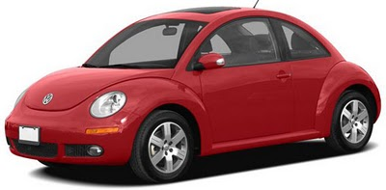

so… IF an air particle (an O₂ molecule, N₂ molecule, Ar atom…)
was as big as a VW beetle…
how far away would the next air particle be?
0.0000000001 m OR 0.0000000000004 in
Dang that’s small….
punchbuggy red
this is how
misconceptions
are born !
170 inches / 14 feet
so… remember
molecules / atoms
are NOT
the size of
VW beetles!!

Slide 6
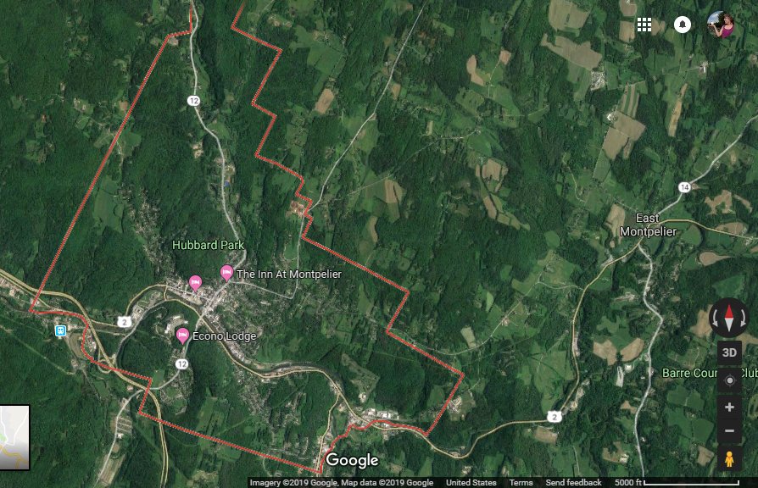
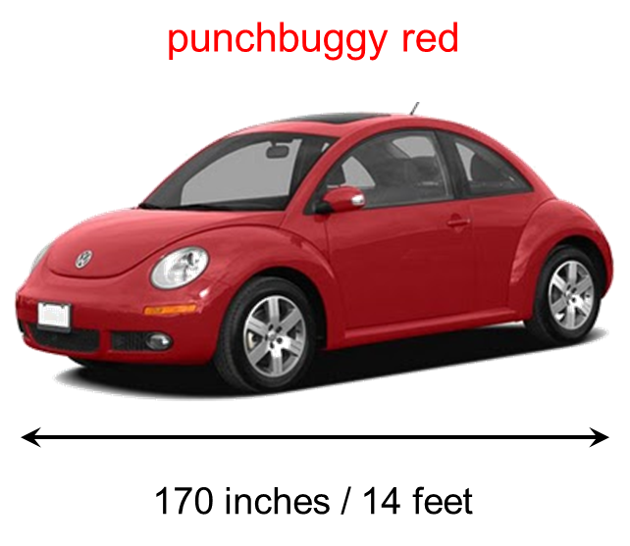
mean free path: 0.00000007 m to 0.0000005 m
size of a molecule: 0.0000000001 m 0.0000000001 m
ratio: = 700 = 5000
in the troposphere, the distance particles need to travel to hit another is
700 to 5000 times the size of the particle
what does that “look” like on our scale?

Slide 7

Troposphere (‘tropo’ to turn)
from surface to ~12 km (7.2 mi)
composed of: 78% N₂, 21% O₂, 1% Ar, + trace
density: 2.5×10²⁵ – 6.5×10²⁴ particles/m³
(25 trillion trillion - 6 trillion trillion in a cubic meter)
mean free path (distance between collisions):
0.00000007 m to 0.0000005 m
temperature: decreases with altitude
less heating from Earth’s surface
fun fact(s): all weather occurs here
all terrestrial and aerial life lives here

Slide 8
Stratosphere (‘strato’ layer)
from ~12 km (7.2 mi) to ~50 km (31 mi)
composed of: 78% N₂, 21% O₂, 1% Ar, + trace
density: 6×10²⁴ - 1×10²² particles/m³
(6 trillion trillion - 10 billion trillion in a cubic meter)
mean free path (distance between collisions):
0.000001 m to 0.00005 m
mean free path: 0.000001 m to 0.00005 m
size of a molecule: 0.0000000001 m 0.0000000001 m
ratio: = 10,000 = 500,000
in the stratosphere, the distance particles need to travel to hit another is
10,000 to 500,000 times the size of the particle
what does that “look” like on our scale

Slide 9
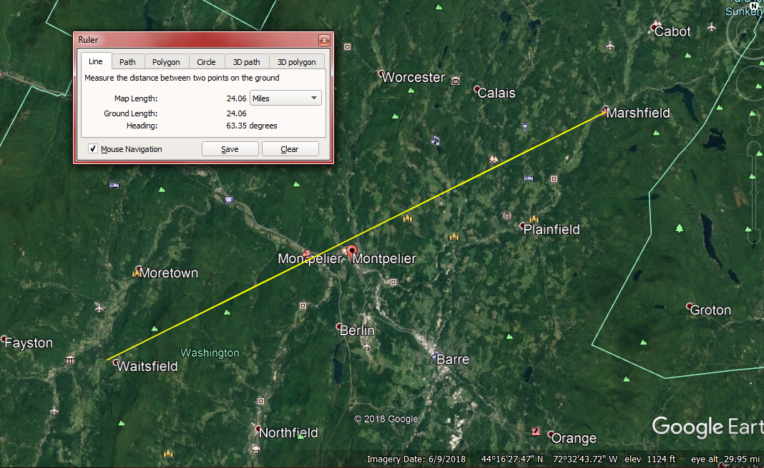
mean free path: 0.000001 m to 0.00005 m
size of a molecule: 0.0000000001 m 0.0000000001 m
ratio: = 10,000 = 500,000
in the stratosphere, the distance particles need to travel to hit another is
10,000 to 500,000 times the size of the particle
what does that “look” like on our scale?

Slide 10
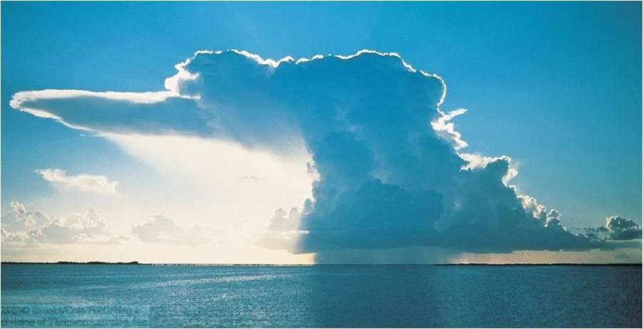
Stratosphere (‘strato’ layer)
from ~12 km (7.2 mi) to ~50 km (31 mi)
composed of: 78% N₂, 21% O₂, 1% Ar, + trace
density: 6×10²⁴ - 1×10²² particles/m³
(6 trillion trillion - 10 billion trillion in a cubic meter)
mean free path (distance between collisions):
0.000001 m to 0.00005 m
temperature: increases with altitude
contains ozone (O₃)…
the O₃ cycle transforms
UV radiation into thermal energy
fun fact(s): can see the bottom of the
stratosphere when you see the
tops of clouds
link

Slide 11
Mesosphere (‘meso’ middle)
from ~50 km (31 mi) to ~85 km (53 mi)
composed of: 78% N₂, 21% O₂, 1% Ar, + trace
density: 1×10²² - 2×10²⁰ particles/m³
(10 billion trillion - 200 million trillion in a cubic meter)
mean free path (distance between collisions):
0.00005 m to 0.01 m
mean free path: 0.00005 m to 0.01 m
size of a molecule: 0.0000000001 m 0.0000000001 m
ratio: = 500,000 = 100,000,000
in the mesosphere, the distance particles need to travel to hit another is
500,000 to 100,000,000 times the size of the particle
what does that “look” like on our scale

Slide 12
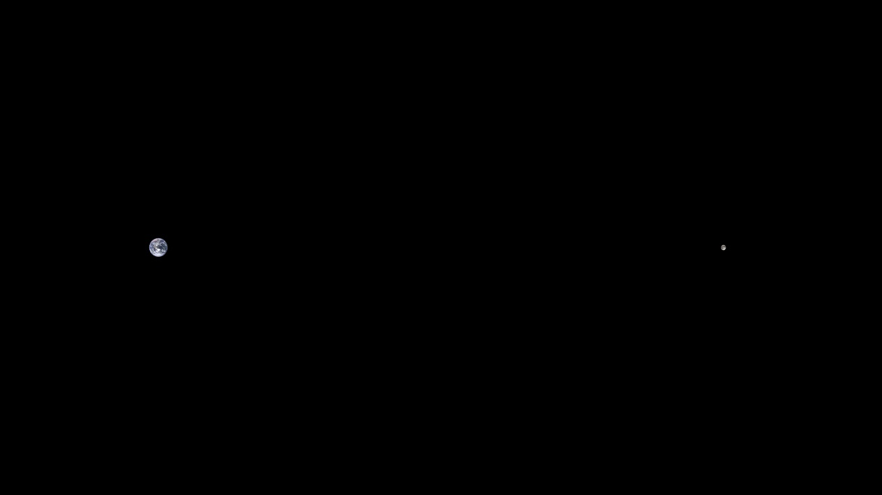
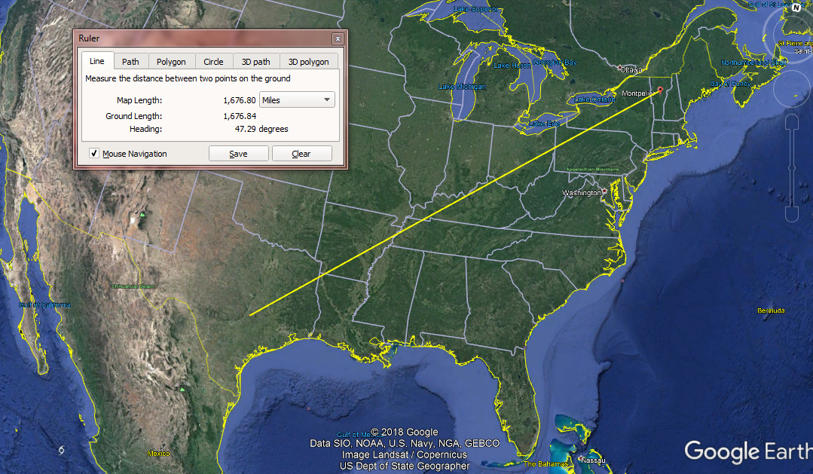
mean free path: 0.00005 m to 0.01 m
size of a molecule: 0.0000000001 m 0.0000000001 m
ratio: = 500,000 = 100,000,000
Moon
240,000 miles
Earth
in the mesosphere, the distance particles need to travel to hit another is
500,000 to 100,000,000 times the size of the particle
what does that “look” like on our scale?

Slide 13
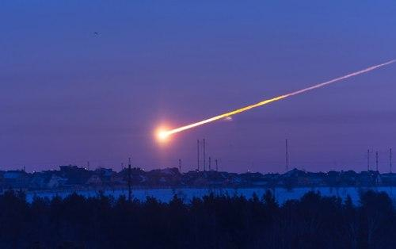
Mesosphere (‘meso’ middle)
from ~50 km (31 mi) to ~85 km (53 mi)
composed of: 78% N₂, 21% O₂, 1% Ar, + trace
density: 1×10²² - 2×10²⁰ particles/m³
(10 billion trillion - 200 million trillion in a cubic meter)
mean free path (distance between collisions):
0.00005 m to 0.01 m
temperature: decreases with altitude
further from warming influence of Earth
fun fact(s): air is dense enough to cause
enough friction to burn up meteors

Slide 14
Thermosphere (‘thermo’ heat/hot)
from ~85 km (53 mi) to ~ 700 km (370 mi)
composed of: (transition between exosphere
and homosphere…)
density: 2×10²⁰ - 5×10¹¹ particles/m³
(200 million trillion - 500 billion in a cubic meter)
mean free path (distance between collisions):
0.01 m to 1000’s of km
temperature: increases with altitude
up to 1500°C (2700°F)
due to absorption of UV and x-ray radiation
→ ionization

Slide 15
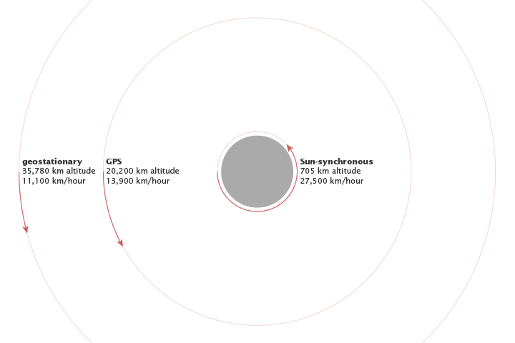
Exosphere (‘exo’ out)
from ~700 km (370 mi) to ~10,000 km (6200 mi) (the moon is 238,900 miles away)
composed of: He and H₂₂ gases
density: < (less than) 5×10¹¹ particles/m³ (500 billion in a cubic meter)
mean free path (distance between collisions): 1000’s of miles
temperature: … ??
fun fact(s): satellites orbit in this layer
“almost space”, (Ijaeda, 2020)

Slide 16
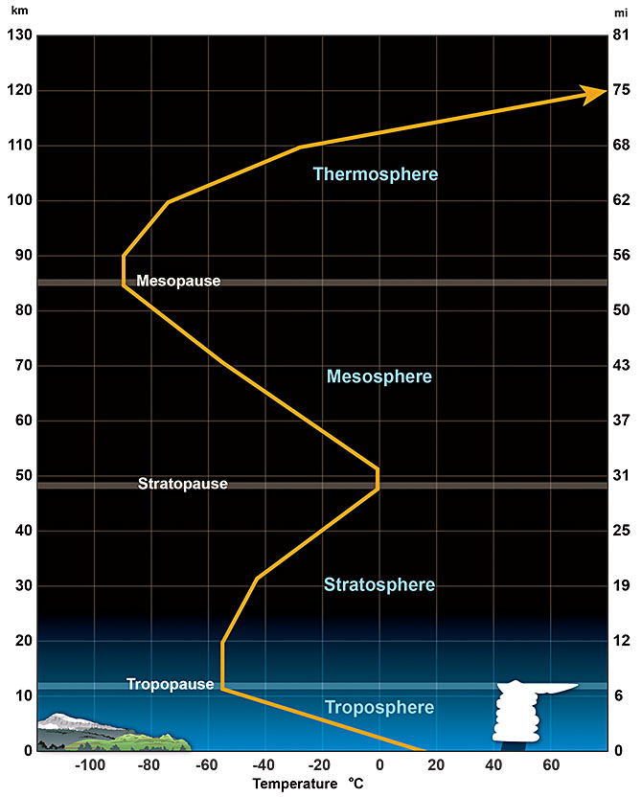
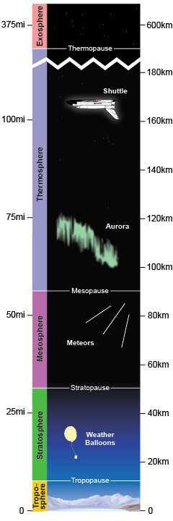
pause
boundaries ("pauses") between layers
vertical region where temperature
stays about the same

Slide 17
need a layers practice…..

Slide 18
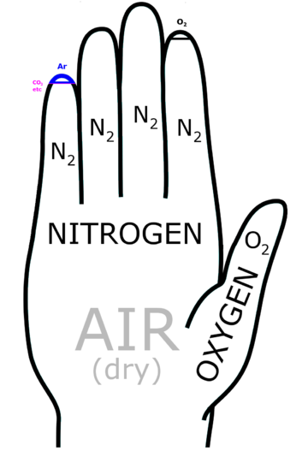
composition of Earth’s atmosphere in the
troposphere
stratosphere
mesosphere
the density of air in these layers is
sufficient to cause turbulent mixing…
homosphere

Slide 19
Composition of the Earth’s Atmosphere (current)
N₂
78.084 %
though the atmosphere
gets “thinner” the further
from the Earth’s surface,
these percentages
stay nearly constant
in the homosphere
O₂
20.946 %
Ar
0.9340 %
trace total
0.037680 %
CO₂
0.035 %
H₂
0.000055 %
Ne
0.001818 %
Kr
0.000114 %
He
0.000524 %
CH₄
0.0001745 %

Slide 20
Review of Lewis Dot Structures
This represents an atom of what element?
How many protons does it have? Atomic Number
How many neutrons does it have? Mass # – Atomic Number
How many electrons does it have? Count them
How many Valence Electrons does this atom have?
Does it have a full outer shell?
Atoms can get a full outer shell by forming ________ with other atoms.
There are two ways that the above can happen:
one way: ______________________ the other way ______________________
called a(n) _____________________ called a(n) ________________________
Draw the Lewis Dot Structure for an atom of the element represented above.
When the above bonds with a chlorine atom a(n) ________________ bond will form.
Draw a Lewis dot structure representing the bonding of these two atoms.
When two chlorine atoms bond together, a ______________________ bond will form.
Draw a Lewis dot structure representing the bonding of these two atoms.
Draw a Lewis dot structure for the molecule CH₃F

Slide 22
Model the composition of our current Atmosphere ….
demo daubing on the
notesheet with Lewis structures
Hydrogen
Helium
Oxygen
Sulfur
TBD
Neon
Nitrogen
Chlorine
Argon
Carbon
Krypton

Slide 23
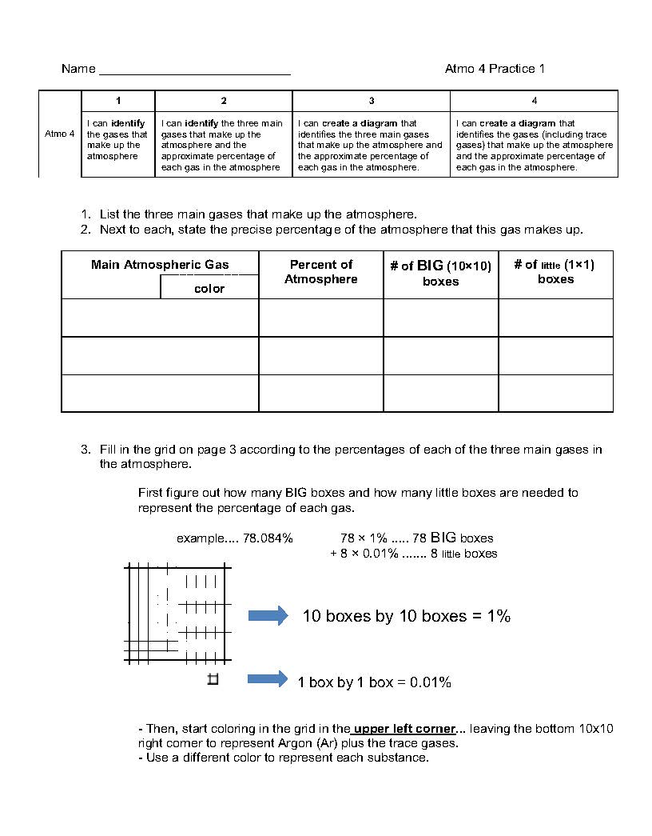
link to instructions

Slide 24
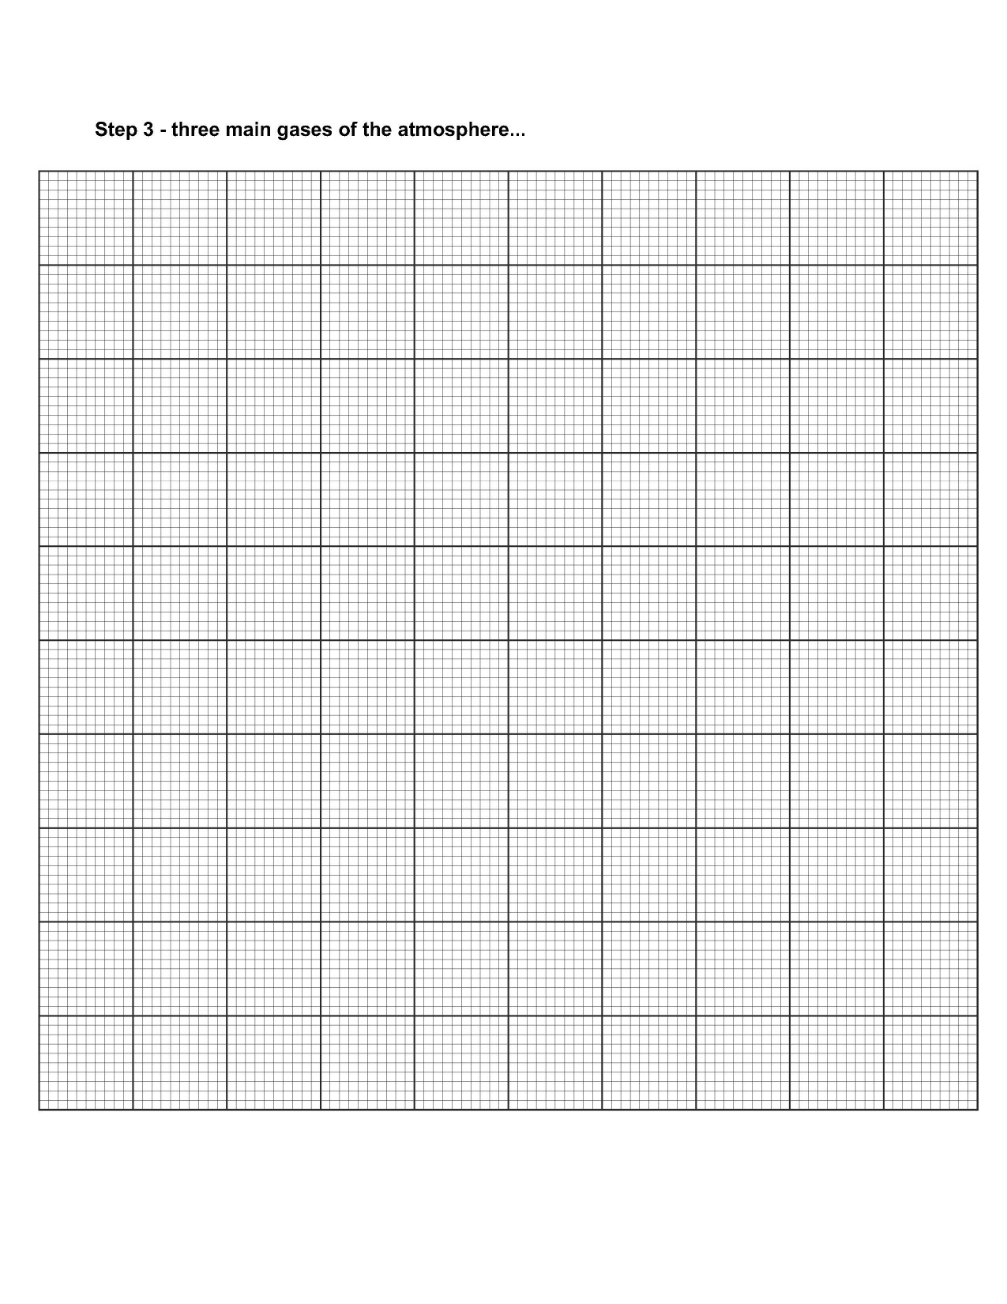

Slide 25
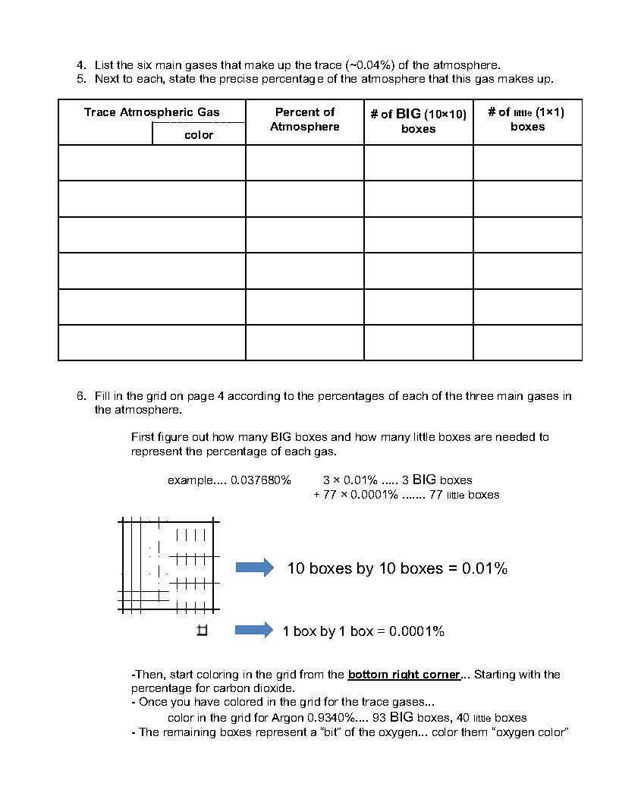
link to instructions

Slide 26
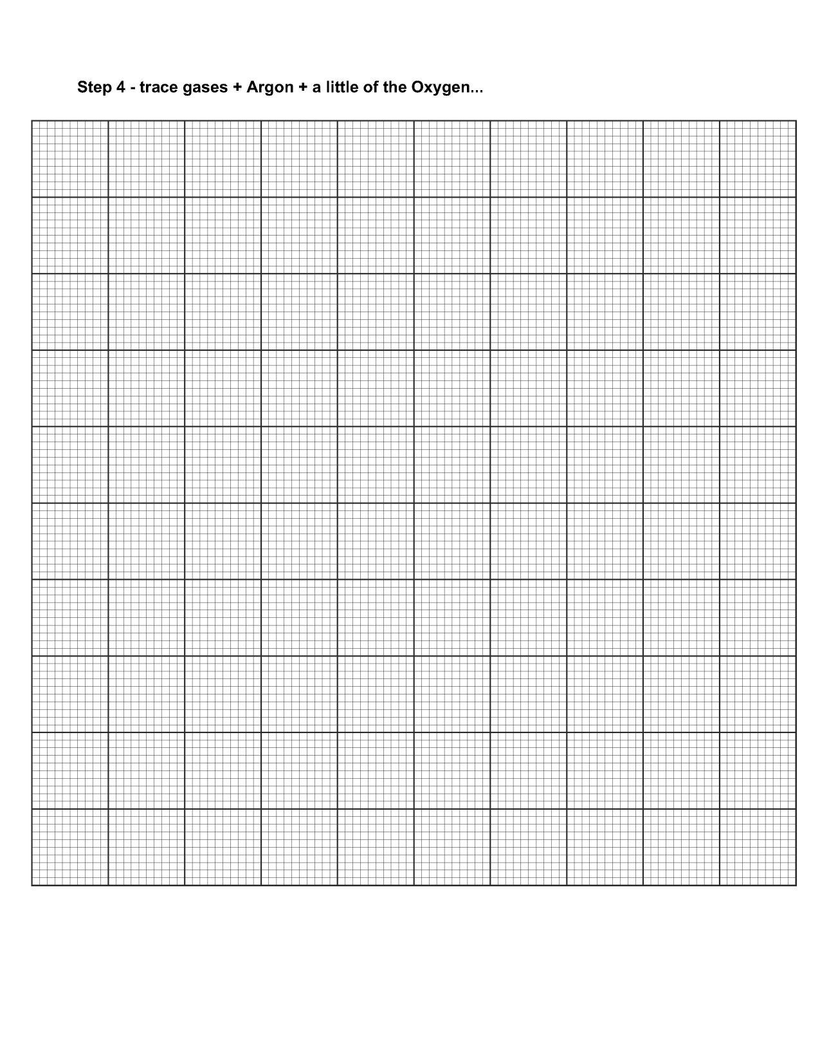

Slide 27
hν
1. O₂ → O + O
2. O₂ + O + M → O₃ + M (thermal energy released)
3. O₃ → O₂ + O
hν
hν
O
→ O O + O
O
O
breaks
link back

